Slide 1
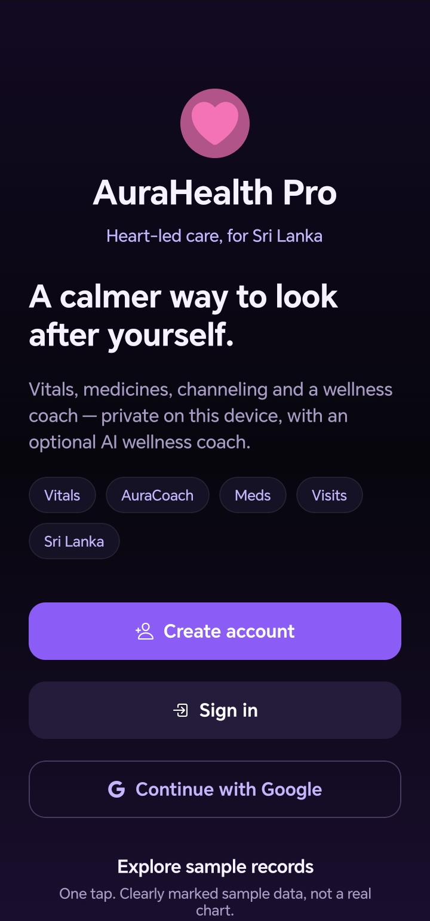
AURAHEALTH PRO
A simpler way to
manage daily health
Features, patient benefits, and how AuraCoach uses AI.
PRODUCT PRESENTATION
Test build • app screenshots
Notes:
Introduce AuraHealth Pro as a wellness companion, not a medical device or replacement for professional care. The deck discusses features, potential benefits, limitations, and the relationship between AI and AuraCoach.

Slide 2
AURAHEALTH PRO / FEATURES & PATIENT BENEFITS
What the app brings together
A practical daily workflow for personal health information.
01 / TRACK
02 / REMEMBER
03 / PREPARE
Record health readings and manage your history.
Keep medication and bedtime schedules.
Organize visits and ask general wellness questions.
PATIENT BENEFIT • Less information scattered across different places.
WELLNESS SUPPORT • NOT A MEDICAL DIAGNOSIS
02
Notes:
Describe the app as bringing several daily health tasks into one interface. Similar combinations may also be found in other products. Do not imply the app makes a person healthier by itself.

Slide 3
AURAHEALTH PRO / FEATURES & PATIENT BENEFITS
Sign-in and personal access
Email verification or Google sign-in; normal session restoration after reopening.
Verified sign-in
Helps associate the app with the user’s account.
REALITY CHECK
Session restoration is not guaranteed after sign-out, reinstall, clearing data or account changes.
Optional device lock
PIN and biometric settings can add an extra barrier on a supported device.
Local records
Health information stays on the device unless the user chooses to share it with AI.
PATIENT BENEFIT • Quicker return to personal information with account-based access.
WELLNESS SUPPORT • NOT A MEDICAL DIAGNOSIS
03
Notes:
Clarify that ordinary app reopening should restore a verified matching Firebase session. Device health records are local and are not an encrypted synced medical record. The device lock is optional.

Slide 4
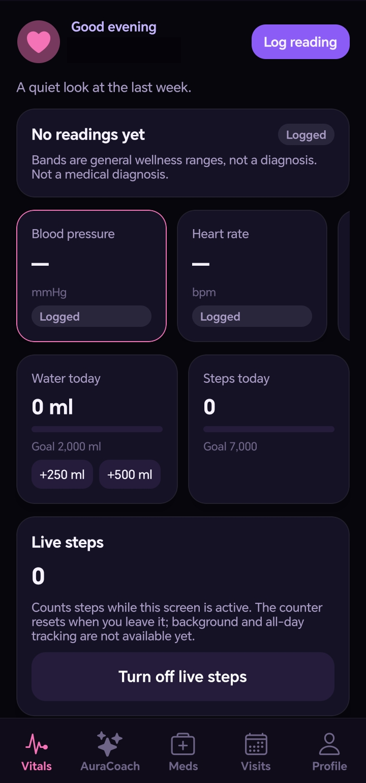
AURAHEALTH PRO / FEATURES & PATIENT BENEFITS
Log readings and review history
App screenshot: readings and daily activity.
Enter medical readings
Blood pressure, heart rate, glucose, oxygen and weight.
Review the history
See earlier entries and delete a reading when needed.
Understand the limits
An unusual value may show a warning; it is not a diagnosis.
PATIENT BENEFIT • A clearer record to discuss with a clinician.
WELLNESS SUPPORT • NOT A MEDICAL DIAGNOSIS
04
Notes:
The screenshot shows an empty readings dashboard. Values and warning bands are not diagnostic.

Slide 5
AURAHEALTH PRO / FEATURES & PATIENT BENEFITS
Scan a report photo
A guided workflow with user review before saving.
1 / CHOOSE
2 / REVIEW
3 / SAVE
Take a photo or choose a report image.
AI suggests one supported reading; check its value and units.
Only save after checking; entry uses the current time.
The image is sent to the hosted AI service and Gemini only after permission. AI can misread reports.
PATIENT BENEFIT • May reduce typing while keeping the person in control.
WELLNESS SUPPORT • NOT A MEDICAL DIAGNOSIS
05
Notes:
This feature is not fully automatic extraction of an entire laboratory report. It suggests one recognized measurement from supported formats, and the user must review before saving. Do not assume the suggestion, units or date are correct.

Slide 6
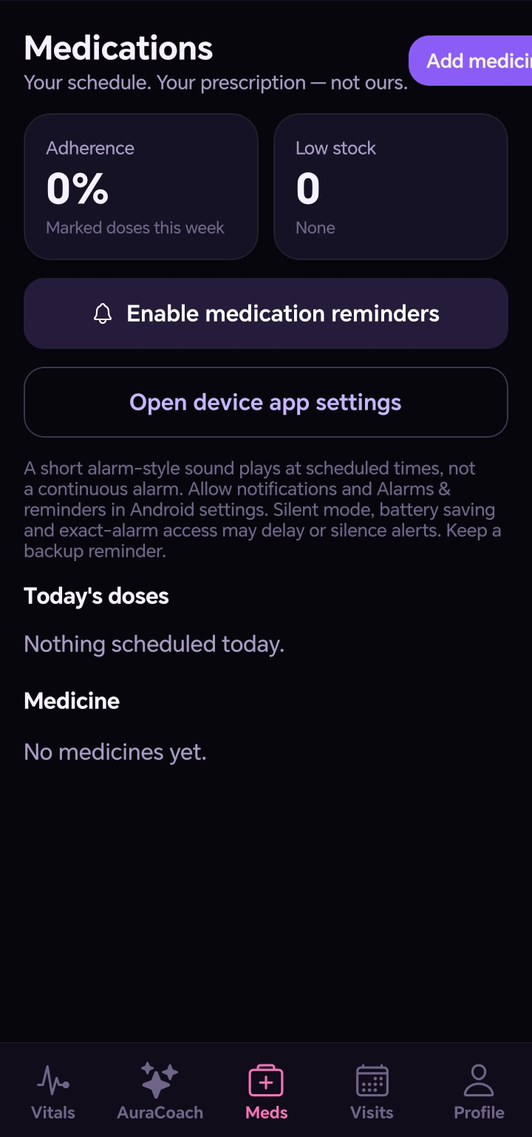
AURAHEALTH PRO / FEATURES & PATIENT BENEFITS
Medicines and reminders
App screenshot: medication schedules and reminders.
Make a daily schedule
Add medicine details and select 24-hour times.
Record doses
Mark taken or skipped; edit or delete a medicine.
Sound and vibration
Enable reminders; device settings can delay or silence them.
PATIENT BENEFIT • Supports an organized routine; keep a backup reminder.
WELLNESS SUPPORT • NOT A MEDICAL DIAGNOSIS
06
Notes:
The screenshot shows an empty medication list. The app cannot guarantee reminder delivery and does not provide a continuous full-screen alarm.

Slide 7
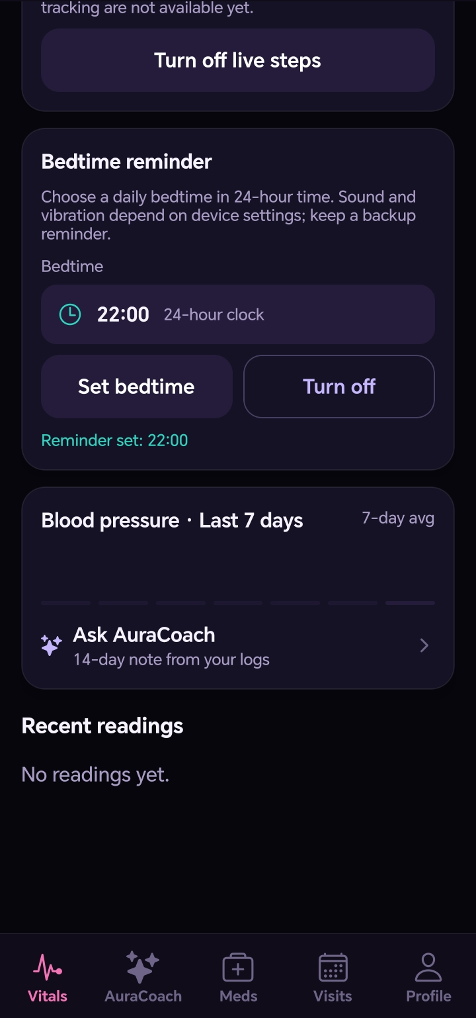
AURAHEALTH PRO / FEATURES & PATIENT BENEFITS
Bedtime and live steps
App screenshot: bedtime reminder and activity.
BEDTIME REMINDER
LIVE STEP COUNTER
Choose a 24-hour bedtime and receive a short notification with sound and vibration, subject to device settings.
With permission and a supported sensor, count steps while the readings screen is active. The counter resets when leaving.
PATIENT BENEFIT • Gentle routine support, without claiming complete activity tracking.
WELLNESS SUPPORT • NOT A MEDICAL DIAGNOSIS
07
Notes:
The step counter is not all-day or background tracking. Its live session value is not automatically a saved clinical record. Bedtime reminders are subject to notification, alarm, battery, and sound settings.

Slide 8
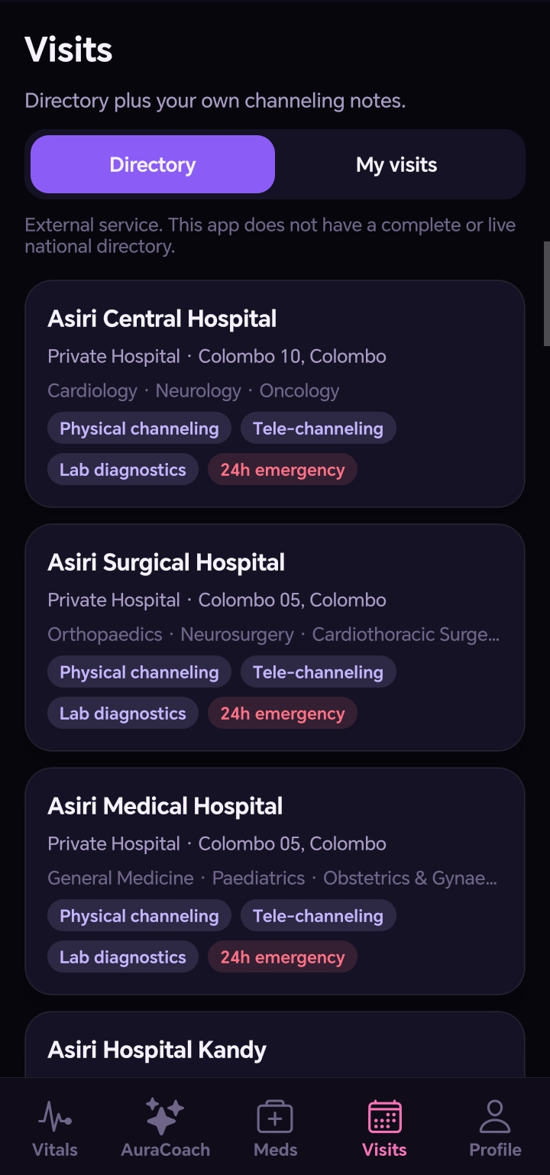
AURAHEALTH PRO / FEATURES & PATIENT BENEFITS
Visits and the directory
App screenshot: facility listings are not a complete or live source.
Search reference listings
Browse by location and other filters.
Keep personal visit notes
Record an appointment, time and notes.
Verify details
Phone numbers and services may change; check directly or use the external eChannelling link.
PATIENT BENEFIT • Helps organize visit information in one place.
WELLNESS SUPPORT • NOT A MEDICAL DIAGNOSIS
08
Notes:
The directory does not include every Sri Lankan channeling centre, and contact details may change. The app does not itself guarantee a booking.

Slide 9
AURAHEALTH PRO / FEATURES & PATIENT BENEFITS
Doctor Visit Brief
A simple select, preview and copy workflow.
SELECT
PREVIEW
COPY
Choose which real records and details to include.
Review the summary and add questions for the visit.
Copy the brief when you choose to share it.
PATIENT BENEFIT • Arrive with organized information and questions.
WELLNESS SUPPORT • NOT A MEDICAL DIAGNOSIS
09
Notes:
The brief excludes sample readings and medicines. It is not automatically sent anywhere; the user previews and copies it. It is not a clinical medical record.

Slide 10
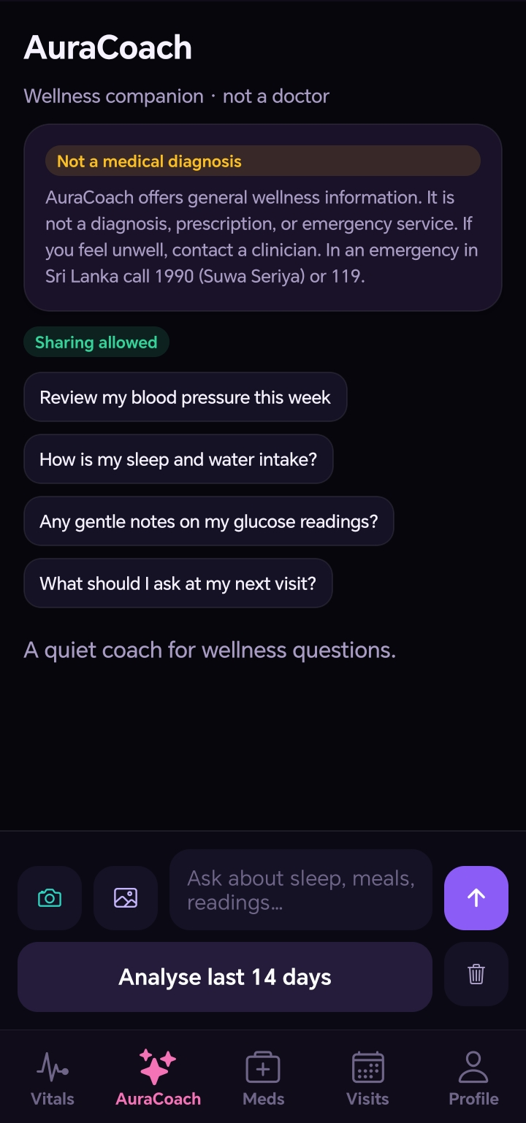
AURAHEALTH PRO / FEATURES & PATIENT BENEFITS
AuraCoach: a wellness conversation
App screenshot: the AuraCoach wellness companion.
Ask a general question
Ask about habits, records or questions to raise with a professional.
IMPORTANT
Gemini can be wrong. It is not a doctor, emergency service or substitute for clinical advice.
Choose what to share
Selected health context is sent after the user grants permission.
Use the hosted connection
A verified account calls the hosted Gemini service; usage limits apply.
PATIENT BENEFIT • A convenient starting point for questions and appointment preparation.
WELLNESS SUPPORT • NOT A MEDICAL DIAGNOSIS
10
Notes:
AuraCoach is the app’s interface and workflow around a hosted Google Gemini model. The user has previously reported a successful AI response, but availability and quotas are not guaranteed.

Slide 11
AURAHEALTH PRO / FEATURES & PATIENT BENEFITS
Camera guides and image questions
User-controlled photo capture and visual guides.
CHOOSE A GUIDE
UNDERSTAND THE LIMIT
Select meal, medicine, report or skin concern, then take and review a photo before sending.
The coloured frames are decorative guides, not object recognition or true AR tracking.
PATIENT BENEFIT • Offers a visual way to ask general questions—with consent.
WELLNESS SUPPORT • NOT A MEDICAL DIAGNOSIS
11
Notes:
Photos are sent only after explicit confirmation. A skin image cannot reliably identify an infection or pathogen. The app is not a diagnostic tool and the AI may make errors even with safety instructions.

Slide 12
AURAHEALTH PRO / FEATURES & PATIENT BENEFITS
AI and AuraCoach: what is the difference?
AuraCoach uses AI; they are not competing technologies.
AI / GEMINI
AURACOACH
The general-purpose technology: a model that can process language and images and generate responses.
The health-focused app experience: question screen, optional context, photo flow, consent and safety messages around Gemini.
PATIENT BENEFIT • A familiar health-focused interface for asking general questions.
WELLNESS SUPPORT • NOT A MEDICAL DIAGNOSIS
12
Notes:
AI is the broad technology category. Gemini is a general-purpose model provider. AuraCoach is the product feature that provides a specific interface and wellness context using Gemini through the hosted server. It is not a separately trained medical model.

Slide 13
AURAHEALTH PRO / FEATURES & PATIENT BENEFITS
How it may differ from other apps
A qualitative comparison—not a claim that these features are unique.
SINGLE-PURPOSE TOOLS
GENERAL AI CHAT
AURAHEALTH PRO
Some tools focus on only one job, such as medication reminders or tracking readings.
A general chatbot answers questions but may not provide this app’s opt-in local health workflow.
Combines a local journal, reminders, visit preparation and an AI interface in one test build.
Other products may offer similar or more advanced features. No named competitor comparison has been verified.
WELLNESS SUPPORT • NOT A MEDICAL DIAGNOSIS
13
Notes:
This is a positioning explanation, not a claim that AuraHealth Pro is the only app with these capabilities or is better than a named competitor. Specific products require separate verified comparison.

Slide 14
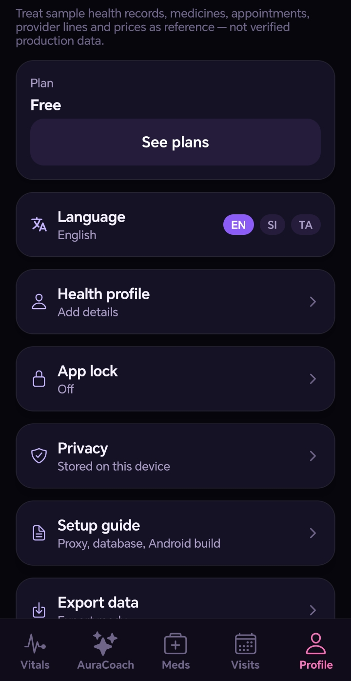
AURAHEALTH PRO / FEATURES & PATIENT BENEFITS
Privacy and safety
Understand what stays local and what leaves the device.
Local health records
Stored on the device; not yet a secure cloud-synced medical record.
AI sharing is opt-in
Selected context and photos go through the hosted service to Gemini.
The app is not an emergency service
If someone has serious symptoms, seek urgent medical help immediately.
PATIENT BENEFIT • Informed choices about sharing and a clearer understanding of limitations.
WELLNESS SUPPORT • NOT A MEDICAL DIAGNOSIS
14
Notes:
Explain that local app data is not a production-grade secure medical record and that AI provider privacy terms and usage rules apply. Do not rely on the app to detect a heart attack or infection.

Slide 15
AURAHEALTH PRO / FEATURES & PATIENT BENEFITS
Current status and future work
A test-signed app with features to validate on real phones.
CURRENT
NOT YET COMPLETE
Sign-in and an AuraCoach response have been reported working on a phone. New camera and alarm flows require device testing.
Background all-day steps, cross-device Family Care, a complete verified directory and production release reviews remain.
PATIENT BENEFIT • Start with a useful foundation while being honest about what remains.
WELLNESS SUPPORT • NOT A MEDICAL DIAGNOSIS
15
Notes:
Conclude that the project remains test-signed. Never promise zero bugs or claim the missing capabilities are complete. Family Care across devices is planned but not implemented.

