Slide 1
Messaging App
Ryan Gallagher
Matt Haffner
Daniel Pellowski
Dylan Skokan

Slide 2
Features
User GUI
User registration
User login / logout
Users are saved to text based database by server
Send a public message to all logged in users
Send a private message to one logged in user
Admin super user may kick users from chat
GUI displays a list of all logged in users

Slide 3
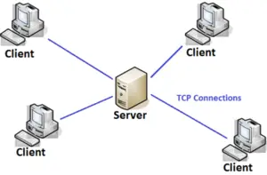
Architecture
Client / Server Architecture
Model-View-Controller
Text based database of users

Slide 4
Libraries
Python 3.9
Server
Flask
Flask Socket IO
Client
Tkinter
Socket IO
Requests

Slide 5
Application Layer Protocols
HTTP
For user registration and authentication
Creates a session so you can connect to through Socket.IO
Socket.IO
Full duplex, low overhead communication between client/server
Combination of WebSockets and HTTP long-polling
Allows for real time updates
Easy API to send messages to a group of users
Built on top of Engine.IO protocol
Adds multiplexing via “namespaces”

Slide 6
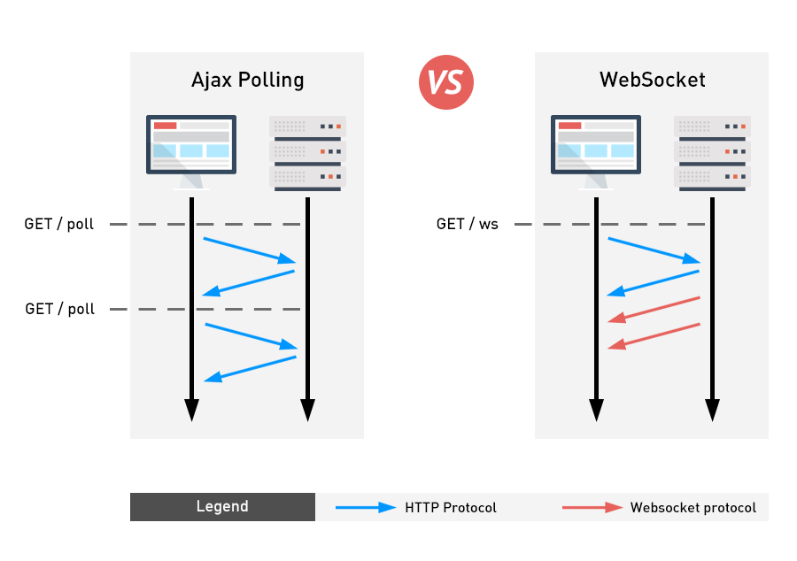
Polling vs WebSockets

Slide 7
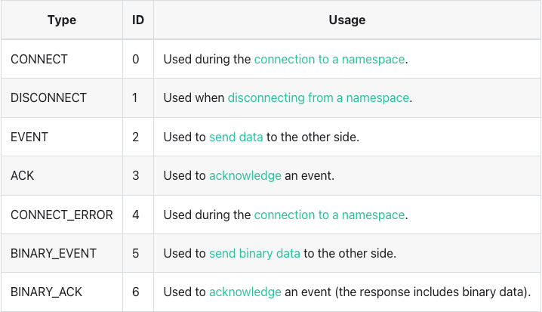
Socket.IO Packets
Fields
Packet Type
Namespace
Payload (optional)
ACK ID (optional)

Slide 8
Encoding
Format
<packet type>[<# of binary attachments>-][<namespace>,][<acknowledgment id>][JSON-stringified payload without binary]
+ binary attachments extracted
Example 1
Packet
{ type: EVENT, namespace: "/", data: ["foo"] }
Encoded
2["foo"]
Example 2
Packet
{ type: BINARY_EVENT, namespace: "/admin", data: ["baz", <Buffer <01 02>>, <Buffer <03 04>> ] }
Encoded
52-/admin,["baz",{"_placeholder":true,"num":0},{"_placeholder":true,"num":1}]
+ <Buffer <01 02>>
+ <Buffer <03 04>>

Slide 9
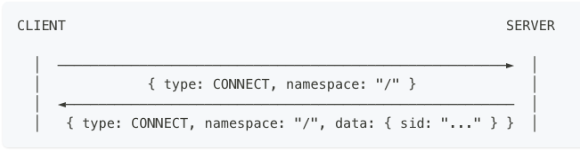
Connecting via Socket.IO
Must connect to server
CONNECT_ERROR if not authorized
Connect to multiple namespaces
Uses same WebSocket connection

Slide 10
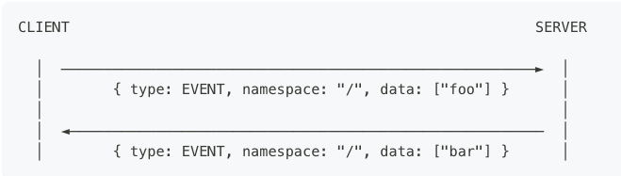
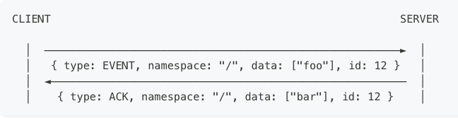
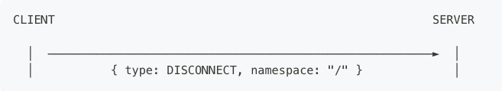
Socket.IO Exchange Protocols

Slide 11
Demo
https://github.com/mrhaffner/messaging_app

