Slide 1



Bank Management System
This presentation introduces our Bank Management System. We will explore its purpose and objectives. Learn how it enhances efficiency and customer service. Discover how it transitions banks from traditional methods to digital solutions.
Created By: Harshil Prajapati
Guide By:- Abhi Shah Sir

Slide 2
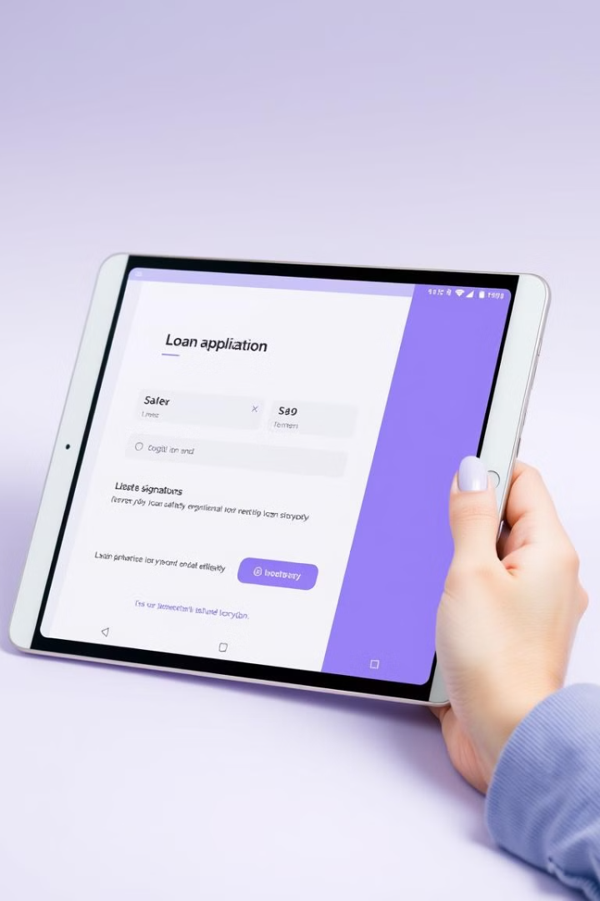



Loan & Funds Management
Select Loan
Automated loan application. Manages approval workflow. Integrates credit scoring.
Interest Calculation
Calculates interest. Schedules repayments. Loan origination volume is up 15%.
Transfer Funds
Secure fund transfers between accounts. Supports internal and external transfers.

Slide 3



Financial Overview: Real-Time Access
Check Balance
Transaction History
Inquiry into real-time account balances.
View statements and transaction history.

Slide 4
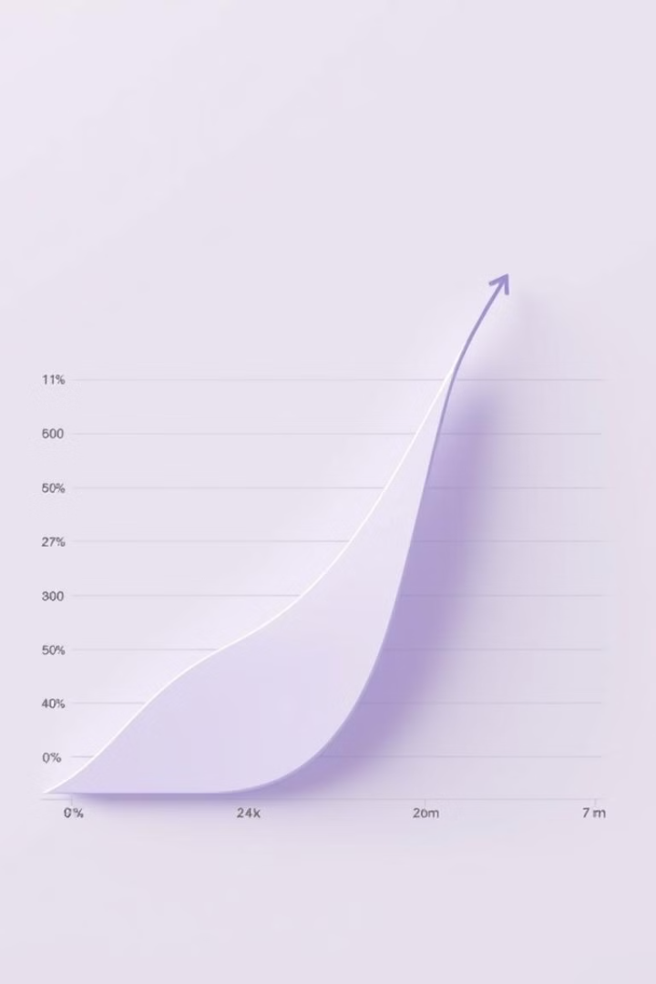
Merits of the System
1
Efficiency
Increased operational efficiency. Reduces transaction processing time by 40%.
2
Customer Experience
Enhanced access. Self-service options are improved.
3
Reduced Costs
Reduced operational costs. Paperless transactions and automation.

Slide 5




Demerits and Challenges
Investment Costs
1
High initial investment.
System Failures
2
Dependence on tech.
Cyber Threats
3
Data breach risk.
Employee Training
4
Resistance to change.

Slide 6

Future Scope and Conclusion
1
Emerging Technologies
2
Mobile Expansion
3
Cybersecurity
Integration with blockchain and AI.
Expansion of mobile banking options.
Focus on cybersecurity and fraud prevention.
A robust bank management system is crucial. It helps to stay competitive in the financial landscape. Expect personalized services based on customer data.

Slide 7
Thank You

