Slide 1
Mitigating Effects of Future Pandemics on Disproportionately Affected Populations
GT1
By Michael Hartnett, Yunus Herman, Josh Slizinov

Slide 2
Agenda
GT1
Problem Statement
Solution Proposition
Gathering Data & EDA
Modeling
Model Performance
Improvements
Recommendation
Questions
Problem Statement
Solution Proposition
Gathering Data & EDA
Modeling
Model Performance
Improvements
Recommendation
Questions

Slide 3
Problem
GT1
We've all been affected by COVID this year. However, some groups have been affected more than others. We set out to discover what factors in the socioeconomic and demographic realm may have led this pandemic to disproportionately affect certain groups.
Problem Statement
Solution Proposition
Gathering Data & EDA
Modeling
Model Performance
Improvements
Recommendation
Questions

Slide 4
Question
GT1
Can we use (socioeconomic, demographic, and employment data) to cluster states with higher risk of being affected by a pandemic to allot resources to those areas for future disproportionate effect mitigation?
Problem Statement
Solution Proposition
Gathering Data & EDA
Modeling
Model Performance
Improvements
Recommendation
Questions

Slide 5
Solution Proposition
GT1
Attempt to cluster states based on demographic, socioeconomic, and COVID-19 data to help identify factors that may lead to disproportionate pandemic effects.
Problem Statement
Solution Proposition
Gathering Data & EDA
Modeling
Model Performance
Improvements
Recommendation
Questions

Slide 6
Data Sources
GT1
Bureau of Labor Statistics
Location 2
Location 3 etc
Problem Statement
Solution Proposition
Gathering Data & EDA
Modeling
Model Performance
Improvements
Recommendation
Questions

Slide 7
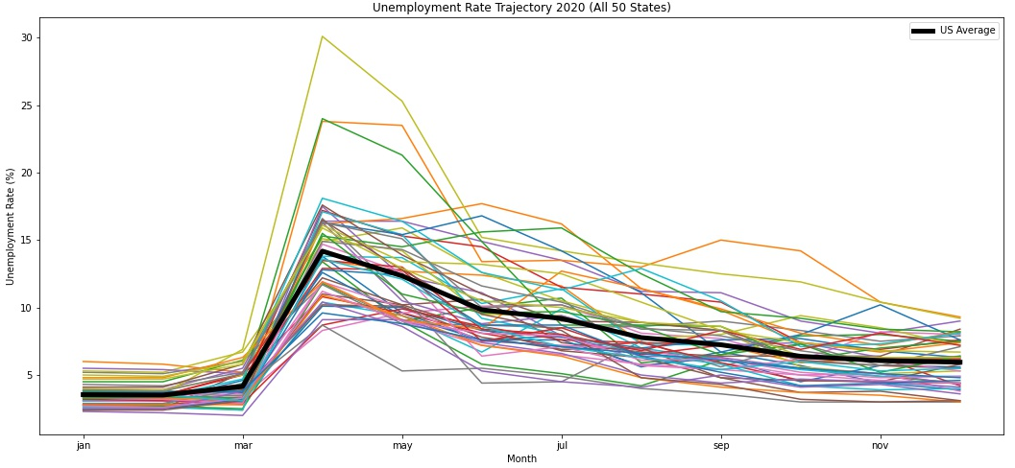
Unemployment EDA
GT1
Several states exhibiting abnormal unemployment compared to the national average
Identify which states exhibited abnormal unemployment
Problem Statement
Solution Proposition
Gathering Data & EDA
Modeling
Model Performance
Improvements
Recommendation
Questions

Slide 8
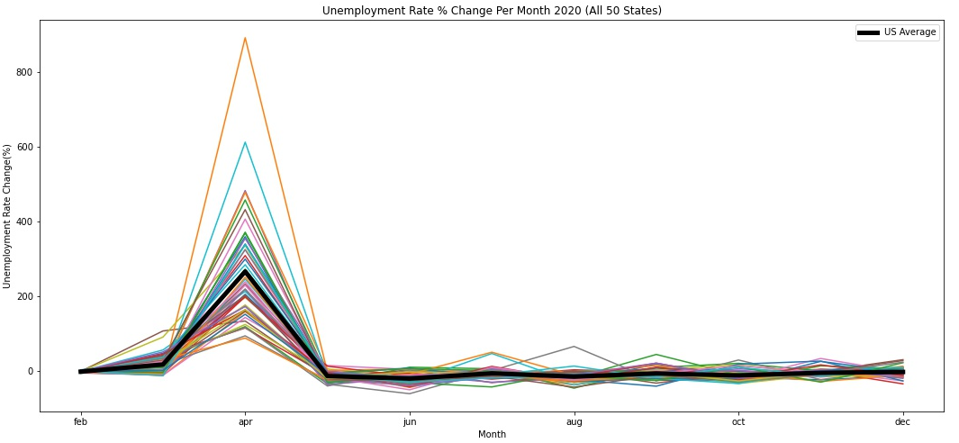
Unemployment EDA
GT1
Percent change MoM better compares states to one another
Use this to better interpret abnormal unemployment rates
Problem Statement
Solution Proposition
Gathering Data & EDA
Modeling
Model Performance
Improvements
Recommendation
Questions

Slide 9
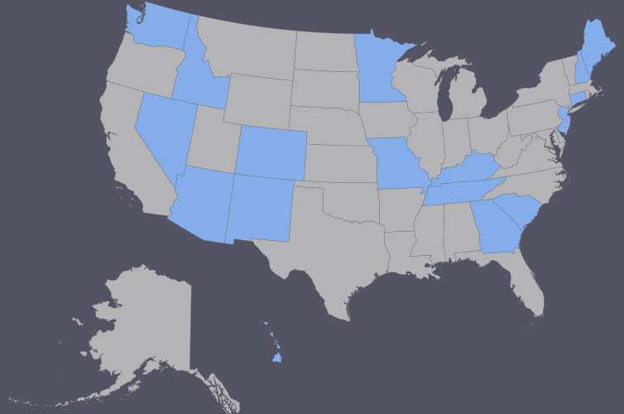
Unemployment EDA
GT1
The following states were determined to have abnormally high unemployment rates in 2020 when compared with the national average:
Arizona
Colorado
Connecticut
Georgia
Hawaii
Idaho
Kentucky
Maine
Minnesota
Missouri
Nevada
New Hampshire
New Jersey
New Mexico
South Carolina
Tennessee
Washington
Problem Statement
Solution Proposition
Gathering Data & EDA
Modeling
Model Performance
Improvements
Recommendation
Questions

Slide 10
Modeling
GT1
Problem Statement
Solution Proposition
Gathering Data & EDA
Modeling
Model Performance
Improvements
Recommendation
Questions

Slide 11
Model Performance
GT1
Problem Statement
Solution Proposition
Gathering Data & EDA
Modeling
Model Performance
Improvements
Recommendation
Questions

Slide 12
Improvements
GT1
Examine data on a lower level (county/city data)
Use more data (data from other pandemics)
Problem Statement
Solution Proposition
Gathering Data & EDA
Modeling
Model Performance
Improvements
Recommendation
Questions

Slide 13
Recommendation
GT1
Problem Statement
Solution Proposition
Gathering Data & EDA
Modeling
Model Performance
Improvements
Recommendation
Questions

Slide 14
Questions?
GT1
Problem Statement
Solution Proposition
Gathering Data & EDA
Modeling
Model Performance
Improvements
Recommendation
Questions

