Slide 1
ELEC 2200-002
Digital Logic Circuits
Fall 2015
Introduction
Vishwani D. Agrawal
James J. Danaher Professor
Department of Electrical and Computer Engineering
Auburn University, Auburn, AL 36849
http://www.eng.auburn.edu/~vagrawal
vagrawal@eng.auburn.edu
Fall 2015, Aug 17
ELEC2200-002 Lecture 1

Slide 2


Course Webpage
http://www.eng.auburn.edu/~vagrawal/COURSE/E2200_Fall15/course.html
Or,
    Go to professor’s webpage http://www.eng.auburn.edu/~vagrawal/
    Click on ELEC2200-002 Digital Logic Circuits, MWF 2PM, Broun 238
Fall 2015, Aug 17
ELEC2200-002 Lecture 1

Slide 3
Course Organization
Text book: V. P. Nelson, H. T. Nagle, B. D. Carroll and J. D. Irwin, Digital Logic Circuit Analysis and Design, Prentice Hall, 1995, ISBN 0-13-463894-8.
Instructor: Vishwani D. Agrawal, Broun 323, x41853, vagrawal@eng.auburn.edu.
Graduate Assistant: Yun Wang, yzw0041@tigermail.auburn.edu
Classroom: Broun 238, MWF 2:00PM-2:50PM.
Fall 2015, Aug 17
ELEC2200-002 Lecture 1

Slide 4
Student Performance Evaluation
Homework (20%): 1 per week, most weeks.
Three Class Tests (20% each):
    Test 1, Friday, Sep 18, 2015, 2:00PM-2:50PM, Broun 238.
    Test 2, Wednesday, Oct 7, 2015, 2:00PM-2:50PM, Broun 238.
    Test 3, Wednesday, Nov 18, 2015, 2:00PM-2:50PM, Broun 238.
Final Exam (20%): Monday, Dec 7, 2015, 4:00PM-6:30PM, Broun 238.
Fall 2015, Aug 17
ELEC2200-002 Lecture 1

Slide 5
Course Objective
This course introduces the student to the design of digital logic circuits, both combinational and sequential, and the design of digital systems in a hierarchical, top-down manner. The student is also introduced to the use of computer-aided design tools used to develop digital circuits.
Fall 2015, Aug 17
ELEC2200-002 Lecture 1

Slide 6
Electronic Systems
Example 1: Cell phone transceiver.
Example 2: Digital computer.
Fall 2015, Aug 17
ELEC2200-002 Lecture 1

Slide 7

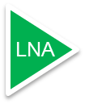






An RF Communications System
Superheterodyne Transceiver
ADC
0°
VGA
Phase
Splitter
LO
90°
ADC
Duplexer
LO
Digital Signal Processor (DSP)
DAC
0°
PA
VGA
Phase
Splitter
LO
90°
DAC
RF
IF
Mixed-Signal
Fall 2015, Aug 17
ELEC2200-002 Lecture 1

Slide 8






An Alternative RF Communications System
Zero-IF (ZIF) Transceiver
ADC
0°
Phase
Splitter
LO
90°
ADC
Duplexer
Digital Signal Processor (DSP)
DAC
0°
PA
Phase
Splitter
LO
90°
DAC
RF
Mixed-Signal
Fall 2015, Aug 17
ELEC2200-002 Lecture 1

Slide 9
The Concept of a Computer
Application software
Systems software
User
Hardware
Operating system
compiler
assembler
Programs user
writes and runs
Fall 2015, Aug 17
ELEC2200-002 Lecture 1

Slide 10
Software
Compiler
Assembler
Application software,
a program in C:
swap (int v[ ], int k)
{int temp;
temp = v[k];
v[k] = v[k+1];
v[k+1] = temp;
}
MIPS compiler output,
assembly language program:
swap;
muli $2, $5, 4
add $2, $4, $2
lw $15, 0 ($2)
lw $16, 4 ($2)
sw $16, 0 ($2)
sw $15, 4 ($2)
jr $31
MIPS binary machine code:
00000000101000010000000000011000
00000000000110000001100000100001
10001100011000100000000000000000
10001100111100100000000000000100
10101100111100100000000000000000
10101100011000100000000000000100
00000011111000000000000000001000
32-bit words
stored in
memory
Application software
Systems software
Hardware
Machine instructions
Fall 2015, Aug 17
ELEC2200-002 Lecture 1

Slide 11
Binary Machine Code
00000000101000010000000000011000
00000000000110000001100000100001
10001100011000100000000000000000
10001100111100100000000000000100
10101100111100100000000000000000
10101100011000100000000000000100
00000011111000000000000000001000
Instruction
code
(opcode)
Encoded data
Fall 2015, Aug 17
ELEC2200-002 Lecture 1

Slide 12
The Hardware of a Computer
Input
Control
Datapath
Memory
Central Processing
Unit (CPU)
or “processor”
Output
Application software
Systems software
Hardware
FIVE PIECES
Fall 2015, Aug 17
ELEC2200-002 Lecture 1

Slide 13
Hardware Processes Machine Code
User program is translated into binary machine code by compiler and assembler and is stored in memory.
Control unit reads program from memory, one word at a time (fetch operation).
Control unit deciphers the instruction bits of program word and configures datapath logic, which processes data and saves results in memory (decode and execute operations).
Fall 2015, Aug 17
ELEC2200-002 Lecture 1

Slide 14
Digital Hardware of Computer
Memory
Control Finite State Machine (FSM)
Datapath: Arithmetic logic and registers
Input/Output bus
Fall 2015, Aug 17
ELEC2200-002 Lecture 1

Slide 15
To Find Out More
J. Rogers, C. Plett and F. Dai, Integrated Circuit Design for High-Speed Frequency Synthesis, Boston: Artech House, 2006.
D. A. Patterson and J. L. Hennessy, Computer Organization & Design, the Hardware/Software Interface, Fourth Edition, San Francisco, California: Morgan Kaufman Publishers (Elsevier), 2009.
Fall 2015, Aug 17
ELEC2200-002 Lecture 1

Slide 16
Exercises
Identify radio frequency (RF), mixed (analog and digital) signal, and digital components in a communications system.
Which parts in computing and communications systems contain digital arithmetic logic circuits?
Where is the binary machine code stored in a digital computer?
What is the difference between sequential and combinational circuits? Which category does the control of a computer belong to?
Fall 2015, Aug 17
ELEC2200-002 Lecture 1

Slide 17
Answers
Components of a communications system:
    RF: Antenna, duplexer, filter, mixer, local oscillator.
    Mixed-signal: ADC, DAC.
    Digital: DSP.
Arithmetic logic is contained in DSP and datapath.
Machine code is stored in a memory.
Sequential and combinational circuits:
    A sequential circuit contains memory. Its output is determined by the input and the content of the memory.
    A combinational circuit contains no memory. Its output depends entirely upon the input.
    Control of a computer is a sequential circuit.
Fall 2015, Aug 17
ELEC2200-002 Lecture 1

Slide 18
Digital Systems
Binary
Arithmetic
Boolean
Algebra
DIGITAL
CIRCUITS
Switching
Theory
Semiconductor
Technology
Fall 2015, Aug 17
ELEC2200-002 Lecture 1

Slide 19
Next
Binary Arithmetic
Fall 2015, Aug 17
ELEC2200-002 Lecture 1

Slide 20
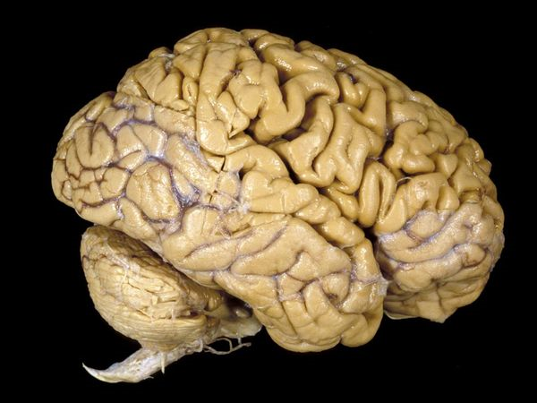
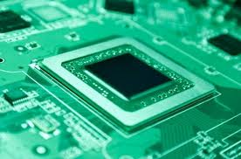
Why Binary Arithmetic?
3 + 5
0011 + 0101
= 8
= 1000
Fall 2015, Aug 17
ELEC2200-002 Lecture 1

