Slide 1
Intro to Database Systems CSIS 3310 Managing Databases with MVC

Slide 2
Using Databases with MVC
Visual Studio gives you many ways to connect a Database to your project as a Data source. In this class, we will be create a database using the SQL Server Express Database that is automatically installed as a service when you install Visual Studio.

Slide 3
Creating Your SQL Database
To create your SQL Database you must choose “SQL Server Database” when you add a new Data source.
You can see your Database in the App_Data folder in you Solution Explorer, or in the Server Explorer Data Connections:

Slide 4
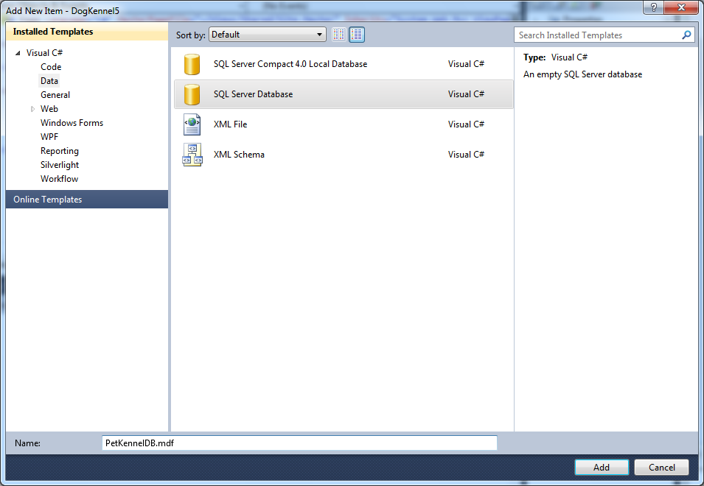
Creating Your SQL Database

Slide 5
Creating A Database Table
When you have created your database, you add a new Table and all of your table fields through the Server Explorer.
You can also view and edit your Table data through the Server Explorer

Slide 6
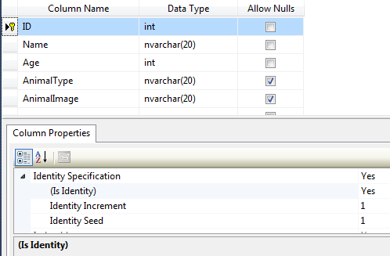
Creating A Database Table

Slide 7
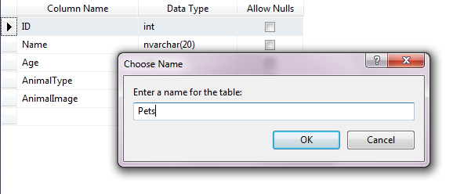
Creating A Database Table

Slide 8
Binding a Database to a Model
When you create a Model for your MVC project, you can use one that is based on the fields of your Database Table. Two of the most popular Data Models are:
ADO.NET Entity Data Model
LINQ to SQL Classes

Slide 9
The benefits of ADO.NET Entity Framework of LINQ to SQL
ADO.NET (often called Entity Frameworks) is similar to LINQ to SQL, but LINQ to SQL has some limitations that are not in Entity Framework:
LINQ to SQL only works with SQL Servers
LINQ to SQL only does 1-1 object to table mapping
LINQ to SQL will not be enhanced in the future

Slide 10
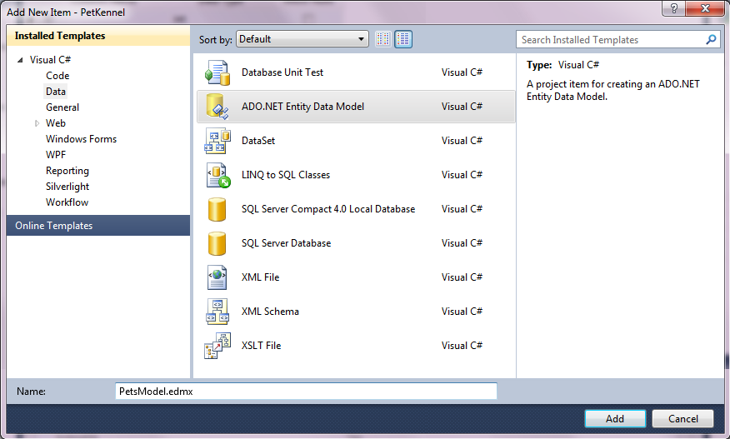
Binding a Database to a Model
Right-Click on the Model Folder and Choose:
Add / New Item / Data / ADO.NET Entity Data Model
Then name Your Data Model:
PetsModel.edmx

Slide 11
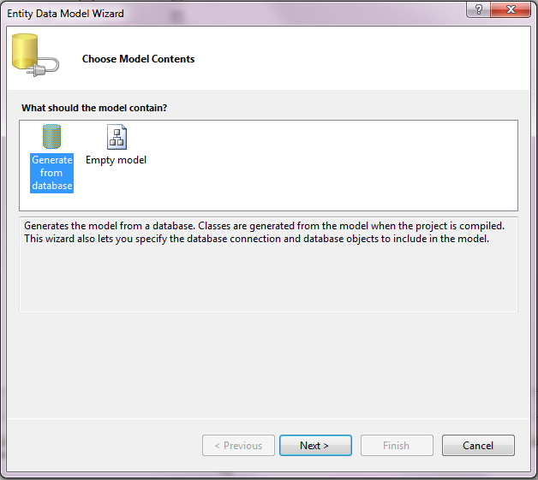
Binding a Database to a Model

Slide 12
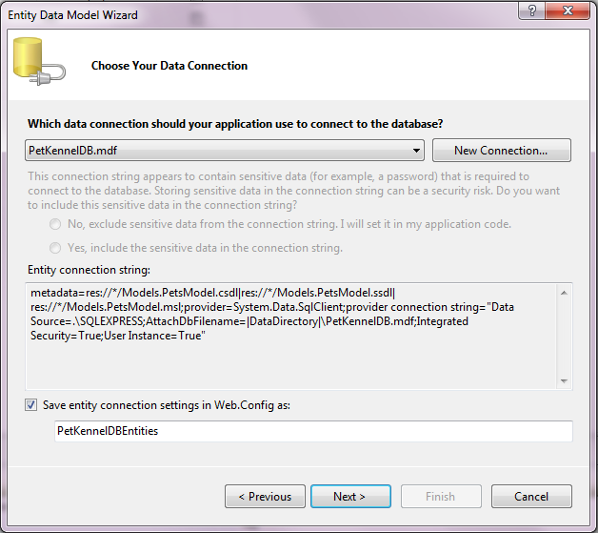
Binding a Database to a Model

Slide 13
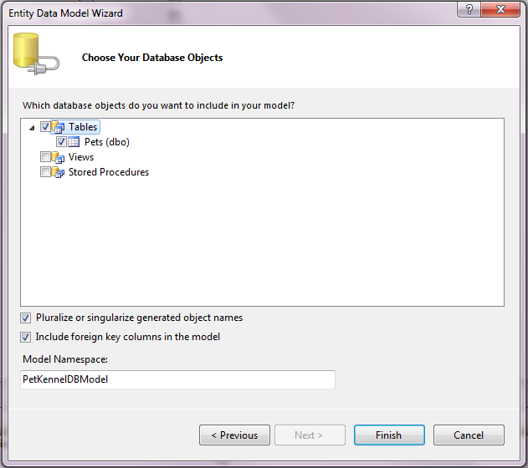
Binding a Database to a Model

Slide 14
Binding a Database to a Model

Slide 15
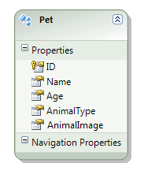
Binding a Database to a Model

Slide 16
Using the Model in a Controller
Once you have bound your database table to a model, the model is in a .edmx file and the following is created:
A dataconnection and class name that ends in the name Entities (e.g. PetKennelDBEntities)
A link to your table in the data connection
A class for the records in your table (usually named with a singular version of the table name)

Slide 17
Using the Model in a Controller
Action Method
To access table data in a Controller you do the following:
public NamedEntities db = new NamedEntities();
// Creates a new data object link for the Database
Return View(db.TableName) // Returns the table data for a view
db.AddToTableName(object) // Adds a record to the table
db.TableName.DeleteObject(object) // Removes a record from table
db.SaveChanges() // Saves the data to the database

Slide 18
Using the Model in a Controller
Action Method
To find a particular record in the table you can use SQL commands like so:
RecordName theObject = (from x in db.TableName
where (x.ID == ID)
select x).First();
You can do the same thing using the following shorter lambda expression:
RecordName theObject = db.TableName.First(x => x.ID == ID);

Slide 19
An Example of the Crud Action Methods for the PetKennelDB
public PetKennelDBEntities db = new PetKennelDBEntities();
public ActionResult Error()
{
return View();
}
public ActionResult List()
{
ViewData["Message"] = "Here's the list of the pets at the Kennel:";
return View(db.Pets);
}

Slide 20
An Example of the Crud Action Methods for the PetKennelDB (cont.)
public ActionResult Details(int ID)
{
ViewData["Message"] = "Details of this pet:";
try
{
Pet thePet = db.Pets.First(p => p.ID == ID);
return View(thePet);
}
catch
{
return RedirectToAction("Error");
}
}

Slide 21
An Example of the Crud Action Methods for the PetKennelDB (cont.)
public ActionResult Create()
{
ViewData["Message"] = "Fill in the details for this pet:";
return View();
}

Slide 22
An Example of the Crud Action Methods for the PetKennelDB (cont.)
[HttpPost]
public ActionResult Create(Pet p)
{
try
{
if (!ModelState.IsValid)
{
ViewData["Message"] = "Problem Creating Pet Account:";
return View("Create", p);
}
db.AddToPets(p);
db.SaveChanges();
return RedirectToAction("List");
}
catch
{
ViewData["Message"] = " Problem Creating Pet Account:";
return View("Create", p);
}
}

Slide 23
An Example of the Crud Action Methods for the PetKennelDB (cont.)
public ActionResult Edit(int ID)
{
ViewData["Message"] = "Edit the following Pet's Information:";
try
{
Pet thePet = db.Pets.First(p => p.ID == ID);
return View(thePet);
}
catch
{
return RedirectToAction("Error");
}
}

Slide 24
An Example of the Crud Action Methods for the PetKennelDB (cont.)
[HttpPost]
public ActionResult Edit(Pet pet)
{
try
{
if (!ModelState.IsValid)
{
ViewData["Message"] = "Problem Editing Pet Account:";
return View("Edit", pet);
}
Pet thePet = db.Pets.First(p => p.ID == pet.ID);
thePet.Name = pet.Name;
thePet.Age = pet.Age;
thePet.AnimalType = pet.AnimalType;
thePet.AnimalImage = pet.AnimalImage;
db.SaveChanges();
return RedirectToAction("List");
}
catch
{
ViewData["Message"] = "Problem Editing Pet Account:";
return View("Edit", pet);
}
}

Slide 25
An Example of the Crud Action Methods for the PetKennelDB (cont.)
public ActionResult Delete(int ID)
{
ViewData["Message"] = "Delete the following Pet:";
try
{
Pet thePet = db.Pets.First(p => p.ID == ID);
return View(thePet);
}
catch
{
return RedirectToAction("Error");
}
}

Slide 26
An Example of the Crud Action Methods for the PetKennelDB (cont.)
[HttpPost]
public ActionResult Delete(Pet pet)
{
try
{
if (pet == null)
return RedirectToAction("Error");
Pet thePet = db.Pets.First(p => p.ID == pet.ID);
db.Pets.DeleteObject(thePet);
db.SaveChanges();
return RedirectToAction("List");
}
catch
{
ViewData["Message"] = "Problem Deleting the Pet Account:";
return View("Delete", pet);
}
}

Slide 27
Using Images with MVC
In a view, when an image is being managed by the logic of the controller, the controller can either send the entire image link, or just the image path to the view:
Entire Image Link:
ViewData["Image1"] = "<img src = ../../Content/cakeimage.jpg />"
Simple Image Path:
ViewData["Image2"] = "../../Content/jokerimage.jpg"

Slide 28
Using Images with MVC
View Page Code:
<p>
<%= ViewData["Image1"] %>
</p>
<p>
<img src= <%: ViewData["Image2"] %> />
</p>
In general we will be using the first approach and send the entire image link because it gives the controller control over things like the size of the image as well

Slide 29
Using Images with MVC
With the AnimalImage Field:
<p>
<img src=/Content/<%: item.AnimalImage %> />
</p>
Or
<p>
<img src=/Content/<%: item.AnimalImage %> />
</p>

