Slide 1


CSIS 3310
Spring 2013
Introduction to Database Systems
Chapters 1 - 3:
Review
KROENKE AND AUER - DATABASE PROCESSING, 12th Edition © 2012 Pearson Prentice Hall
1-<number>

Slide 2
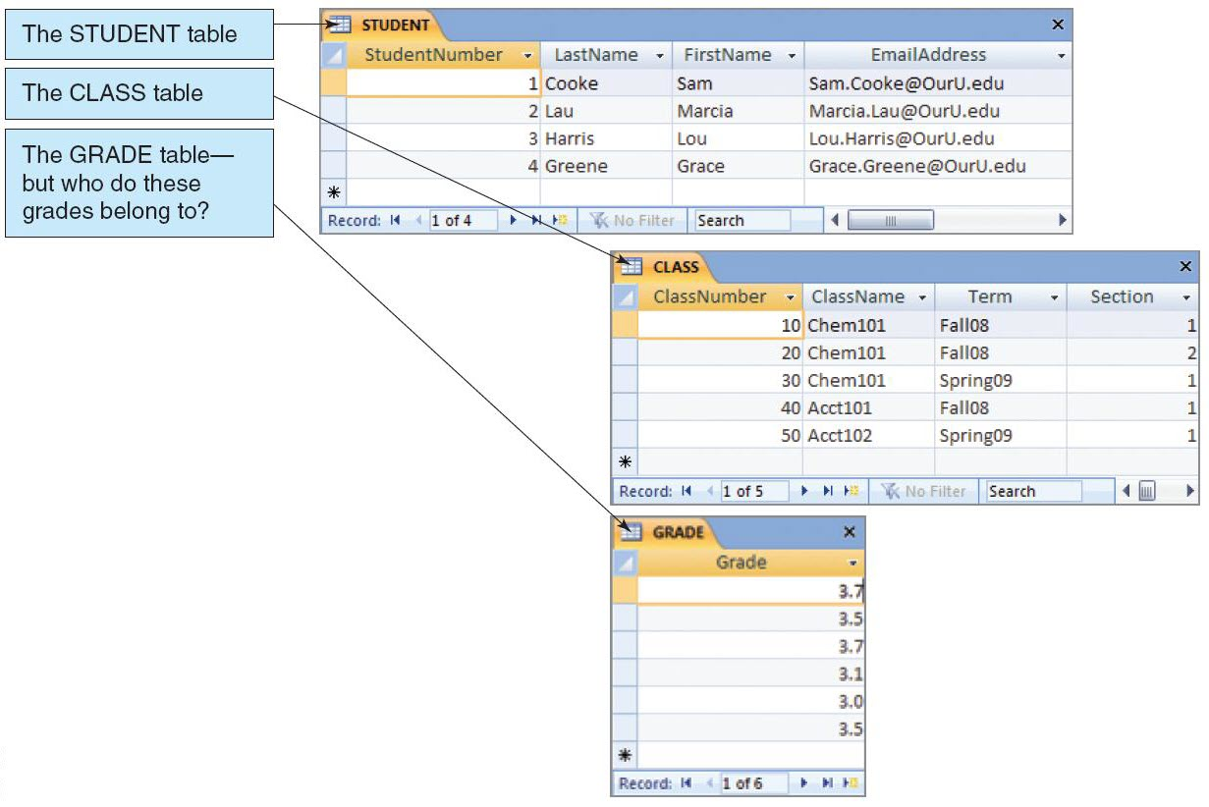
Representing Data in Tables
KROENKE AND AUER - DATABASE PROCESSING, 11th Edition © 2010 Pearson Prentice Hall
1-<number>

Slide 3
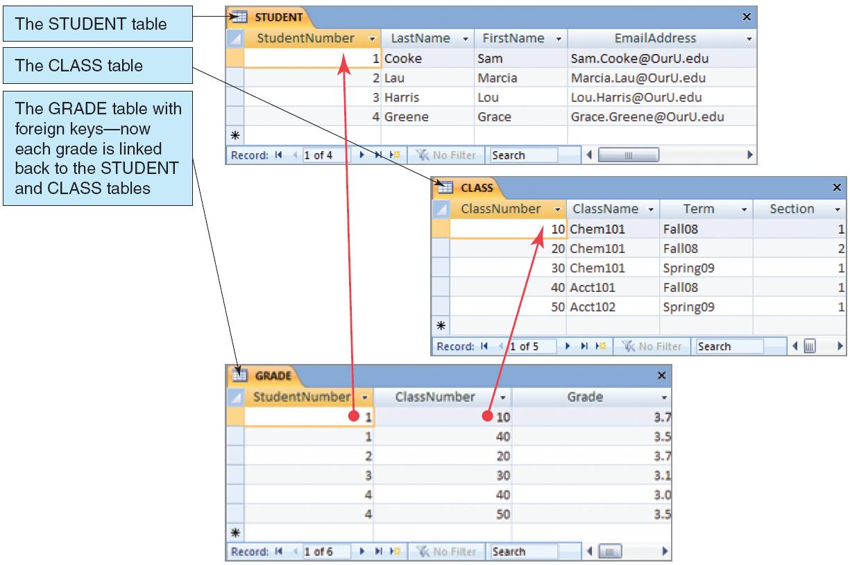
The Key Characteristic of Databases: Related Tables
KROENKE AND AUER - DATABASE PROCESSING, 11th Edition © 2010 Pearson Prentice Hall
1-<number>

Slide 4
Naming Conventions in this Textbook
Table names are written with all capital letters:
  STUDENT, CLASS, GRADE
Column names are written with an initial capital letter, and compound names are written with a capital letter on each word:
  Term, Section, ClassNumber, StudentName
KROENKE AND AUER - DATABASE PROCESSING, 11th Edition © 2010 Pearson Prentice Hall
1-<number>

Slide 5
Databases Create Information
Data = recorded facts and figures
Information = knowledge derived from data
Databases record data, but they do so in such a way that we can produce information from the data.
  The data on STUDENTs, CLASSes, and GRADEs could produce information about each student’s GPA.
KROENKE AND AUER - DATABASE PROCESSING, 11th Edition © 2010 Pearson Prentice Hall
1-<number>

Slide 6
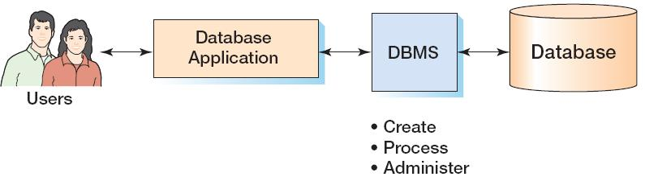
Components of a Database System
KROENKE AND AUER - DATABASE PROCESSING, 11th Edition © 2010 Pearson Prentice Hall
1-<number>

Slide 7
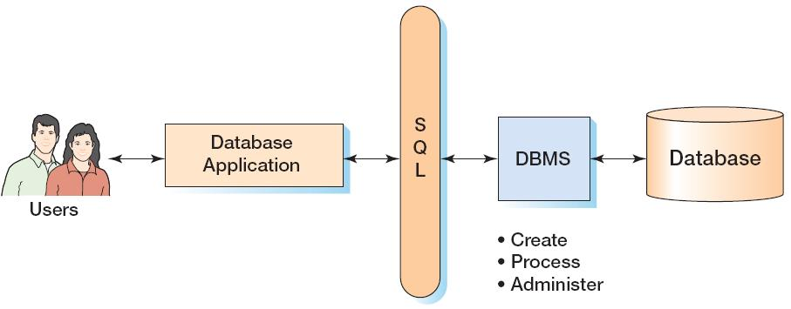
Components of a Database System with SQL
KROENKE AND AUER - DATABASE PROCESSING, 11th Edition © 2010 Pearson Prentice Hall
1-<number>

Slide 8
Applications, the DBMS, and SQL
Applications are the computer programs that users work with.
The Database Management System (DBMS) creates, processes, and administers databases.
Structured Query Language (SQL) is an internationally recognized standard database language that is used by all commercial DBMSs.
KROENKE AND AUER - DATABASE PROCESSING, 11th Edition © 2010 Pearson Prentice Hall
1-<number>

Slide 9
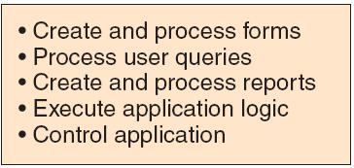
Database Applications
KROENKE AND AUER - DATABASE PROCESSING, 11th Edition © 2010 Pearson Prentice Hall
1-<number>

Slide 10
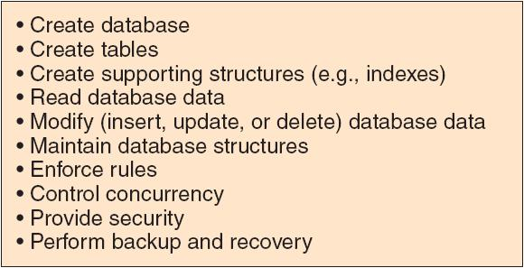
The DBMS
KROENKE AND AUER - DATABASE PROCESSING, 11th Edition © 2010 Pearson Prentice Hall
1-<number>

Slide 11
The Database
A database is a self-describing collection of integrated tables.
The tables are called integrated because they store data about the relationships between the rows of data.
A database is called self-describing because it stores a description of itself.
The self-describing data is called metadata, which is data about data.
KROENKE AND AUER - DATABASE PROCESSING, 11th Edition © 2010 Pearson Prentice Hall
1-<number>

Slide 12
Prominent DBMS Products
Microsoft Access
Microsoft SQL Server 2008
  New: Microsoft SQL Server 2998 Express
Oracle Corporation Oracle Database 11g
MySQL 5.1
IBM DB2
KROENKE AND AUER - DATABASE PROCESSING, 11th Edition © 2010 Pearson Prentice Hall
1-<number>

Slide 13
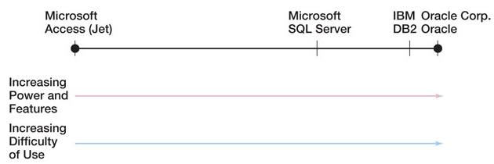
DBMS Power vs. Ease of Use
KROENKE AND AUER - DATABASE PROCESSING, 11th Edition © 2010 Pearson Prentice Hall
1-<number>

Slide 14
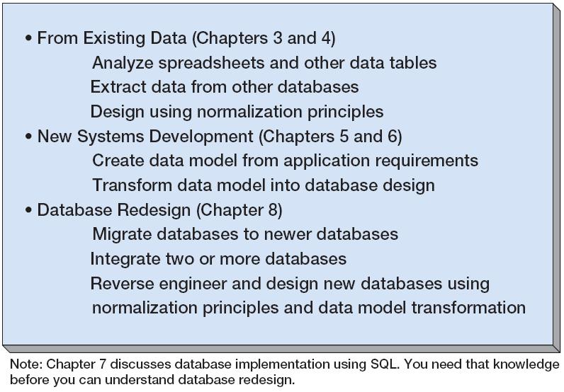
Three Types of Database Design
KROENKE AND AUER - DATABASE PROCESSING, 11th Edition © 2010 Pearson Prentice Hall
1-<number>

Slide 15
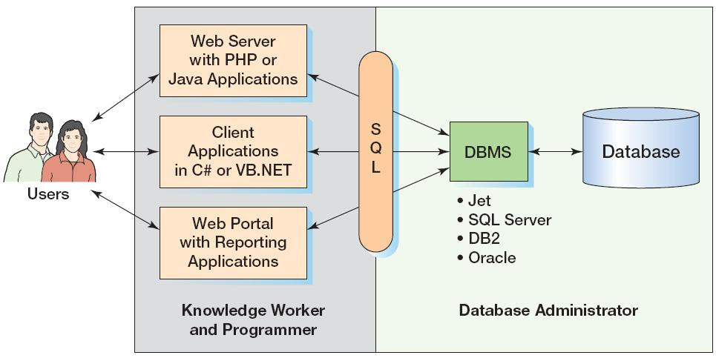
What You Need To Learn
KROENKE AND AUER - DATABASE PROCESSING, 11th Edition © 2010 Pearson Prentice Hall
1-<number>

Slide 16
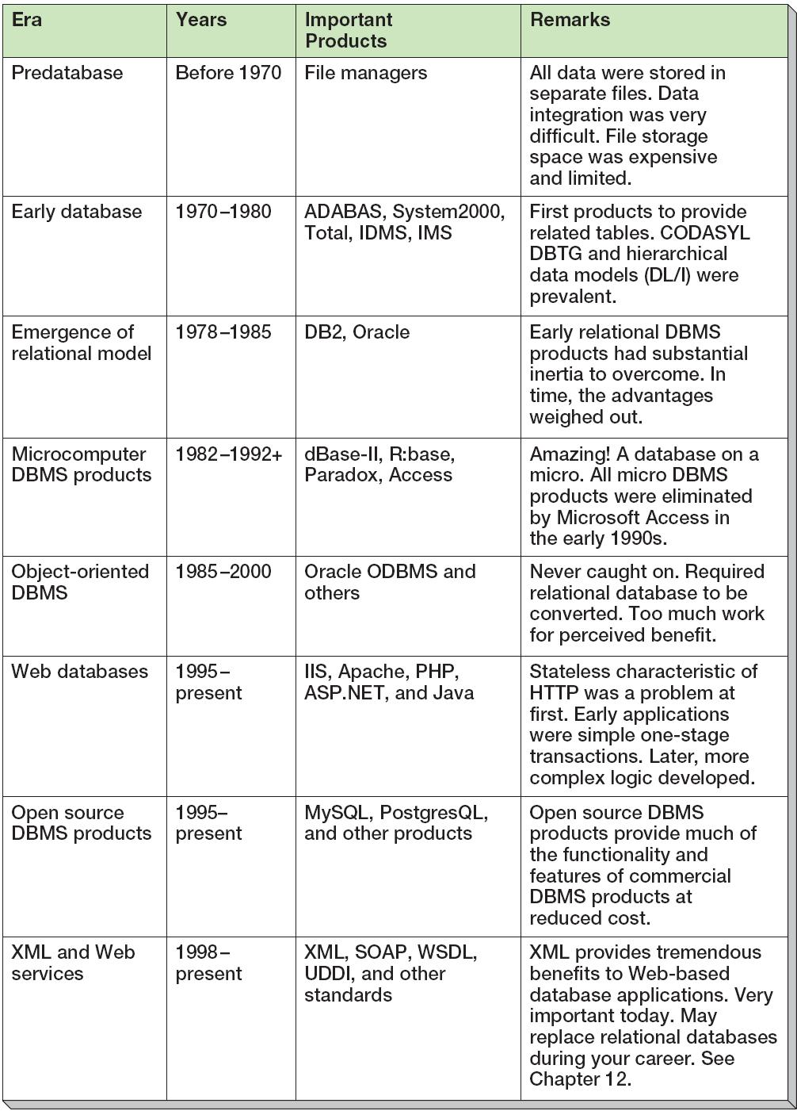
A Brief History of Database Processing
KROENKE AND AUER - DATABASE PROCESSING, 11th Edition © 2010 Pearson Prentice Hall
1-<number>

Slide 17
The Relational Database Model
The dominant database model is the relational database model—all current major DBMS products are based on it.
It was created by IBM engineer E. F. Codd in 1970.
It was based on mathematics called relational algebra.
This text examines and explains the relational database model.
KROENKE AND AUER - DATABASE PROCESSING, 11th Edition © 2010 Pearson Prentice Hall
1-<number>

Slide 18
Structured Query Language
Structured Query Language (SQL) was developed by the IBM Corporation in the late 1970’s.
SQL was endorsed as a United States national standard by the American National Standards Institute (ANSI) in 1992 [SQL-92].
Newer versions exist, and incorporate XML and some object-oriented concepts.
KROENKE AND AUER - DATABASE PROCESSING, 11th Edition © 2010 Pearson Prentice Hall
2-<number>

Slide 19
SQL as a Data Sublanguage
SQL is not a full featured programming language.
  C, C#, Java
SQL is a data sublanguage for creating and processing database data and metadata.
SQL is ubiquitous in enterprise-class DBMS products.
SQL programming is a critical skill.
KROENKE AND AUER - DATABASE PROCESSING, 11th Edition © 2010 Pearson Prentice Hall
2-<number>

Slide 20
SQL DDL and DML
SQL statements can be divided into two categories:
  Data definition language (DDL) statements
    Used for creating tables, relationships and other structures.
    Covered in Chapter Seven.
  Data manipulation language (DML) statements.
    Used for queries and data modification.
    Covered in this chapter (Chapter Two).
KROENKE AND AUER - DATABASE PROCESSING, 11th Edition © 2010 Pearson Prentice Hall
2-<number>

Slide 21
The SQL SELECT Statement
The fundamental framework for SQL query states is the SQL SELECT statement.
  SELECT {ColumnName(s)}
  FROM {TableName(s)}
  WHERE {Conditions}
All SQL statements end with a semi-colon (;).
KROENKE AND AUER - DATABASE PROCESSING, 11th Edition © 2010 Pearson Prentice Hall
2-<number>

Slide 22
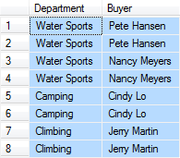
Specific Columns on One Table
SELECT Department, Buyer
FROM SKU_DATA;
KROENKE AND AUER - DATABASE PROCESSING, 11th Edition © 2010 Pearson Prentice Hall
2-<number>

Slide 23
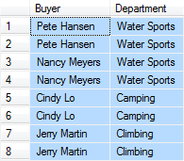
Specifying Column Order
SELECT Buyer, Department
FROM SKU_DATA;
KROENKE AND AUER - DATABASE PROCESSING, 11th Edition © 2010 Pearson Prentice Hall
2-<number>

Slide 24

The DISTINCT Keyword
SELECT DISTINCT Buyer, Department
FROM SKU_DATA;
KROENKE AND AUER - DATABASE PROCESSING, 11th Edition © 2010 Pearson Prentice Hall
2-<number>

Slide 25
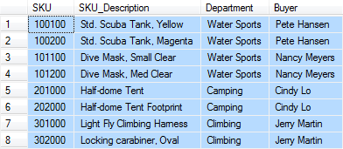
Selecting All Columns:
The Asterisk (*) Keyword
SELECT *
FROM SKU_DATA;
KROENKE AND AUER - DATABASE PROCESSING, 11th Edition © 2010 Pearson Prentice Hall
2-<number>

Slide 26

Specific Rows from One Table
SELECT *
FROM SKU_DATA
WHERE Department = 'Water Sports';
NOTE: SQL wants a plain ASCII single quote: ' NOT ‘ !
KROENKE AND AUER - DATABASE PROCESSING, 11th Edition © 2010 Pearson Prentice Hall
2-<number>

Slide 27

Specific Columns and Rows from One Table
SELECT SKU_Description, Buyer
FROM SKU_DATA
WHERE Department = 'Climbing';
KROENKE AND AUER - DATABASE PROCESSING, 11th Edition © 2010 Pearson Prentice Hall
2-<number>

Slide 28
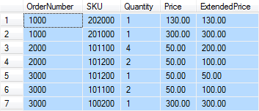
Sorting the Results – ORDER BY
SELECT *
FROM ORDER_ITEM
ORDER BY OrderNumber, Price;
KROENKE AND AUER - DATABASE PROCESSING, 11th Edition © 2010 Pearson Prentice Hall
2-<number>

Slide 29
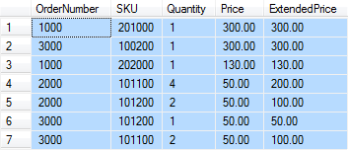
Sort Order:
Ascending and Descending
SELECT *
FROM ORDER_ITEM
ORDER BY Price DESC, OrderNumber ASC;
NOTE: The default sort order is ASC – does not have to be specified.
KROENKE AND AUER - DATABASE PROCESSING, 11th Edition © 2010 Pearson Prentice Hall
2-<number>

Slide 30

WHERE Clause Options - AND
SELECT *
FROM SKU_DATA
WHERE Department = 'Water Sports'
AND Buyer = 'Nancy Meyers';
KROENKE AND AUER - DATABASE PROCESSING, 11th Edition © 2010 Pearson Prentice Hall
2-<number>

Slide 31

WHERE Clause Options - OR
SELECT *
FROM SKU_DATA
WHERE Department = 'Camping'
OR Department = 'Climbing';
KROENKE AND AUER - DATABASE PROCESSING, 11th Edition © 2010 Pearson Prentice Hall
2-<number>

Slide 32
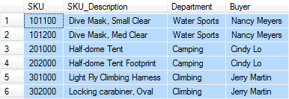
WHERE Clause Options - IN
SELECT *
FROM SKU_DATA
WHERE Buyer IN ('Nancy Meyers',
'Cindy Lo', 'Jerry Martin');
KROENKE AND AUER - DATABASE PROCESSING, 11th Edition © 2010 Pearson Prentice Hall
2-<number>

Slide 33

WHERE Clause Options – NOT IN
SELECT *
FROM SKU_DATA
WHERE Buyer NOT IN ('Nancy Meyers',
'Cindy Lo', 'Jerry Martin');
KROENKE AND AUER - DATABASE PROCESSING, 11th Edition © 2010 Pearson Prentice Hall
2-<number>

Slide 34

WHERE Clause Options – Ranges with BETWEEN
SELECT *
FROM ORDER_ITEM
WHERE ExtendedPrice
BETWEEN 100 AND 200;
KROENKE AND AUER - DATABASE PROCESSING, 11th Edition © 2010 Pearson Prentice Hall
2-<number>

Slide 35
WHERE Clause Options – Ranges with Math Symbols
SELECT *
FROM ORDER_ITEM
WHERE ExtendedPrice >= 100
AND ExtendedPrice <= 200;
KROENKE AND AUER - DATABASE PROCESSING, 11th Edition © 2010 Pearson Prentice Hall
2-<number>

Slide 36
WHERE Clause Options –
LIKE and Wildcards
The SQL keyword LIKE can be combined with wildcard symbols:
  SQL 92 Standard (SQL Server, Oracle, etc.):
    _ = Exactly one character
    % = Any set of zero or more characters
  MS Access (based on MS DOS)
    ? = Exactly one character
    * = Any set of zero or more characters
KROENKE AND AUER - DATABASE PROCESSING, 11th Edition © 2010 Pearson Prentice Hall
2-<number>

Slide 37
WHERE Clause Options –
LIKE and Wildcards
SELECT *
FROM SKU_DATA
WHERE Buyer LIKE 'Pete%';
KROENKE AND AUER - DATABASE PROCESSING, 11th Edition © 2010 Pearson Prentice Hall
2-<number>

Slide 38

WHERE Clause Options –
LIKE and Wildcards
SELECT *
FROM SKU_DATA
WHERE SKU_Descripton LIKE '%Tent%';
KROENKE AND AUER - DATABASE PROCESSING, 11th Edition © 2010 Pearson Prentice Hall
2-<number>

Slide 39

WHERE Clause Options –
LIKE and Wildcards
SELECT *
FROM SKU_DATA
WHERE SKU LIKE '%2__';
KROENKE AND AUER - DATABASE PROCESSING, 11th Edition © 2010 Pearson Prentice Hall
2-<number>

Slide 40
SQL Built-in Functions
There are five SQL Built-in Functions:
  COUNT
  SUM
  AVG
  MIN
  MAX
KROENKE AND AUER - DATABASE PROCESSING, 11th Edition © 2010 Pearson Prentice Hall
2-<number>

Slide 41

SQL Built-in Functions
SELECT SUM (ExtendedPrice)
AS Order3000Sum
FROM ORDER_ITEM
WHERE OrderNumber = 3000;
KROENKE AND AUER - DATABASE PROCESSING, 11th Edition © 2010 Pearson Prentice Hall
2-<number>

Slide 42

SQL Built-in Functions
SELECT SUM (ExtendedPrice) AS OrderItemSum,
AVG (ExtendedPrice) AS OrderItemAvg,
MIN (ExtendedPrice) AS OrderItemMin,
MAX (ExtendedPrice) AS OrderItemMax
FROM ORDER_ITEM;
KROENKE AND AUER - DATABASE PROCESSING, 11th Edition © 2010 Pearson Prentice Hall
2-<number>

Slide 43

SQL Built-in Functions
SELECT COUNT(*) AS NumberOfRows
FROM ORDER_ITEM;
KROENKE AND AUER - DATABASE PROCESSING, 11th Edition © 2010 Pearson Prentice Hall
2-<number>

Slide 44

SQL Built-in Functions
SELECT COUNT
(DISTINCT Department)
AS DeptCount
FROM SKU_DATA;
KROENKE AND AUER - DATABASE PROCESSING, 11th Edition © 2010 Pearson Prentice Hall
2-<number>

Slide 45
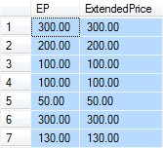
Arithmetic in SELECT Statements
SELECT Quantity * Price AS EP,
ExtendedPrice
FROM ORDER_ITEM;
KROENKE AND AUER - DATABASE PROCESSING, 11th Edition © 2010 Pearson Prentice Hall
2-<number>

Slide 46

String Functions in SELECT Statements
SELECT DISTINCT RTRIM (Buyer)
+ ' in ' + RTRIM (Department) AS Sponsor
FROM SKU_DATA;
KROENKE AND AUER - DATABASE PROCESSING, 11th Edition © 2010 Pearson Prentice Hall
2-<number>

Slide 47

The SQL keyword GROUP BY
SELECT Department, Buyer,
COUNT(*) AS
Dept_Buyer_SKU_Count
FROM SKU_DATA
GROUP BY Department, Buyer;
KROENKE AND AUER - DATABASE PROCESSING, 11th Edition © 2010 Pearson Prentice Hall
2-<number>

Slide 48

The SQL keyword GROUP BY
SELECT Department, COUNT(*) AS
Dept_SKU_Count
FROM SKU_DATA
WHERE SKU <> 302000
GROUP BY Department
ORDER BY Dept_SKU_Count;
KROENKE AND AUER - DATABASE PROCESSING, 11th Edition © 2010 Pearson Prentice Hall
2-<number>

Slide 49

The SQL keyword GROUP BY
SELECT Department, COUNT(*) AS
Dept_SKU_Count
FROM SKU_DATA
WHERE SKU <> 302000
GROUP BY Department
HAVING COUNT (*) > 1
ORDER BY Dept_SKU_Count;
KROENKE AND AUER - DATABASE PROCESSING, 11th Edition © 2010 Pearson Prentice Hall
2-<number>

Slide 50

Querying Multiple Tables: Subqueries
SELECT SUM (ExtendedPrice) AS Revenue
FROM ORDER_ITEM
WHERE SKU IN
(SELECT SKU
FROM SKU_DATA
WHERE Department = 'Water Sports');
Note: The second SELECT statement is a subquery.
KROENKE AND AUER - DATABASE PROCESSING, 11th Edition © 2010 Pearson Prentice Hall
2-<number>

Slide 51

Querying Multiple Tables: Subqueries
SELECT Buyer
FROM SKU_DATA
WHERE SKU IN
(SELECT SKU
FROM ORDER_ITEM
WHERE OrderNumber IN
(SELECT OrderNumber
FROM RETAIL_ORDER
WHERE OrderMonth = 'January'
AND OrderYear = 2004));
KROENKE AND AUER - DATABASE PROCESSING, 11th Edition © 2010 Pearson Prentice Hall
2-<number>

Slide 52
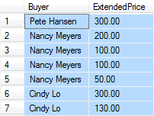
Querying Multiple Tables:
Joins
SELECT Buyer, ExtendedPrice
FROM SKU_DATA, ORDER_ITEM
WHERE SKU_DATA.SKU = ORDER_ITEM.SKU;
KROENKE AND AUER - DATABASE PROCESSING, 11th Edition © 2010 Pearson Prentice Hall
2-<number>

Slide 53

Querying Multiple Tables:
Joins
SELECT Buyer, SUM(ExtendedPrice)
AS BuyerRevenue
FROM SKU_DATA, ORDER_ITEM
WHERE SKU_DATA.SKU = ORDER_ITEM.SKU
GROUP BY Buyer
ORDER BY BuyerRevenue DESC;
KROENKE AND AUER - DATABASE PROCESSING, 11th Edition © 2010 Pearson Prentice Hall
2-<number>

Slide 54
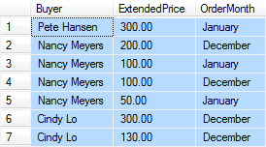
Querying Multiple Tables:
Joins
SELECT Buyer, ExtendedPrice, OrderMonth
FROM SKU_DATA, ORDER_ITEM, RETAIL_ORDER
WHERE SKU_DATA.SKU = ORDER_ITEM.SKU
AND ORDER_ITEM.OrderNumber =
RETAIL_ORDER.OrderNumber;
KROENKE AND AUER - DATABASE PROCESSING, 11th Edition © 2010 Pearson Prentice Hall
2-<number>

Slide 55
Premise
We have received one or more tables of existing data.
The data is to be stored in a new database.
QUESTION: Should the data be stored as received, or should it be transformed for storage?
KROENKE AND AUER - DATABASE PROCESSING, 11th Edition © 2010 Pearson Prentice Hall
3-<number>

Slide 56
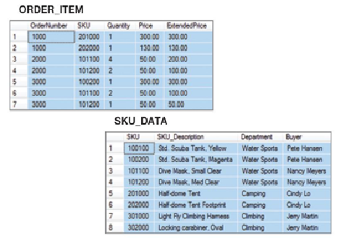
How Many Tables?
Should we store these two tables as they are, or should we combine them into one table in our new database?
KROENKE AND AUER - DATABASE PROCESSING, 11th Edition © 2010 Pearson Prentice Hall
3-<number>

Slide 57
Important Relational Model Terms
Entity
Relation
Functional dependency
Determinant
Candidate key
Composite key
Primary key
Surrogate key
Foreign key
Referential integrity constraint
Normal form
Multivalued dependency
KROENKE AND AUER - DATABASE PROCESSING, 11th Edition © 2010 Pearson Prentice Hall
3-<number>

Slide 58
Entity
An entity is some identifiable thing that users want to track:
  Customers
  Computers
  Sales
KROENKE AND AUER - DATABASE PROCESSING, 11th Edition © 2010 Pearson Prentice Hall
3-<number>

Slide 59
Relation
Relational DBMS products store data about entities in relations, which are a special type of table.
A relation is a two-dimensional table that has the following characteristics:
  Rows contain data about an entity.
  Columns contain data about attributes of the entity.
  All entries in a column are of the same kind.
  Each column has a unique name.
  Cells of the table hold a single value.
  The order of the columns is unimportant.
  The order of the rows is unimportant.
  No two rows may be identical.
KROENKE AND AUER - DATABASE PROCESSING, 11th Edition © 2010 Pearson Prentice Hall
3-<number>

Slide 60
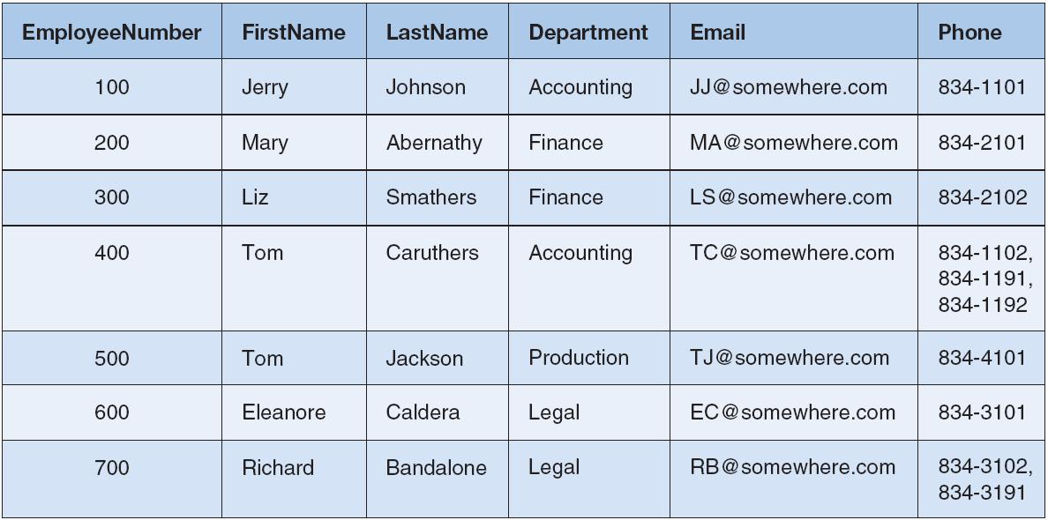
Tables That Are Not Relations:
Multiple Entries per Cell
KROENKE AND AUER - DATABASE PROCESSING, 11th Edition © 2010 Pearson Prentice Hall
3-<number>

Slide 61
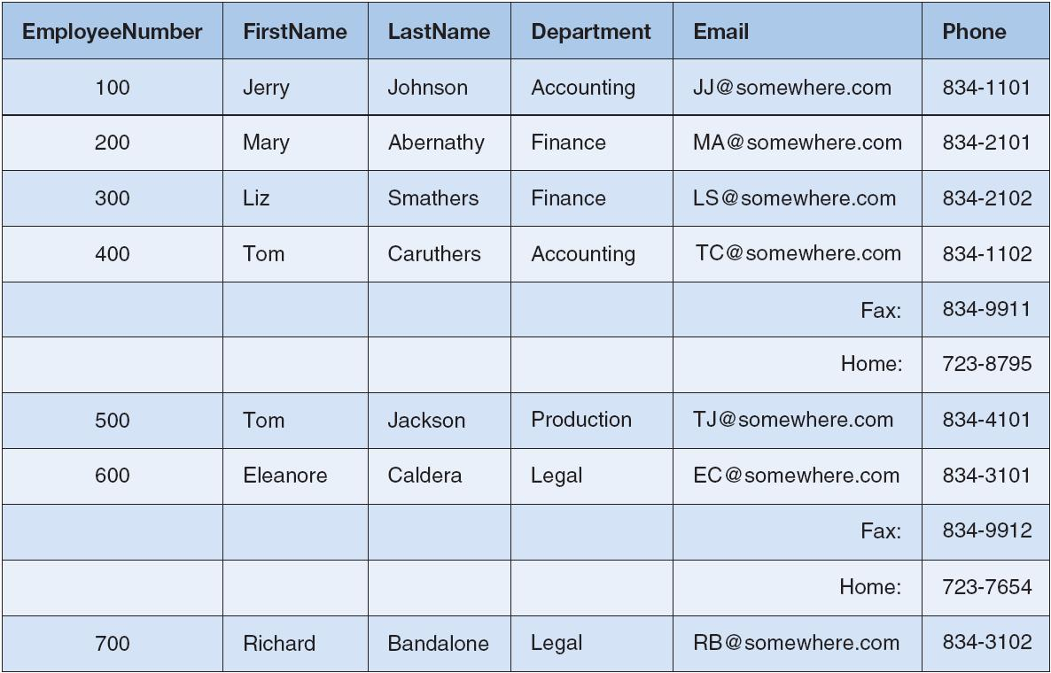
Tables That Are Not Relations:
Table with Required Row Order
KROENKE AND AUER - DATABASE PROCESSING, 11th Edition © 2010 Pearson Prentice Hall
3-<number>

Slide 62
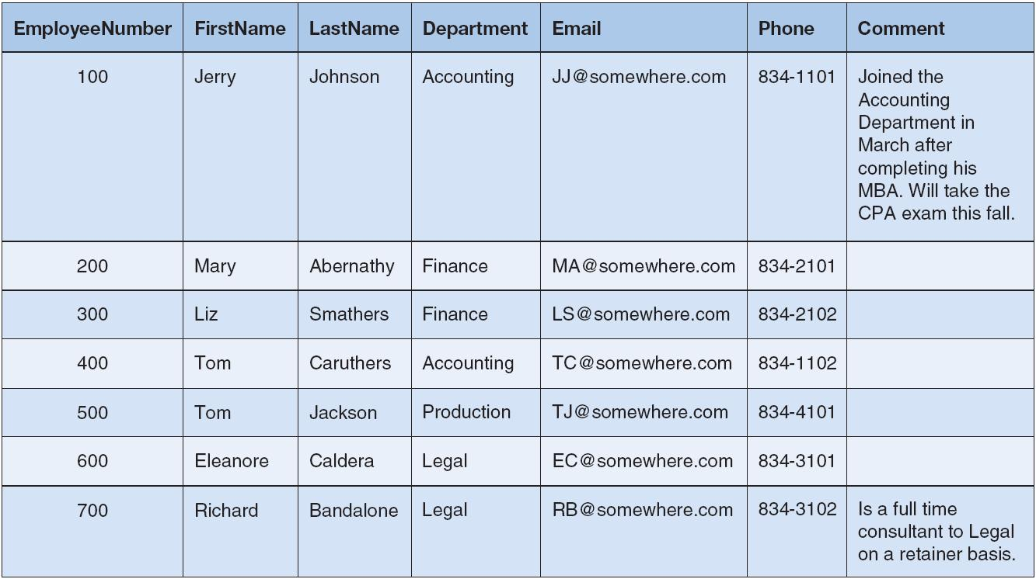
A Relation with Values of Varying Length
KROENKE AND AUER - DATABASE PROCESSING, 11th Edition © 2010 Pearson Prentice Hall
3-<number>

Slide 63
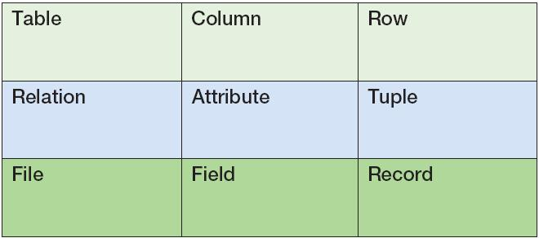
Alternative Terminology
Although not all tables are relations, the terms table and relation are normally used interchangeably.
The following sets of terms are equivalent:
KROENKE AND AUER - DATABASE PROCESSING, 11th Edition © 2010 Pearson Prentice Hall
3-<number>

Slide 64
Functional Dependency
A functional dependency occurs when the value of one (set of) attribute(s) determines the value of a second (set of) attribute(s):
    StudentID → StudentName
    StudentID → (DormName, DormRoom, Fee)
The attribute on the left side of the functional dependency is called the determinant.
Functional dependencies may be based on equations:
  ExtendedPrice = Quantity X UnitPrice
  (Quantity, UnitPrice) → ExtendedPrice
Function dependencies are not equations!
KROENKE AND AUER - DATABASE PROCESSING, 11th Edition © 2010 Pearson Prentice Hall
3-<number>

Slide 65
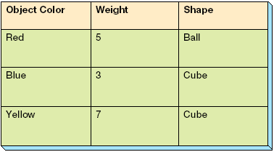
Functional Dependencies Are Not Equations
      ObjectColor → Weight
      ObjectColor → Shape
      ObjectColor → (Weight, Shape)
KROENKE AND AUER - DATABASE PROCESSING, 11th Edition © 2010 Pearson Prentice Hall
3-<number>

Slide 66
Composite Determinants
Composite determinant = a determinant of a functional dependency that consists of more than one attribute.
(StudentName, ClassName) → (Grade)
KROENKE AND AUER - DATABASE PROCESSING, 11th Edition © 2010 Pearson Prentice Hall
3-<number>

Slide 67
Functional Dependency Rules
If A → (B, C), then A → B and A→ C.
If (A,B) → C, then neither A nor B determines C by itself.
KROENKE AND AUER - DATABASE PROCESSING, 11th Edition © 2010 Pearson Prentice Hall
3-<number>

Slide 68
Functional Dependencies in the SKU_DATA Table
KROENKE AND AUER - DATABASE PROCESSING, 11th Edition
© 2010 Pearson Prentice Hall
3-<number>

Slide 69
Functional Dependencies in the SKU_DATA Table
SKU → (SKU_Description, Department, Buyer)
SKU_Description → (SKU, Department, Buyer)
Buyer → Department
KROENKE AND AUER - DATABASE PROCESSING, 11th Edition © 2010 Pearson Prentice Hall
3-<number>

Slide 70
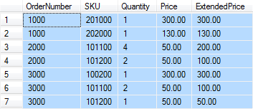
Functional Dependencies in the ORDER_ITEM Table
KROENKE AND AUER - DATABASE PROCESSING, 11th Edition © 2010 Pearson Prentice Hall
3-<number>

Slide 71
Functional Dependencies in the ORDER_ITEM Table
(OrderNumber, SKU) →
(Quantity, Price, ExtendedPrice)
(Quantity, Price) → (ExtendedPrice)
KROENKE AND AUER - DATABASE PROCESSING, 11th Edition © 2010 Pearson Prentice Hall
3-<number>

Slide 72
What Makes Determinant Values Unique?
A determinant is unique in a relation if and only if, it determines every other column in the relation.
You cannot find the determinants of all functional dependencies simply by looking for unique values in one column:
  Data set limitations
  Must be logically a determinant
KROENKE AND AUER - DATABASE PROCESSING, 11th Edition © 2010 Pearson Prentice Hall
3-<number>

Slide 73
Keys
A key is a combination of one or more columns that is used to identify rows in a relation.
A composite key is a key that consists of two or more columns.
KROENKE AND AUER - DATABASE PROCESSING, 11th Edition © 2010 Pearson Prentice Hall
3-<number>

Slide 74
Candidate and Primary Keys
A candidate key is a key that determines all of the other columns in a relation.
A primary key is a candidate key selected as the primary means of identifying rows in a relation.
  There is only one primary key per relation.
  The primary key may be a composite key.
  The ideal primary key is short, numeric, and never changes.
KROENKE AND AUER - DATABASE PROCESSING, 11th Edition © 2010 Pearson Prentice Hall
3-<number>

Slide 75
Surrogate Keys
A surrogate key is an artificial column added to a relation to serve as a primary key.
  DBMS supplied
  Short, numeric, and never changes—an ideal primary key
  Has artificial values that are meaningless to users
  Normally hidden in forms and reports
KROENKE AND AUER - DATABASE PROCESSING, 11th Edition © 2010 Pearson Prentice Hall
3-<number>

Slide 76
Surrogate Keys
NOTE: The primary key of the relation is underlined below:
RENTAL_PROPERTY without surrogate key:
RENTAL_PROPERTY (Street, City,
State/Province, Zip/PostalCode, Country, Rental_Rate)
RENTAL_PROPERTY with surrogate key:
  RENTAL_PROPERTY (PropertyID, Street, City,
  State/Province, Zip/PostalCode, Country, Rental_Rate)
KROENKE AND AUER - DATABASE PROCESSING, 11th Edition © 2010 Pearson Prentice Hall
3-<number>

Slide 77
Foreign Keys
A foreign key is the primary key of one relation that is placed in another relation to form a link between the relations.
  A foreign key can be a single column or a composite key.
  The term refers to the fact that key values are foreign to the relation in which they appear as foreign key values .
KROENKE AND AUER - DATABASE PROCESSING, 11th Edition © 2010 Pearson Prentice Hall
3-<number>

Slide 78
Foreign Keys
NOTE: The primary keys of the relations are underlined and any foreign keys are in italics in the relations below:
DEPARTMENT (DepartmentName, BudgetCode, ManagerName)
EMPLOYEE (EmployeeNumber, EmployeeName, DepartmentName)
KROENKE AND AUER - DATABASE PROCESSING, 11th Edition © 2010 Pearson Prentice Hall
3-<number>

Slide 79
The Referential Integrity Constraint
A referential integrity constraint is a statement that limits the values of the foreign key to those already existing as primary key values in the corresponding relation.
KROENKE AND AUER - DATABASE PROCESSING, 11th Edition © 2010 Pearson Prentice Hall
3-<number>

Slide 80
Foreign Key with a
Referential Integrity Constraint
NOTE: The primary key of the relation is underlined and any foreign keys are in italics in the relations below:
SKU_DATA (SKU, SKU_Description, Department, Buyer)
ORDER_ITEM (OrderNumber, SKU, Quantity, Price,
ExtendedPrice)
Where ORDER_ITEM.SKU must exist in SKU_DATA.SKU
KROENKE AND AUER - DATABASE PROCESSING, 11th Edition © 2010 Pearson Prentice Hall
3-<number>

Slide 81
Modification Anomalies
Deletion anomaly
Insertion anomaly
Update anomaly
KROENKE AND AUER - DATABASE PROCESSING, 11th Edition © 2010 Pearson Prentice Hall
3-<number>

Slide 82
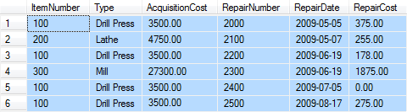
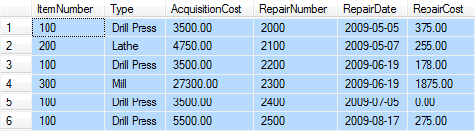
Modification Anomalies
The EQUIPMENT_REPAIR table before and after an incorrect update operation on AcquisitionCost for Type = Drill Press:
KROENKE AND AUER - DATABASE PROCESSING, 11th Edition © 2010 Pearson Prentice Hall
3-<number>

Slide 83
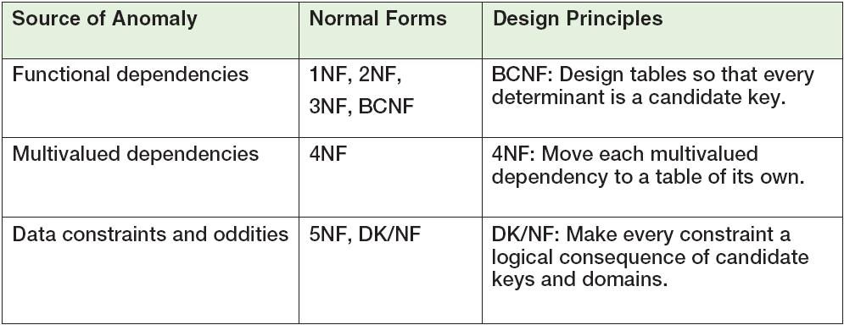
Normal Forms
Relations are categorized as a normal form based on which modification anomalies or other problems that they are subject to:
KROENKE AND AUER - DATABASE PROCESSING, 11th Edition © 2010 Pearson Prentice Hall
3-<number>

Slide 84
Normal Forms
1NF—a table that qualifies as a relation is in 1NF.
2NF—a relation is in 2NF if all of its nonkey attributes are dependent on all of the primary keys.
3NF—a relation is in 3NF if it is in 2NF and has no determinants except the primary key.
Boyce-Codd Normal Form (BCNF)—a relation is in BCNF if every determinant is a candidate key.
“I swear to construct my tables so that all nonkey
columns are dependent on the key, the whole key and nothing but the key, so help me Codd.”
KROENKE AND AUER - DATABASE PROCESSING, 11th Edition © 2010 Pearson Prentice Hall
3-<number>

Slide 85
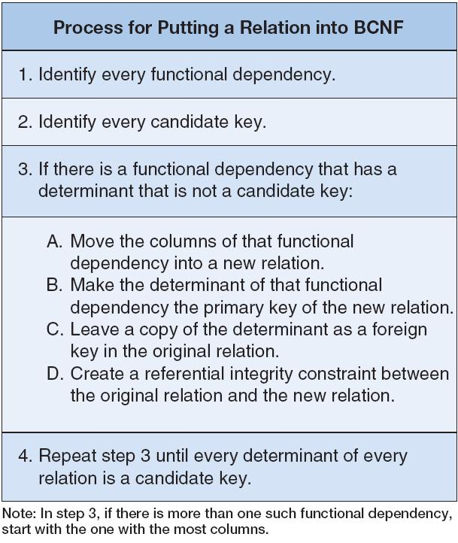
Eliminating Modification Anomalies from Functional Dependencies in Relations:
Put All Relations into BCNF
KROENKE AND AUER - DATABASE PROCESSING, 11th Edition © 2010 Pearson Prentice Hall
3-<number>

