Slide 1


CSIS 3310
Spring 2013
Introduction to Database Systems
Chapters 4 - 5:
Review
KROENKE AND AUER - DATABASE PROCESSING, 12th Edition © 2012 Pearson Prentice Hall
1-<number>

Slide 2
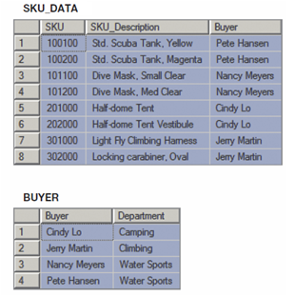
Chapter 4 - How Many Tables?
SKU_DATA (SKU, SKU_Description, Buyer)
BUYER (Buyer, Department)
Where SKU_DATA.Buyer must exist in BUYER.Buyer
Should we store these two tables as they are, or should we combine them into one table in our new database?
KROENKE AND AUER - DATABASE PROCESSING, 12th Edition © 2012 Pearson Prentice Hall
3-<number>

Slide 3
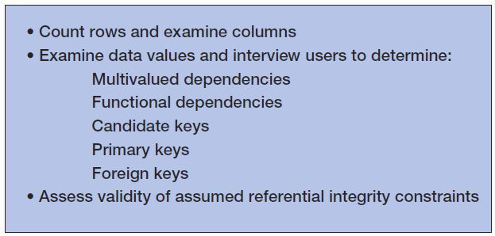
Assessing Table Structure
KROENKE AND AUER - DATABASE PROCESSING, 12th Edition © 2012 Pearson Prentice Hall
4-<number>

Slide 4
Counting Rows in a Table
To count the number of rows in a table use the SQL COUNT(*) built-in function :
SELECT COUNT(*) AS NumRows
FROM SKU_DATA;
KROENKE AND AUER - DATABASE PROCESSING, 12th Edition © 2012 Pearson Prentice Hall
4-<number>

Slide 5
Examining the Columns
To determine the number and type of columns in a table, use an SQL SELECT statement.
To limit the number of rows retrieved, use the SQL TOP {NumberOfRows} expression:
SELECT TOP (10) *
FROM SKU_DATA;
KROENKE AND AUER - DATABASE PROCESSING, 12th Edition © 2012 Pearson Prentice Hall
4-<number>

Slide 6
Checking Validity of Assumed Referential Integrity Constraints I
Given two tables with an assumed foreign key constraint:
SKU_DATA (SKU, SKU_Description, Buyer)
BUYER (Buyer, Department)
Where SKU_DATA.Buyer must exist in BUYER.Buyer
KROENKE AND AUER - DATABASE PROCESSING, 12th Edition © 2012 Pearson Prentice Hall
4-<number>

Slide 7
Checking Validity of Assumed Referential Integrity Constraints II
To find any foreign key values that violate the foreign key constraint:
SELECT Buyer
FROM SKU_DATA
WHERE Buyer NOT IN
(SELECT SKU_DATA.Buyer
FROM SKU_DATA, BUYER
WHERE SKU_DATA.BUYER =
BUYER.Buyer);
KROENKE AND AUER - DATABASE PROCESSING, 12th Edition © 2012 Pearson Prentice Hall
4-<number>

Slide 8
Type of Database
Updateable database, or read-only database?
If updateable database, we normally want tables in BCNF.
If read-only database, we may not use BCNF tables.
KROENKE AND AUER - DATABASE PROCESSING, 12th Edition © 2012 Pearson Prentice Hall
4-<number>

Slide 9
Designing
Updatable Databases
KROENKE AND AUER - DATABASE PROCESSING, 12th Edition © 2012 Pearson Prentice Hall
4-<number>

Slide 10
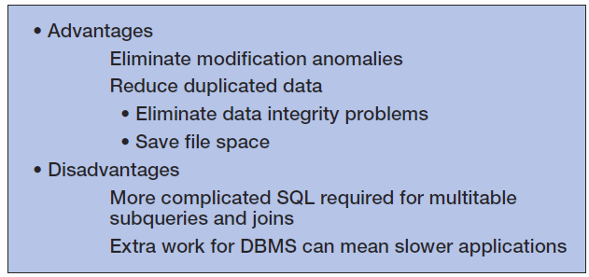
Normalization:
Advantages and Disadvantages
KROENKE AND AUER - DATABASE PROCESSING, 12th Edition © 2012 Pearson Prentice Hall
4-<number>

Slide 11
Choosing Not To Use BCNF
BCNF is used to control anomalies from functional dependencies.
There are times when BCNF is not desirable.
The classic example is ZIP codes:
  ZIP codes almost never change.
  Any anomalies are likely to be caught by normal business practices.
  Not having to use SQL to join data in two tables will speed up application processing.
KROENKE AND AUER - DATABASE PROCESSING, 12th Edition © 2012 Pearson Prentice Hall
4-<number>

Slide 12
Designing
Read-Only Databases
KROENKE AND AUER - DATABASE PROCESSING, 12th Edition © 2012 Pearson Prentice Hall
4-<number>

Slide 13
Read-Only Databases
Read-only databases are nonoperational databases using data extracted from operational databases.
They are used for querying, reporting, and data mining applications.
They are never updated (in the operational database sense—they may have new data imported from time to time).
KROENKE AND AUER - DATABASE PROCESSING, 12th Edition © 2012 Pearson Prentice Hall
4-<number>

Slide 14
Denormalization
For read-only databases, normalization is seldom an advantage.
  Application processing speed is more important.
Denormalization is the joining of the data in normalized tables prior to storing the data.
The data is then stored in nonnormalized tables.
KROENKE AND AUER - DATABASE PROCESSING, 12th Edition © 2012 Pearson Prentice Hall
4-<number>

Slide 15
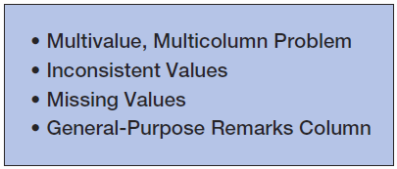
Common Design Problems
KROENKE AND AUER - DATABASE PROCESSING, 12th Edition © 2012 Pearson Prentice Hall
4-<number>

Slide 16
The Multivalue, Multicolumn Problem
The multivalue, multicolumn problem occurs when multiple values of an attribute are stored in more than one column:
EMPLOYEE (EmployeeNumber, EmployeeLastName, EmployeeLastName, Email, Auto1_LicenseNumber, Auto2_LicenseNumber, Auto3_LicenseNumber)
This is another form of a multivalued dependecy.
Solution = like the 4NF solution for multivalued dependencies, use a separate table to store the multiple values.
KROENKE AND AUER - DATABASE PROCESSING, 12th Edition © 2012 Pearson Prentice Hall
4-<number>

Slide 17
Inconsistent Values I
Inconsistent values occur when different users, or different data sources, use slightly different forms of the same data value:
  Different codings:
    SKU_Description = 'Corn, Large Can'
    SKU_Description = 'Can, Corn, Large'
    SKU_Description = 'Large Can Corn‘
  Different spellings:
    Coffee, Cofee, Coffeee
KROENKE AND AUER - DATABASE PROCESSING, 12th Edition © 2012 Pearson Prentice Hall
4-<number>

Slide 18
Inconsistent Values II
Particularly problematic are primary or foreign key values.
To detect:
  Use referential integrity check already discussed for checking keys.
  Use the SQL GROUP BY clause on suspected columns.
KROENKE AND AUER - DATABASE PROCESSING, 12th Edition © 2012 Pearson Prentice Hall
4-<number>

Slide 19
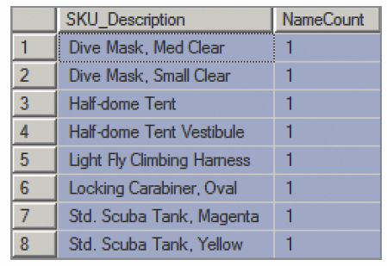
Inconsistent Values III
SELECT SKU_Description, COUNT(*) AS NameCount
FROM SKU_DATA
GROUP BY SKU_Description;
KROENKE AND AUER - DATABASE PROCESSING, 12th Edition © 2012 Pearson Prentice Hall
4-<number>

Slide 20
Missing Values
A missing value or null value is a value that has never been provided.
KROENKE AND AUER - DATABASE PROCESSING, 12th Edition © 2012 Pearson Prentice Hall
4-<number>

Slide 21
Null Values
Null values are ambiguous:
  May indicate that a value is inappropriate;
    DateOfLastChildbirth is inappropriate for a male.
  May indicate that a value is appropriate but unknown;
    DateOfLastChildbirth is appropriate for a female, but may be unknown.
  May indicate that a value is appropriate and known, but has never been entered;
    DateOfLastChildbirth is appropriate for a female, and may be known but no one has recorded it in the database.
KROENKE AND AUER - DATABASE PROCESSING, 12th Edition © 2012 Pearson Prentice Hall
4-<number>

Slide 22

Checking for Null Values
Use the SQL keyword IS NULL to check for null values:
SELECT COUNT(*) AS QuantityNullCount
FROM ORDER_ITEM
WHERE Quantity IS NULL;
KROENKE AND AUER - DATABASE PROCESSING, 12th Edition © 2012 Pearson Prentice Hall
4-<number>

Slide 23
The General-Purpose Remarks Column
A general-purpose remarks column is a column with a name such as:
  Remarks
  Comments
  Notes
It often contains important data stored in an inconsistent, verbal, and verbose way.
  A typical use is to store data on a customer’s interests.
Such a column may:
  Be used inconsistently
  Hold multiple data items
KROENKE AND AUER - DATABASE PROCESSING, 12th Edition © 2012 Pearson Prentice Hall
4-<number>

Slide 24
Chapter 5 - The Data Model
A data model is a plan or blueprint for a database design.
A data model is more generalized and abstract than a database design.
It is easier to change a data model then it is to change a database design, so it is the appropriate place to work through conceptual database problems.
KROENKE AND AUER - DATABASE PROCESSING, 12th Edition © 2012 Pearson Prentice Hall
5-<number>

Slide 25
E-R Model
Entity-Relationship model is a set of concepts and graphical symbols that can be used to create conceptual schemas.
Versions:
  Original E-R model—by Peter Chen (1976)
  Extended E-R model—extensions to the Chen model
  Information Engineering (IE)—by James Martin (1990); it uses “crow’s foot” notation, is easier to understand, and we will use it.
  IDEF1X—a national standard developed by the National Institute of Standards and Technology [see Appendix B]
  Unified Modeling Language (UML)—by the Object Management Group; it supports object-oriented methodology [see Appendix C]
KROENKE AND AUER - DATABASE PROCESSING, 12th Edition © 2012 Pearson Prentice Hall
5-<number>

Slide 26
Entities
Something that can be identified and the users want to track:
  Entity class—a collection of entities of a given type
  Entity instance—the occurrence of a particular entity
There are usually many instances of an entity in an entity class.
KROENKE AND AUER - DATABASE PROCESSING, 12th Edition © 2012 Pearson Prentice Hall
5-<number>

Slide 27
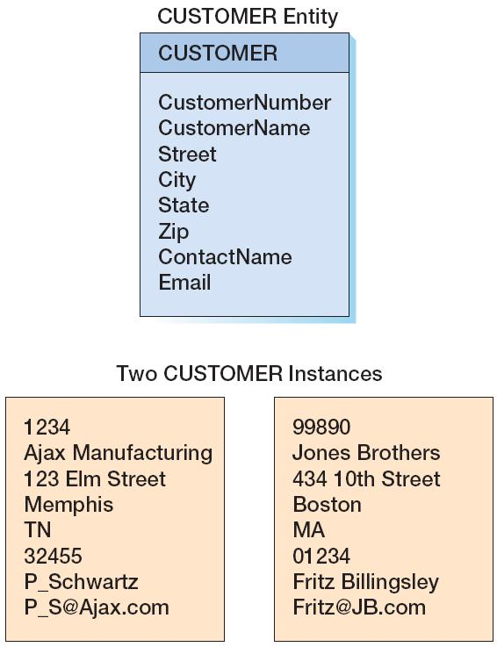
CUSTOMER:
The Entity Class and Two Entity Instances
KROENKE AND AUER - DATABASE PROCESSING, 12th Edition © 2012 Pearson Prentice Hall
5-<number>

Slide 28
Attributes
Attributes describe an entity’s characteristics.
All entity instances of a given entity class have the same attributes, but vary in the values of those attributes.
Originally shown in data models as ellipses.
Data modeling products today commonly show attributes in rectangular form.
KROENKE AND AUER - DATABASE PROCESSING, 12th Edition © 2012 Pearson Prentice Hall
5-<number>

Slide 29
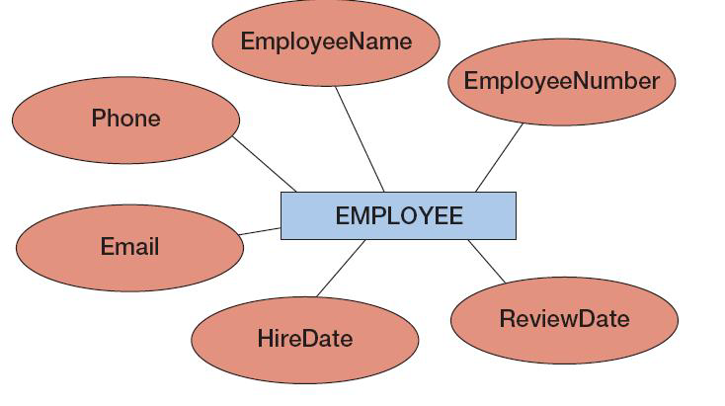
EMPLOYEE:
Attributes in Ellipses
KROENKE AND AUER - DATABASE PROCESSING, 12th Edition © 2012 Pearson Prentice Hall
5-<number>

Slide 30
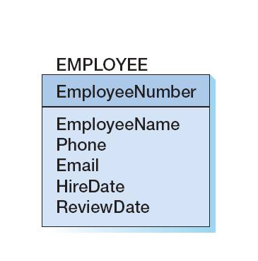
EMPLOYEE:
Attributes in Entity Rectangle
KROENKE AND AUER - DATABASE PROCESSING, 12th Edition © 2012 Pearson Prentice Hall
5-<number>

Slide 31
Identifiers
Identifiers are attributes that name, or identify, entity instances.
The identifier of an entity instance consists of one or more of the entity’s attributes.
Composite identifiers are identifiers that consist of two or more attributes.
Identifiers in data models become keys in database designs.
  Entities have identifiers.
  Tables (or relations) have keys.
KROENKE AND AUER - DATABASE PROCESSING, 12th Edition © 2012 Pearson Prentice Hall
5-<number>

Slide 32
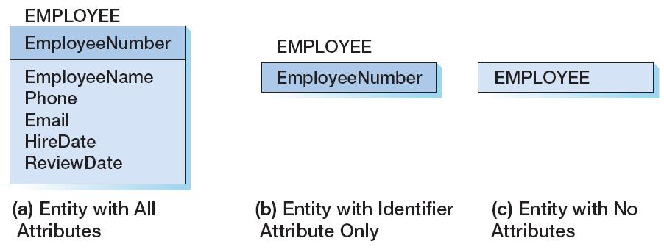
Entity Attribute Display in Data Models
KROENKE AND AUER - DATABASE PROCESSING, 12th Edition © 2012 Pearson Prentice Hall
5-<number>

Slide 33
Relationships
Entities can be associated with one another in relationships:
  Relationship classes: associations among entity classes
  Relationship instances: associations among entity instances
In the original E-R model, relationships could have attributes, but today this is no longer done.
A relationship class can involve two or more entity classes.
KROENKE AND AUER - DATABASE PROCESSING, 12th Edition © 2012 Pearson Prentice Hall
5-<number>

Slide 34
Degree of the Relationship
The degree of the relationship is the number of entity classes in the relationship:
  Two entities have a binary relationship of degree two.
  Three entities have a ternary relationship of degree three.
KROENKE AND AUER - DATABASE PROCESSING, 12th Edition © 2012 Pearson Prentice Hall
5-<number>

Slide 35
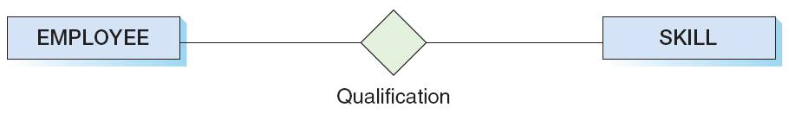
Binary Relationship
KROENKE AND AUER - DATABASE PROCESSING, 12th Edition © 2012 Pearson Prentice Hall
5-<number>

Slide 36
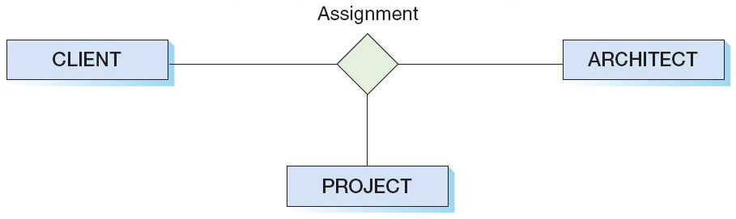
Ternary Relationship
KROENKE AND AUER - DATABASE PROCESSING, 12th Edition © 2012 Pearson Prentice Hall
5-<number>

Slide 37
Entities and Tables
The principle difference between an entity and a table (relation) is that you can express a relationship between entities without using foreign keys.
This makes it easier to work with entities in the early design process where the very existence of entities and the relationships between them is uncertain.
KROENKE AND AUER - DATABASE PROCESSING, 12th Edition © 2012 Pearson Prentice Hall
5-<number>

Slide 38
Cardinality
Cardinality means “count,” and is expressed as a number.
Maximum cardinality is the maximum number of entity instances that can participate in a relationship.
Minimum cardinality is the minimum number of entity instances that must participate in a relationship.
KROENKE AND AUER - DATABASE PROCESSING, 12th Edition © 2012 Pearson Prentice Hall
5-<number>

Slide 39
Maximum Cardinality
Maximum cardinality is the maximum number of entity instances that can participate in a relationship.
There are three types of maximum cardinality:
  One-to-One [1:1]
  One-to-Many [1:N]
  Many-to-Many [N:M]
KROENKE AND AUER - DATABASE PROCESSING, 12th Edition © 2012 Pearson Prentice Hall
5-<number>

Slide 40
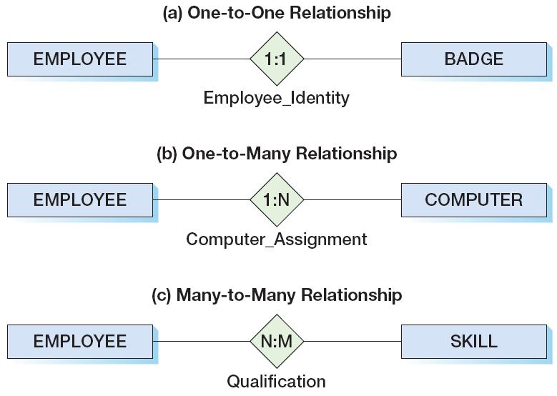
The Three Types of
Maximum Cardinality
KROENKE AND AUER - DATABASE PROCESSING, 12th Edition © 2012 Pearson Prentice Hall
5-<number>

Slide 41
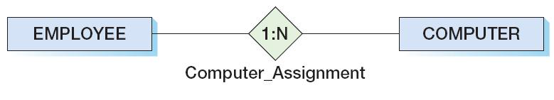
Parent and Child Entities
In a one-to-many relationship:
  The entity on the one side of the relationship is called the parent entity or just the parent.
  The entity on the many side of the relationship is called the child entity or just the child.
In the figure below, EMPLOYEE is the parent and COMPUTER is the child:
KROENKE AND AUER - DATABASE PROCESSING, 12th Edition © 2012 Pearson Prentice Hall
5-<number>

Slide 42
HAS-A Relationships
The relationships we have been discussing are known as HAS-A relationships:
  Each entity instance has a relationship with another entity instance.
    An EMPLOYEE has one or more COMPUTERs.
    A COMPUTER has one assigned EMPLOYEE.
KROENKE AND AUER - DATABASE PROCESSING, 12th Edition © 2012 Pearson Prentice Hall
5-<number>

Slide 43
Minimum Cardinality
Minimum cardinality is the minimum number of entity instances that must participate in a relationship.
Minimums are generally stated as either zero or one:
  IF zero [0] THEN participation in the relationship by the entity is optional, and no entity instance must participate in the relationship.
  IF one [1] THEN participation in the relationship by the entity is mandatory, and at least one entity instance must participate in the relationship.
KROENKE AND AUER - DATABASE PROCESSING, 12th Edition © 2012 Pearson Prentice Hall
5-<number>

Slide 44
Indicating Minimum Cardinality
As shown in the examples in a following slide:
  Minimum cardinality of zero [0] indicating optional participation is indicated by placing an oval next to the optional entity.
  Minimum cardinality of one [1] indicating mandatory (required) participation is indicated by placing a vertical hash mark next to the required entity.
KROENKE AND AUER - DATABASE PROCESSING, 12th Edition © 2012 Pearson Prentice Hall
5-<number>

Slide 45
Reading Minimum Cardinality
Look toward the entity in question:
  IF you see an oval THEN that entity is optional (minimum cardinality of zero [0]).
  IF you see a vertical hash mark THEN that entity is mandatory (required) (minimum cardinality of one [ 1]).
KROENKE AND AUER - DATABASE PROCESSING, 12th Edition © 2012 Pearson Prentice Hall
5-<number>

Slide 46
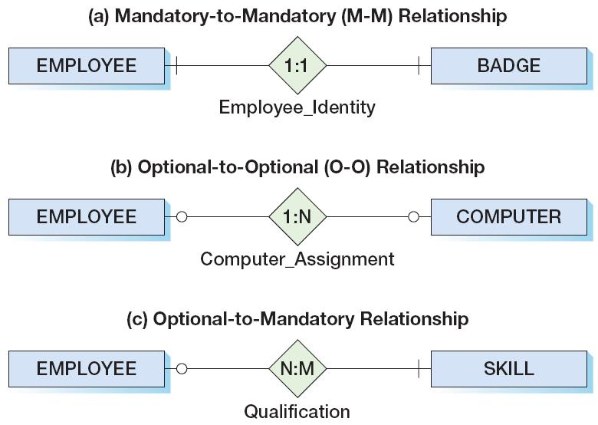
The Three Types of
Minimum Cardinality
KROENKE AND AUER - DATABASE PROCESSING, 12th Edition © 2012 Pearson Prentice Hall
5-<number>

Slide 47
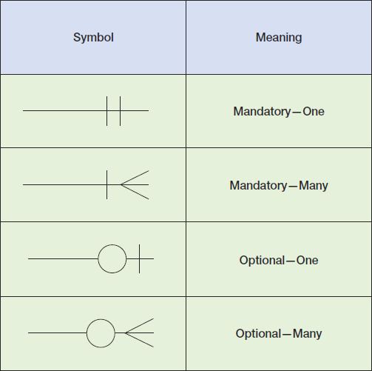
Data Modeling Notation:
IE Crow’s Foot I
KROENKE AND AUER - DATABASE PROCESSING, 12th Edition © 2012 Pearson Prentice Hall
5-<number>

Slide 48
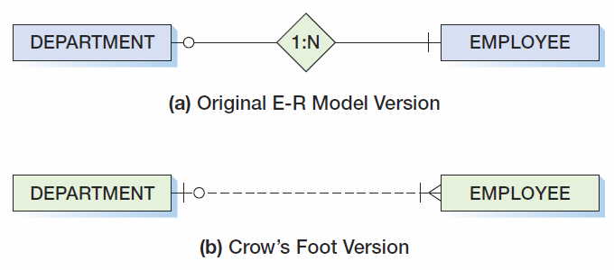
Data Modeling Notation:
IE Crow’s Foot 1:N
KROENKE AND AUER - DATABASE PROCESSING, 12th Edition © 2012 Pearson Prentice Hall
5-<number>

Slide 49
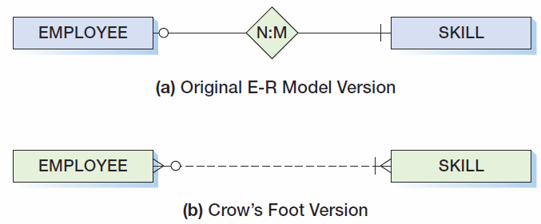
Data Modeling Notation:
IE Crow’s Foot N:M
KROENKE AND AUER - DATABASE PROCESSING, 12th Edition © 2012 Pearson Prentice Hall
5-<number>

Slide 50
ID-Dependent Entities
An ID-dependent entity is an entity (child) whose identifier includes the identifier of another entity (parent).
The ID-dependent entity is a logical extension or subunit of the parent:
  BUILDING : APARTMENT
  PAINTING : PRINT
The minimum cardinality from the ID-dependent entity to the parent is always one.
KROENKE AND AUER - DATABASE PROCESSING, 12th Edition © 2012 Pearson Prentice Hall
5-<number>

Slide 51
Weak Entities
A weak entity is an entity whose existence depends upon another entity.
All ID-Dependent entities are considered weak.
There are also non-ID-dependent weak entities.
  The identifier of the parent does not appear in the identifier of the weak child entity.
KROENKE AND AUER - DATABASE PROCESSING, 12th Edition © 2012 Pearson Prentice Hall
5-<number>

Slide 52
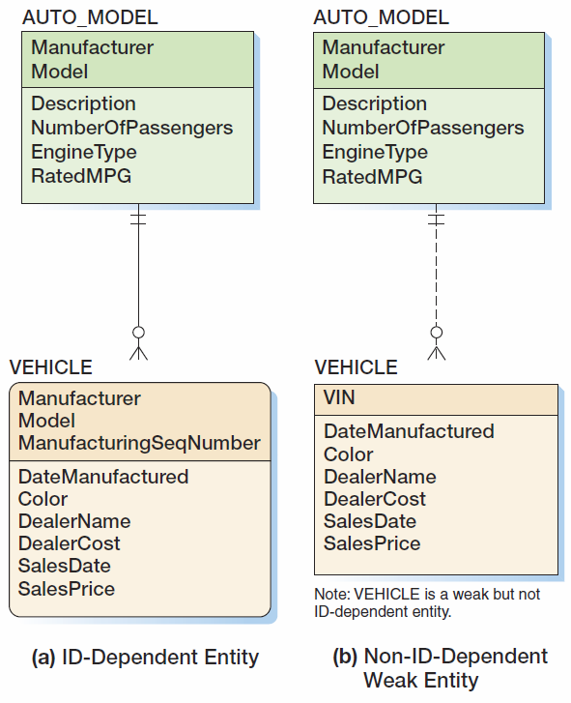
Weak Entities
KROENKE AND AUER - DATABASE PROCESSING, 12th Edition © 2012 Pearson Prentice Hall
5-<number>

Slide 53
Subtype Entities
A subtype entity is a special case of a supertype entity:
  STUDENT :
  UNDERGRADATE or GRADUATE
The supertype contains all common attributes, while the subtypes contain specific attributes.
The supertype may have a discriminator attribute which indicates the subtype.
KROENKE AND AUER - DATABASE PROCESSING, 12th Edition © 2012 Pearson Prentice Hall
5-<number>

Slide 54
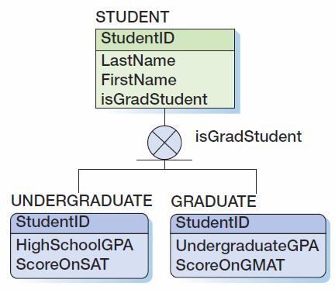
Subtypes with a Discriminator
KROENKE AND AUER - DATABASE PROCESSING, 12th Edition © 2012 Pearson Prentice Hall
5-<number>

Slide 55
Subtypes: Exclusive or Inclusive
If subtypes are exclusive, one supertype relates to at most one subtype.
If subtypes are inclusive, one supertype can relate to one or more subtypes.
KROENKE AND AUER - DATABASE PROCESSING, 12th Edition © 2012 Pearson Prentice Hall
5-<number>

Slide 56
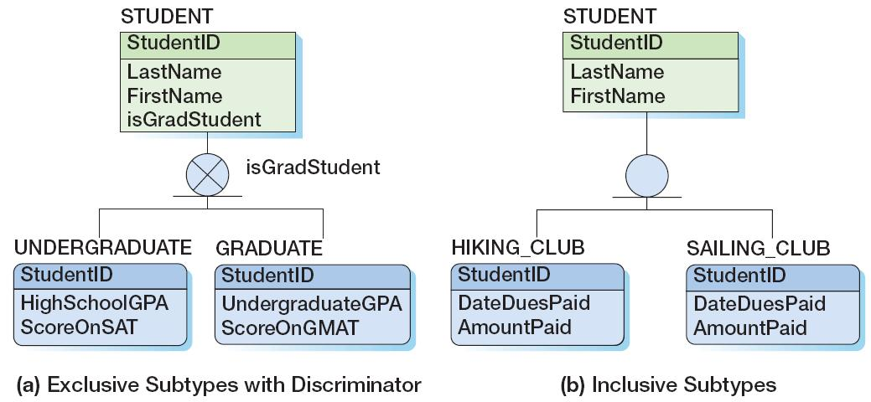
Subtypes: Exclusive or Inclusive
KROENKE AND AUER - DATABASE PROCESSING, 12th Edition © 2012 Pearson Prentice Hall
5-<number>

Slide 57
Subtypes: IS-A Relationships
Relationships connecting supertypes and subtypes are called IS-A relationships, because a subtype is a supertype.
The identifier of the supertype and all of its subtypes must be identical; i.e., the identifier of the supertype becomes the identifier of the related subtype(s).
Subtypes are used to avoid value-inappropriate nulls.
KROENKE AND AUER - DATABASE PROCESSING, 12th Edition © 2012 Pearson Prentice Hall
5-<number>

Slide 58
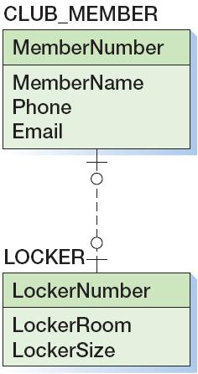
Strong Entity Patterns:
1:1 Strong Entity Relationships
KROENKE AND AUER - DATABASE PROCESSING, 12th Edition © 2012 Pearson Prentice Hall
5-<number>

Slide 59
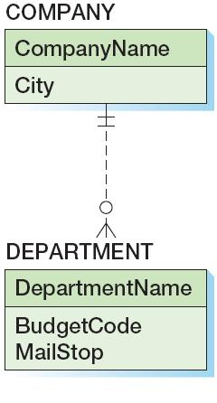
Strong Entity Patterns:
1:N Strong Entity Relationships
KROENKE AND AUER - DATABASE PROCESSING, 12th Edition © 2012 Pearson Prentice Hall
5-<number>

Slide 60
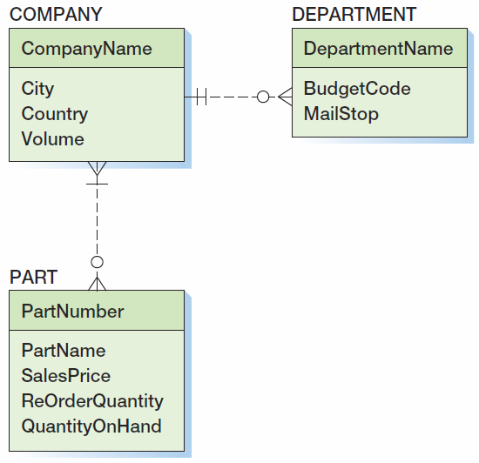
Strong Entity Patterns:
N:M Strong Entity Relationships
KROENKE AND AUER - DATABASE PROCESSING, 12th Edition © 2012 Pearson Prentice Hall
5-<number>

Slide 61
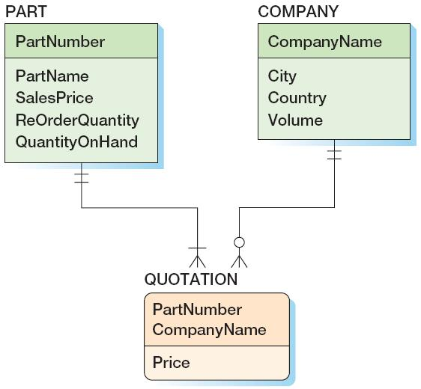
ID-Dependent Relationships:
The Association Pattern
KROENKE AND AUER - DATABASE PROCESSING, 12th Edition © 2012 Pearson Prentice Hall
5-<number>

Slide 62
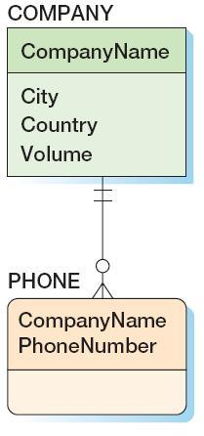
ID-Dependent Relationships:
The Multivalued Attribute Pattern
KROENKE AND AUER - DATABASE PROCESSING, 12th Edition © 2012 Pearson Prentice Hall
5-<number>

Slide 63
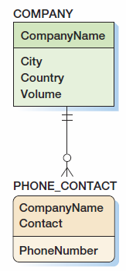
ID-Dependent Relationships:
Composite Multivalued Attributes
KROENKE AND AUER - DATABASE PROCESSING, 12th Edition © 2012 Pearson Prentice Hall
5-<number>

Slide 64
ID-Dependent Relationships:
The Archetype/Instance Pattern
The archetype/instance pattern occurs when the ID-dependent child entity is the physical manifestation (instance) of an abstract or logical parent.
  PAINTING : PRINT
  CLASS : SECTION
  YACHT_DESIGN : YACHT
  HOUSE_MODEL: HOUSE
KROENKE AND AUER - DATABASE PROCESSING, 12th Edition © 2012 Pearson Prentice Hall
5-<number>

Slide 65
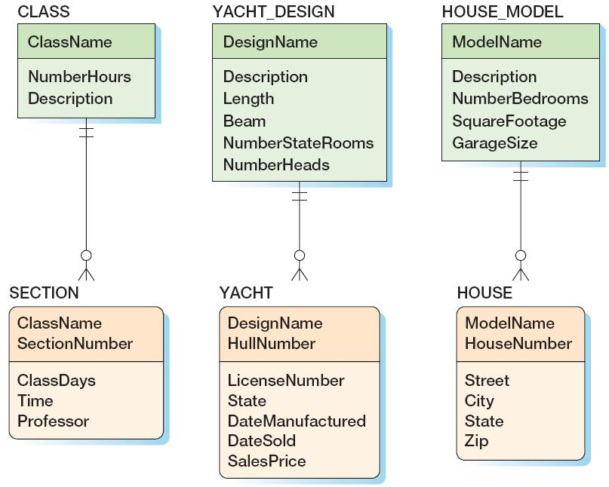
ID-Dependent Relationships:
The Archetype/Instance Pattern
KROENKE AND AUER - DATABASE PROCESSING, 12th Edition © 2012 Pearson Prentice Hall
5-<number>

Slide 66
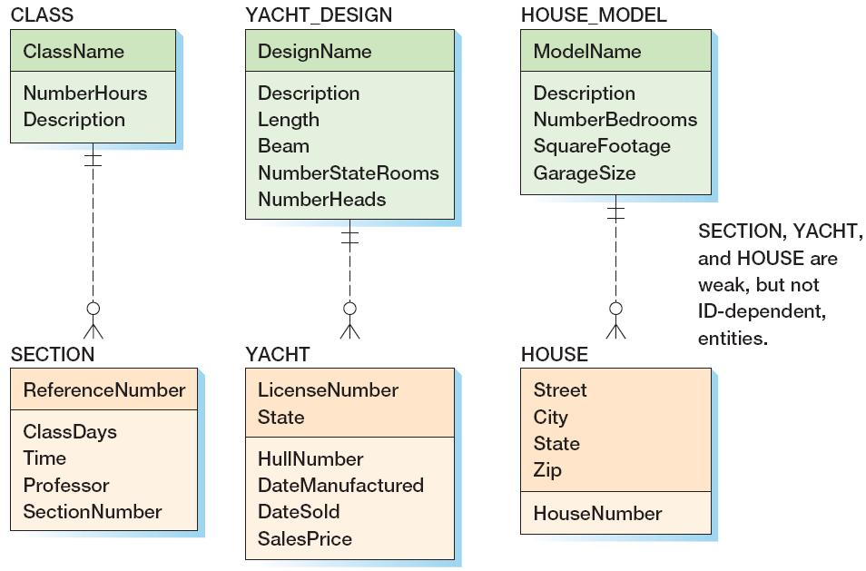
ID-Dependent Relationships:
The Archetype/Instance Pattern
KROENKE AND AUER - DATABASE PROCESSING, 12th Edition © 2012 Pearson Prentice Hall
5-<number>

Slide 67
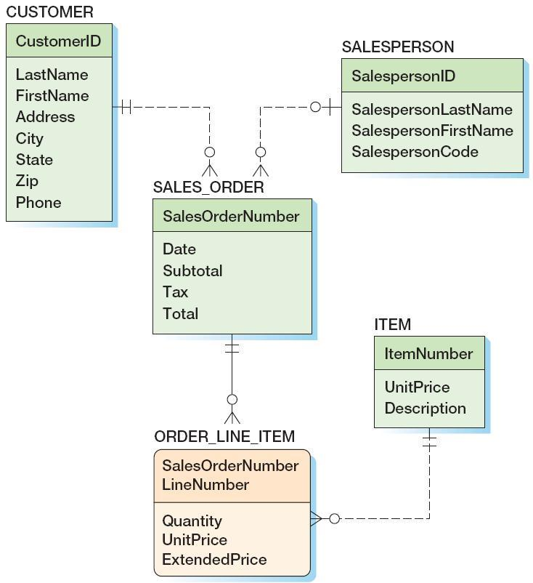
Mixed Patterns:
The Line-Item Pattern
KROENKE AND AUER - DATABASE PROCESSING, 12th Edition © 2012 Pearson Prentice Hall
5-<number>

Slide 68
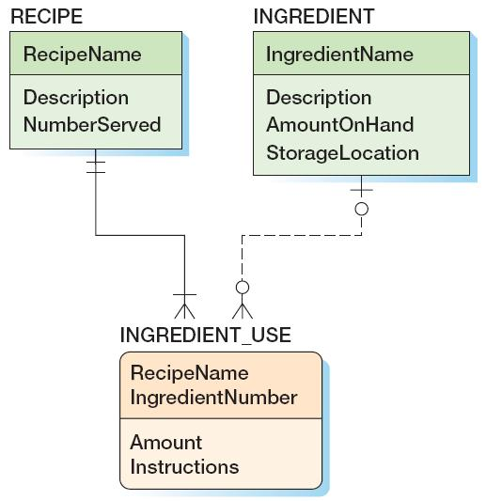
Mixed Patterns:
Other Mixed Patterns
KROENKE AND AUER - DATABASE PROCESSING, 12th Edition © 2012 Pearson Prentice Hall
5-<number>

Slide 69
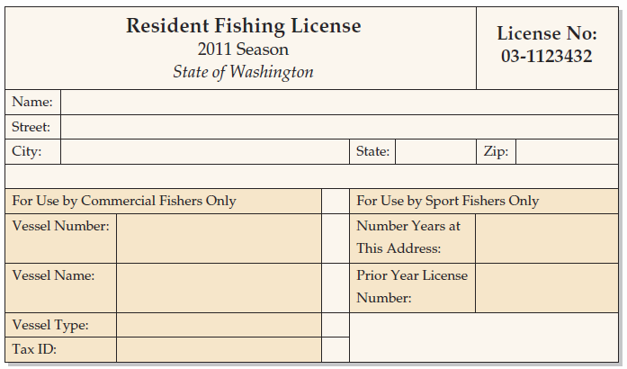
Mixed Patterns:
The For-Use-By Pattern
KROENKE AND AUER - DATABASE PROCESSING, 12th Edition © 2012 Pearson Prentice Hall
5-<number>

Slide 70
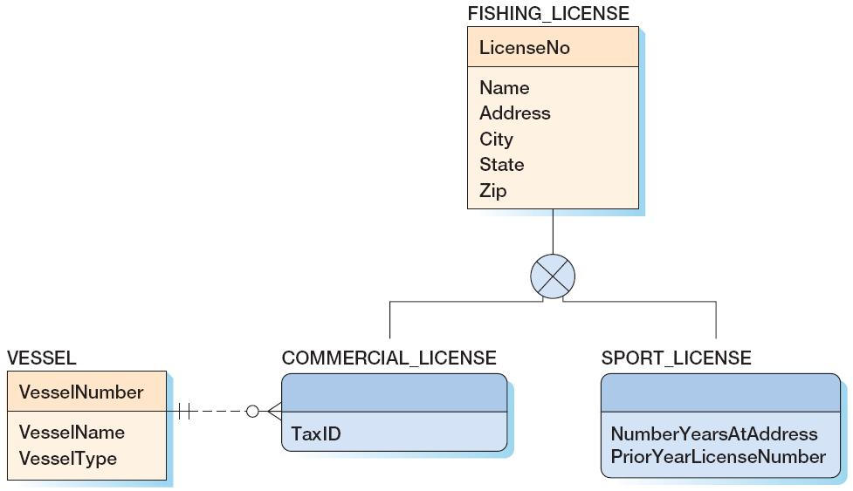
Mixed Patterns:
The For-Use-By Pattern
KROENKE AND AUER - DATABASE PROCESSING, 12th Edition © 2012 Pearson Prentice Hall
5-<number>

Slide 71
Recursive Relationships
A recursive relationship occurs when an entity has a relationship to itself.
KROENKE AND AUER - DATABASE PROCESSING, 12th Edition © 2012 Pearson Prentice Hall
5-<number>

Slide 72
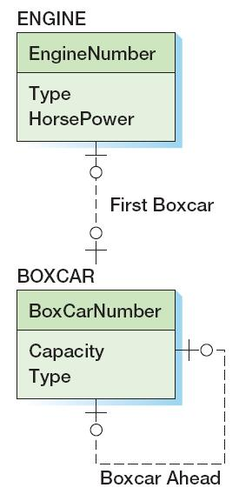
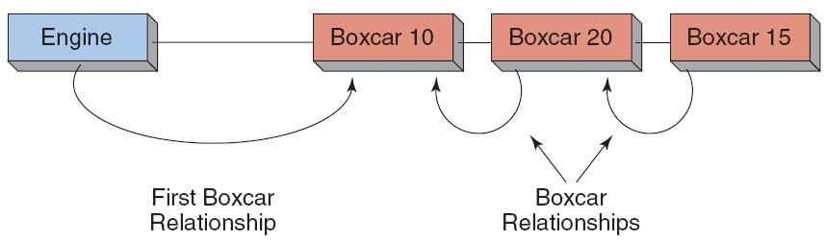
Recursive Patterns:
1:1 Recursive Relationship
KROENKE AND AUER - DATABASE PROCESSING, 12th Edition © 2012 Pearson Prentice Hall
5-<number>

Slide 73
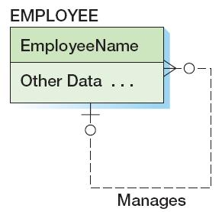
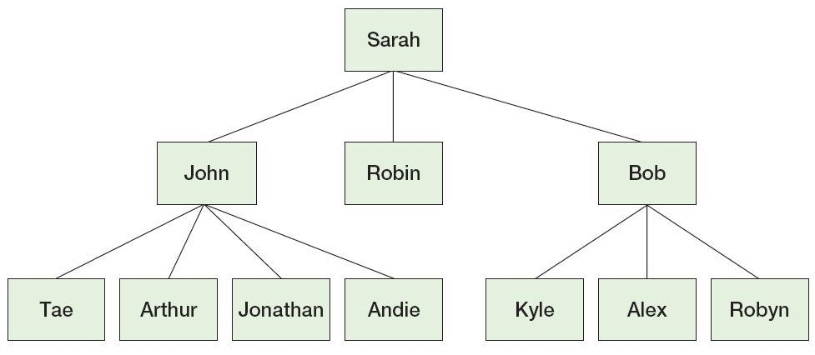
Recursive Patterns:
1:N Recursive Relationship
KROENKE AND AUER - DATABASE PROCESSING, 12th Edition © 2012 Pearson Prentice Hall
5-<number>

Slide 74
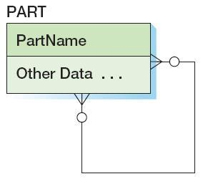
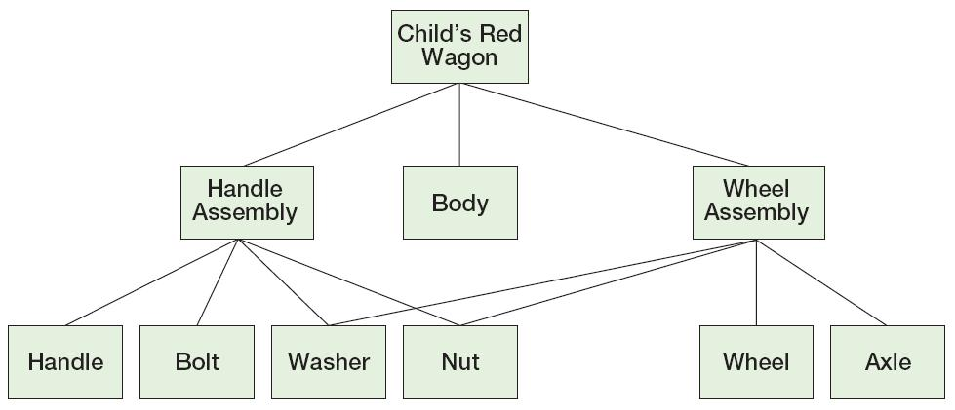
Recursive Patterns:
N:M Recursive Relationship
KROENKE AND AUER - DATABASE PROCESSING, 12th Edition © 2012 Pearson Prentice Hall
5-<number>

