Slide 1


CSIS 3310
Spring 2013
Introduction to Database Systems
Chapter One:
Introduction
KROENKE AND AUER - DATABASE PROCESSING, 12th Edition © 2012 Pearson Prentice Hall
1-<number>

Slide 2
Chapter Objectives
To understand the nature and characteristics of databases
To survey some important and interesting database applications
To gain a general understanding of tables and relationships
To describe the components of a Microsoft Access database system and explain the functions they perform
To describe the components of an enterprise-class database system and explain the functions they perform
To define the term database management system (DBMS) and describe the functions of a DBMS
KROENKE AND AUER - DATABASE PROCESSING, 12th Edition © 2012 Pearson Prentice Hall
1-<number>

Slide 3
Chapter Objectives
To define the term database and describe what is contained within the database
To define the term metadata and provide examples of metadata
To define and understand database design from existing data
To define and understand database design as new systems development
To define and understand database design in database redesign
To understand the history and development of database processing
KROENKE AND AUER - DATABASE PROCESSING, 12th Edition © 2012 Pearson Prentice Hall
1-<number>

Slide 4
The Characteristics of Databases
The purpose of a database is to help people track things of interest to them.
Data is stored in tables, which have rows and columns like a spreadsheet. A database may have multiple tables, where each table stores data about a different thing.
Each row in a table stores data about an occurrence or instance of the thing of interest.
A database stores data and relationships.
KROENKE AND AUER - DATABASE PROCESSING, 12th Edition © 2012 Pearson Prentice Hall
1-<number>

Slide 5
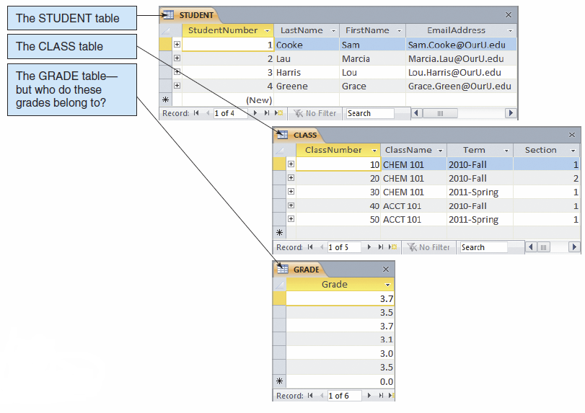
Data in Tables
KROENKE AND AUER - DATABASE PROCESSING, 12th Edition © 2012 Pearson Prentice Hall
1-<number>

Slide 6
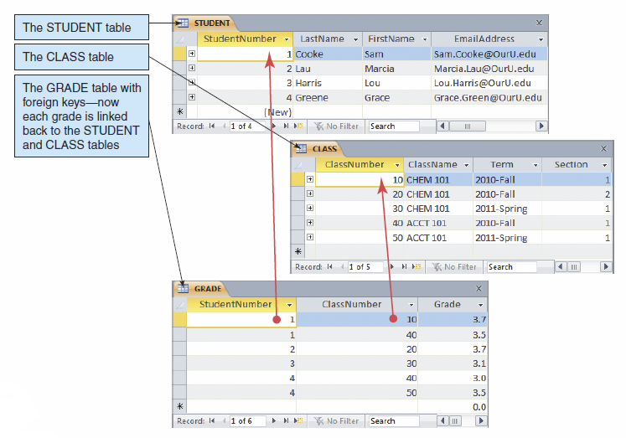
The Key Characteristic of Databases: Related Tables
KROENKE AND AUER - DATABASE PROCESSING, 12th Edition © 2012 Pearson Prentice Hall
1-<number>

Slide 7
Naming Conventions in this Textbook
Table names are written with all capital letters:
  STUDENT, CLASS, GRADE
Column names are written with an initial capital letter, and compound names are written with a capital letter on each word:
  Term, Section, ClassNumber, StudentName
KROENKE AND AUER - DATABASE PROCESSING, 12th Edition © 2012 Pearson Prentice Hall
1-<number>

Slide 8
Databases Create Information
Data = recorded facts and figures
Information = knowledge derived from data
Databases record data, but they do so in such a way that we can produce information from the data.
  The data on STUDENTs, CLASSes, and GRADEs could produce information about each student’s GPA.
KROENKE AND AUER - DATABASE PROCESSING, 12th Edition © 2012 Pearson Prentice Hall
1-<number>

Slide 9
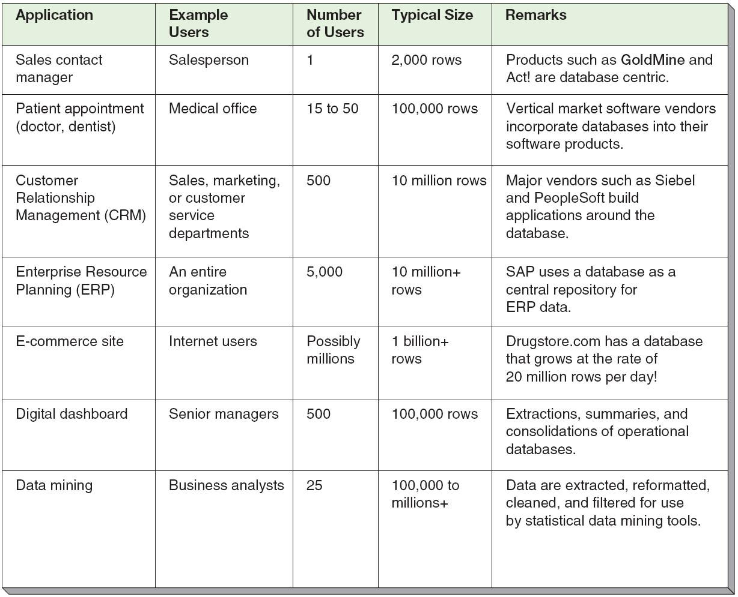
Database Examples
KROENKE AND AUER - DATABASE PROCESSING, 12th Edition © 2012 Pearson Prentice Hall
1-<number>

Slide 10
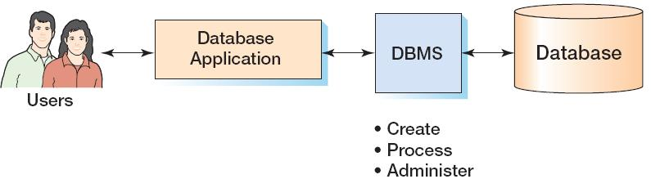
Components of a Database System
KROENKE AND AUER - DATABASE PROCESSING, 12th Edition © 2012 Pearson Prentice Hall
1-<number>

Slide 11
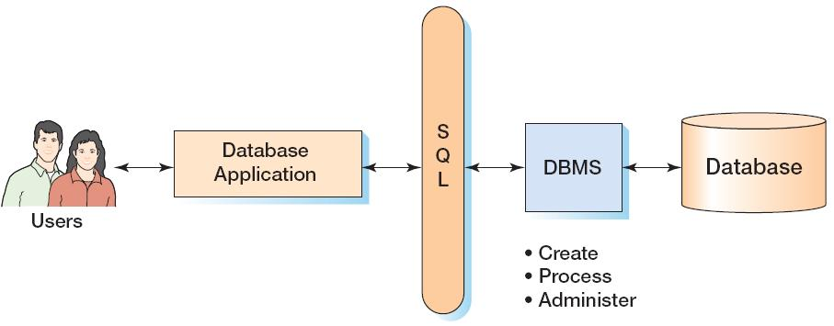
Components of a Database System with SQL
KROENKE AND AUER - DATABASE PROCESSING, 12th Edition © 2012 Pearson Prentice Hall
1-<number>

Slide 12
Applications, the DBMS, and SQL
Applications are the computer programs that users work with.
The Database Management System (DBMS) creates, processes, and administers databases.
Structured Query Language (SQL) is an internationally recognized standard database language that is used by all commercial DBMSs.
KROENKE AND AUER - DATABASE PROCESSING, 12th Edition © 2012 Pearson Prentice Hall
1-<number>

Slide 13
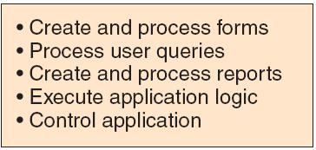
Database Applications
KROENKE AND AUER - DATABASE PROCESSING, 12th Edition © 2012 Pearson Prentice Hall
1-<number>

Slide 14
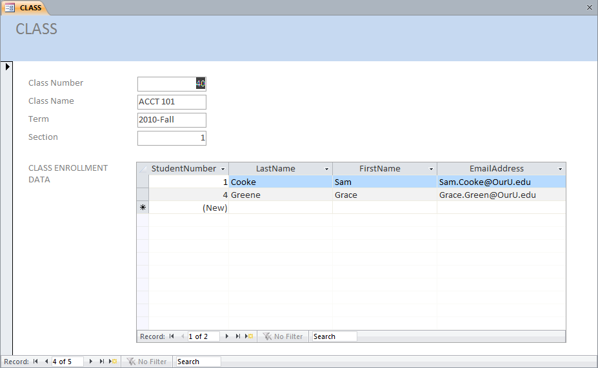
Database Applications—Forms
KROENKE AND AUER - DATABASE PROCESSING, 12th Edition © 2012 Pearson Prentice Hall
1-<number>

Slide 15
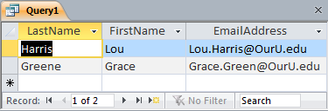
Database Applications—Queries
SELECT LastName, FirstName, EmailAddress
FROM STUDENT
WHERE StudentNumber > 2;
KROENKE AND AUER - DATABASE PROCESSING, 12th Edition © 2012 Pearson Prentice Hall
1-<number>

Slide 16
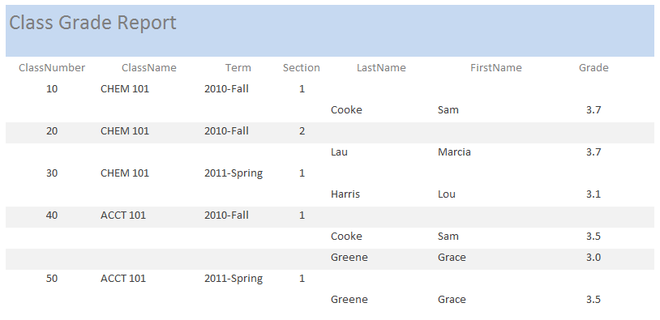
Database—Reports
KROENKE AND AUER - DATABASE PROCESSING, 12th Edition © 2012 Pearson Prentice Hall
1-<number>

Slide 17
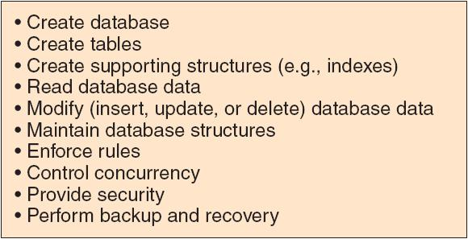
The DBMS
KROENKE AND AUER - DATABASE PROCESSING, 12th Edition © 2012 Pearson Prentice Hall
1-<number>

Slide 18
The Database
A database is a self-describing collection of integrated tables.
The tables are called integrated because they store data about the relationships between the rows of data.
A database is called self-describing because it stores a description of itself.
The self-describing data is called metadata, which is data about data.
KROENKE AND AUER - DATABASE PROCESSING, 12th Edition © 2012 Pearson Prentice Hall
1-<number>

Slide 19
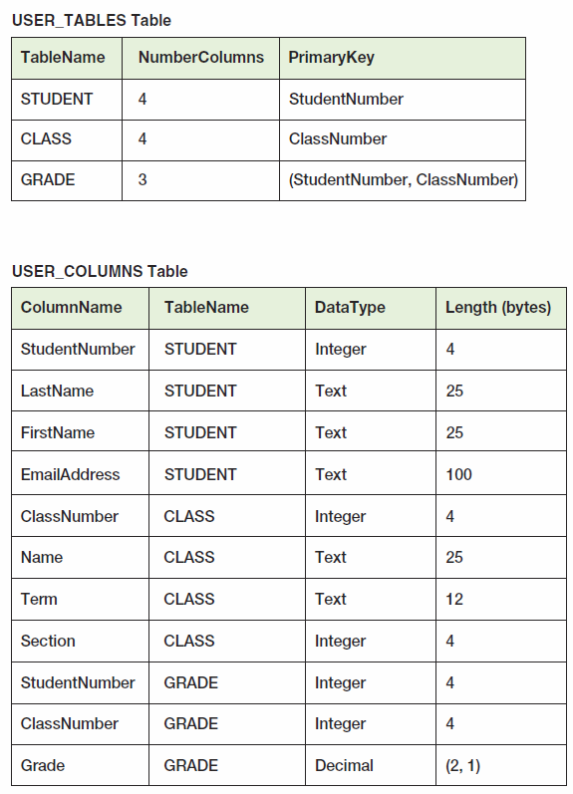
Typical Metadata Tables
KROENKE AND AUER - DATABASE PROCESSING, 12th Edition © 2012 Pearson Prentice Hall
1-<number>

Slide 20
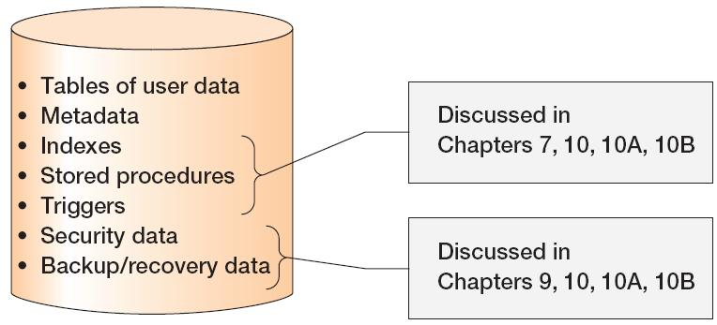
Database Contents
KROENKE AND AUER - DATABASE PROCESSING, 12th Edition © 2012 Pearson Prentice Hall
1-<number>

Slide 21
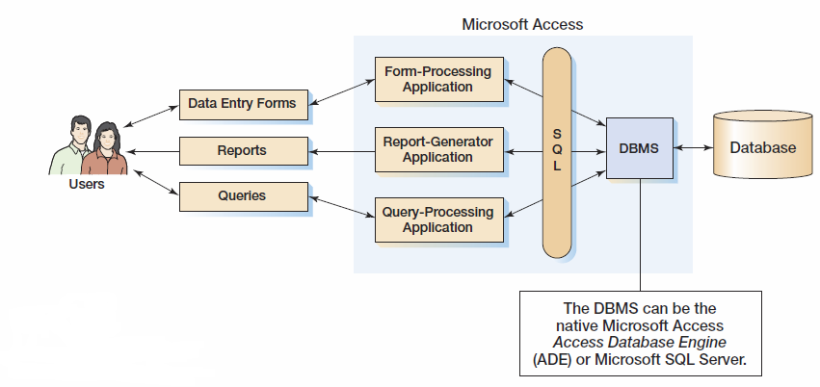
Personal Database Systems: Microsoft Access
KROENKE AND AUER - DATABASE PROCESSING, 12th Edition © 2012 Pearson Prentice Hall
1-<number>

Slide 22
Microsoft Access
Microsoft Access is a low-end product intended for individual users and small workgroups.
Microsoft Access tries to hide much of the underlying database technology from the user.
A good strategy for beginners, but not for database professionals.
NOTE: Microsoft Access 2007 is discussed in detail in Appendix A.
KROENKE AND AUER - DATABASE PROCESSING, 12th Edition © 2012 Pearson Prentice Hall
1-<number>

Slide 23
What Is Microsoft Access?
Microsoft Access is a DBMS plus an application generator:
  The DBMS creates, processes, and administers Microsoft Access databases.
  The application generator includes query, form, and report components.
The Microsoft Access DBMS engine is called the Access Data Engine (ADE).
Microsoft Access 2000 and later can be used as an application generator for the Microsoft SQL Server DBMS.
KROENKE AND AUER - DATABASE PROCESSING, 12th Edition © 2012 Pearson Prentice Hall
1-<number>

Slide 24
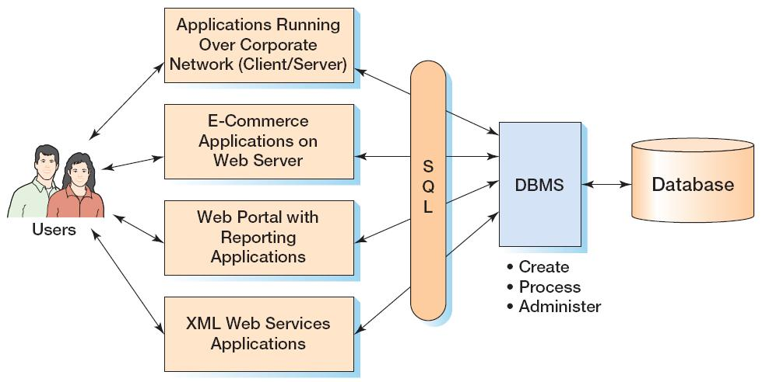
Enterprise-Class Database Systems
KROENKE AND AUER - DATABASE PROCESSING, 12th Edition © 2012 Pearson Prentice Hall
1-<number>

Slide 25
Prominent DBMS Products
Microsoft Access 2010
Microsoft SQL Server 2008 R2
  Microsoft SQL Server 2008 R2 Express
Oracle Corporation Oracle Database 11g
MySQL 5.5
IBM DB2
KROENKE AND AUER - DATABASE PROCESSING, 12th Edition © 2012 Pearson Prentice Hall
1-<number>

Slide 26
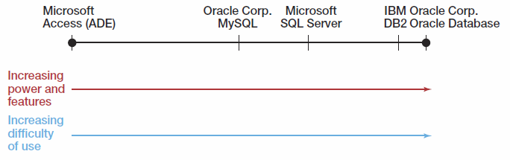
DBMS Power vs. Ease of Use
KROENKE AND AUER - DATABASE PROCESSING, 12th Edition © 2012 Pearson Prentice Hall
1-<number>

Slide 27
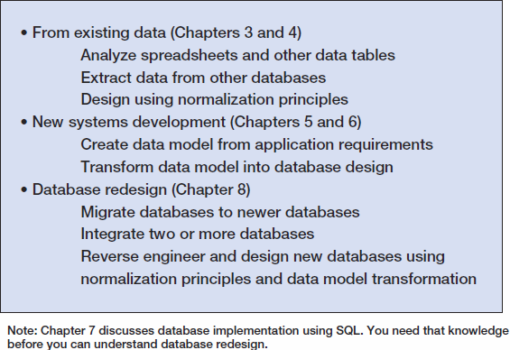
Three Types of Database Design
KROENKE AND AUER - DATABASE PROCESSING, 12th Edition © 2012 Pearson Prentice Hall
1-<number>

Slide 28
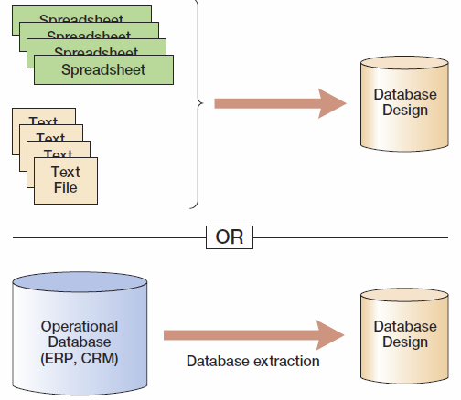
Database Design from Existing Data
KROENKE AND AUER - DATABASE PROCESSING, 12th Edition © 2012 Pearson Prentice Hall
1-<number>

Slide 29
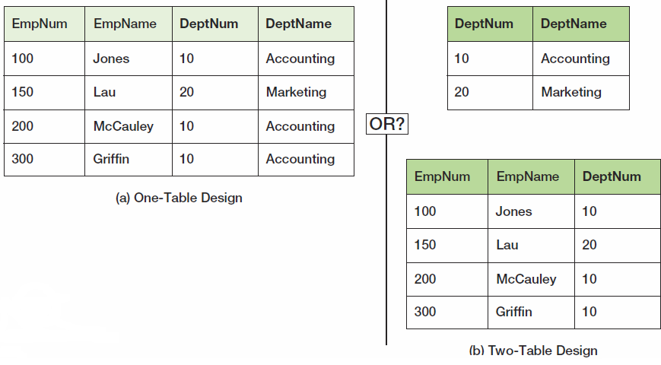
Data Import: One or Two Tables?
This is an important decision, and based on a set of rules known as normalization (which is covered in Chapter 3).
KROENKE AND AUER - DATABASE PROCESSING, 12th Edition © 2012 Pearson Prentice Hall
1-<number>

Slide 30
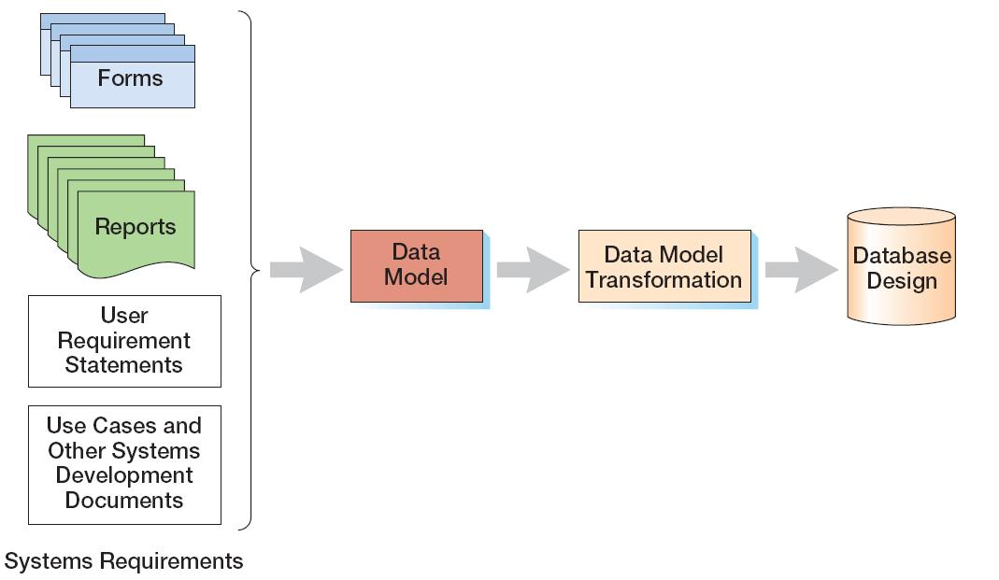
Database Design from New Systems Development
Entity-Relationship data modeling is covered in Chapter 5, and data model transformations to database designs are covered in Chapter 6.
KROENKE AND AUER - DATABASE PROCESSING, 12th Edition © 2012 Pearson Prentice Hall
1-<number>

Slide 31
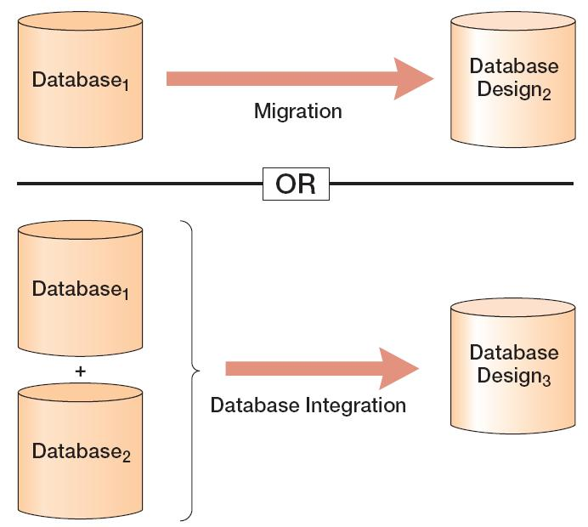
Database Design from Database Redesign
Database redesign is covered in Chapter 8, after coverage of SQL in Chapter Seven.
KROENKE AND AUER - DATABASE PROCESSING, 12th Edition © 2012 Pearson Prentice Hall
1-<number>

Slide 32
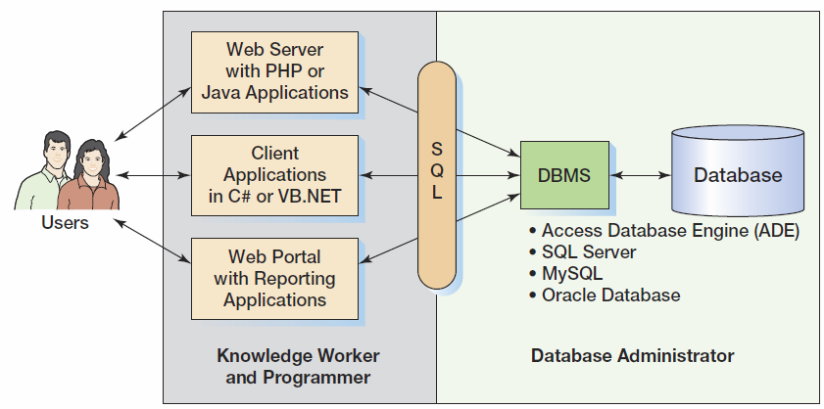
What You Need To Learn
KROENKE AND AUER - DATABASE PROCESSING, 12th Edition © 2012 Pearson Prentice Hall
1-<number>

Slide 33
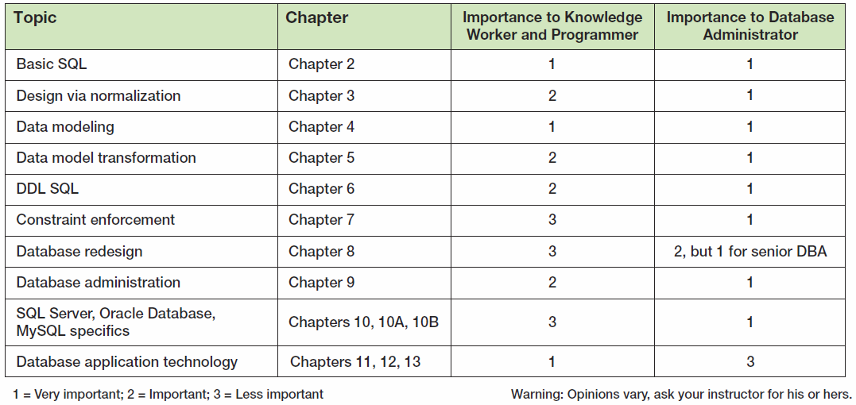
Knowledge Priorities
KROENKE AND AUER - DATABASE PROCESSING, 12th Edition © 2012 Pearson Prentice Hall
1-<number>

Slide 34
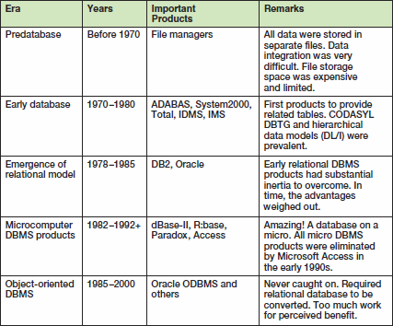
A Brief History of Database Processing
I
KROENKE AND AUER - DATABASE PROCESSING, 12th Edition © 2012 Pearson Prentice Hall
1-<number>

Slide 35
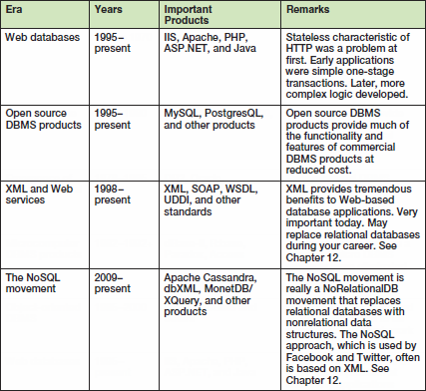
A Brief History of Database Processing
II
KROENKE AND AUER - DATABASE PROCESSING, 12th Edition © 2012 Pearson Prentice Hall
1-<number>

Slide 36
The Relational Database Model
The dominant database model is the relational database model—all current major DBMS products are based on it.
It was created by IBM engineer E. F. Codd in 1970.
It was based on mathematics called relational algebra.
This text examines and explains the relational database model.
KROENKE AND AUER - DATABASE PROCESSING, 12th Edition © 2012 Pearson Prentice Hall
1-<number>

