Slide 1


CSIS 3310
Spring 2013
Introduction to Database Systems
Chapter Four:
Database Design
Using Normalization
KROENKE AND AUER - DATABASE PROCESSING, 12th Edition © 2012 Pearson Prentice Hall
4-<number>

Slide 2
Chapter Objectives
To design updatable databases to store data received from another source
To use SQL to access table structure
To understand the advantages and disadvantages of normalization
To understand denormalization
To design read-only databases to store data from updateable databases
KROENKE AND AUER - DATABASE PROCESSING, 12th Edition © 2012 Pearson Prentice Hall
4-<number>

Slide 3
Chapter Objectives
To recognize and be able to correct common design problems:
  The multivalue, multicolumn problem
  The inconsistent values problem
  The missing values problem
  The general-purpose remarks column problem
KROENKE AND AUER - DATABASE PROCESSING, 12th Edition © 2012 Pearson Prentice Hall
4-<number>

Slide 4
Chapter Premise
We have received one or more tables of existing data.
The data is to be stored in a new database.
QUESTION: Should the data be stored as received, or should it be transformed for storage?
KROENKE AND AUER - DATABASE PROCESSING, 12th Edition © 2012 Pearson Prentice Hall
4-<number>

Slide 5
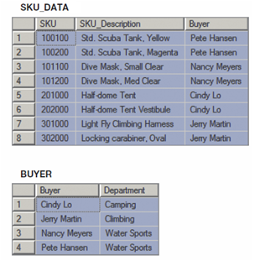
How Many Tables?
SKU_DATA (SKU, SKU_Description, Buyer)
BUYER (Buyer, Department)
Where SKU_DATA.Buyer must exist in BUYER.Buyer
Should we store these two tables as they are, or should we combine them into one table in our new database?
KROENKE AND AUER - DATABASE PROCESSING, 12th Edition © 2012 Pearson Prentice Hall
3-<number>

Slide 6
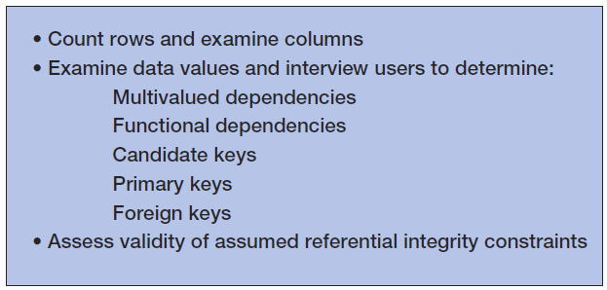
Assessing Table Structure
KROENKE AND AUER - DATABASE PROCESSING, 12th Edition © 2012 Pearson Prentice Hall
4-<number>

Slide 7
Counting Rows in a Table
To count the number of rows in a table use the SQL COUNT(*) built-in function :
SELECT COUNT(*) AS NumRows
FROM SKU_DATA;
KROENKE AND AUER - DATABASE PROCESSING, 12th Edition © 2012 Pearson Prentice Hall
4-<number>

Slide 8
Examining the Columns
To determine the number and type of columns in a table, use an SQL SELECT statement.
To limit the number of rows retrieved, use the SQL TOP {NumberOfRows} expression:
SELECT TOP (10) *
FROM SKU_DATA;
KROENKE AND AUER - DATABASE PROCESSING, 12th Edition © 2012 Pearson Prentice Hall
4-<number>

Slide 9
Checking Validity of Assumed Referential Integrity Constraints I
Given two tables with an assumed foreign key constraint:
SKU_DATA (SKU, SKU_Description, Buyer)
BUYER (Buyer, Department)
Where SKU_DATA.Buyer must exist in BUYER.Buyer
KROENKE AND AUER - DATABASE PROCESSING, 12th Edition © 2012 Pearson Prentice Hall
4-<number>

Slide 10
Checking Validity of Assumed Referential Integrity Constraints II
To find any foreign key values that violate the foreign key constraint:
SELECT Buyer
FROM SKU_DATA
WHERE Buyer NOT IN
(SELECT SKU_DATA.Buyer
FROM SKU_DATA, BUYER
WHERE SKU_DATA.BUYER =
BUYER.Buyer);
KROENKE AND AUER - DATABASE PROCESSING, 12th Edition © 2012 Pearson Prentice Hall
4-<number>

Slide 11
Type of Database
Updateable database, or read-only database?
If updateable database, we normally want tables in BCNF.
If read-only database, we may not use BCNF tables.
KROENKE AND AUER - DATABASE PROCESSING, 12th Edition © 2012 Pearson Prentice Hall
4-<number>

Slide 12
Designing
Updatable Databases
KROENKE AND AUER - DATABASE PROCESSING, 12th Edition © 2012 Pearson Prentice Hall
4-<number>

Slide 13
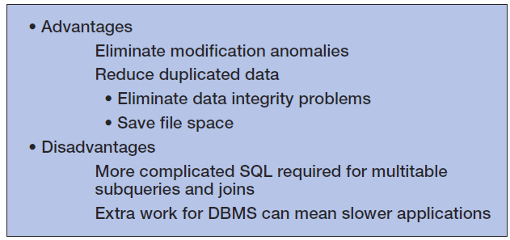
Normalization:
Advantages and Disadvantages
KROENKE AND AUER - DATABASE PROCESSING, 12th Edition © 2012 Pearson Prentice Hall
4-<number>

Slide 14
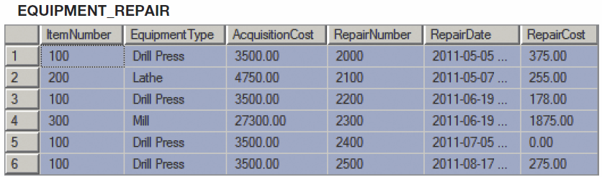
Non-Normalized Table:
EQUIPMENT_REPAIR
KROENKE AND AUER - DATABASE PROCESSING, 12th Edition © 2012 Pearson Prentice Hall
4-<number>

Slide 15
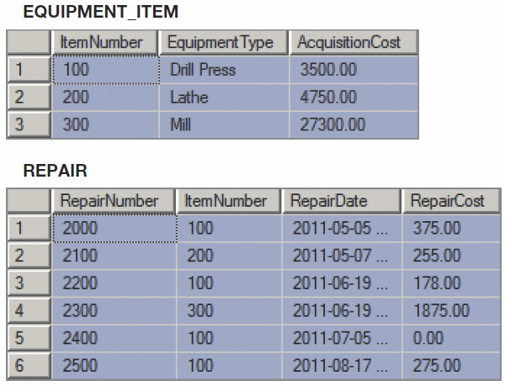
Normalized Tables:
ITEM and REPAIR
KROENKE AND AUER - DATABASE PROCESSING, 12th Edition © 2012 Pearson Prentice Hall
4-<number>

Slide 16
Copying Data to New Tables
To copy data from one table to another, use the SQL command INSERT INTO TableName command:
INSERT INTO EQUIPMENT_ITEM
SELECT DISTINCT ItemNumber, EquipmentType, AcquisitionCost
FROM EQUIPMENT_REPAIR;
INSERT INTO REPAIR
SELECT RepairNumber, ItemNumber,
RepairDate, RepairCost
FROM EQUIPMENT_REPAIR;
KROENKE AND AUER - DATABASE PROCESSING, 12th Edition © 2012 Pearson Prentice Hall
4-<number>

Slide 17
Choosing Not To Use BCNF
BCNF is used to control anomalies from functional dependencies.
There are times when BCNF is not desirable.
The classic example is ZIP codes:
  ZIP codes almost never change.
  Any anomalies are likely to be caught by normal business practices.
  Not having to use SQL to join data in two tables will speed up application processing.
KROENKE AND AUER - DATABASE PROCESSING, 12th Edition © 2012 Pearson Prentice Hall
4-<number>

Slide 18
Multivalued Dependencies
Anomalies from multivalued dependencies are very problematic.
Always place the columns of a multivalued dependency into a separate table (4NF).
KROENKE AND AUER - DATABASE PROCESSING, 12th Edition © 2012 Pearson Prentice Hall
4-<number>

Slide 19
Designing
Read-Only Databases
KROENKE AND AUER - DATABASE PROCESSING, 12th Edition © 2012 Pearson Prentice Hall
4-<number>

Slide 20
Read-Only Databases
Read-only databases are nonoperational databases using data extracted from operational databases.
They are used for querying, reporting, and data mining applications.
They are never updated (in the operational database sense—they may have new data imported from time to time).
KROENKE AND AUER - DATABASE PROCESSING, 12th Edition © 2012 Pearson Prentice Hall
4-<number>

Slide 21
Denormalization
For read-only databases, normalization is seldom an advantage.
  Application processing speed is more important.
Denormalization is the joining of the data in normalized tables prior to storing the data.
The data is then stored in nonnormalized tables.
KROENKE AND AUER - DATABASE PROCESSING, 12th Edition © 2012 Pearson Prentice Hall
4-<number>

Slide 22
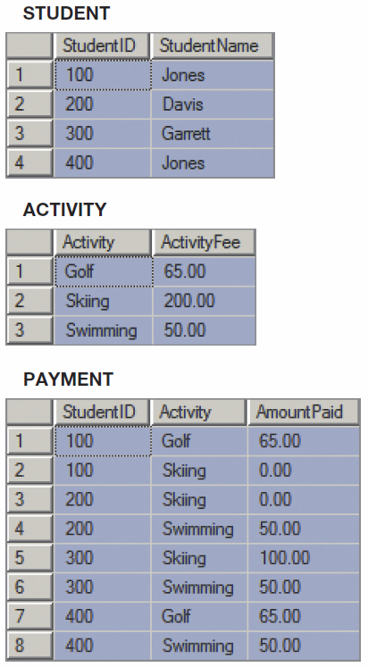
Normalized Tables
KROENKE AND AUER - DATABASE PROCESSING, 12th Edition © 2012 Pearson Prentice Hall
4-<number>

Slide 23
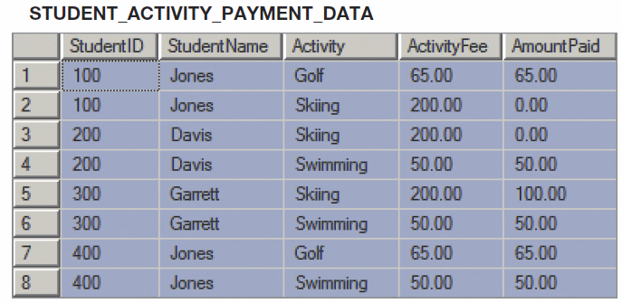
Denormalizing the Data
INSERT INTO STUDENT_ACTIVITY_PAYMENT_DATA
SELECT STUDENT.StudentID, StudentName, ACTIVITY.Activity,
ActivityFee, AmountPaid
FROM STUDENT, PAYMENT, ACTIVITY
WHERE STUDENT.StudentID = PAYMENT.StudentID
AND PAYMENT.Activity = ACTIVITY.Activity;
KROENKE AND AUER - DATABASE PROCESSING, 12th Edition © 2012 Pearson Prentice Hall
4-<number>

Slide 24
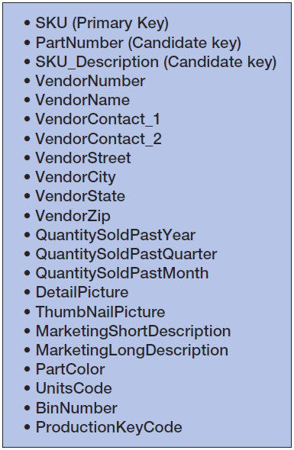
Customized Tables I
Read-only databases are often designed with many copies of the same data, but with each copy customized for a specific application.
Consider the PRODUCT table:
KROENKE AND AUER - DATABASE PROCESSING, 12th Edition © 2012 Pearson Prentice Hall
4-<number>

Slide 25
Customized Tables II
PRODUCT_PURCHASING (SKU, SKU_Description, VendorNumber, VendorName, VendorContact_1, VendorContact_2, VendorStreet, VendorCity, VendorState, VendorZip)
PRODUCT_USAGE (SKU, SKU_Description, QuantitySoldPastYear, QuantitySoldPastQuarter, QuantitySoldPastMonth)
PRODUCT_WEB (SKU, DetailPicture, ThumbnailPicture, MarketingShortDescription, MarketingLongDescription, PartColor)
PRODUCT_INVENTORY (SKU, PartNumber, SKU_Description, UnitsCode, BinNumber, ProductionKeyCode)
KROENKE AND AUER - DATABASE PROCESSING, 12th Edition © 2012 Pearson Prentice Hall
4-<number>

Slide 26
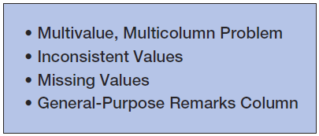
Common Design Problems
KROENKE AND AUER - DATABASE PROCESSING, 12th Edition © 2012 Pearson Prentice Hall
4-<number>

Slide 27
The Multivalue, Multicolumn Problem
The multivalue, multicolumn problem occurs when multiple values of an attribute are stored in more than one column:
EMPLOYEE (EmployeeNumber, EmployeeLastName, EmployeeLastName, Email, Auto1_LicenseNumber, Auto2_LicenseNumber, Auto3_LicenseNumber)
This is another form of a multivalued dependecy.
Solution = like the 4NF solution for multivalued dependencies, use a separate table to store the multiple values.
KROENKE AND AUER - DATABASE PROCESSING, 12th Edition © 2012 Pearson Prentice Hall
4-<number>

Slide 28
Inconsistent Values I
Inconsistent values occur when different users, or different data sources, use slightly different forms of the same data value:
  Different codings:
    SKU_Description = 'Corn, Large Can'
    SKU_Description = 'Can, Corn, Large'
    SKU_Description = 'Large Can Corn‘
  Different spellings:
    Coffee, Cofee, Coffeee
KROENKE AND AUER - DATABASE PROCESSING, 12th Edition © 2012 Pearson Prentice Hall
4-<number>

Slide 29
Inconsistent Values II
Particularly problematic are primary or foreign key values.
To detect:
  Use referential integrity check already discussed for checking keys.
  Use the SQL GROUP BY clause on suspected columns.
KROENKE AND AUER - DATABASE PROCESSING, 12th Edition © 2012 Pearson Prentice Hall
4-<number>

Slide 30
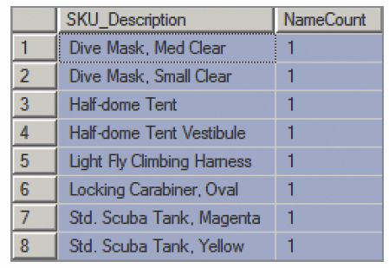
Inconsistent Values III
SELECT SKU_Description, COUNT(*) AS NameCount
FROM SKU_DATA
GROUP BY SKU_Description;
KROENKE AND AUER - DATABASE PROCESSING, 12th Edition © 2012 Pearson Prentice Hall
4-<number>

Slide 31
Missing Values
A missing value or null value is a value that has never been provided.
KROENKE AND AUER - DATABASE PROCESSING, 12th Edition © 2012 Pearson Prentice Hall
4-<number>

Slide 32
Null Values
Null values are ambiguous:
  May indicate that a value is inappropriate;
    DateOfLastChildbirth is inappropriate for a male.
  May indicate that a value is appropriate but unknown;
    DateOfLastChildbirth is appropriate for a female, but may be unknown.
  May indicate that a value is appropriate and known, but has never been entered;
    DateOfLastChildbirth is appropriate for a female, and may be known but no one has recorded it in the database.
KROENKE AND AUER - DATABASE PROCESSING, 12th Edition © 2012 Pearson Prentice Hall
4-<number>

Slide 33

Checking for Null Values
Use the SQL keyword IS NULL to check for null values:
SELECT COUNT(*) AS QuantityNullCount
FROM ORDER_ITEM
WHERE Quantity IS NULL;
KROENKE AND AUER - DATABASE PROCESSING, 12th Edition © 2012 Pearson Prentice Hall
4-<number>

Slide 34
The General-Purpose Remarks Column
A general-purpose remarks column is a column with a name such as:
  Remarks
  Comments
  Notes
It often contains important data stored in an inconsistent, verbal, and verbose way.
  A typical use is to store data on a customer’s interests.
Such a column may:
  Be used inconsistently
  Hold multiple data items
KROENKE AND AUER - DATABASE PROCESSING, 12th Edition © 2012 Pearson Prentice Hall
4-<number>

Slide 35
David Kroenke and David Auer
Database Processing
Fundamentals, Design, and Implementation
(12th Edition)
End of Presentation:
Chapter Four
KROENKE AND AUER - DATABASE PROCESSING, 12th Edition © 2012 Pearson Prentice Hall
4-<number>

Slide 36

All rights reserved. No part of this publication may be reproduced, stored in a retrieval system, or transmitted, in any form or by any means, electronic, mechanical, photocopying, recording, or otherwise, without the prior written permission of the publisher. Printed in the United States of America.
Copyright © 2012 Pearson Education, Inc.
Publishing as Prentice Hall
KROENKE AND AUER - DATABASE PROCESSING, 12th Edition © 2012 Pearson Prentice Hall
4-<number>

