Slide 1


CSIS 3310
Spring 2013
Introduction to Database Systems
Chapter Five:
Data Modeling with the
Entity-Relationship Model
KROENKE AND AUER - DATABASE PROCESSING, 12th Edition © 2012 Pearson Prentice Hall
5-<number>

Slide 2
Chapter Objectives
To understand the two-phase data modeling/database design process
To understand the purpose of the data modeling process
To understand entity-relationship (E-R) diagrams
To be able to determine entities, attributes, and relationships
To be able to create entity identifiers
To be able to determine minimum and maximum cardinalities
KROENKE AND AUER - DATABASE PROCESSING, 12th Edition © 2012 Pearson Prentice Hall
5-<number>

Slide 3
Chapter Objectives
To understand variations of the E-R model
To understand and be able to use ID-dependent and other weak entities
To understand and be able to use supertype/subtype entities
To understand and be able to use strong entity patterns
To understand and be able to use the ID-dependent association pattern
To understand and be able to use the ID-dependent multivalued attribute pattern
KROENKE AND AUER - DATABASE PROCESSING, 12th Edition © 2012 Pearson Prentice Hall
5-<number>

Slide 4
Chapter Objectives
To understand and be able to use the ID-dependent archetype/instance pattern
To understand and be able to use the line-item pattern
To understand and be able to use the for-use-by pattern
To understand and be able to use recursive patterns
To understand the iterative nature of the data modeling process
To be able to use the data modeling process
KROENKE AND AUER - DATABASE PROCESSING, 12th Edition © 2012 Pearson Prentice Hall
5-<number>

Slide 5
The Data Model
A data model is a plan or blueprint for a database design.
A data model is more generalized and abstract than a database design.
It is easier to change a data model then it is to change a database design, so it is the appropriate place to work through conceptual database problems.
KROENKE AND AUER - DATABASE PROCESSING, 12th Edition © 2012 Pearson Prentice Hall
5-<number>

Slide 6
E-R Model
Entity-Relationship model is a set of concepts and graphical symbols that can be used to create conceptual schemas.
Versions:
  Original E-R model—by Peter Chen (1976)
  Extended E-R model—extensions to the Chen model
  Information Engineering (IE)—by James Martin (1990); it uses “crow’s foot” notation, is easier to understand, and we will use it.
  IDEF1X—a national standard developed by the National Institute of Standards and Technology [see Appendix B]
  Unified Modeling Language (UML)—by the Object Management Group; it supports object-oriented methodology [see Appendix C]
KROENKE AND AUER - DATABASE PROCESSING, 12th Edition © 2012 Pearson Prentice Hall
5-<number>

Slide 7
Entities
Something that can be identified and the users want to track:
  Entity class—a collection of entities of a given type
  Entity instance—the occurrence of a particular entity
There are usually many instances of an entity in an entity class.
KROENKE AND AUER - DATABASE PROCESSING, 12th Edition © 2012 Pearson Prentice Hall
5-<number>

Slide 8
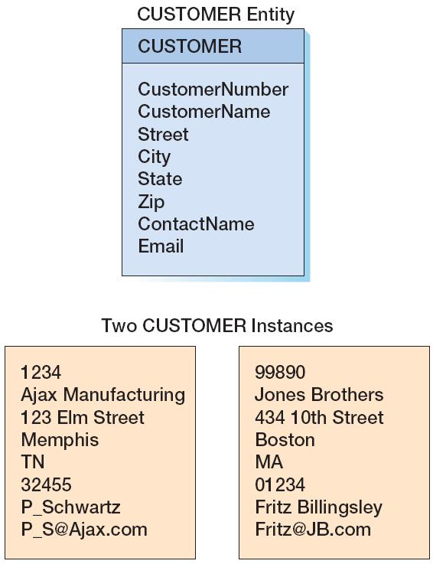
CUSTOMER:
The Entity Class and Two Entity Instances
KROENKE AND AUER - DATABASE PROCESSING, 12th Edition © 2012 Pearson Prentice Hall
5-<number>

Slide 9
Attributes
Attributes describe an entity’s characteristics.
All entity instances of a given entity class have the same attributes, but vary in the values of those attributes.
Originally shown in data models as ellipses.
Data modeling products today commonly show attributes in rectangular form.
KROENKE AND AUER - DATABASE PROCESSING, 12th Edition © 2012 Pearson Prentice Hall
5-<number>

Slide 10
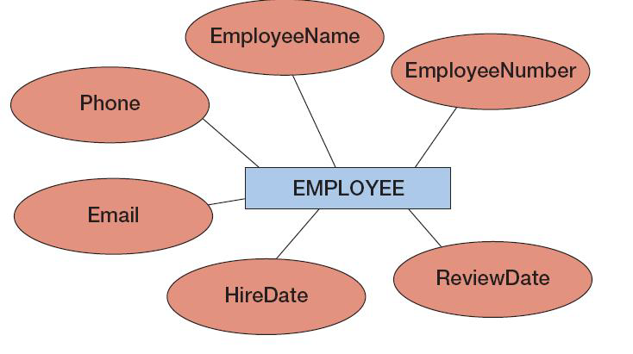
EMPLOYEE:
Attributes in Ellipses
KROENKE AND AUER - DATABASE PROCESSING, 12th Edition © 2012 Pearson Prentice Hall
5-<number>

Slide 11
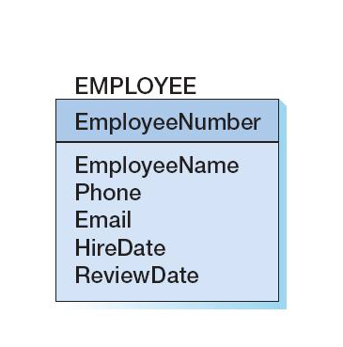
EMPLOYEE:
Attributes in Entity Rectangle
KROENKE AND AUER - DATABASE PROCESSING, 12th Edition © 2012 Pearson Prentice Hall
5-<number>

Slide 12
Identifiers
Identifiers are attributes that name, or identify, entity instances.
The identifier of an entity instance consists of one or more of the entity’s attributes.
Composite identifiers are identifiers that consist of two or more attributes.
Identifiers in data models become keys in database designs.
  Entities have identifiers.
  Tables (or relations) have keys.
KROENKE AND AUER - DATABASE PROCESSING, 12th Edition © 2012 Pearson Prentice Hall
5-<number>

Slide 13
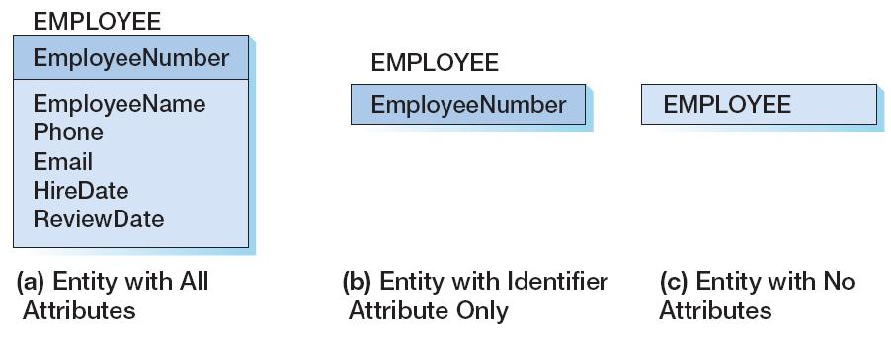
Entity Attribute Display in Data Models
KROENKE AND AUER - DATABASE PROCESSING, 12th Edition © 2012 Pearson Prentice Hall
5-<number>

Slide 14
Relationships
Entities can be associated with one another in relationships:
  Relationship classes: associations among entity classes
  Relationship instances: associations among entity instances
In the original E-R model, relationships could have attributes, but today this is no longer done.
A relationship class can involve two or more entity classes.
KROENKE AND AUER - DATABASE PROCESSING, 12th Edition © 2012 Pearson Prentice Hall
5-<number>

Slide 15
Degree of the Relationship
The degree of the relationship is the number of entity classes in the relationship:
  Two entities have a binary relationship of degree two.
  Three entities have a ternary relationship of degree three.
KROENKE AND AUER - DATABASE PROCESSING, 12th Edition © 2012 Pearson Prentice Hall
5-<number>

Slide 16
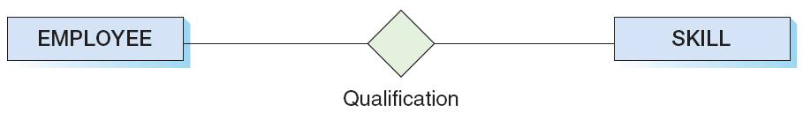
Binary Relationship
KROENKE AND AUER - DATABASE PROCESSING, 12th Edition © 2012 Pearson Prentice Hall
5-<number>

Slide 17
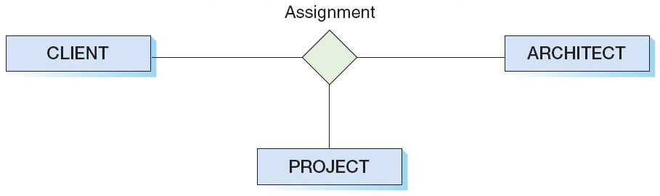
Ternary Relationship
KROENKE AND AUER - DATABASE PROCESSING, 12th Edition © 2012 Pearson Prentice Hall
5-<number>

Slide 18
Entities and Tables
The principle difference between an entity and a table (relation) is that you can express a relationship between entities without using foreign keys.
This makes it easier to work with entities in the early design process where the very existence of entities and the relationships between them is uncertain.
KROENKE AND AUER - DATABASE PROCESSING, 12th Edition © 2012 Pearson Prentice Hall
5-<number>

Slide 19
Cardinality
Cardinality means “count,” and is expressed as a number.
Maximum cardinality is the maximum number of entity instances that can participate in a relationship.
Minimum cardinality is the minimum number of entity instances that must participate in a relationship.
KROENKE AND AUER - DATABASE PROCESSING, 12th Edition © 2012 Pearson Prentice Hall
5-<number>

Slide 20
Maximum Cardinality
Maximum cardinality is the maximum number of entity instances that can participate in a relationship.
There are three types of maximum cardinality:
  One-to-One [1:1]
  One-to-Many [1:N]
  Many-to-Many [N:M]
KROENKE AND AUER - DATABASE PROCESSING, 12th Edition © 2012 Pearson Prentice Hall
5-<number>

Slide 21
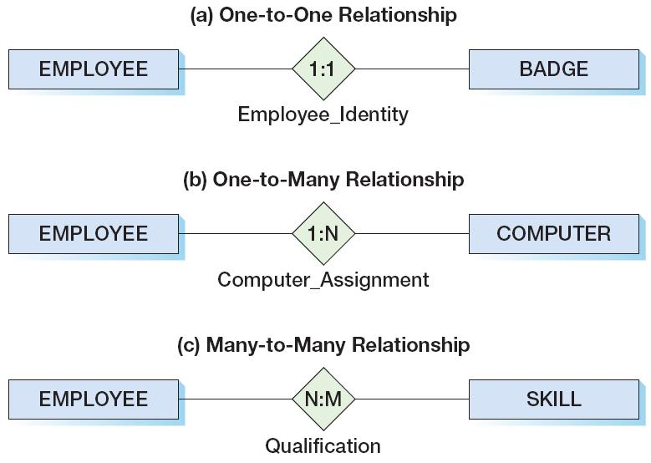
The Three Types of
Maximum Cardinality
KROENKE AND AUER - DATABASE PROCESSING, 12th Edition © 2012 Pearson Prentice Hall
5-<number>

Slide 22
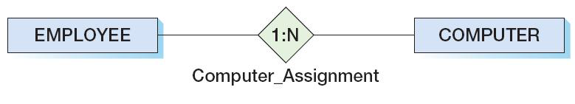
Parent and Child Entities
In a one-to-many relationship:
  The entity on the one side of the relationship is called the parent entity or just the parent.
  The entity on the many side of the relationship is called the child entity or just the child.
In the figure below, EMPLOYEE is the parent and COMPUTER is the child:
KROENKE AND AUER - DATABASE PROCESSING, 12th Edition © 2012 Pearson Prentice Hall
5-<number>

Slide 23
HAS-A Relationships
The relationships we have been discussing are known as HAS-A relationships:
  Each entity instance has a relationship with another entity instance.
    An EMPLOYEE has one or more COMPUTERs.
    A COMPUTER has one assigned EMPLOYEE.
KROENKE AND AUER - DATABASE PROCESSING, 12th Edition © 2012 Pearson Prentice Hall
5-<number>

Slide 24
Minimum Cardinality
Minimum cardinality is the minimum number of entity instances that must participate in a relationship.
Minimums are generally stated as either zero or one:
  IF zero [0] THEN participation in the relationship by the entity is optional, and no entity instance must participate in the relationship.
  IF one [1] THEN participation in the relationship by the entity is mandatory, and at least one entity instance must participate in the relationship.
KROENKE AND AUER - DATABASE PROCESSING, 12th Edition © 2012 Pearson Prentice Hall
5-<number>

Slide 25
Indicating Minimum Cardinality
As shown in the examples in a following slide:
  Minimum cardinality of zero [0] indicating optional participation is indicated by placing an oval next to the optional entity.
  Minimum cardinality of one [1] indicating mandatory (required) participation is indicated by placing a vertical hash mark next to the required entity.
KROENKE AND AUER - DATABASE PROCESSING, 12th Edition © 2012 Pearson Prentice Hall
5-<number>

Slide 26
Reading Minimum Cardinality
Look toward the entity in question:
  IF you see an oval THEN that entity is optional (minimum cardinality of zero [0]).
  IF you see a vertical hash mark THEN that entity is mandatory (required) (minimum cardinality of one [ 1]).
KROENKE AND AUER - DATABASE PROCESSING, 12th Edition © 2012 Pearson Prentice Hall
5-<number>

Slide 27
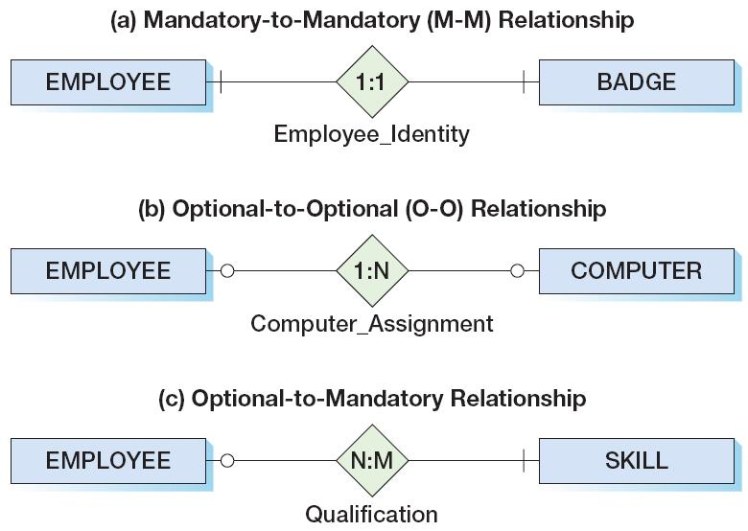
The Three Types of
Minimum Cardinality
KROENKE AND AUER - DATABASE PROCESSING, 12th Edition © 2012 Pearson Prentice Hall
5-<number>

Slide 28
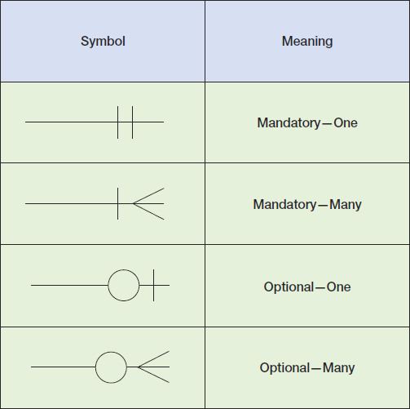
Data Modeling Notation:
IE Crow’s Foot I
KROENKE AND AUER - DATABASE PROCESSING, 12th Edition © 2012 Pearson Prentice Hall
5-<number>

Slide 29
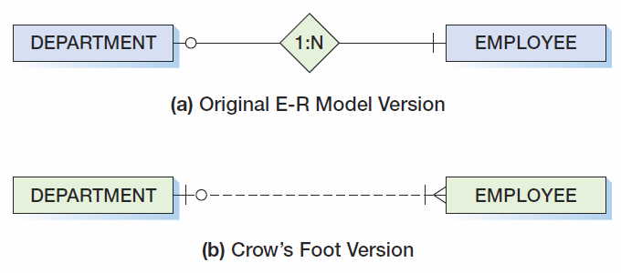
Data Modeling Notation:
IE Crow’s Foot 1:N
KROENKE AND AUER - DATABASE PROCESSING, 12th Edition © 2012 Pearson Prentice Hall
5-<number>

Slide 30
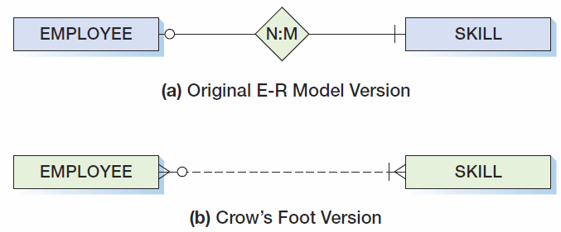
Data Modeling Notation:
IE Crow’s Foot N:M
KROENKE AND AUER - DATABASE PROCESSING, 12th Edition © 2012 Pearson Prentice Hall
5-<number>

Slide 31
ID-Dependent Entities
An ID-dependent entity is an entity (child) whose identifier includes the identifier of another entity (parent).
The ID-dependent entity is a logical extension or subunit of the parent:
  BUILDING : APARTMENT
  PAINTING : PRINT
The minimum cardinality from the ID-dependent entity to the parent is always one.
KROENKE AND AUER - DATABASE PROCESSING, 12th Edition © 2012 Pearson Prentice Hall
5-<number>

Slide 32
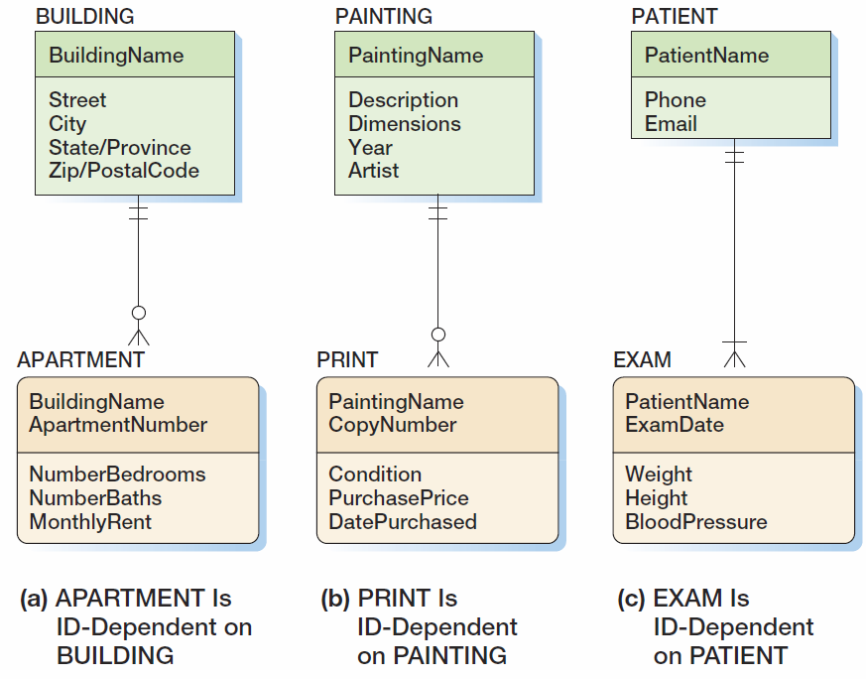
ID-Dependent Entities
KROENKE AND AUER - DATABASE PROCESSING, 12th Edition © 2012 Pearson Prentice Hall
5-<number>

Slide 33
Weak Entities
A weak entity is an entity whose existence depends upon another entity.
All ID-Dependent entities are considered weak.
There are also non-ID-dependent weak entities.
  The identifier of the parent does not appear in the identifier of the weak child entity.
KROENKE AND AUER - DATABASE PROCESSING, 12th Edition © 2012 Pearson Prentice Hall
5-<number>

Slide 34
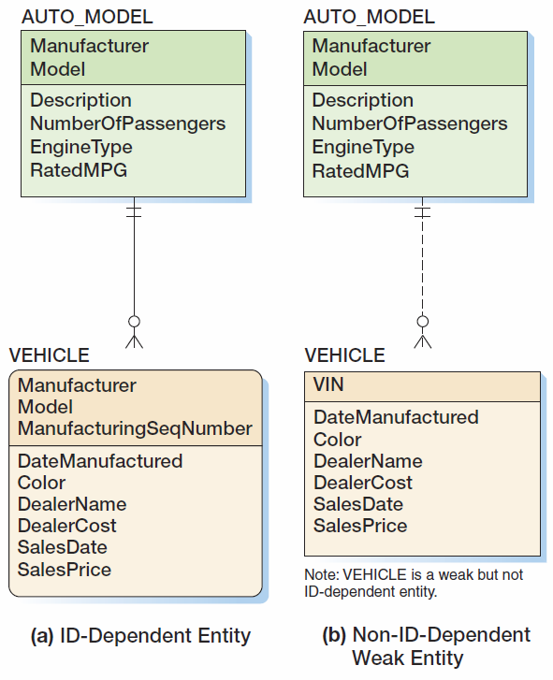
Weak Entities
KROENKE AND AUER - DATABASE PROCESSING, 12th Edition © 2012 Pearson Prentice Hall
5-<number>

Slide 35
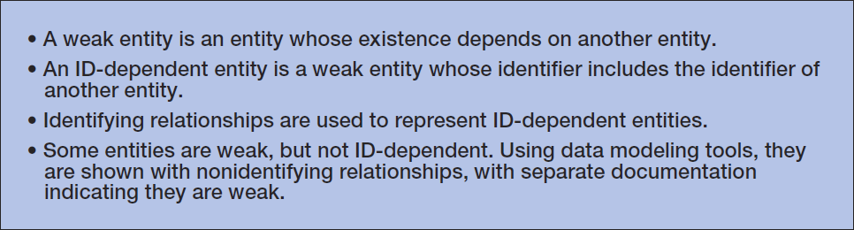
ID-Dependent and Weak Entities
KROENKE AND AUER - DATABASE PROCESSING, 12th Edition © 2012 Pearson Prentice Hall
5-<number>

Slide 36
Subtype Entities
A subtype entity is a special case of a supertype entity:
  STUDENT :
  UNDERGRADATE or GRADUATE
The supertype contains all common attributes, while the subtypes contain specific attributes.
The supertype may have a discriminator attribute which indicates the subtype.
KROENKE AND AUER - DATABASE PROCESSING, 12th Edition © 2012 Pearson Prentice Hall
5-<number>

Slide 37
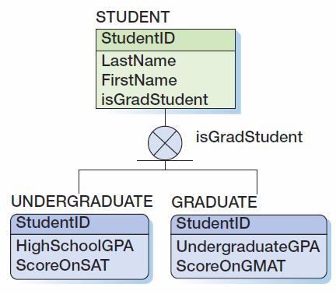
Subtypes with a Discriminator
KROENKE AND AUER - DATABASE PROCESSING, 12th Edition © 2012 Pearson Prentice Hall
5-<number>

Slide 38
Subtypes: Exclusive or Inclusive
If subtypes are exclusive, one supertype relates to at most one subtype.
If subtypes are inclusive, one supertype can relate to one or more subtypes.
KROENKE AND AUER - DATABASE PROCESSING, 12th Edition © 2012 Pearson Prentice Hall
5-<number>

Slide 39
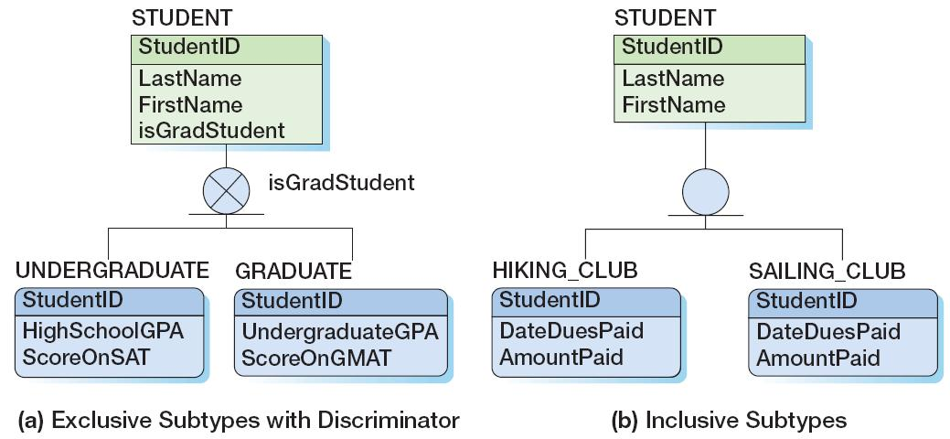
Subtypes: Exclusive or Inclusive
KROENKE AND AUER - DATABASE PROCESSING, 12th Edition © 2012 Pearson Prentice Hall
5-<number>

Slide 40
Subtypes: IS-A Relationships
Relationships connecting supertypes and subtypes are called IS-A relationships, because a subtype is a supertype.
The identifier of the supertype and all of its subtypes must be identical; i.e., the identifier of the supertype becomes the identifier of the related subtype(s).
Subtypes are used to avoid value-inappropriate nulls.
KROENKE AND AUER - DATABASE PROCESSING, 12th Edition © 2012 Pearson Prentice Hall
5-<number>

Slide 41
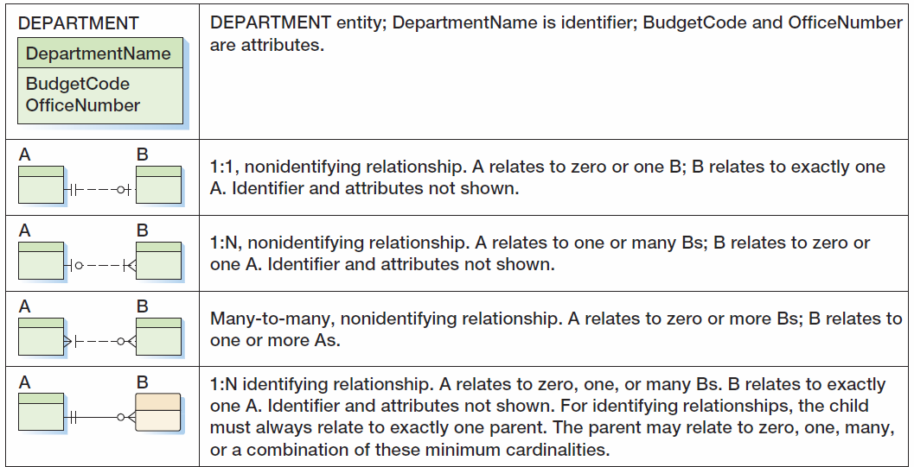
IE Crow’s Foot Symbol Summary I
KROENKE AND AUER - DATABASE PROCESSING, 12th Edition © 2012 Pearson Prentice Hall
5-<number>

Slide 42
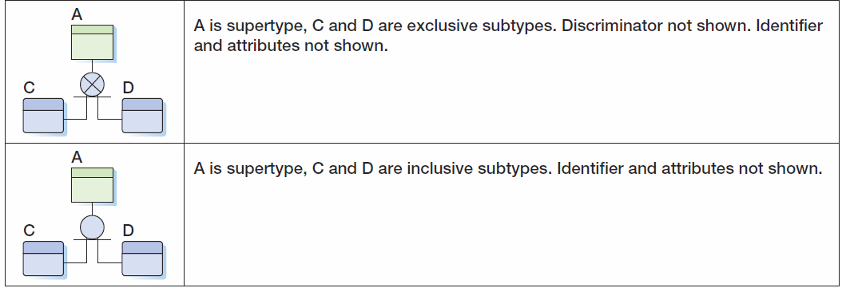
IE Crow’s Foot Symbol Summary II
KROENKE AND AUER - DATABASE PROCESSING, 12th Edition © 2012 Pearson Prentice Hall
5-<number>

Slide 43
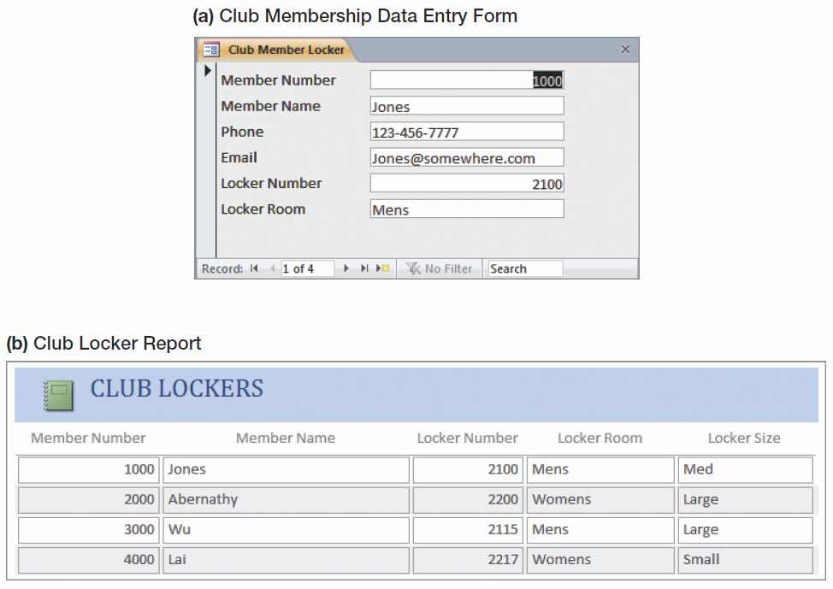
Strong Entity Patterns:
1:1 Strong Entity Relationships
KROENKE AND AUER - DATABASE PROCESSING, 12th Edition © 2012 Pearson Prentice Hall
5-<number>

Slide 44
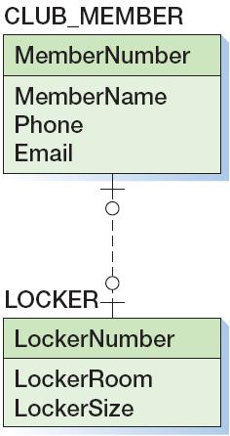
Strong Entity Patterns:
1:1 Strong Entity Relationships
KROENKE AND AUER - DATABASE PROCESSING, 12th Edition © 2012 Pearson Prentice Hall
5-<number>

Slide 45
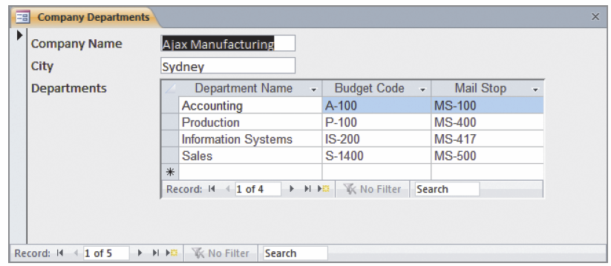
Strong Entity Patterns:
1:N Strong Entity Relationships
KROENKE AND AUER - DATABASE PROCESSING, 12th Edition © 2012 Pearson Prentice Hall
5-<number>

Slide 46
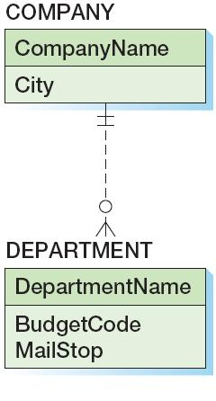
Strong Entity Patterns:
1:N Strong Entity Relationships
KROENKE AND AUER - DATABASE PROCESSING, 12th Edition © 2012 Pearson Prentice Hall
5-<number>

Slide 47
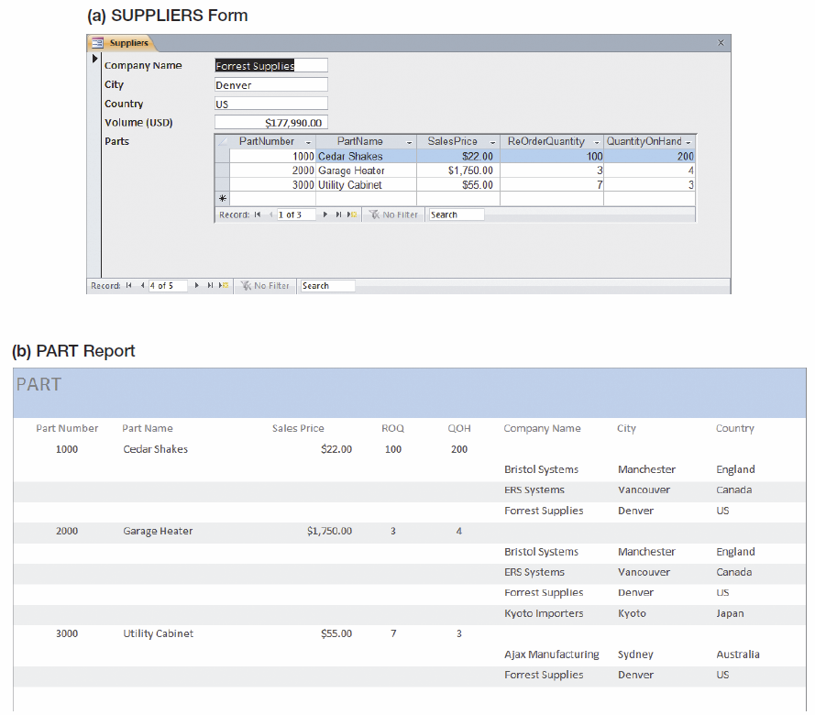
Strong Entity Patterns:
N:M Strong Entity Relationships
KROENKE AND AUER - DATABASE PROCESSING, 12th Edition © 2012 Pearson Prentice Hall
5-<number>

Slide 48
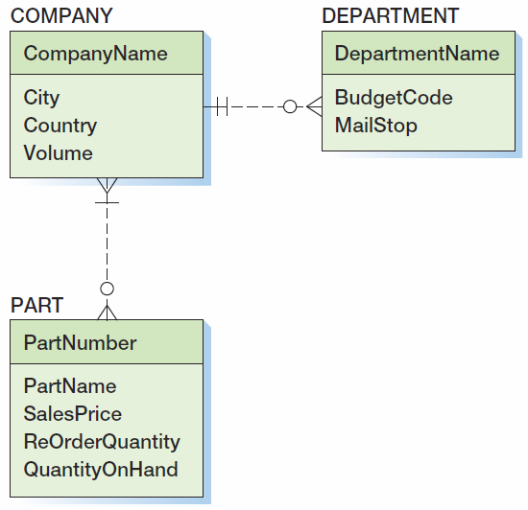
Strong Entity Patterns:
N:M Strong Entity Relationships
KROENKE AND AUER - DATABASE PROCESSING, 12th Edition © 2012 Pearson Prentice Hall
5-<number>

Slide 49
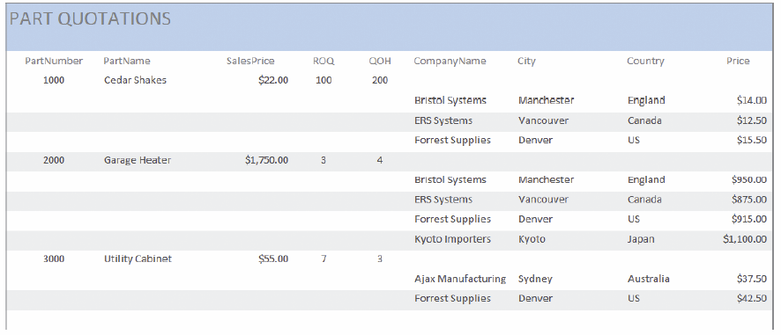
ID-Dependent Relationships:
The Association Pattern
KROENKE AND AUER - DATABASE PROCESSING, 12th Edition © 2012 Pearson Prentice Hall
5-<number>

Slide 50
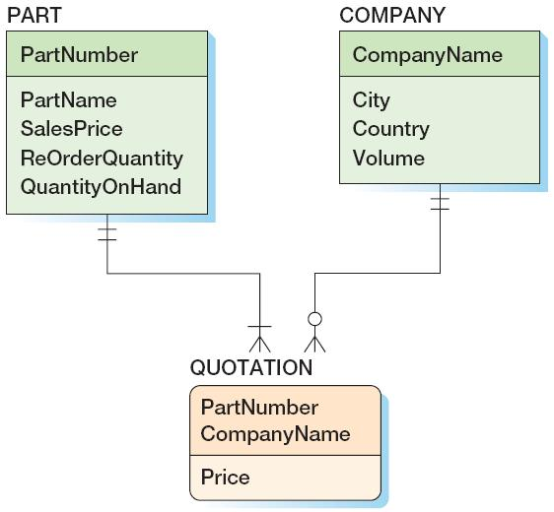
ID-Dependent Relationships:
The Association Pattern
KROENKE AND AUER - DATABASE PROCESSING, 12th Edition © 2012 Pearson Prentice Hall
5-<number>

Slide 51
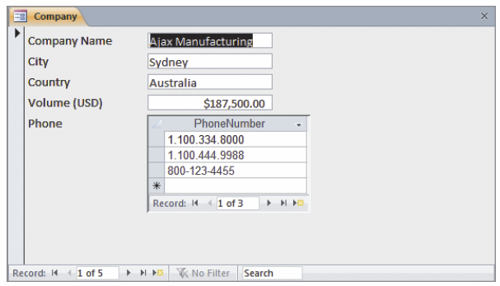
ID-Dependent Relationships:
The Multivalued Attribute Pattern
KROENKE AND AUER - DATABASE PROCESSING, 12th Edition © 2012 Pearson Prentice Hall
5-<number>

Slide 52
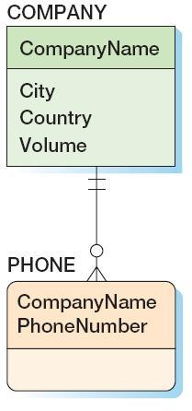
ID-Dependent Relationships:
The Multivalued Attribute Pattern
KROENKE AND AUER - DATABASE PROCESSING, 12th Edition © 2012 Pearson Prentice Hall
5-<number>

Slide 53
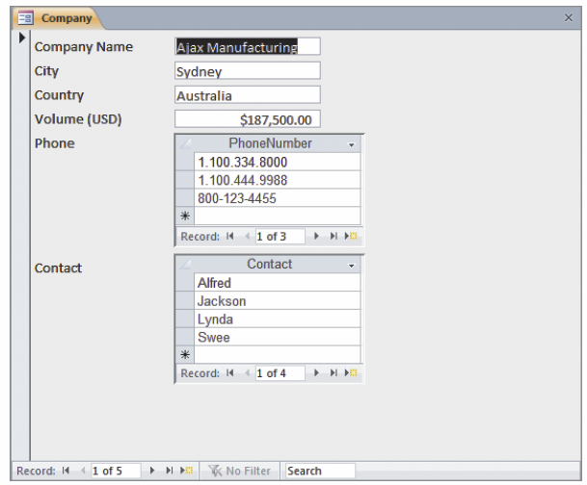
ID-Dependent Relationships:
The Multivalued Attribute Pattern
KROENKE AND AUER - DATABASE PROCESSING, 12th Edition © 2012 Pearson Prentice Hall
5-<number>

Slide 54
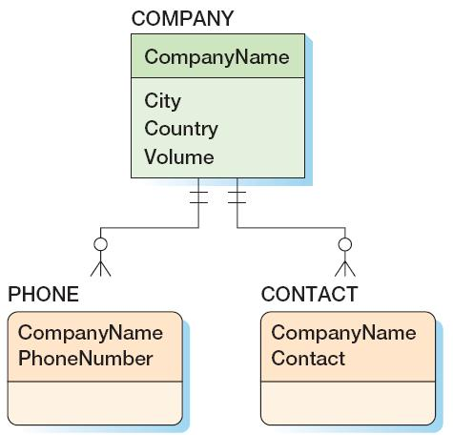
ID-Dependent Relationships:
The Multivalued Attribute Pattern
KROENKE AND AUER - DATABASE PROCESSING, 12th Edition © 2012 Pearson Prentice Hall
5-<number>

Slide 55
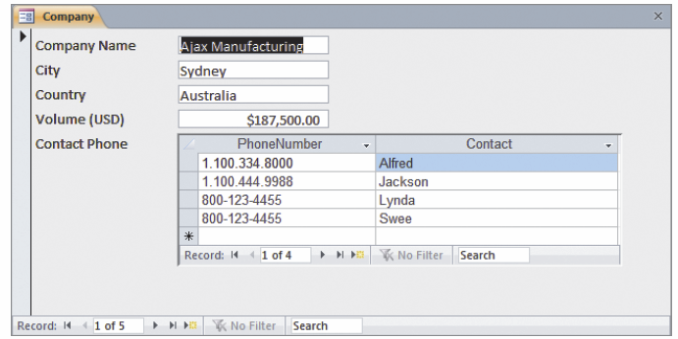
ID-Dependent Relationships:
Composite Multivalued Attributes
KROENKE AND AUER - DATABASE PROCESSING, 12th Edition © 2012 Pearson Prentice Hall
5-<number>

Slide 56
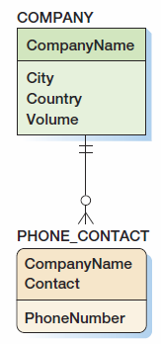
ID-Dependent Relationships:
Composite Multivalued Attributes
KROENKE AND AUER - DATABASE PROCESSING, 12th Edition © 2012 Pearson Prentice Hall
5-<number>

Slide 57
ID-Dependent Relationships:
The Archetype/Instance Pattern
The archetype/instance pattern occurs when the ID-dependent child entity is the physical manifestation (instance) of an abstract or logical parent.
  PAINTING : PRINT
  CLASS : SECTION
  YACHT_DESIGN : YACHT
  HOUSE_MODEL: HOUSE
KROENKE AND AUER - DATABASE PROCESSING, 12th Edition © 2012 Pearson Prentice Hall
5-<number>

Slide 58
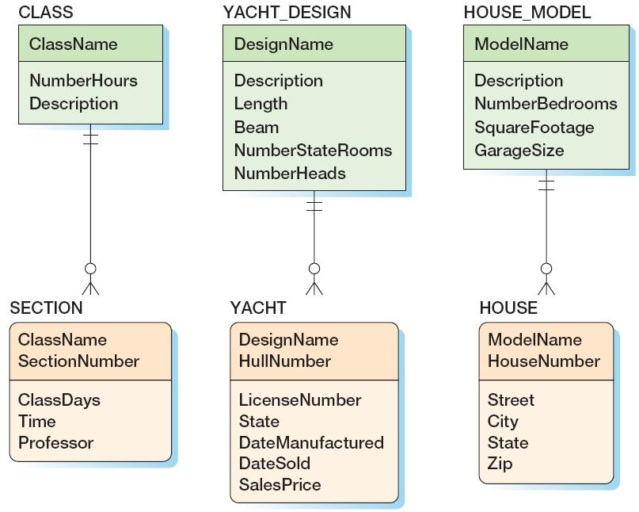
ID-Dependent Relationships:
The Archetype/Instance Pattern
KROENKE AND AUER - DATABASE PROCESSING, 12th Edition © 2012 Pearson Prentice Hall
5-<number>

Slide 59
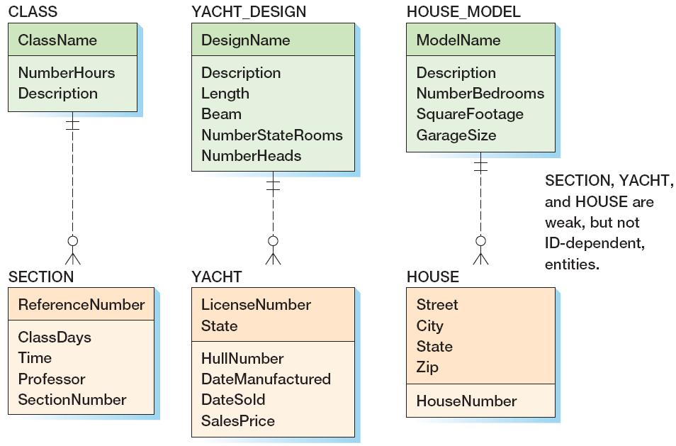
ID-Dependent Relationships:
The Archetype/Instance Pattern
KROENKE AND AUER - DATABASE PROCESSING, 12th Edition © 2012 Pearson Prentice Hall
5-<number>

Slide 60
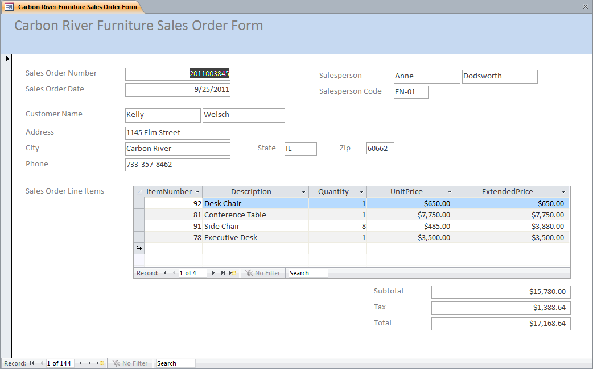
Mixed Patterns:
The Line-Item Pattern
KROENKE AND AUER - DATABASE PROCESSING, 12th Edition © 2012 Pearson Prentice Hall
5-<number>

Slide 61
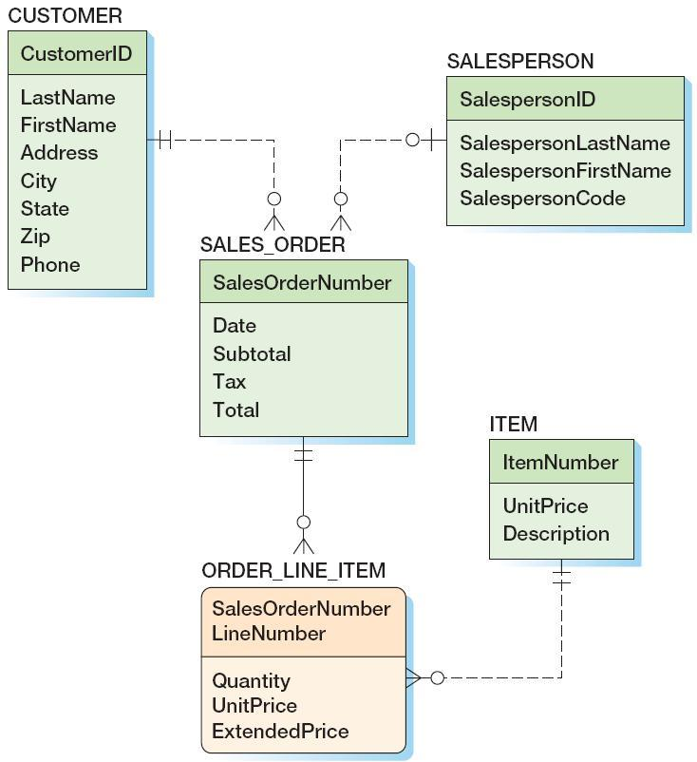
Mixed Patterns:
The Line-Item Pattern
KROENKE AND AUER - DATABASE PROCESSING, 12th Edition © 2012 Pearson Prentice Hall
5-<number>

Slide 62
Mixed Patterns:
Other Mixed Patterns
Look for a mixed pattern where:
  A strong entity has a multivalued composite group
  One of the elements of the composite group is an identifier of another strong entity.
KROENKE AND AUER - DATABASE PROCESSING, 12th Edition © 2012 Pearson Prentice Hall
5-<number>

Slide 63
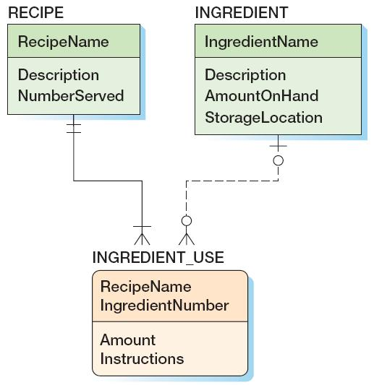
Mixed Patterns:
Other Mixed Patterns
KROENKE AND AUER - DATABASE PROCESSING, 12th Edition © 2012 Pearson Prentice Hall
5-<number>

Slide 64
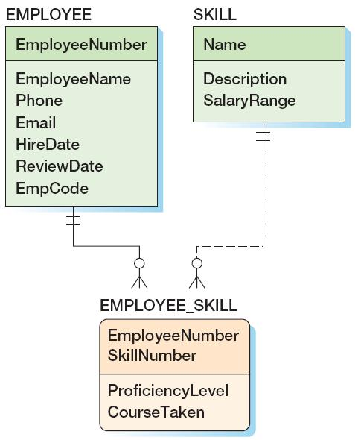
Mixed Patterns:
Other Mixed Patterns
KROENKE AND AUER - DATABASE PROCESSING, 12th Edition © 2012 Pearson Prentice Hall
5-<number>

Slide 65
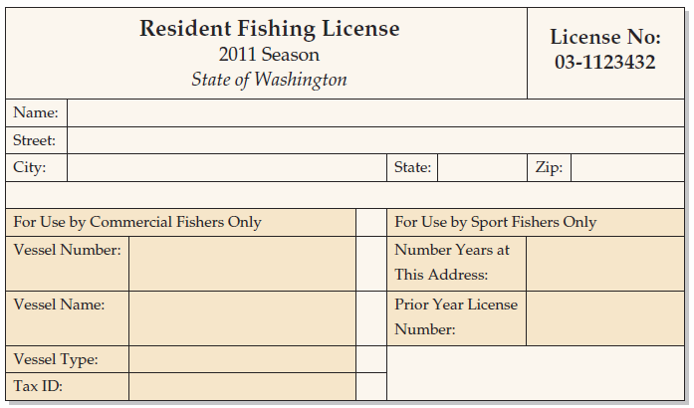
Mixed Patterns:
The For-Use-By Pattern
KROENKE AND AUER - DATABASE PROCESSING, 12th Edition © 2012 Pearson Prentice Hall
5-<number>

Slide 66
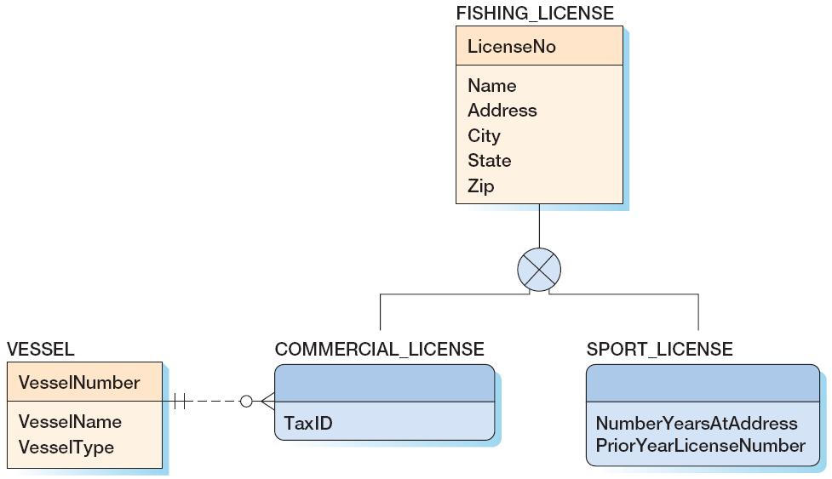
Mixed Patterns:
The For-Use-By Pattern
KROENKE AND AUER - DATABASE PROCESSING, 12th Edition © 2012 Pearson Prentice Hall
5-<number>

Slide 67
Recursive Relationships
A recursive relationship occurs when an entity has a relationship to itself.
KROENKE AND AUER - DATABASE PROCESSING, 12th Edition © 2012 Pearson Prentice Hall
5-<number>

Slide 68
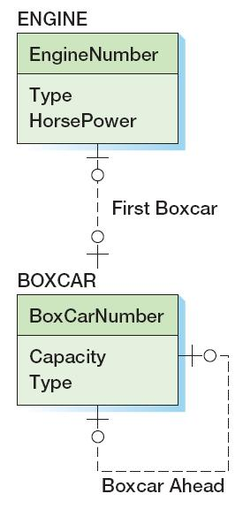
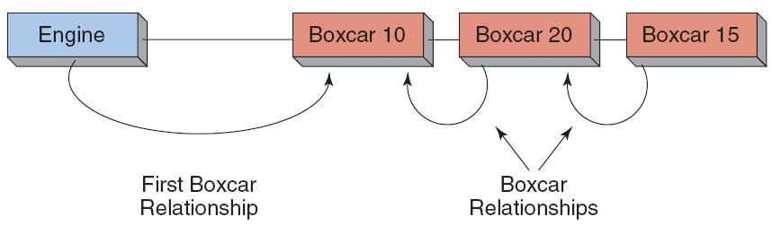
Recursive Patterns:
1:1 Recursive Relationship
KROENKE AND AUER - DATABASE PROCESSING, 12th Edition © 2012 Pearson Prentice Hall
5-<number>

Slide 69
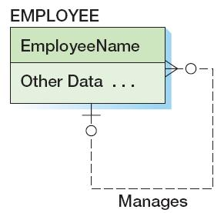
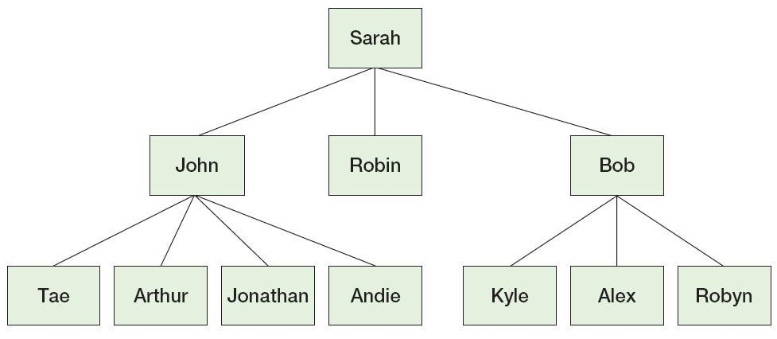
Recursive Patterns:
1:N Recursive Relationship
KROENKE AND AUER - DATABASE PROCESSING, 12th Edition © 2012 Pearson Prentice Hall
5-<number>

Slide 70
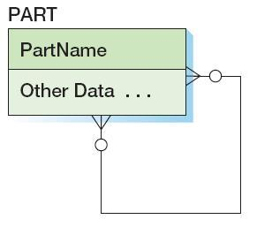
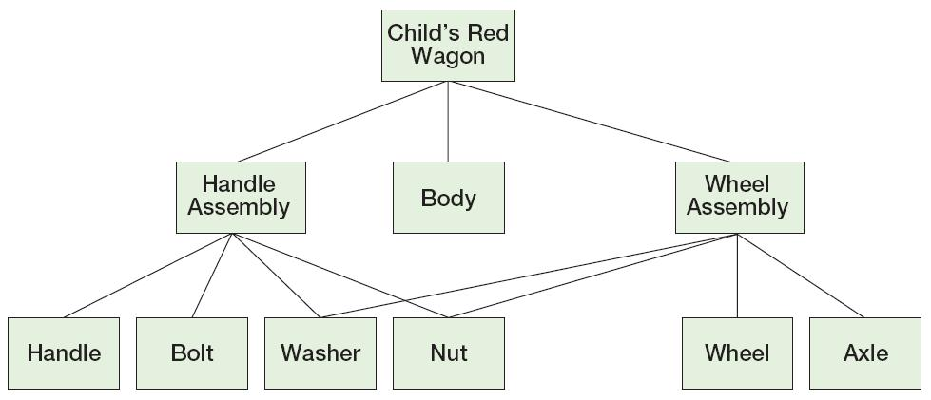
Recursive Patterns:
N:M Recursive Relationship
KROENKE AND AUER - DATABASE PROCESSING, 12th Edition © 2012 Pearson Prentice Hall
5-<number>

Slide 71
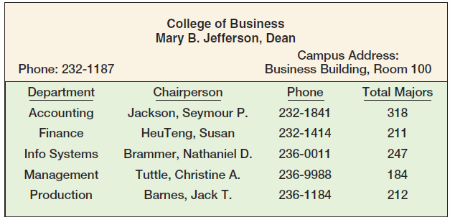
Highline University
The College Report
KROENKE AND AUER - DATABASE PROCESSING, 12th Edition © 2012 Pearson Prentice Hall
5-<number>

Slide 72
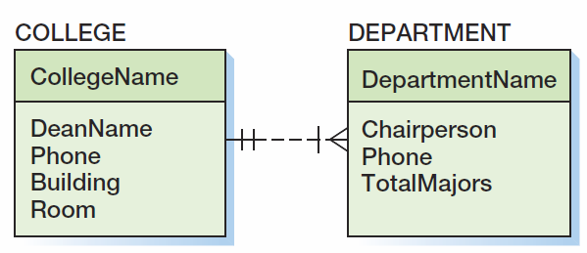
Highline University
First Data Model
KROENKE AND AUER - DATABASE PROCESSING, 12th Edition © 2012 Pearson Prentice Hall
5-<number>

Slide 73
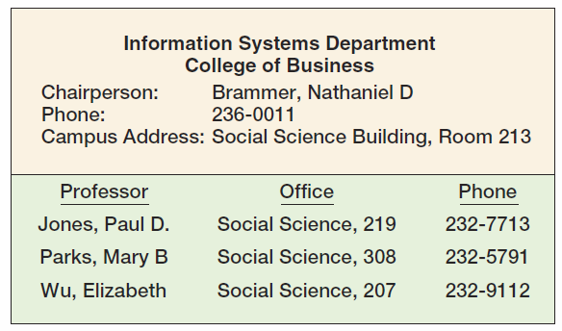
Highline University
The Department Report
KROENKE AND AUER - DATABASE PROCESSING, 12th Edition © 2012 Pearson Prentice Hall
5-<number>

Slide 74

Highline University
Second Data Model
KROENKE AND AUER - DATABASE PROCESSING, 12th Edition © 2012 Pearson Prentice Hall
5-<number>

Slide 75

Highline University
Second Data Model
KROENKE AND AUER - DATABASE PROCESSING, 12th Edition © 2012 Pearson Prentice Hall
5-<number>

Slide 76

Highline University
Second Data Model
KROENKE AND AUER - DATABASE PROCESSING, 12th Edition © 2012 Pearson Prentice Hall
5-<number>

Slide 77

Highline University
Second Data Model
KROENKE AND AUER - DATABASE PROCESSING, 12th Edition © 2012 Pearson Prentice Hall
5-<number>

Slide 78

Highline University
The Department Student Report
KROENKE AND AUER - DATABASE PROCESSING, 12th Edition © 2012 Pearson Prentice Hall
5-<number>

Slide 79

Highline University
Third Data Model
KROENKE AND AUER - DATABASE PROCESSING, 12th Edition © 2012 Pearson Prentice Hall
5-<number>

Slide 80

Highline University
Sample Student Acceptance Letter
KROENKE AND AUER - DATABASE PROCESSING, 12th Edition © 2012 Pearson Prentice Hall
5-<number>

Slide 81

Highline University
Fourth Data Model
KROENKE AND AUER - DATABASE PROCESSING, 12th Edition © 2012 Pearson Prentice Hall
5-<number>

Slide 82

Highline University
Final Data Model
KROENKE AND AUER - DATABASE PROCESSING, 12th Edition © 2012 Pearson Prentice Hall
5-<number>

Slide 83
David Kroenke and David Auer
Database Processing
Fundamentals, Design, and Implementation
(11th Edition)
End of Presentation:
Chapter Five
KROENKE AND AUER - DATABASE PROCESSING, 12th Edition © 2012 Pearson Prentice Hall
5-<number>

Slide 84

All rights reserved. No part of this publication may be reproduced, stored in a retrieval system, or transmitted, in any form or by any means, electronic, mechanical, photocopying, recording, or otherwise, without the prior written permission of the publisher. Printed in the United States of America.
Copyright © 2012 Pearson Education, Inc.
Publishing as Prentice Hall
KROENKE AND AUER - DATABASE PROCESSING, 12th Edition © 2012 Pearson Prentice Hall
5-<number>

