Slide 1
CS 4500 Advanced Data Communications
Dr. Clincy
Full Professor of CS
Dr. Clincy
Lecture 1

Slide 2
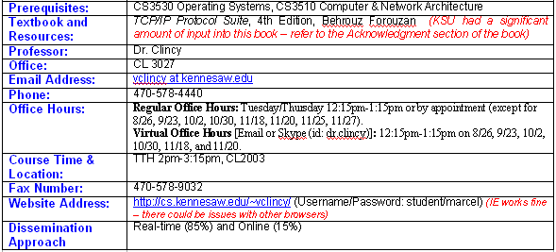
Kick Off
Special note on IE browser issue – compatibility feature
Explain “regular” and “virtual” office hours
Dr. Clincy
Lecture 1

Slide 3
Tentative Course Outline: Subject to Change
General Topic & Exam Coverage | Lecture Coverage | Chapters (in order)
Exam 1 - Introduction and Overview of Underlying Technologies: Review critical concepts covered in foundation course, RFC’s; the importance of standards; underlying network technologies; OSI reference model & protocol layering, etc.. | 1 through 5 | 1, 2, and 3
Exam 2 - Addressing Issues: IP, Internet addresses (classful and classless), subnetting and supernetting, ARP; RARP; BOOTP; DHCP; DNS, NAT, Mobile IP, etc.. | 6 through 11 | 7, 5, 8, 10, 18 and 19
Exam 3 - Network Layer Protocols: ICMP; router functionality, dynamic versus static routing, routing tables, unicast routing (RIP, BGP, OSPF), routing algorithms (link state, distance vector) | 12 through 14 | 4, 9, 6 and 11
Exam 3 – Multicast Routing multicasting, routing algorithm (path vector), multicast routing protocols (MOSPF, DVMRP, CBT, PIM), MBONE, IGMP, End-to-end datagram delivery, and Flow control | 15 through 16 | 12
Exam 4 – Transport Layer Protocols, Next Generation IP UDP and TCP, IPv6, ICMPv6, transitioning from IPv4 to IPv6 | 17 through 20 | 13, 14, 15, 26, 27 and 28
Dr. Clincy
Lecture 1

Slide 4
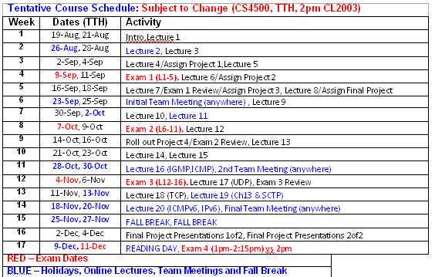
Tentative Course Schedule: Subject to Change
Note: Nov 18th – two weeks to watch
Some online lectures will be shorter than in-class lectures because no time is built in for class participation
Dr. Clincy
Lecture 1

Slide 5
Lecture Dissemination Approach
Hybrid – both in-classroom (and real-time) (50%) and online (50%)
Just simply run the pre-recorded lectures from your website
Dr. Clincy
Lecture 1

Slide 6
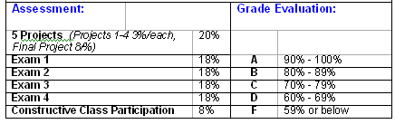
Assessment
will curve GRADES if the SCORE AVERAGE is lower than 70 (curving vs bell-curve approach, TCP/IP new topic) (give example of curving concept – next bullet)
No make-up exams – final will count for missed exam – can miss only 1 exam
Can’t use laptops for exams - no e-books or pdf-books for exams – must print the pages (there are plenty of books in the bookstore)
Dr. Clincy
Lecture 1

Slide 7
Explanation for curving
Explain why NOT force-fitting traditional 10-point grading approach
Heterogeneous student make up (vs homogeneous)
Gurus in class ?
Partially or Fully cover topic ?
A more demanding subject matter ?
Should the SD be dictated or flexible ?
Should the Avg be dictated or flexible ?
Students need not perceive the SCORE as their GRADE – but if they insist on doing so , think of the exam SCORE as an NATIONAL GRADE
Dr. Clincy
Lecture 1

Slide 8
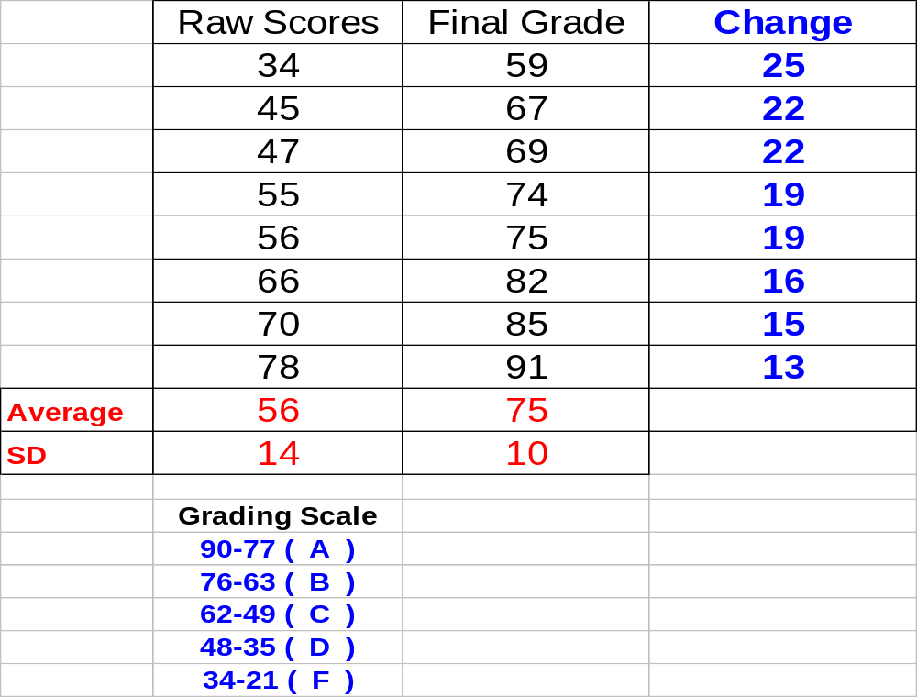
Lesson in Stats – Example of Curving Grades –
Raw Score to Final Grade
What is an Avg ?
What is the SD ?
This is the curve
Fitting raw scores to a curve
? = 90 + (RS-77)/1.4
? = 80 + (RS-63)/1.4
? = 70 + (RS-49)/1.4
? = 60 + (RS-35)/1.4
Dr. Clincy
Lecture 1

Slide 9
Constructive Class Participation Grade
Purpose of class participation grade
No 2 students learn the same – No 2 Profs teach the same (or have the same expectations) – class participation helps the Prof gauge and it also helps other students – so important you get a grade for it
This grade comes from my personal perception and judgment. Here is my personal guideline though:
8-6 very impressive student that made exceptional class contribution through out the course - all questions were of significance - consistent and very constructive
5-4 Good class contribution (somewhat consistent to sporadic)
3-2 Occasional contribution
1-0 Didn't participate (or very negative and disruptive when they participated)
Note 1: Also, I look at positive and not-so-positive contributions balancing themselves out
Note 2: I don't count the cases when students simply respond to my questioning of them - that is my attempt to create an environment where students feel comfortable to ask questions.
Note 3: I MORESO pay attention to quality and frequency of participation and NOT just frequency
Dr. Clincy
Lecture 1

Slide 10
General Policies and Expectations:
Attendance at all classes is highly encouraged but NOT required. Concepts and ideas discussed in one class are used as building blocks for more concepts and ideas in the next class.
Any class session missed by the student is the student's responsibility to make up.
Makeup exams will NOT be given; instead, the last exam will count in place of the missed exam.
Exams should be returned to the Professor in class right after the review for the student to receive a grade. Grades are not logged until the students have reviewed the exams for grading mistakes. If students take the exam from the classroom, a grading penalty of 50% will be used due to the fact the Professor has no real way of determining if the exam was tampered with or not.
Project assignments MUST be turned in on time to receive full credit. Late project assignments will be graded severely – for each day the assignment is late, the assignment’s grade will be reduced by 20%.
Students will not be allowed to makeup missed project assignments.
It’s hard to teach a subject like TCP/IP from a single source. The Professor will use multiple sources to teach various concepts – multiple sources such as (1) text book, (2) lecture notes, (3) handouts, (4) URL’s, and (5) project assignments. Every topic detail WILL NOT necessarily be found in the our text.
Students are expected to read the text and any other supporting documentation the Professor distributes.
Dr. Clincy
Lecture 1

Slide 11
General Policies and Expectations:
In being successful in this subject, expect a minimum of 2-3 hours of study per hour of lecture (6-9 hours per week)
The Professor expects students to take advantage of office hours when needing clarification or help.
Purpose of class participation grade – no 2 students learn the same – no 2 Profs teach the same (or have the same expectations) – I feel constructive class participation is very important
The Professor greatly supports students sending emails at any time – it will be the goal of the Professor to reply to emails within a 24-hour time span (not counting weekends).
Be sure and provide the Professor a functioning personal email address for you (on your Sign-up List) – already has KSU address
Lecture notes purpose: serve as a guide to the Professor – help organize and time lecture
Guarantee: current lecture notes will be posted before the next up-and-coming lecture (ie. lecture notes 1 will be posted before lecture 2 occurs)
See syllabus for withdrawal policy, enrollment policy, and the Academic Integrity Statement. Be sure and give me the signed copy at the next class meeting
Go to my website for a syllabus and lecture notes
Dr. Clincy
Lecture 1

