Slide 1
CS 4500 Advanced Data Communications
Lecture 1
Reminder: Lecture 2 (next lecture) online
Dr. Clincy
Lecture 1

Slide 2
Introduction and Overview
Just 50 years ago, networks were proprietary (ie. IBM, HP, DEC, etc)
Both the software (protocols or rules) and hardware used to make a network functional were proprietary.
Also, the networks’ technologies (components) were designed for a specific purpose in mind (ie. Business, manufacturing, high/low-speed, small/large capacity, etc..)
The certain applications could run on certain type networks
Larger corporations would typically have many different disjointed computer networks - company mergers caused this problem too (wasn’t perceived as a problem then)
Engineers and Scientists (or whomever) could have 3-4 terminals on his/her desk for different uses
Customer would have to go to a specific vendor for an application or network upgrade
Dr. Clincy
Lecture 1

Slide 3
Introduction and Overview
Back in the 70’s and early 80’s, there was a big push to make communication systems or networks “open”
“open” means “non-proprietary” - instead of the “specifications” being known only by the vendor, the specs would be be publicly known
By having publicly published specifications, all of the various vendors could design and manufacture network components that were compatible and interchangeable
Why was this a good thing ???? (Even if you were a network-component-producing company with a significant market share)
Dr. Clincy
Lecture 1

Slide 4
Introduction and Overview
Answer: would drive more (1) computer, (2) software application and (3) network usage - therefore, drive more revenue for all
Answer: more efficiency for businesses, government, etc..
Also, what happened with the computer industry as it relates to OS’s ???
Dr. Clincy
Lecture 1

Slide 5
Introduction and Overview
The idea behind having “open systems” is to have the ability to interconnect many different networks into a single network.
The technology that allows this is called “Internetworking”
Internetworking provides:
  The Interconnection of heterogeneous (different) networks
  Set of communication standards/protocols that make the interconnected heterogeneous networks interoperate
  (river, language scenario)
Internetworking “hides” the details of the underlying hardware and allow the network nodes to communicate independent of their physical connection (or hardware)
Internetworking can be called “internet technology” – notice to lower case “i” on internet
Dr. Clincy
Lecture 1

Slide 6
Introduction and Overview
Some time ago, the government realized the benefit of internet technology and funded a research project through an agency called ARPA – Advanced Research Projects Agency
Through ARPA support, the “open” system specs were realized.
These open specs were called “TCP/IP Internet Protocol Suite”, commonly called “TCP/IP”
TCP – Transmission Control Protocol – dealt with higher level issues like segmentation, reassembly and error detection.
IP – Internetworking Protocol – dealt with datagram routing
TCP/IP was heavenly sent in that: (1) previously disjointed networks WITHIN companies could now function as a single network and (2) it facilitated communications amongst geographically dispersed sites
With TCP/IP, the Internet was born. Notice the “I” on Internet – called the Global Internet
Global Internet interconnects over 170 million nodes – testimonial for TCP/IP
Dr. Clincy
Lecture 1

Slide 7
Introduction and Overview
Bottom Line: what makes TCP/IP so great and unique from other network protocols ??:
  Network Technology Independence – independent of a particular vendor’s hardware
  Universal Interconnection – any 2 computers connected to the internet can communicate – each computer has a unique internationally recognized address
  End-to-End Acknowledgements – acknowledgements between the source and destination versus intermediate nodes
  Application Protocol Standards – TCP/IP provides services (or software) to applications needing lower level communication services
We will cover each of these attributes in detail throughout the course
Internet uses TCP/IP
Dr. Clincy
Lecture 1

Slide 8
Introduction and Overview
Read more details about the history in your book (Chapter 1)
Who is responsible the Internet ?. Internet Architecture Board (IAB)
IAB coordinates the research and development in relation to the TCP/IP protocols. The organization decides which protocols are required and sets policies
Each member of the IAB chaired an Internet Task Force responsible for investigating a set of problems or issues each (there were 10 task forces)
The chairman of the IAB was called the Internet Architect
Dr. Clincy
Lecture 1

Slide 9
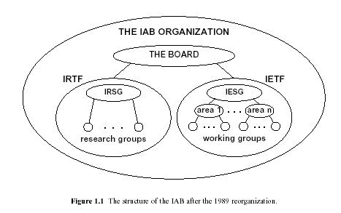
Introduction and Overview
In 1989, the IAB was re-organized due to commercial usage increases
The original IAB researchers were moved under the Internet Research Task Force – their focus is longer term research
The Internet Engineering Task Force is more concerned about short-term issues and is mostly comprised of industry types
The Internet Engineering Task Force Chairman and managers of each “working group” forms the Internet Engineering Steering Group – this group is responsible for coordination
In 1992, a group called the Internet Society (ISOC) was form to encourage participation on the Internet.
Dr. Clincy
Lecture 1

Slide 10
Introduction and Overview
Documentation of TCP/IP is placed in online repositories and made available at no charge – you will be responsible for collecting some of this documentation
The final and official TCP/IP documents start out as an Internet draft (working document)
Upon recommendation from Internet authorities, the draft may be published as a Request for Comment (RFC)
Each RFC is edited, assigned a number and made available to all interested parties. RFC’s go through maturity levels and are organized according to their requirement level
The six maturity levels are: proposed standard, draft standard, Internet standard, historic, experimental and informational
RFC’s are classified into 5 requirements levels: required, recommended, elective, limited use and not recommended
You can secure RFC’s: regular mail, e-mail, ftp or Internet (http://www.rfc-editor.org)
Dr. Clincy
Lecture 1

Slide 11
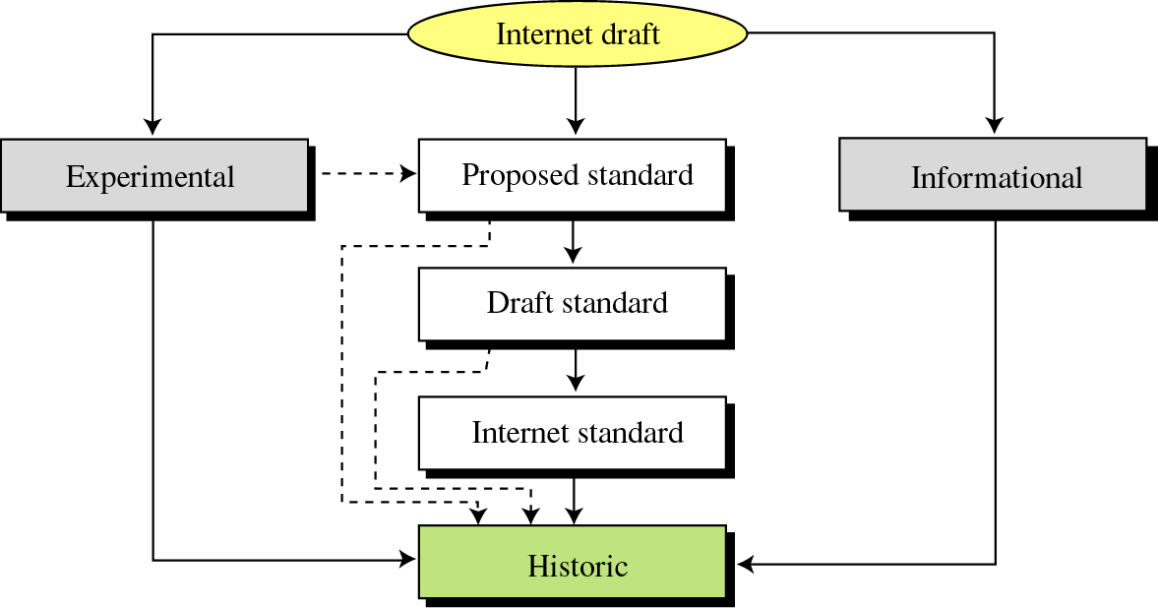
Introduction and Overview
Dr. Clincy
Lecture 1

Slide 12
Introduction and Overview
Protocols – set of rules that governs data communications – defines what is communicated, how it is communicated and when it is communicated
Protocol elements are:
  Syntax – structure or format of the data (order of the bits)
  Semantics – meaning of each section of bits – how to interpret the pattern of bits
  Timing – deals with (1) when the data should be sent and (2) how fast it should be sent (ie. a Tx can overload a Rx and therefore data can be lost or mis-interpreted)
More clarity: the TCP/IP protocol allows one to specify data communications without understanding the details of the underlying hardware.
Dr. Clincy
Lecture 1

Slide 13
Why Study OSI?
Still an excellent model for conceptualizing and understanding protocol architectures
More granularity in functionality - more functional delineation
Key points:
  Modular
  Hierarchical (chain of command, pecking order)
  Boundaries between layers (called interfaces)
  NOTE: the protocols or functionality with in the layer could change however, the interface remains the same – this facilitates the flexibility
Dr. Clincy
Lecture 1

Slide 14
OSI Reference Model ?
OSI – Open Systems Interconnection
Set of rules of how to transmit data across a network
at the lower levels of the model protocols define the electrical and physical standards
at the lower levels, the bit ordering, the transmission of the bits, and error detecting and correcting are defined
at the higher levels of the model, the protocols define the data formatting, message syntax, dialogue management, message sequences and info presentation
Dr. Clincy
Lecture 1

Slide 15
Advantages of Layering
Easier application development
Network can change without all programs being modified
Breaks complex tasks into subtasks
Each layer handles a specific subset of tasks
Communication occurs
  between different layers on the same node or stack (INTERFACES)
  between similar layers on different nodes or stacks (PEER-TO-PEER PROCESSES
Dr. Clincy
Lecture 1

Slide 16
OSI’s Layered Approach Example
Network A
Network B
Actual commands invoked, presentation
Top Layer
Top Layer
Facilitate the actual communications
Some Intermediate Layer
Some Intermediate Layer
Network interfaces, raw bits
Bottom Layer
Bottom Layer
Dr. Clincy
How does peer-to-peer communication work ?
Lecture 1

Slide 17
OSI
Open Systems Interconnection
Developed by ISO
(International Organization for Standardization)
Contains seven layers
Application
Presentation
Session
Transport
Network
Data Link
Physical
Dr. Clincy
Lecture 1

Slide 18
OSI Reference Model ?
Bottom 3 layers
Bottom 3 layers responsible for getting the info to the destination
(Bottom 3 layers): at the lower levels of the model protocols define the electrical and physical standards
(Bottom 3 layers) at the lower levels, the bit ordering, the transmission of the bits, and error detecting and correcting are defined
Top 4 layers
at the higher levels of the model, the protocols define the data formatting, message syntax, dialogue management, message sequences and info presentation
Dr. Clincy
Lecture 1

