Slide 1
Ch 2: TCP/IP and OSI
Lecture 2
Project 1 Posted on website

Slide 2
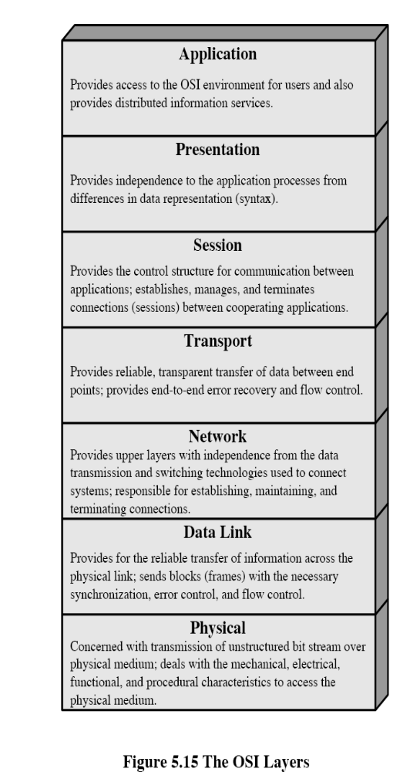
Recap – Two General Objectives of Networking ?
Upper Layers – creating and interpreting the signal, data or info
Lower Layers – getting the signal/data/info from one place to the next

Slide 3
OSI Physical Layer
Responsible for transmission of bits
Always implemented through hardware
Encompasses mechanical, electrical, and functional interfaces
Encoding issues: how 0’s and 1’s are converted to signals
Transport medium: Coaxial, Twisted Pair, Optical, etc..
Transmission Rate/Data Rate – how fast to send bits
Transmission mode: transmission direction (simplex, duplex)
Physical Topology: network layout

Slide 4
OSI Data Link Layer
Responsible for error-free, reliable transmission of data
Framing, Flow control, Error control (detection/correction)
Makes use of physical address because with in the same network
Network Layer
Actually sends the packets (groups of frames) from node to node using a routing algorithm
Data Link Layer
Takes raw data (bits) and transform them into frames, error control, etc.
Physical Layer
Transmit and receive the raw data (bits)

Slide 5
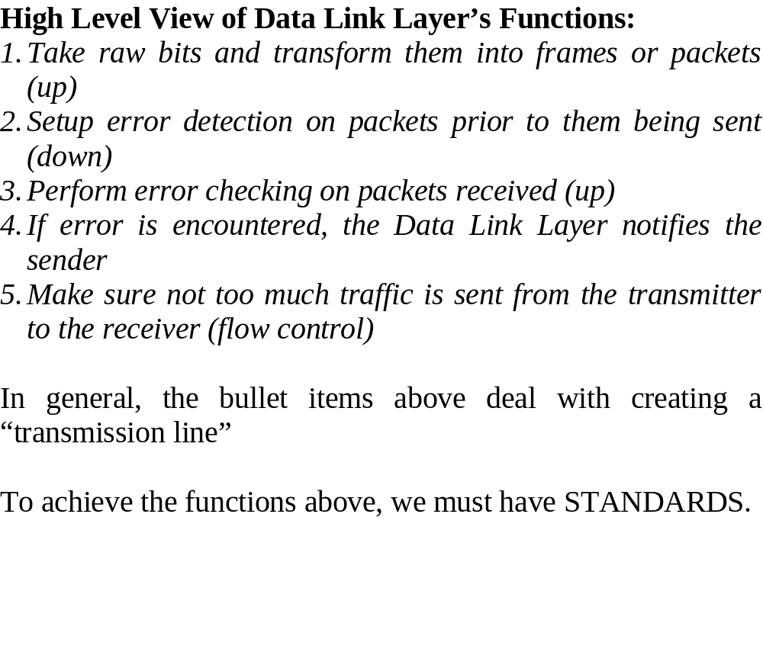
OSI Data Link Layer

Slide 6
OSI Network Layer
Responsible for routing of messages through networks
Concerned with type of switching used (circuit v. packet)
Handles routing among different networks
NOTE: with in the same network, only the DATA LINK layer is needed – amongst multiple networks, the NETWORK LAYER is needed
No need for routing with in the same network (LAN)
Routing across “internetworks”
Makes use of logical address vs physical address because not with in same network

Slide 7
OSI Network Layer
Transport
Concerned with an error-free end-to-end flow of data
Network Layer
Actually sends the packets (groups of frames) from node to node using a routing algorithm
Data Link Layer
Takes raw data (bits) and transform them into frames

Slide 8
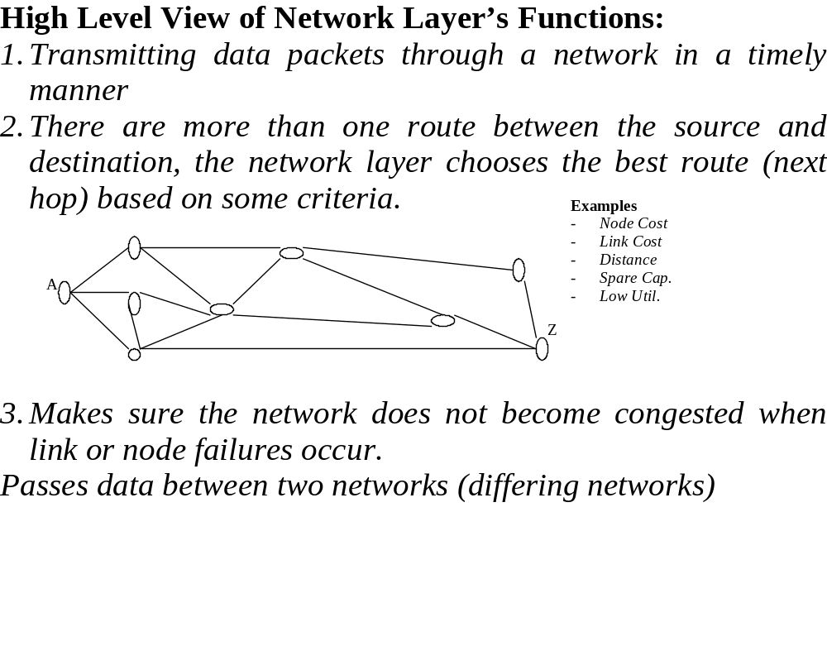
OSI Network Layer

Slide 9
OSI Transport Layer
Isolates messages from lower and upper layers
Breaks down message size (segmentation) (down) and performs re-assembly (up)
Monitors quality of communications channel (oversee all hops)
Selects most efficient communication service necessary for a given transmission (could change over hops)
Flow and Error control for Source and Sink

Slide 10
OSI Session Layer
Establishes logical connections between systems (up/down)
Manages log-ons, password exchange, log-offs (up/down)
Terminates connection at end of session (up/down)

Slide 11
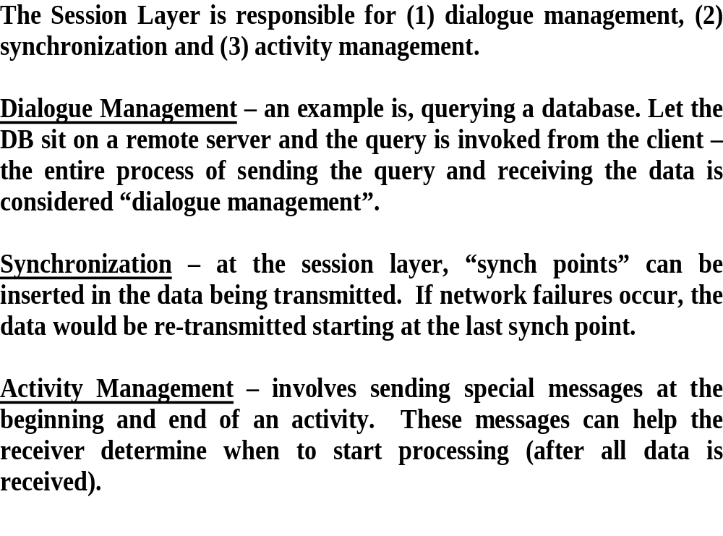
OSI Session Layer

Slide 12
OSI Presentation Layer
Provides format and code conversion services
Examples
  File conversion from ASCII to EBDIC
  Invoking character sequences to generate bold, italics, etc on a printer
The source and sink could operate using different encoding schemes – the presentation layer makes the translations
Security
Compression

Slide 13
OSI Application Layer
Provides access to network for end-user (end-user being a human being or software application)
User’s capabilities are determined by what items are available on this layer (ie. remote log-in, file transfer, email service, directory service, etc.)

Slide 14
What happens at the End and Intermediate Nodes ?
Tx
Rx
7
Intermediate Nodes
3
1
1
A
B
C
Q
T
Z

Slide 15

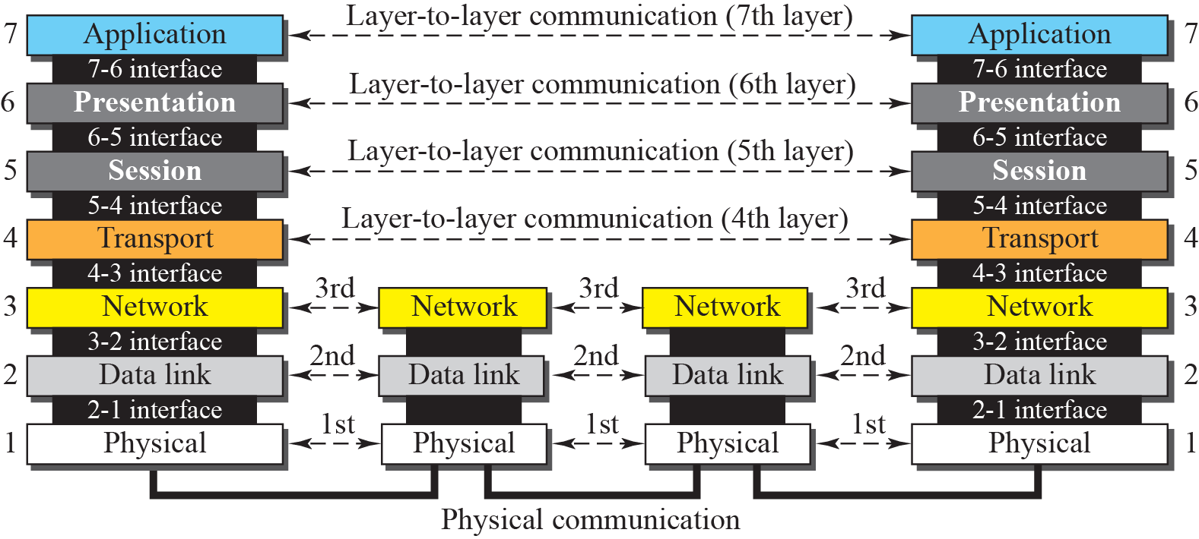
Recap - OSI’s Layered Approach
  between different layers on the same node or stack (INTERFACE)
  between similar layers on different nodes or stacks (PEER-TO-PEER PROCESSES)

Slide 16
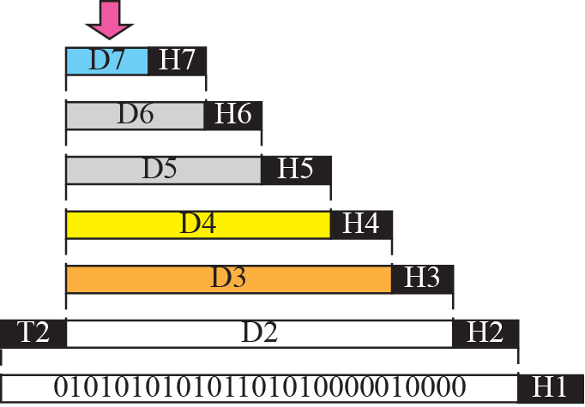


An exchange using the OSI model
Explain encapsulation and decapsulation

Slide 17
COMPLEXITY TO CONSIDER
Any particular node in an internetwork can be functioning as follows simultaneously:
Tx to other internetwork nodes
Rx from other internetwork nodes
Intermediate node to some other internetwork nodes

Slide 18
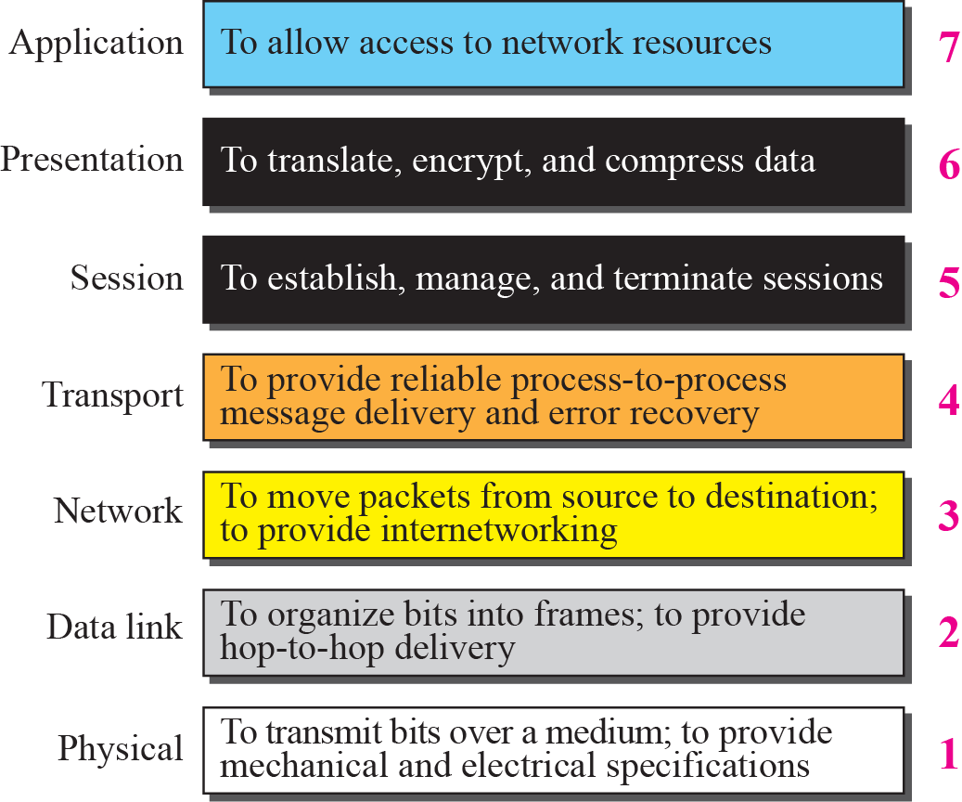
Summary of OSI Layers

Slide 19
OSI in Action: Outgoing File Transfer
The File Transfer Program issues a command to the Application Layer
Application passes it to Presentation, which may reformat, encrypt, encode, compress, passes to Session (adds overhead)
Session requests a connection, passes to Transport (adds overhead)
Transport breaks file into chunks, adds error-checking and flow-control info, process-to-process, passes to Network (adds overhead)
Network selects the data’s route (internetworking), passes to Data Link (adds overhead)
Data Link adds error-control and flow-control info, passes to Physical (adds overhead)
Physical translates bits to signal and transmits the signal, which includes information added by each layer

Slide 20
OSI in Action: Incoming File Transfer
Physical receives signal and translates to bits, passes to Data Link
Data Link checks for errors and performs flow control on bits, formulates bits into some formation (frames), passes to Network
Network verifies routing (if intermediate node, determines next hop), passes to Transport
Transport checks for errors and performs flow control on the chunks, reassembles the chunks, passes to Session
Session determines if transfer is complete, may end session, passes to Presentation
Presentation may reformat, perform conversions, decode, decrypt, decompress, pass to Application layer
Application presents results to user (e.g. updates FTP program display)

Slide 21
How TCP/IP Map to OSI ??
OSI
Application
Presentation
Session
Transport
Network
Data Link
Physical
Application
Transport
Internet or IP
Network Access
Physical
TCP/IP
Layers’ name differ source to source

Slide 22
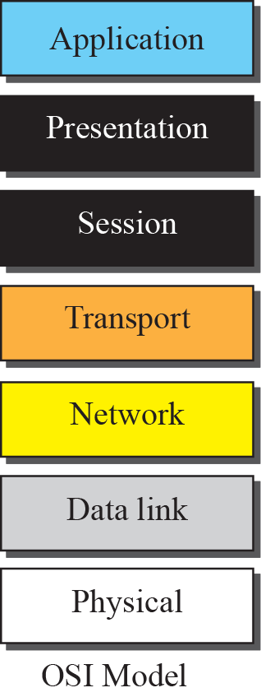
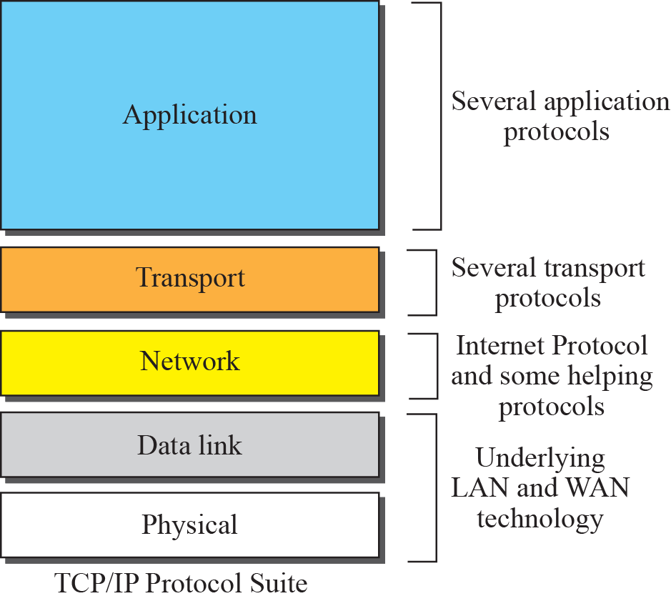
How TCP/IP maps to OSI ??

Slide 23
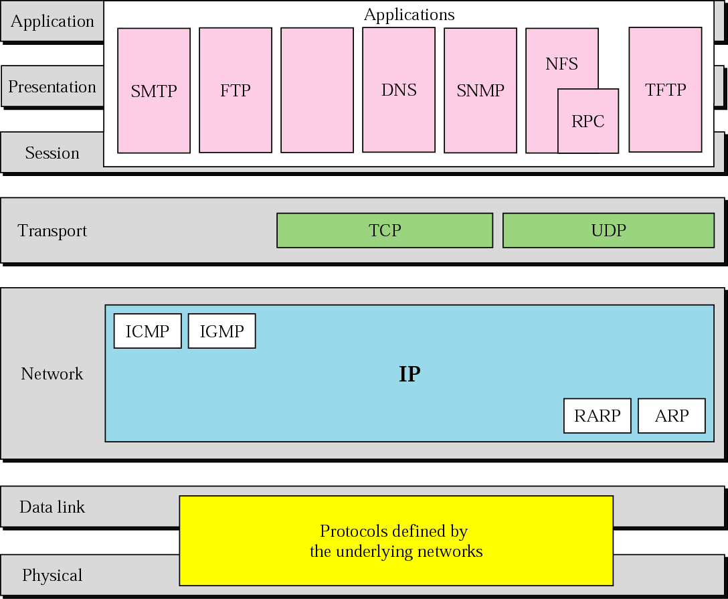
TCP/IP Model
Explain Suite and Stack Concept
SCTP
Protocols for different underlying technologies – this is key

