Slide 1
Secure SMTP Email Infrastructure
Charter / Spectrum Architecture Overview

Slide 2
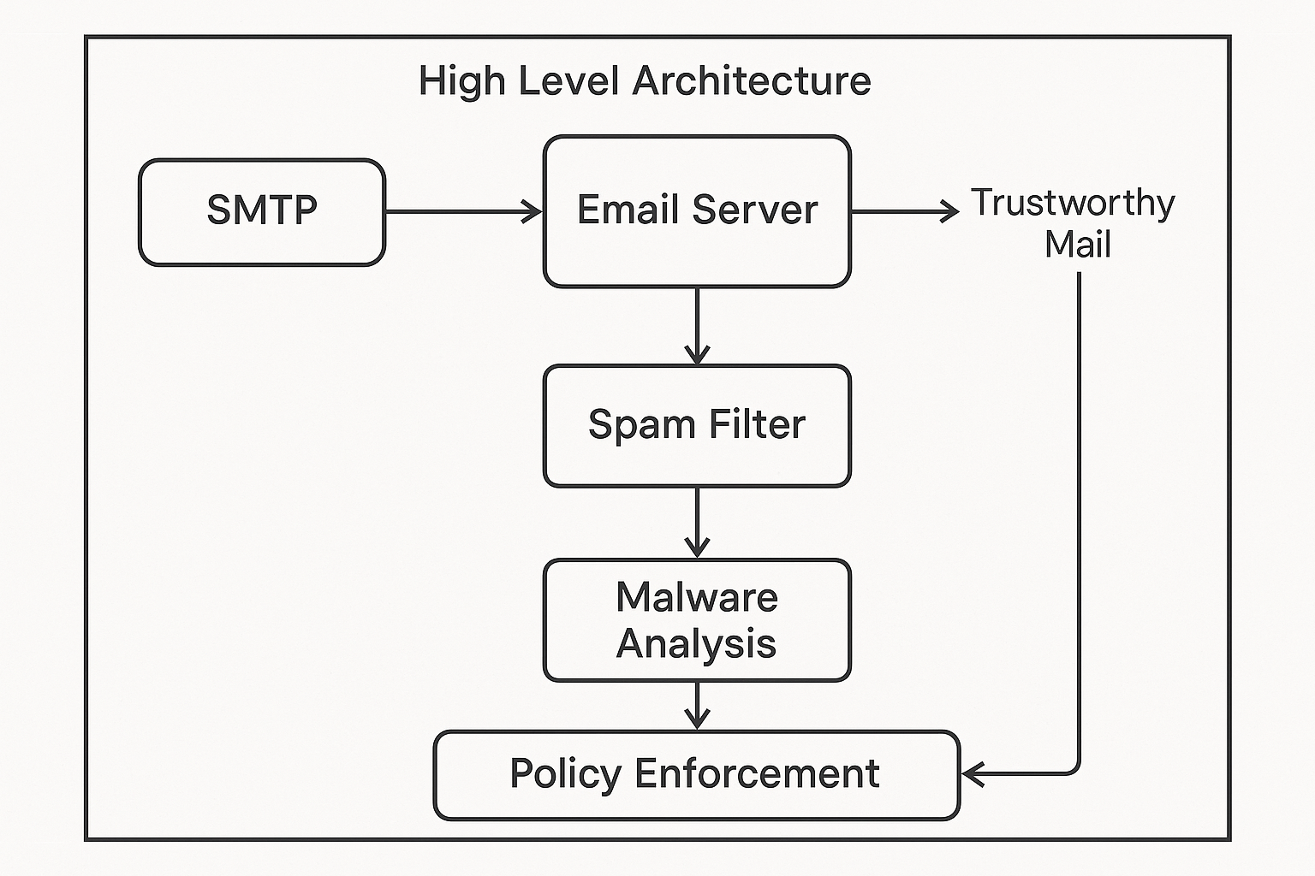
High-Level Architecture Diagram

Slide 3
SMTP Gateway Layer
Postfix, Exim, or Sendmail as SMTP proxy
TLS Enforcement using Let's Encrypt or Entrust
Rate Limiting, DNSBL integration

Slide 4
Inbound Email Server
Postfix or Exim for MTA, Dovecot/Cyrus for MDA
SPF, DKIM, DMARC enforcement
SMTP AUTH + SASL + TLS

Slide 5
Spam Filtering Cluster
SpamAssassin / Rspamd for scoring
ClamAV, Sophos AV, Greylisting
Custom heuristics and Bayesian learning

Slide 6
Malware Analysis
Cuckoo Sandbox for detonation
YARA Rules and AV scanning
File-type whitelisting and stripping

Slide 7
Policy Enforcement Engine
Custom rule engine (Lua, Go, Python)
Amavis or MailScanner quarantine
GeoIP, rate limits, behavior-based rules

Slide 8
Mailbox & User Access
Dovecot IMAP/POP3, PostgreSQL
Roundcube or SOGo for Webmail
OAuth2, MFA, role-based access

Slide 9
Monitoring and Threat Intel
SIEM (Splunk, Elastic, QRadar), MISP Threat Feeds
Syslog forwarding and alerting
Prometheus + Grafana for dashboards

Slide 10
Common Threats and Mitigations
Spoofed Emails → SPF/DKIM/DMARC
Malware Attachments → AV engines, sandboxing
Phishing Links → URL rewrite + SafeBrowsing
Brute-force Auth → TLS, OAuth2, 2FA
Insider Threats → SIEM, Logging, UEBA
Zero-Day Exploits → Heuristic filters + Feeds

Slide 11
Deployment Architecture (Roles)
smtp-gateway-1: Postfix + TLS proxy
filter-node-[N]: SpamAssassin, ClamAV, Policy engine
sandbox-node-[N]: Cuckoo Sandbox, AV, YARA
mailbox-backend: Dovecot, PostgreSQL
webmail-ui: Roundcube, OAuth2
siem-node: Splunk, Elastic, Threat Intel
monitoring-node: Prometheus, Grafana
admin-portal: Quarantine, policy UI

