Slide 1
Amazon EKS Overview & Comparison
Architecture, Best Practices, and EC2 Migration Considerations

Slide 2
What is Amazon EKS?
Amazon Elastic Kubernetes Service (EKS) is a managed Kubernetes service by AWS.
• AWS manages the control plane (multi-AZ, HA)
• Data plane runs in your VPC (EC2 or Fargate)
• Native AWS integrations: IAM, VPC CNI, ELB/NLB, EBS/EFS

Slide 3
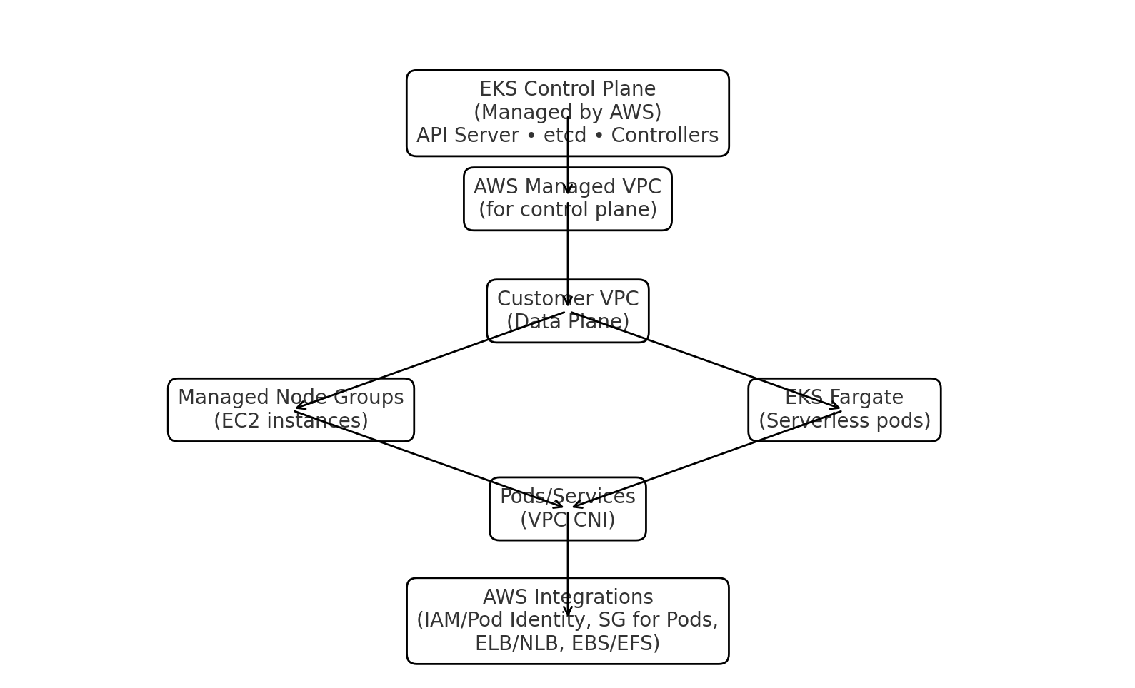
EKS Architecture

Slide 4
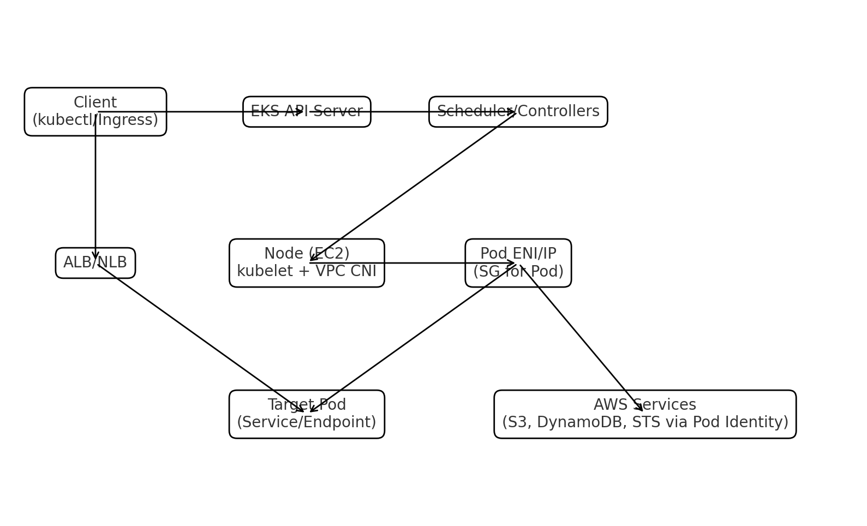
EKS Request/Networking Flow

Slide 5
Best Practices & Workload Fit
Best suited workloads:
• Cloud-native microservices needing AWS integration
• Event/data streaming with autoscaling (Karpenter)
• Security-sensitive workloads (per-pod IAM, SGs for Pods)
• Teams offloading ops of control plane
Avoid or consider alternatives:
• Very small/low-cost clusters (control-plane fee overhead)
• Highly customized control plane needs
• Heavy DaemonSet usage on Fargate

Slide 6
EKS vs EC2 Cluster Approaches
• EKS vs kops: EKS removes etcd/masters ops, adds per-cluster cost
• EKS vs kubeadm: EKS avoids bootstrap toil, adds limits on control-plane tuning
• EKS vs plain EC2 ASGs: EKS provides orchestration & per-pod IAM vs raw VM simplicity

Slide 7
What You Gain & Lose Moving to EKS
Gains:
• No master/etcd ops, built-in HA
• Native AWS networking (VPC CNI, SGs for Pods)
• Pod Identity per workload
• Fargate option for serverless pods
• Faster autoscaling (Karpenter/Auto Mode)
Losses:
• Less control over control plane tuning
• Limited CNI flexibility vs DIY
• Extra per-cluster cost

