Slide 1
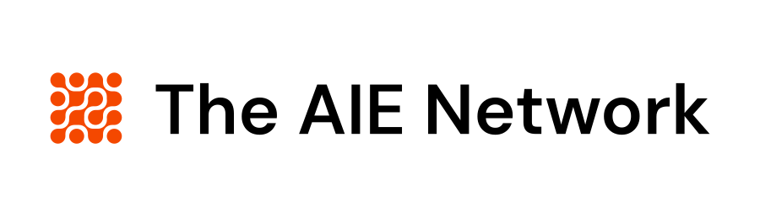
// AI PRIMER · 60 MINUTES
Selling with AI
Claude gives you superpowers, but only if you set it up. Here's how, and what to do this week.
Mark R. Hinkle
Publisher, The AIE Network · CEO, Peripety Labs
NOVEMBER 4, 2026
Notes:
Welcome. Say the time budget out loud and the promise. By the end you'll have seen three real prompts run on one live target account, and you'll know which one to run on your own tomorrow morning. Nothing to open, nothing to install. I drive, you watch and heckle, and you get every prompt afterward. Housekeeping: questions any time, I'd rather go off script than leave you behind.

Slide 2
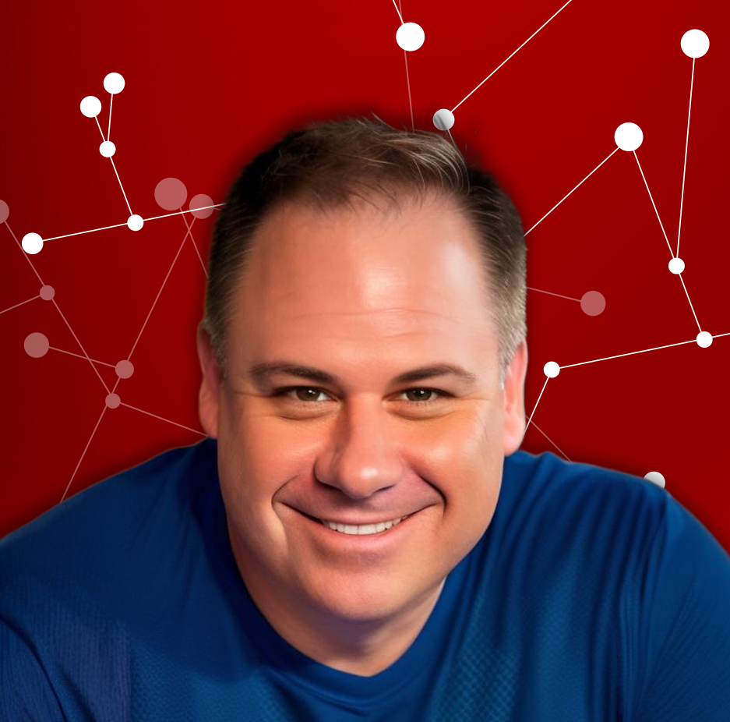
OPENING · 4 MIN · TALK
0:00 – 0:04
I've been on both sides of this table
Thirty years in enterprise tech: the dot-com run, open source, cloud, now AI
Ran marketing at cloud.com through the Citrix acquisition, ran the Node.js Foundation, co-founded TriggerMesh
Today I run Peripety Labs and publish The AIE Network, seven newsletters and the All Things AI conference
I still sell every day: sponsorships, tickets, consulting. Same quota pressure you have, smaller team
MARK R. HINKLE
FIT
TOOLS
FILES
SKILLS
RESEARCH
OUTREACH
CALLS
RULES
WEEK
MAIL
02 / 46
Notes:
One story, under a minute. The point to land: I'm not a vendor selling you an AI tool. I use these things to sell, and I've watched three platform shifts. Every time, the people who won weren't the earliest adopters. They were the ones who understood what the thing actually was before they bet their week on it.

Slide 3
OPENING · 4 MIN · TALK
0:00 – 0:04
The AI drafts. You send.
Everything today hangs off that sentence. Research, email, call prep, follow-up, proposals. The assistant does the reading and the first draft. Your name goes on it, so you read it and you hit send.
FIT
TOOLS
FILES
SKILLS
RESEARCH
OUTREACH
CALLS
RULES
WEEK
MAIL
03 / 46
Notes:
Say it twice. This is the rule that keeps the whole thing safe and useful at the same time. It isn't because the tools are bad. It's because it's your name and your relationship. If you remember one thing, remember this one.

Slide 4
OPENING · 4 MIN · TALK
0:00 – 0:04
Here's how we'll spend the time
CLOCK | BLOCK | WHAT | MIN | FORMAT
0:00 – 0:04 | OPENING | Opening | 4 | Talk
0:04 – 0:08 | BLOCK 1 | Where AI fits in a seller's week | 4 | Talk
0:08 – 0:16 | BLOCK 2 | Give Claude your tools | 8 | Talk
0:16 – 0:19 | BLOCK 3 | Set it up once, the three files | 3 | Talk
0:19 – 0:24 | BLOCK 4 | Teach it once with skills | 5 | Talk
0:24 – 0:30 | BLOCK 5 | Research an account in ten minutes | 6 | Live demo
0:30 – 0:38 | BLOCK 6 | Outreach with Prospector | 8 | Talk
0:38 – 0:41 | BLOCK 7 | Outreach that sounds like you | 3 | Talk
0:41 – 0:45 | BLOCK 8 | Before, during and after the call | 4 | Talk
0:45 – 0:48 | BLOCK 9 | The rules that keep you employed | 3 | Talk
0:48 – 0:50 | BLOCK 10 | Your first week | 2 | Talk
0:50 – 0:58 | BLOCK 11 | Put it all together, Chatterbuilt Mail | 8 | Live demo
0:58 – 1:00 | CLOSE | Close | 2 | Talk
FIT
TOOLS
FILES
SKILLS
RESEARCH
OUTREACH
CALLS
RULES
WEEK
MAIL
04 / 46
Notes:
Walk the agenda in thirty seconds. Flag the demo bits so people have a real target account in mind. Following along in their own assistant is optional; don't wait on them.

Slide 5
BLOCK 1 · WHERE AI FITS IN A SELLER'S WEEK · 4 MIN · TALK
0:04 – 0:08
About half of a seller's week isn't selling.
It's reading, looking things up, writing the same email a slightly different way, and typing into HubSpot or Salesforce. That half is what we're going after today.
FIT
TOOLS
FILES
SKILLS
RESEARCH
OUTREACH
CALLS
RULES
WEEK
MAIL
05 / 46
Notes:
Ask for a show of hands: who spent more than an hour yesterday on research, drafting, or CRM updates? Everybody. That's the target. We are not replacing the part where you build trust and read a room. We're buying that part more hours.

Slide 6
BLOCK 1 · WHERE AI FITS IN A SELLER'S WEEK · 4 MIN · TALK
0:04 – 0:08
What it's good at today, and what it isn't
GOOD AT
GOOD AT
NOT YET
NOT YET
Reading and summarizing
First drafts and rehearsal
Knowing your buyer
Judgment and relationships
A 10-K, forty job postings, a two-hour transcript. Faster than you, and it doesn't get tired. It does miss things, which is why the sources matter.
It has never met them. It doesn't know what was said at the last QBR unless you tell it.
Email, follow-ups, proposals, and playing the skeptical buyer so you can practice.
When to push, when to walk, who actually signs. That's still you, and it's the paid part.
FIT
TOOLS
FILES
SKILLS
RESEARCH
OUTREACH
CALLS
RULES
WEEK
MAIL
06 / 46
Notes:
Keep this honest. The tools are good at volume and language. They are bad at truth they haven't been given and at judgment. Think of a very well-read new hire on their first day: eager, fast, and knows nothing about your accounts until you tell them. Everything we do today is about telling them.

Slide 7
BLOCK 1 · WHERE AI FITS IN A SELLER'S WEEK · 4 MIN · TALK
0:04 – 0:08
You probably already own the tools
A general assistant: Claude, ChatGPT or Gemini. One is plenty. Use the paid company seat
A meeting recorder: Zoom's AI Companion or a recorder like Fireflies, or the one built into your video calls
Your CRM's assistant: HubSpot or Salesforce ships one now. It's fine for notes and summaries
Enrichment and sequencing: Apollo for the lists and sends. Keep the AI in the drafting seat
FIT
TOOLS
FILES
SKILLS
RESEARCH
OUTREACH
CALLS
RULES
WEEK
MAIL
07 / 46
Notes:
Resist the urge to buy anything this quarter. The general assistant plus a recorder gets you ninety percent of what we'll cover. The CRM copilots are good at the boring parts, which is exactly where you want them. Tool shopping is procrastination with a budget.

Slide 8
BLOCK 2 · GIVE CLAUDE YOUR TOOLS · 8 MIN · TALK
0:08 – 0:16
02
Give Claude your tools
Settings first. Connections before prompts.
FIT
TOOLS
FILES
SKILLS
RESEARCH
OUTREACH
CALLS
RULES
WEEK
MAIL
08 / 46
Notes:
Everything after this depends on the next ten minutes. A chatbot that can't see your inbox, your calendar or your CRM is a very smart stranger. Let's fix that first.

Slide 9
BLOCK 2 · GIVE CLAUDE YOUR TOOLS · 8 MIN · TALK
0:08 – 0:16
Claude gives you superpowers. Only if you set it up.
Out of the box it knows the internet. It doesn't know your accounts, your calendar or your pipeline.
FIT
TOOLS
FILES
SKILLS
RESEARCH
OUTREACH
CALLS
RULES
WEEK
MAIL
09 / 46
Notes:
Most people open Claude, type a question, get a generic answer and decide AI is overhyped. That's like hiring a great rep and never giving them a CRM login. The setup is twenty minutes, once. After that every chat starts with your tools, your files and your rules already loaded. That's the difference between a toy and a teammate.

Slide 10
BLOCK 2 · GIVE CLAUDE YOUR TOOLS · 8 MIN · TALK
0:08 – 0:16
Start in Settings, not in the chat box
Connectors
Plug in your tools
Gmail, calendar, CRM, Slack. Claude reads and drafts inside them.
Skills
Teach it how you work
Your voice, your ICP, your call prep. Loaded only when needed.
Projects
Keep the three files handy
Every chat in the project starts with them already read.
Chrome
Let it use the browser
For the sites that have no connector. You approve what happens.
FIT
TOOLS
FILES
SKILLS
RESEARCH
OUTREACH
CALLS
RULES
WEEK
MAIL
10 / 46
Notes:
Four places, and we'll take them in order. Connectors are the big one. Skills are how you stop explaining yourself. Projects hold the files we'll write in a minute. And Claude in Chrome covers every tool that doesn't have a connector yet, which in sales is a lot of them. Open Settings on your own screen while I talk if you want to follow along.

Slide 11
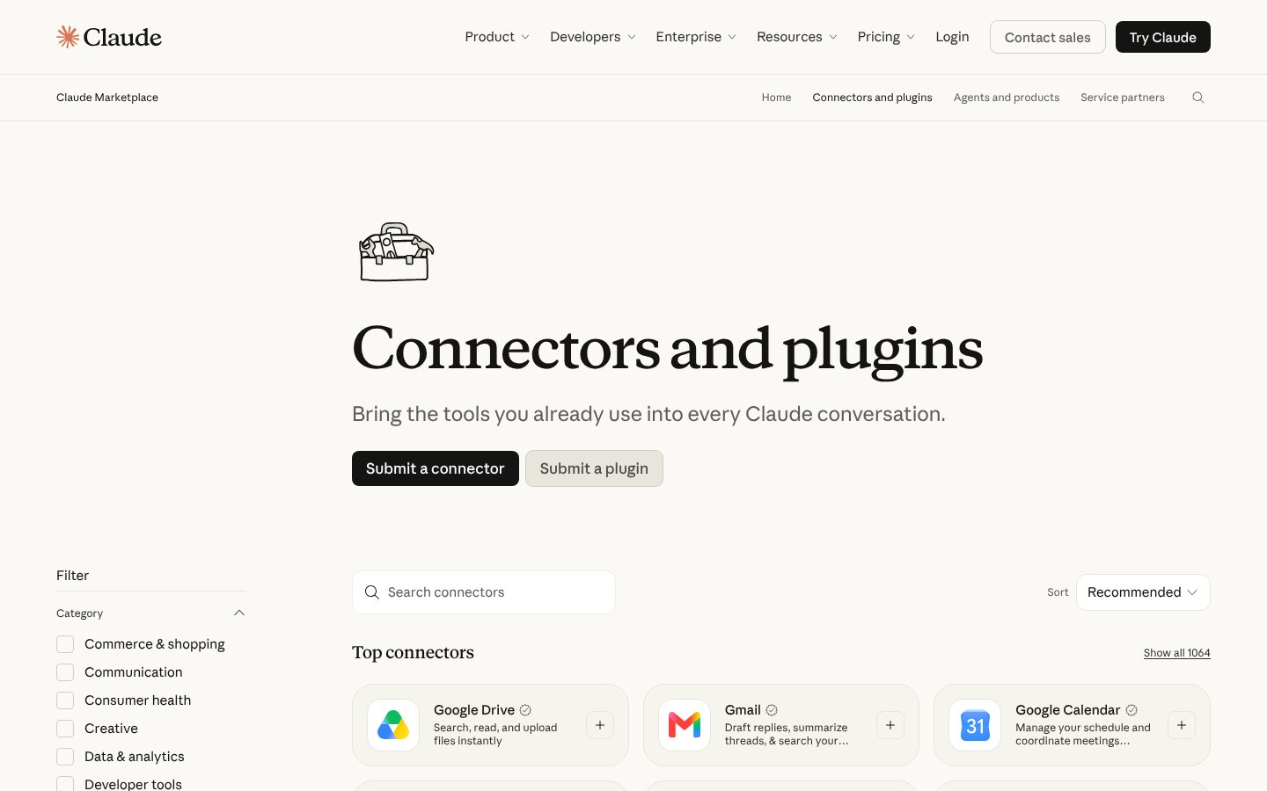
BLOCK 2 · GIVE CLAUDE YOUR TOOLS · 8 MIN · TALK
0:08 – 0:16
Turn on the connectors Claude already ships
Gmail, Google Calendar and Drive, or Microsoft 365 for Outlook and Teams
HubSpot, Slack, Notion and Zoom, each a one-click connect
Over a thousand more in the directory. Start with five
CLAUDE'S CONNECTORS DIRECTORY, CLAUDE.COM. NOVEMBER 2026
FIT
TOOLS
FILES
SKILLS
RESEARCH
OUTREACH
CALLS
RULES
WEEK
MAIL
11 / 46
Notes:
This is the directory. You get to it from Settings, then Connectors, then Browse. Click one, sign in with the account you already use, done. Start with email, calendar and your CRM. Those three alone change the research and follow-up we're about to do, because Claude can read the thread and the meeting instead of you pasting them in. Use your company account, and if IT controls connectors, ask them which ones are approved before you start clicking.

Slide 12
BLOCK 2 · GIVE CLAUDE YOUR TOOLS · 8 MIN · TALK
0:08 – 0:16
Connect the tools you already sell with
CRM
HubSpot or Salesforce
Account history before every call, notes after it.
Email and calendar
Gmail, Outlook
Read the thread, draft the reply, find the meeting.
Prospecting
Apollo
Lists, enrichment and sequences, from inside the chat.
Calls and team
Zoom, Fireflies, Slack
Transcripts in, recaps out, deal channels kept current.
FIT
TOOLS
FILES
SKILLS
RESEARCH
OUTREACH
CALLS
RULES
WEEK
MAIL
12 / 46
Notes:
Here's the map for a seller. CRM first, because that's where the truth about an account lives. HubSpot has a native connector. Salesforce and Apollo you can reach through Composio, which is next. Email and calendar second. Then whatever you prospect with and whatever records your calls. If your company uses something not on this slide, the question is the same: does it have a connector, and if not, can Composio or the browser reach it.

Slide 13
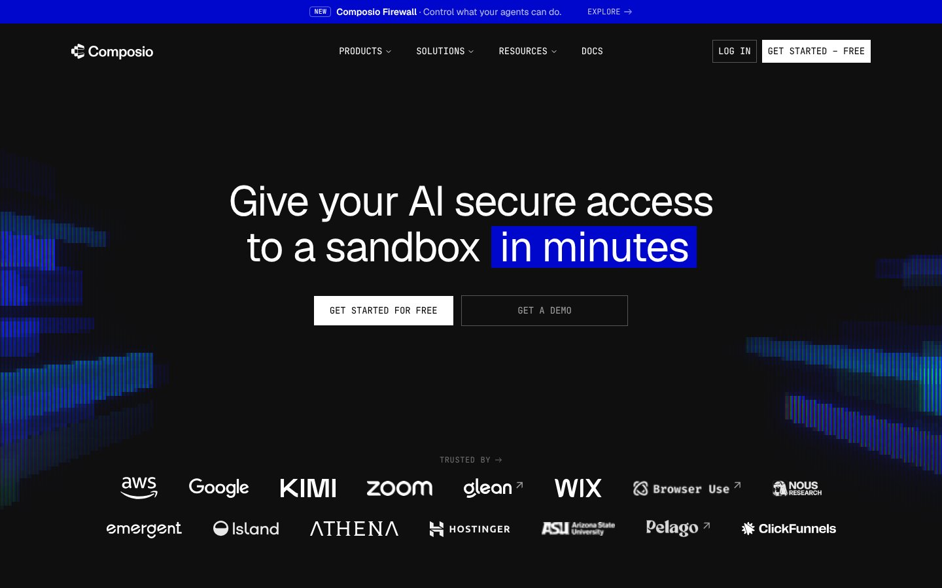
BLOCK 2 · GIVE CLAUDE YOUR TOOLS · 8 MIN · TALK
0:08 – 0:16
Or do what I do: Composio, everything in one place
One connection gives Claude access to over 1,500 tools
Salesforce, HubSpot, Gmail, LinkedIn and the long tail
Check with IT before connecting company systems
COMPOSIO, COMPOSIO.DEV. NOVEMBER 2026
FIT
TOOLS
FILES
SKILLS
RESEARCH
OUTREACH
CALLS
RULES
WEEK
MAIL
13 / 46
Notes:
This is what I run. Instead of connecting tools one at a time, Composio is one connector that brokers the rest, with the logins handled in one place. Their sales pitch is literally enrich a lead, draft the follow-up, book the meeting, across Salesforce, HubSpot, Gmail and LinkedIn. Native connectors are simpler and fine for most of you. Composio is for when your stack is bigger than the directory. Either way, company systems go through IT first.

Slide 14
BLOCK 3 · SET IT UP ONCE, THE THREE FILES · 3 MIN · TALK
0:16 – 0:19
Three files your assistant reads before every task
VOICE
ICP
PRODUCT
How you actually write
Who buys, who doesn't
[product] in the buyer's words
Five emails you were proud of. Three you'd never send. A line about how you talk to [buyer].
Company size, titles, the trigger events that make them call, and what disqualifies a lead on sight.
What it does, the three problems it fixes, proof you can name, and what you're not allowed to promise.
FIT
TOOLS
FILES
SKILLS
RESEARCH
OUTREACH
CALLS
RULES
WEEK
MAIL
14 / 46
Notes:
Plain text, each under a page. Keep them in whatever your assistant calls a project or a folder, so they load automatically. The voice file is the one people underestimate. Give it your real emails and it stops sounding like a brochure. The ICP file is what makes research and list-ranking useful. The product file keeps it from inventing features.

Slide 15
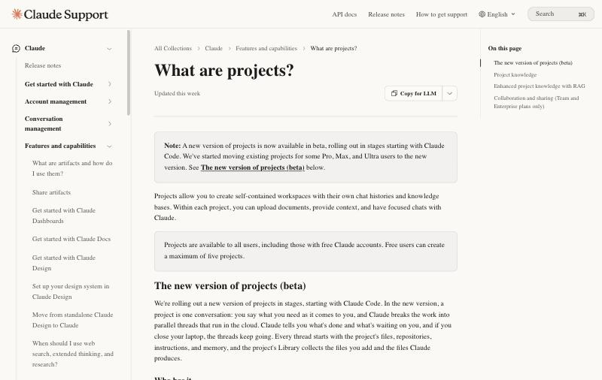
BLOCK 3 · SET IT UP ONCE, THE THREE FILES · 3 MIN · TALK
0:16 – 0:19
Put them where the assistant reads them every time
ChatGPT calls it a Project, Claude calls it a Project, Gemini calls it a Gem
Upload the three files once. Every new chat in that folder starts with them loaded
Use the company seat, so the files stay inside your company's account
CLAUDE PROJECTS, WHERE THE THREE FILES LIVE. NOVEMBER 2026
FIT
TOOLS
FILES
SKILLS
RESEARCH
OUTREACH
CALLS
RULES
WEEK
MAIL
15 / 46
Notes:
Show the folder feature in whichever assistant the room uses. The point is one-time setup: you never paste the three files again. If someone's company tool has no projects feature, a pinned chat with the three files pasted at the top works, it's just slower.

Slide 16
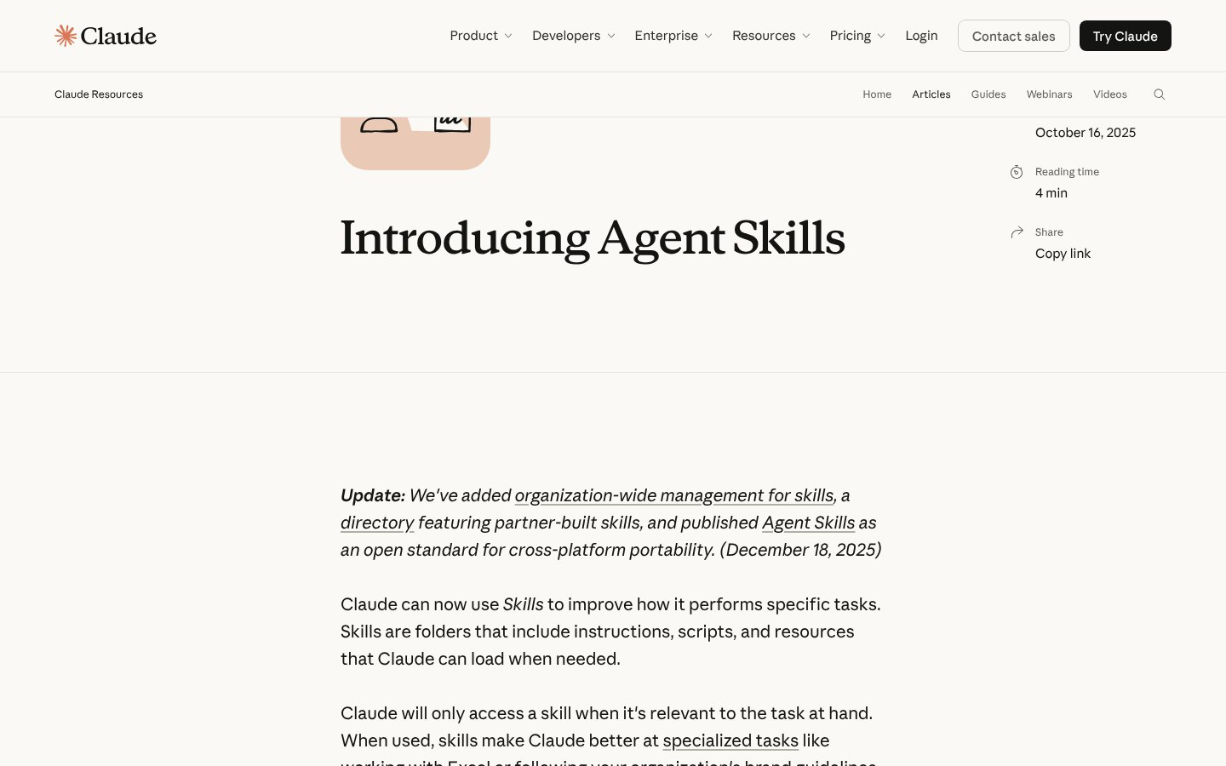
BLOCK 4 · TEACH IT ONCE WITH SKILLS · 5 MIN · TALK
0:19 – 0:24
Skills are how you stop explaining yourself
A folder of instructions Claude loads only when the task needs it
Write it once. It works in every chat, every project
Turn them on in Settings, or ask Claude to write one for you
INTRODUCING AGENT SKILLS, CLAUDE.COM. NOVEMBER 2026
FIT
TOOLS
FILES
SKILLS
RESEARCH
OUTREACH
CALLS
RULES
WEEK
MAIL
16 / 46
Notes:
A skill is a set of instructions, sometimes with a template or a script, that Claude pulls in when the task matches. Anthropic's own description is folders of instructions, scripts and resources Claude loads when needed. The easiest way to make one is to ask: "Turn my voice file into a skill." Then you never paste it again, and it only loads when you're writing.

Slide 17
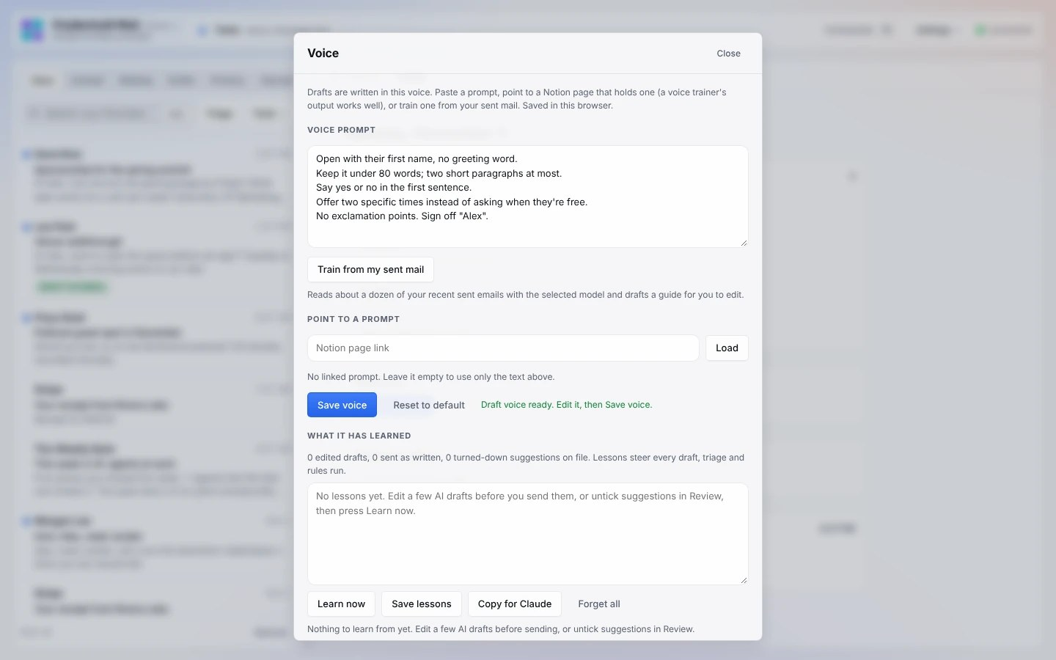
BLOCK 4 · TEACH IT ONCE WITH SKILLS · 5 MIN · TALK
0:19 – 0:24
Train it on your own sent mail
The email voice profile skill reads your recent sent email
It writes a one-page guide: tone, length, openers, words you never use
Every draft after that sounds like you, not a polite robot
TRAINING A VOICE FROM SENT MAIL, CHATTERBUILT MAIL. MADE-UP DATA. NOVEMBER 2026
FIT
TOOLS
FILES
SKILLS
RESEARCH
OUTREACH
CALLS
RULES
WEEK
MAIL
17 / 46
Notes:
This is the voice file, done for you. The skill reads about a dozen of your recent sent emails, skips the one-liners, and writes a short guide: how long you write, how you open and sign off, the words you use and the ones you never would. Read it, fix what's off, and from then on every draft starts from it. Out of the box, AI writes like a polite robot. Ten minutes of this and it writes like you.

Slide 18
BLOCK 4 · TEACH IT ONCE WITH SKILLS · 5 MIN · TALK
0:19 – 0:24
Three skills every seller should build first
01
02
03
My voice
Account brief
Call follow-up
Your best emails, the words you'd never use, how you handle a no.
The research steps, the sources, the UNVERIFIED rule.
Summary, email, CRM notes and tasks, in your team's headings.
FIT
TOOLS
FILES
SKILLS
RESEARCH
OUTREACH
CALLS
RULES
WEEK
MAIL
18 / 46
Notes:
These are the three files and two prompts you'll see today, packaged so Claude reaches for them on its own. Voice first, because every draft depends on it. The account brief is the research module in one skill. Follow-up is the one that saves the most time per week. Build one a day this week and you're done by Friday.

Slide 19
BLOCK 5 · RESEARCH AN ACCOUNT IN TEN MINUTES · 6 MIN · DEMO
0:24 – 0:30
05
Research an account in ten minutes
The brief you'd want before any first call, with links, from a company name.
FIT
TOOLS
FILES
SKILLS
RESEARCH
OUTREACH
CALLS
RULES
WEEK
MAIL
19 / 46
Notes:
This is the fastest payback in the whole session. Most reps either skip research or spend an hour on it. Ten minutes, every time, is the goal.

Slide 20
BLOCK 5 · RESEARCH AN ACCOUNT IN TEN MINUTES · 6 MIN · DEMO
0:24 – 0:30
Collect, brief, verify, then one sentence on why now
01
02
03
04
Collect
Brief
Verify
Why now
Their site, latest news, open job postings, the annual report if public, and the LinkedIn pages for your two or three contacts.
One prompt, with your ICP and product files loaded, produces the page.
Every claim gets a link. No link, no claim. Fix the two things it got wrong.
One line you could say out loud: the trigger, the likely pain, your angle.
FIT
TOOLS
FILES
SKILLS
RESEARCH
OUTREACH
CALLS
RULES
WEEK
MAIL
20 / 46
Notes:
Collect is where most of the ten minutes goes, and it's mostly copy and paste. If your assistant can browse, let it, but still paste the job postings. Hiring is the best public signal of what a company is about to do. Verify is non-negotiable. The brief is a draft, not a fact sheet, until you've clicked the links.

Slide 21
BLOCK 5 · RESEARCH AN ACCOUNT IN TEN MINUTES · 6 MIN · DEMO
0:24 – 0:30
The account brief prompt
TYPE THIS, VERBATIM
Build a one-page account brief on [Company]. Use my ICP and product files.
Sources attached: [paste or link site, news, job posts, filings, contact profiles].
Sections: what they do and how they make money; what changed in the last six months;
what they're hiring for and what that says; who my contacts are and what they care about;
where [product] plausibly fits, in their words; three discovery questions; one "why now" sentence.
Cite a source for every factual claim. If you can't source it, mark it UNVERIFIED.
FIT
TOOLS
FILES
SKILLS
RESEARCH
OUTREACH
CALLS
RULES
WEEK
MAIL
21 / 46
Notes:
Read the last line out loud. UNVERIFIED in capital letters is the whole trick. The model will tell you what it's unsure of if you give it permission. Then the brief becomes a to-do list for your own checking instead of a trap. I'll paste each prompt in the chat as I run it; they're all in the repo. Nobody needs to transcribe a slide.

Slide 22
BLOCK 5 · RESEARCH AN ACCOUNT IN TEN MINUTES · 6 MIN · DEMO
0:24 – 0:30
Watch me do it on a real target account.
Ten minutes on the clock. Collect, run the prompt, click two links, write the "why now" sentence.
FIT
TOOLS
FILES
SKILLS
RESEARCH
OUTREACH
CALLS
RULES
WEEK
MAIL
22 / 46
Notes:
Screen share. Run the prompt from the last slide on the target account, thinking out loud. When UNVERIFIED markers show up, stop and point at them; that's the moment to land. Click one link live, fix one wrong thing, then say the "why now" sentence in your own words. If the assistant stalls, read the prepared brief instead and keep moving.

Slide 23
BLOCK 5 · RESEARCH AN ACCOUNT IN TEN MINUTES · 6 MIN · DEMO
0:24 – 0:30
Four things it gets wrong, and how you catch them
Stale people. Titles change. Check the two contacts on LinkedIn before you mention them
Look-alike companies. Two firms with similar names get blended. Confirm the domain
Invented numbers and quotes. If you can't click to it, it didn't happen
Trigger events that are old news. Check the date on anything it calls recent
FIT
TOOLS
FILES
SKILLS
RESEARCH
OUTREACH
CALLS
RULES
WEEK
MAIL
23 / 46
Notes:
These four cover almost every embarrassing research mistake I've seen. They take ninety seconds to check and they are the difference between sounding prepared and sounding like you used a bot. Which is exactly what the buyer is listening for right now.

Slide 24
BLOCK 6 · OUTREACH WITH PROSPECTOR · 8 MIN · TALK
0:30 – 0:38
06
Outreach that sounds like you
Prospector finds who to talk to and why now. You send.
FIT
TOOLS
FILES
SKILLS
RESEARCH
OUTREACH
CALLS
RULES
WEEK
MAIL
24 / 46
Notes:
Research gives you one great account. Outreach is doing that every day without losing your voice or your LinkedIn account. This is where the Prospector skills come in.

Slide 25
BLOCK 6 · OUTREACH WITH PROSPECTOR · 8 MIN · TALK
0:30 – 0:38
Prospector: who to talk to, and why now
icp
Define who fits
The ideal customer profile and a fit-times-timing score.
signals
Rank this week's reasons
Job posts, press, intent and Sales Navigator alerts, ranked.
qualify
Research with sources
Sourced facts on each account. No fabrication.
draft
Write in your voice
Drafts go into a queue. Nothing is sent.
queue
You approve
What's waiting, today's caps, mark it sent or drop it.
FIT
TOOLS
FILES
SKILLS
RESEARCH
OUTREACH
CALLS
RULES
WEEK
MAIL
25 / 46
Notes:
Prospector is a set of skills I built for Claude, and it runs the same loop we just did by hand. ICP first, so it knows who fits. Signals, so every message has a reason to exist this week. Qualify does the research with a source on every fact. Draft writes from your voice skill. And then everything lands in a queue. You read it, you send it. That's the rule, built into the tool.

Slide 26
BLOCK 6 · OUTREACH WITH PROSPECTOR · 8 MIN · TALK
0:30 – 0:38
The guardrails are in the code, not a promise
01
02
03
04
It never sends
LinkedIn stays yours
Paced and capped
Email law built in
Every draft waits in the approval queue for you.
Clicks that connect, post or message are blocked outright.
Quiet hours, daily caps, a suppression list.
CAN-SPAM, GDPR, CASL and the platforms' own terms.
FIT
TOOLS
FILES
SKILLS
RESEARCH
OUTREACH
CALLS
RULES
WEEK
MAIL
26 / 46
Notes:
This is the part I care about most. The browser helper reads at a human pace and is blocked from any click that would send, connect, post or comment on LinkedIn, X or Reddit. Daily caps and a suppression list live in the queue. The compliance skill knows the email rules by country. You can't accidentally get your account restricted or spam a list, because the tool won't let you.

Slide 27
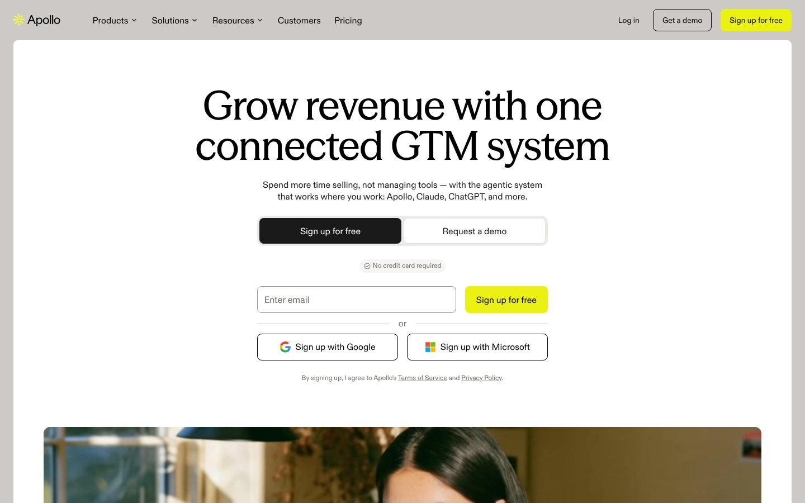
BLOCK 6 · OUTREACH WITH PROSPECTOR · 8 MIN · TALK
0:30 – 0:38
Apollo already works where Claude works
Lists, enrichment and sequences without leaving the chat
Connect it through Apollo's Claude integration or Composio
Your ICP decides who goes on the list
APOLLO, APOLLO.IO. NOVEMBER 2026
FIT
TOOLS
FILES
SKILLS
RESEARCH
OUTREACH
CALLS
RULES
WEEK
MAIL
27 / 46
Notes:
Apollo is built to be driven from Claude now; their own homepage says it works where you work, and lists Claude by name. Prospector uses it for enrichment, in cost order, with the source of every field kept. The ICP is what keeps it from pulling every VP with a pulse.

Slide 28
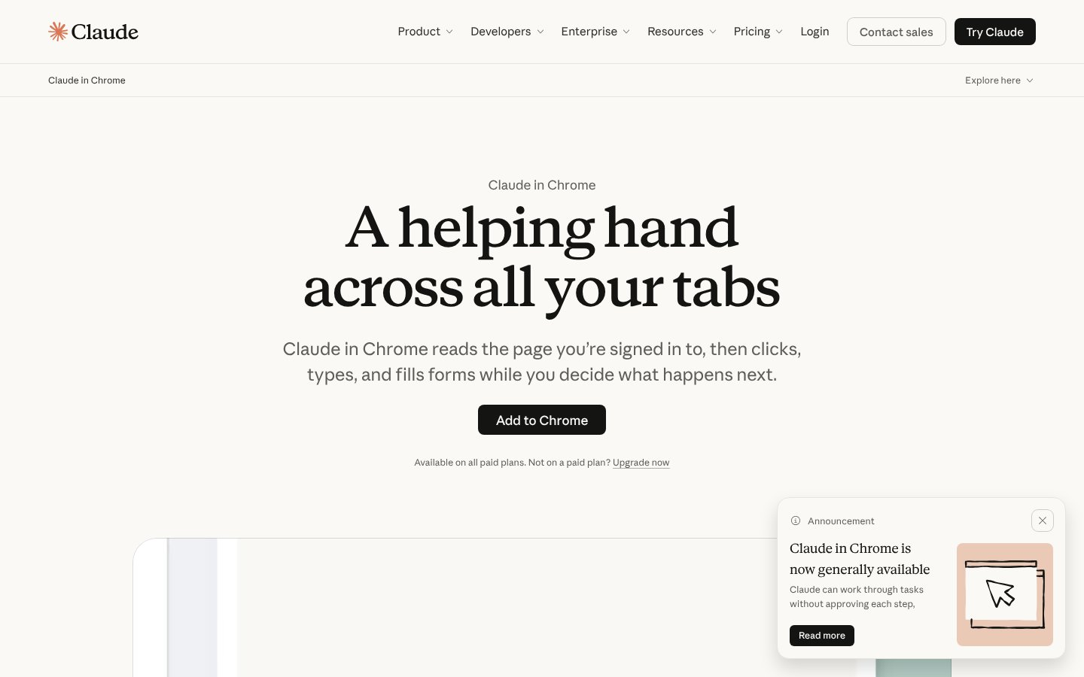
BLOCK 6 · OUTREACH WITH PROSPECTOR · 8 MIN · TALK
0:30 – 0:38
No connector? Claude uses the browser
Claude in Chrome reads the page, clicks, types and fills forms
It works in the tools you're already signed in to
You decide what happens next. Sending stays with you
CLAUDE IN CHROME, CLAUDE.COM. NOVEMBER 2026
FIT
TOOLS
FILES
SKILLS
RESEARCH
OUTREACH
CALLS
RULES
WEEK
MAIL
28 / 46
Notes:
This is computer use, in the browser you already have. Claude reads the page you're signed in to and does the clicking: build the Apollo list, load the sequence, update the CRM record. It's on every paid plan. Prospector's browser helper runs here, paced, and never sends.

Slide 29
BLOCK 6 · OUTREACH WITH PROSPECTOR · 8 MIN · TALK
0:30 – 0:38
Outreach with Claude driving and you approving
01
02
03
04
Signals
Qualify
Draft
You send
Prospector ranks who has a reason to talk this week.
Sourced brief per account, from connectors and Apollo.
Your voice skill writes three short emails per person.
Read the first send to each person. Then let it run.
FIT
TOOLS
FILES
SKILLS
RESEARCH
OUTREACH
CALLS
RULES
WEEK
MAIL
29 / 46
Notes:
Here's the whole thread end to end, and I'll run it live on one account. Signals pick the account. Qualify builds the brief with sources. Draft writes it in your voice. Then it stops and waits for you in the queue. The automation does the sorting and the drafting. You approve the first send to every person, and every LinkedIn step is yours.

Slide 30
BLOCK 7 · OUTREACH THAT SOUNDS LIKE YOU · 3 MIN · TALK
0:38 – 0:41
The same email, before and after the brief
BEFORE, FROM A COLD TEMPLATE
AFTER, FROM THE BRIEF AND THE VOICE FILE
Hi Sarah, I hope this finds you well. I'm reaching out because [company] helps organizations like yours unlock value with [product]. Leading companies trust us to drive outcomes. I'd love to find 30 minutes to share how we can help Acme accelerate its journey. Are you free next week?
Sarah, your team posted four platform roles last month, which usually means the Kubernetes footprint just got bigger than one person can watch. What are you trying to fix first with it?
Happy to point you at the right docs, or 20 minutes if talking is easier. If it's not on your radar, say so and I'll stop.
FIT
TOOLS
FILES
SKILLS
RESEARCH
OUTREACH
CALLS
RULES
WEEK
MAIL
30 / 46
Notes:
Read both out loud. The left one could have been sent by any company to any company. The right one proves homework in the first sentence, asks one real question, and makes "no" a free answer. Say up front that the left one was written to be bad on purpose; every phrase in it is from a real vendor email. Same model wrote both. The difference is what it was given.

Slide 31
BLOCK 7 · OUTREACH THAT SOUNDS LIKE YOU · 3 MIN · TALK
0:38 – 0:41
Nothing goes out that you didn't read. Not because the AI is bad. Because it's your name.
FIT
TOOLS
FILES
SKILLS
RESEARCH
OUTREACH
CALLS
RULES
WEEK
MAIL
31 / 46
Notes:
Say it plainly and move on. People remember the short version.

Slide 32
BLOCK 8 · BEFORE, DURING AND AFTER THE CALL · 4 MIN · TALK
0:41 – 0:45
08
Before, during and after the call
Prep in five minutes, listen instead of typing, follow up before lunch.
FIT
TOOLS
FILES
SKILLS
RESEARCH
OUTREACH
CALLS
RULES
WEEK
MAIL
32 / 46
Notes:
The call is where the relationship happens, so the assistant stays out of the room. It earns its keep on either side of it.

Slide 33
BLOCK 8 · BEFORE, DURING AND AFTER THE CALL · 4 MIN · TALK
0:41 – 0:45
Five minutes before, nothing during, ten minutes after
01
02
03
Before
During
After
From the brief: five discovery questions, the two objections you'll hear, who's in the room and what each one cares about.
Recorder on, with consent. You look at the person, not the keyboard. Your notes are three words and a star.
Transcript in, out comes the summary, the follow-up email in your voice, the CRM notes, the tasks with dates.
FIT
TOOLS
FILES
SKILLS
RESEARCH
OUTREACH
CALLS
RULES
WEEK
MAIL
33 / 46
Notes:
Ask for consent on recording every time; most teams already do. The "during" box is the point: the best sellers in the room already don't take notes. Now nobody has to. After the call, ten minutes, before you open the next tab, or the follow-up slides to tomorrow and the energy is gone. Preview of the rules: a transcript is customer data, so the demo uses a redacted one in the company's approved tool.

Slide 34
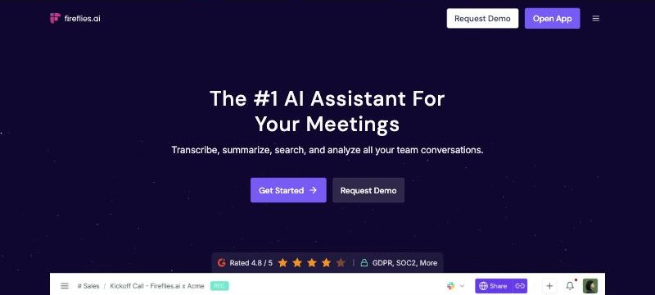
BLOCK 8 · BEFORE, DURING AND AFTER THE CALL · 4 MIN · TALK
0:41 – 0:45
The recorder is the only new tool most of you need
Zoom's AI Companion or a recorder like Fireflies: it joins the call, you get the transcript
Ask for consent at the top of every call, every time
The transcript goes into the company-approved assistant, never a free one
FIREFLIES.AI, ONE OF THE MEETING RECORDERS. NOVEMBER 2026
FIT
TOOLS
FILES
SKILLS
RESEARCH
OUTREACH
CALLS
RULES
WEEK
MAIL
34 / 46
Notes:
Any recorder works: the one built into Zoom, Teams or Meet, or a standalone one like Fireflies or Gong. What matters is that you stop typing during the call and that the transcript lands somewhere approved. Consent is a sentence: "I'm recording so I can pay attention instead of taking notes, okay with you?"

Slide 35
BLOCK 8 · BEFORE, DURING AND AFTER THE CALL · 4 MIN · TALK
0:41 – 0:45
Follow up in ten minutes from the transcript
TYPE THIS, VERBATIM
Here's the transcript of my call with [Company]. [paste]
Produce four things: a 5-line summary in my words; a follow-up email in my voice that restates what
they said they need, confirms the next step and date, and asks nothing new; CRM notes under
"Pain, Timeline, Budget, Decision process, Competition, Next step"; and a task list with owners
and dates. Flag anything they said that contradicts our account brief.
FIT
TOOLS
FILES
SKILLS
RESEARCH
OUTREACH
CALLS
RULES
WEEK
MAIL
35 / 46
Notes:
The structure for CRM notes is whatever your team uses. Change the six headings to match HubSpot or Salesforce. The contradiction flag at the end is the quiet win: it catches the moment the buyer told you something that changes the deal and you were too busy listening to write it down.

Slide 36
BLOCK 9 · THE RULES THAT KEEP YOU EMPLOYED · 3 MIN · TALK
0:45 – 0:48
09
The rules that keep you employed
Four of them. None are complicated.
FIT
TOOLS
FILES
SKILLS
RESEARCH
OUTREACH
CALLS
RULES
WEEK
MAIL
36 / 46
Notes:
Short module, serious tone. These aren't legal boilerplate. Every one of them is a story I've watched happen to someone.

Slide 37
BLOCK 9 · THE RULES THAT KEEP YOU EMPLOYED · 3 MIN · TALK
0:45 – 0:48
Four rules
01
02
03
04
Some things never go in
Use the company seat
Check before you trust
It never sends
Customer confidential data, personal data beyond a name and title, unreleased pricing or roadmap. Unless your company's tool is approved for it, it stays out.
The team or business account has the retention and training settings your admin set. Your personal login doesn't.
Names, numbers, dates, quotes. If you'd be embarrassed to be wrong about it, click the source.
A working unsubscribe and your postal address on every sequence, by law. The assistant drafts. A person reads and sends.
FIT
TOOLS
FILES
SKILLS
RESEARCH
OUTREACH
CALLS
RULES
WEEK
MAIL
37 / 46
Notes:
Rule one is the one people break by accident, usually by pasting a whole transcript with a customer's architecture in it into a free consumer tool. Ask your security team which tool is approved and what can go in it. Rule two is the fix for most of rule one. Rule four has a legal half: every commercial email needs a working unsubscribe and a real postal address, and the sequencer handles both if the template is set up right. Check with ops before the first send. The other half you've heard all session.

Slide 38
BLOCK 9 · THE RULES THAT KEEP YOU EMPLOYED · 3 MIN · TALK
0:45 – 0:48
At 99 percent accuracy, a thousand automated sends is ten mistakes with your signature on them.
Errors compound at machine speed. The human gate is the circuit breaker.
FIT
TOOLS
FILES
SKILLS
RESEARCH
OUTREACH
CALLS
RULES
WEEK
MAIL
38 / 46
Notes:
This is why the one rule exists. I'm not claiming models are 99 percent accurate; even if they were, the math still gets you. A model that's right 99 times out of 100 feels perfect in a demo. Run it unattended across a thousand contacts and the ten bad ones are the ones that get forwarded. Keep the person in the loop where the name goes on it.

Slide 39
BLOCK 10 · YOUR FIRST WEEK · 2 MIN · TALK
0:48 – 0:50
10
Your first week
One workflow, every day, for two weeks. Then add the next one.
FIT
TOOLS
FILES
SKILLS
RESEARCH
OUTREACH
CALLS
RULES
WEEK
MAIL
39 / 46
Notes:
Don't try to do all of this Monday. Pick one. The research brief is the usual winner because it pays off on the very first call.

Slide 40
BLOCK 10 · YOUR FIRST WEEK · 2 MIN · TALK
0:48 – 0:50
Five days, one habit each
Day 1
Build the three files
Voice, ICP, product. Twenty minutes. Save them where your assistant loads them automatically.
Day 2
Brief three accounts
Ten minutes each. Click the links. Write the "why now" sentence for each.
Day 3
Rewrite one sequence
Three emails, under ninety words each, in your voice. Approve the first send yourself.
Day 4
Record one call
Prep sheet before, recorder on, follow-up and CRM notes sent inside ten minutes.
Day 5
Review your toughest deal
Run the skeptic prompt. Take the one action it names.
FIT
TOOLS
FILES
SKILLS
RESEARCH
OUTREACH
CALLS
RULES
WEEK
MAIL
40 / 46
Notes:
Point, don't read. Each day is a module from today. By Friday they've done every workflow once on real accounts. Then they pick the one that paid off most and make it daily.

Slide 41
BLOCK 11 · PUT IT ALL TOGETHER, CHATTERBUILT MAIL · 8 MIN · DEMO
0:50 – 0:58
11
Put it all together: Chatterbuilt Mail
Connectors, skills and your voice, in one inbox.
FIT
TOOLS
FILES
SKILLS
RESEARCH
OUTREACH
CALLS
RULES
WEEK
MAIL
41 / 46
Notes:
Everything we've covered, the connectors, the skills, the voice file, the rule that you send, running in one place. This is my inbox.

Slide 42
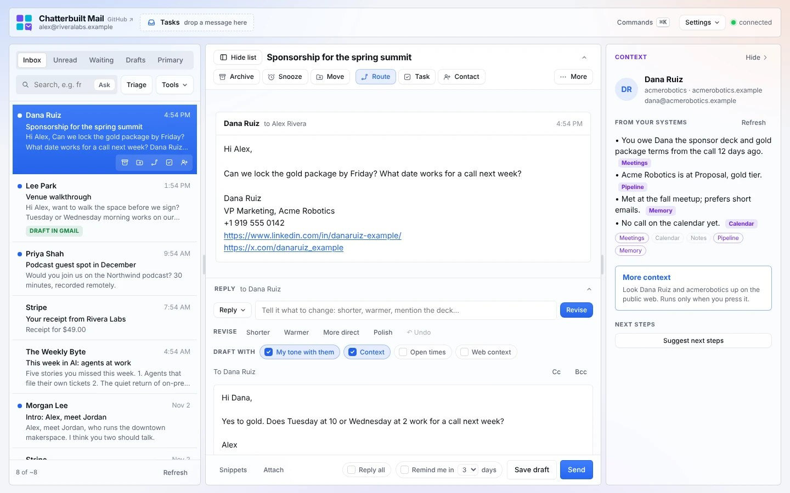
BLOCK 11 · PUT IT ALL TOGETHER, CHATTERBUILT MAIL · 8 MIN · DEMO
0:50 – 0:58
Chatterbuilt Mail reads the room before you reply
Open a thread. It shows what your CRM, calendar and notes know
Drafts in your voice, then checks it before you hit Send
Nothing sends, moves or files until you click
CHATTERBUILT MAIL, THE PRE-SEND CHECK. MADE-UP DATA. NOVEMBER 2026
FIT
TOOLS
FILES
SKILLS
RESEARCH
OUTREACH
CALLS
RULES
WEEK
MAIL
42 / 46
Notes:
Full disclosure, this one's mine, and it's free and open source. I built it because I've never once been caught up on email. It's a private Claude artifact on top of Gmail. Open a thread and the panel on the right tells you what you owe this person, where the deal stands, when you last met, and every line names its source. Then it drafts a reply that sounds like me, and right before Send it reminds me about the deck I promised.

Slide 43
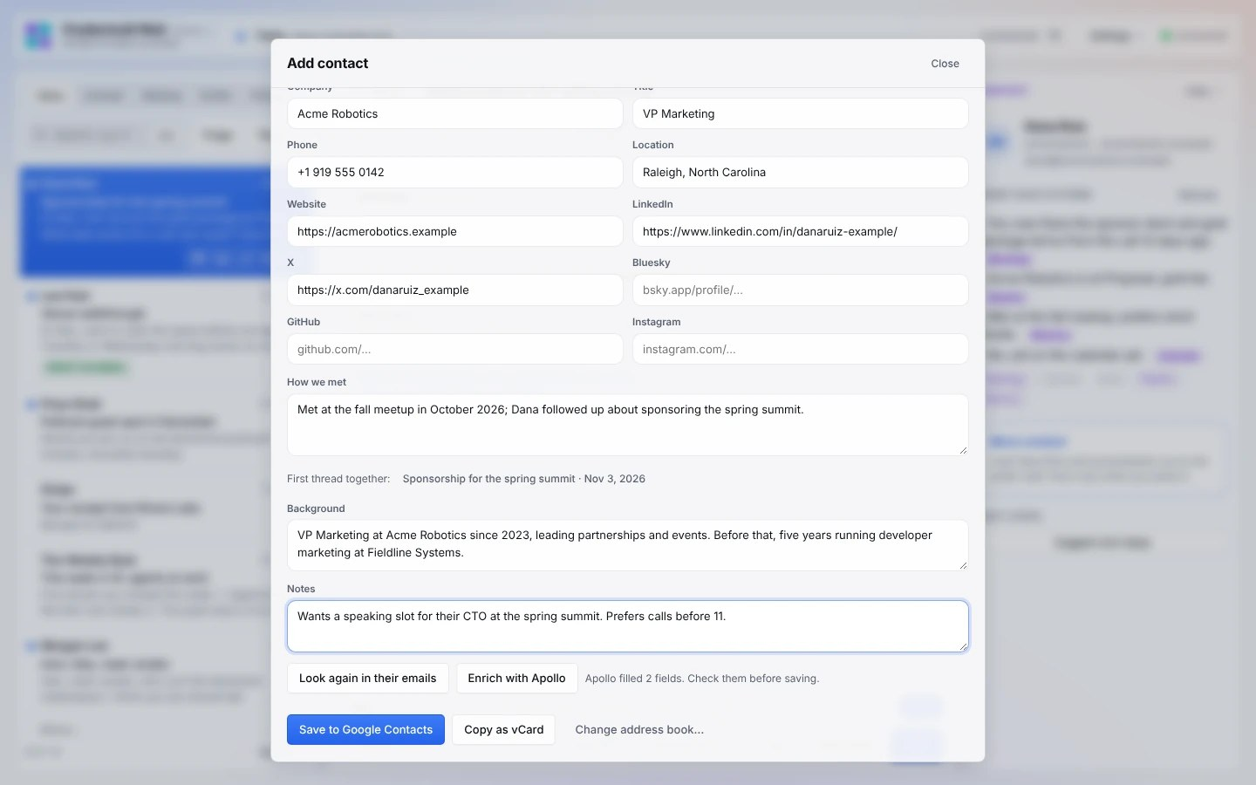
BLOCK 11 · PUT IT ALL TOGETHER, CHATTERBUILT MAIL · 8 MIN · DEMO
0:50 – 0:58
Every contact gets the whole picture
How you met, from your first email together
Title, company and history, enriched with Apollo or Clay
Saved to your address book or your CRM after you check it
CHATTERBUILT MAIL, ADDING A CONTACT WITH APOLLO ENRICHMENT. MADE-UP DATA. NOVEMBER 2026
FIT
TOOLS
FILES
SKILLS
RESEARCH
OUTREACH
CALLS
RULES
WEEK
MAIL
43 / 46
Notes:
This is the part sellers like. Add contact reads their signature, finds your first thread together and writes how you met. Enrich with Apollo fills in the rest. You check it, then it saves to Google Contacts or your CRM. Ten seconds instead of ten minutes of copying fields.

Slide 44
BLOCK 11 · PUT IT ALL TOGETHER, CHATTERBUILT MAIL · 8 MIN · DEMO
0:50 – 0:58
Watch it work my inbox.
Triage, a draft in my voice, the pre-send check. Nothing sends without me.
FIT
TOOLS
FILES
SKILLS
RESEARCH
OUTREACH
CALLS
RULES
WEEK
MAIL
44 / 46
Notes:
Screen share Chatterbuilt Mail, in read-only mode if you're nervous. Run Triage and read two of the reasons out loud. Open a thread with a real person in your CRM, point at the context panel, and click one source. Draft a reply, ask for it shorter, then let the pre-send check flag something. Add one contact and press Enrich with Apollo. Don't send anything. The install prompt is in the repo; anyone with the Gmail connector can have it running today.

Slide 45
CLOSE · 2 MIN · TALK
0:58 – 1:00
Everything from today lives in one place
The one rule, one more time: the AI drafts. You send.
The repository
Questions after today
github.com/mrhinkle/ai-for-sales-training
mrhinkle@peripety.com
The deck, the speaker notes, every prompt you saw, and how to point your own assistant at it.
Reply with the account you briefed and I'll read it.
The AIE Network
All Things AI
theaie.net
allthingsai.org
Seven newsletters, four mornings a week, on using AI at work.
The conference in Durham, April 18 to 20, 2027.
FIT
TOOLS
FILES
SKILLS
RESEARCH
OUTREACH
CALLS
RULES
WEEK
MAIL
45 / 46
Notes:
Give them the link and tell them the folder is built to be read by a chatbot, not just a person. "Open the repo, paste the prompts folder into your assistant, tell it who you sell to." Then take questions for whatever time is left.

Slide 46
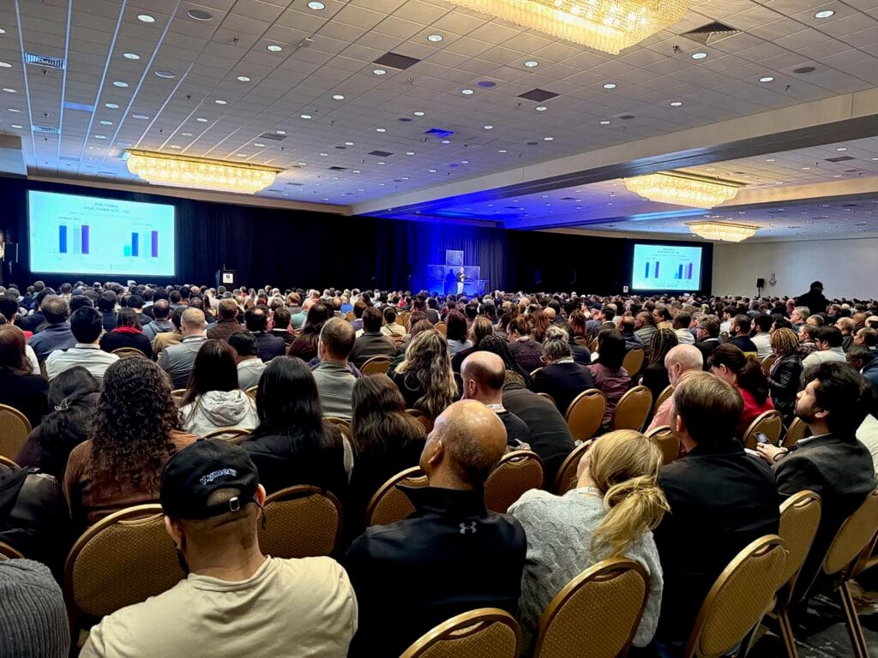

CLOSE · 2 MIN · TALK
0:58 – 1:00
Thanks. Go brief three accounts before Friday.
Mark R. Hinkle · mrhinkle@peripety.com
ALL THINGS AI, DURHAM
FIT
TOOLS
FILES
SKILLS
RESEARCH
OUTREACH
CALLS
RULES
WEEK
MAIL
46 / 46
Notes:
That's it. Stay on for anyone who wants to show you what they built.

