Slide 1
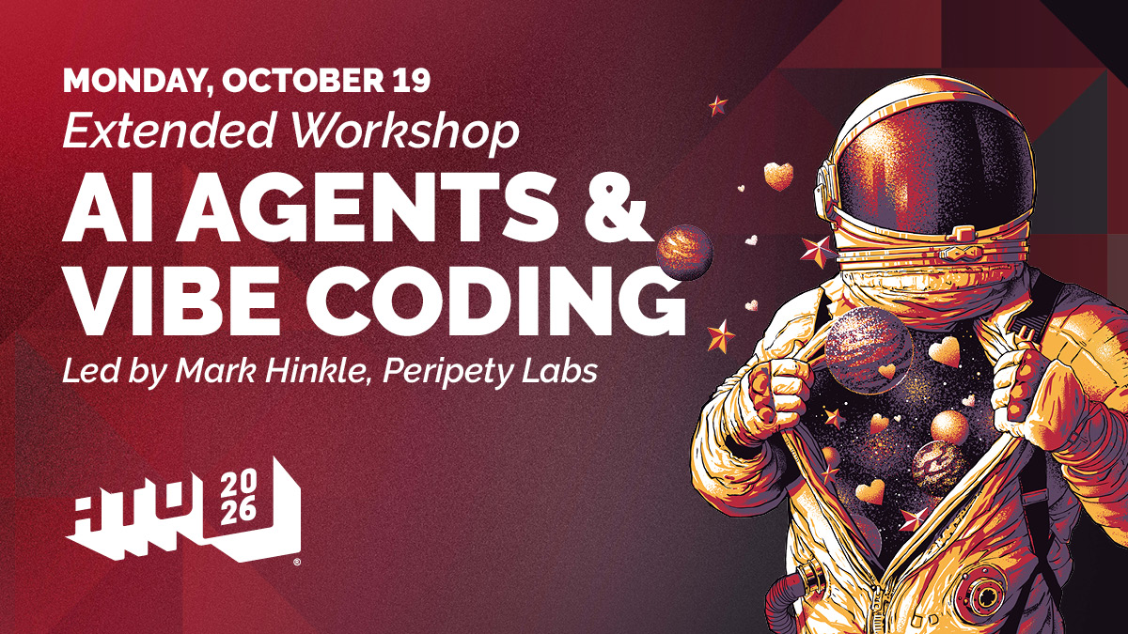
Notes:
Opening slide for the All Things Open 2026 extended workshop.
Event page: https://2026.allthingsopen.org/ai-agents-vibe-coding
Organizer card image: https://2026.allthingsopen.org/wp-content/uploads/2026/09/2026_ATO_ExtendedWorkshop_AIAgentsVibeCoding.jpg
Sources accessed October 16, 2026.

Slide 2


// OPENING · YOUR HOST
0:00–0:02
Mark Hinkle
I HELP PEOPLE TURN NEW TECHNOLOGY INTO USEFUL WORK
Peripety Labs
I lead an AI consulting and product company that helps teams put AI into real operations.
The AIE Network
I publish practical AI news and analysis for more than 250,000 subscribers.
All Things AI
I co-founded the Triangle's AI business conference and year-round community.
I came up through the internet, Linux, open source, and cloud. I teach from what we learned shipping real systems.
02 / 63
Notes:
Keep this to two minutes. The credential that matters today is that I have shipped the mistakes I am about to show you.
I have spent more than 30 years working through the internet, Linux, open source, cloud, DevOps, and now AI. The pattern repeats: the toy gets useful faster than the experts expect.
Current speaker biography and training background, accessed October 18, 2026: https://2026.allthingsai.org/speakers/mark-hinkle
Current Peripety Labs, AIE Network, and All Things AI roles, accessed October 18, 2026: https://2026.allthingsai.org/meet-the-organizers
The organizer biography reports that The AIE Network reaches more than 250,000 subscribers: https://2026.allthingsai.org/meet-the-organizers

Slide 3
// OPENING · THE PROMISE
0:02–0:05
This is a workshop
CHOOSE YOUR OWN ADVENTURE · WE WILL BUILD THE MATERIALS WITH YOU
I am not training you to become a programmer.
We’ll start with two core builds. Your questions decide where we slow down, what we explain, and what we add to the course repository.
01
02
03
Build it
Test it
Own it
Use an AI coding agent to turn plain language into working files.
Try the important action. Record what passed, failed, or was not tested.
Keep the project, its history, and its live URL in accounts you control.
We’ll vibe code the workshop materials in front of you—then put the useful changes back in the repo.
03 / 63
Notes:
Say the promise plainly: this is a workshop, not passive training and not programmer certification.
Success is confidence grounded in observable work: two projects, two repositories, two Vercel projects, and two checked URLs.
Treat the workshop materials as a living project. A useful question can become an issue, an edit, a review, and an accepted update to the course repository.
Choose your own adventure means the room can shape the explanation and examples. The website and game remain the two core builds so the workshop still has a clear finish line.

Slide 4
// OPENING · HOW THIS WORKS
0:05–0:08
We’ll build this with you
YOUR QUESTIONS CAN CHANGE THE WORKSHOP
01
02
03
04
Ask
Add
Check
Keep
Tell us where the process feels unclear, incomplete, or unlike your real work.
We update the example or explanation while the room watches.
We review the change the same way we review the two projects.
Useful changes go back into the course repository for everyone.
You leave with the two builds and the explanations your group needed to repeat the process.
04 / 63
Notes:
This is a living workshop. We will use participant questions as input, update the material, review the change, and keep useful improvements in the repository.
The finish line remains stable: a website and a game, each built through the same six-step process and published from the participant's own accounts.

Slide 5
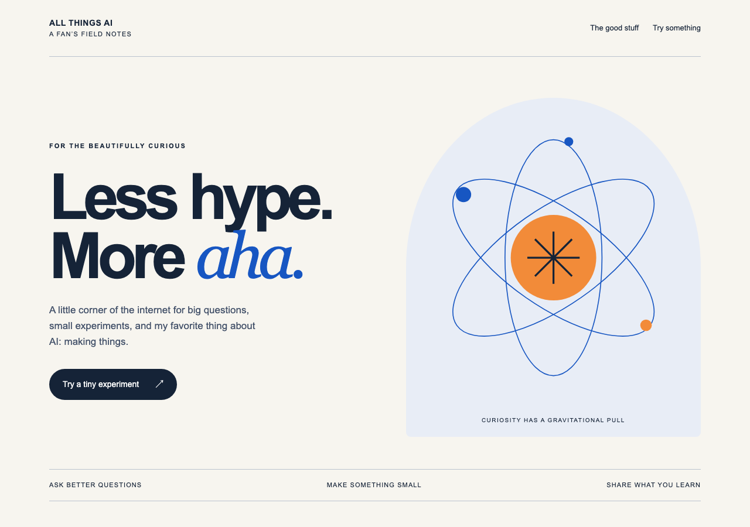
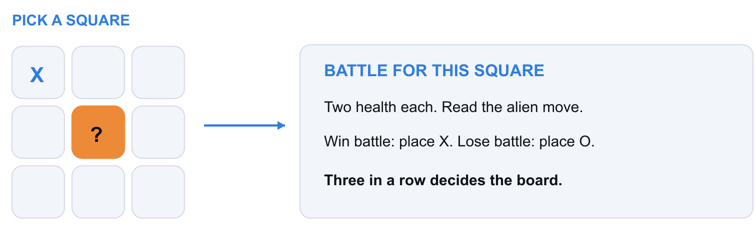
// OPENING · THE OUTCOME
0:08–0:12
Two projects, one process
PROJECT 1 · WEBSITE
PROJECT 2 · GAME
Alien Tic-Tac-Toe
Pick a square. Battle for it. Win and you place X. Lose and the alien places O.
A live website
A player can start, finish, and restart a round.
Start with a complete page. Get it live, check the main action, then make it yours.
Both projects use the same six steps. Each gets its own GitHub repository, Vercel project, and live URL.
05 / 63
Notes:
Show the destination before the vocabulary. Both builds are required workshop exercises.
The website image is the ATA Orbit starter. The game image is the featured Alien Tic-Tac-Toe concept.
Each project ends in its own learner-owned GitHub repository, Vercel project, and checked URL.

Slide 6
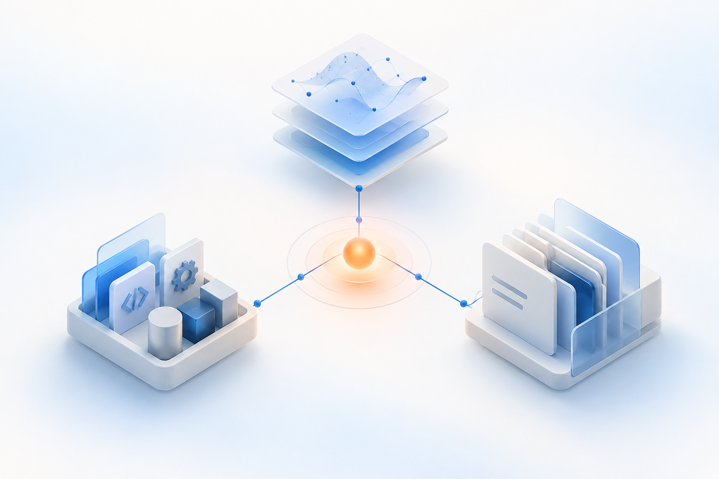
// BEFORE WE BUILD · AI AGENTS
0:12–0:27
The parts of an agent
MODEL · TOOLS · MEMORY
01
Model
Reads the goal, chooses the next step, and produces the words or code.
02
Tools
Open files, edit them, run commands, search, and use connected services.
03
Memory
Carries project rules, past decisions, and the last stopping point forward.
A good agent remembers the project. You check the facts before it acts.
06 / 63
PLAN
DESIGN
BUILD
TEST
DEPLOY
MAINTAIN
Notes:
Keep the definition concrete. The model supplies judgment. Tools let the agent act. Memory helps it continue without starting from zero.
Memory may live in the current conversation, saved project instructions, repository files, or a product memory system. Useful memory still needs verification against the current project.
The light concept illustration was generated for this workshop. Treat it as an illustration, not a product screenshot.

Slide 7
// BEFORE WE BUILD · CODING HARNESSES
0:12–0:27
The coding harness
THE WORKING ENVIRONMENT AROUND THE MODEL
The harness supplies the tools and memory around the model. Together, they make an agent.
01
02
03
04
Context
Tools
Permissions
Evidence
Gives the model the right files, instructions, and project history.
Reads and edits files, searches the project, and runs commands.
Sets the boundaries and asks before a sensitive action.
Shows the changed files, checks, and what remains uncertain.
Permissions and checks keep the agent's work visible.
07 / 63
PLAN
DESIGN
BUILD
TEST
DEPLOY
MAINTAIN
Notes:
A coding harness is the software around the model. It assembles context, offers tools, applies permissions, manages the work loop, and reports evidence.
This distinction matters: changing the model can change the judgment, while changing the harness changes what the agent can see, do, remember, and prove.

Slide 8



// BEFORE WE BUILD · THREE HARNESSES
0:12–0:27
Claude Code, Codex, and Grok Build
THREE PRODUCTS · THE SAME BASIC JOB
01
02
03
Claude Code
Codex
Grok Build
Anthropic's coding agent for the terminal and editor. Useful for close back-and-forth work, visible plans, and checkpoints.
OpenAI's coding agent in the app, terminal, editor, and cloud. Useful for handing off a task, running checks, and reviewing the result.
xAI's terminal coding agent and open-source harness. Useful for fast project work with plans, reusable skills, and parallel help.
Pick the harness that can open your files and show you what changed.
08 / 63
PLAN
DESIGN
BUILD
TEST
DEPLOY
MAINTAIN
Notes:
These are coding-agent products and harnesses, not single model names. Their available models, surfaces, permissions, and features can change by plan and version.
Claude Code setup and product description, accessed October 18, 2026: https://docs.anthropic.com/en/docs/claude-code/getting-started
OpenAI Codex product description, accessed October 18, 2026: https://openai.com/codex/
xAI Grok Build product description, accessed October 18, 2026: https://x.ai/build
Product marks are included for recognition only and do not imply endorsement. Claude mark: claude.com. OpenAI wordmark: openai.com/brand. xAI mark: x.ai/legal/brand-guidelines.

Slide 9
// BEFORE WE BUILD · SECOND OPINION
0:27–0:38
Let another model check the work
BUILD · REVIEW · DECIDE
Use one agent to make the change. Give a different model the same goal and the evidence.
01
02
03
Build
Review
Decide
One coding agent makes the change and shows the files, checks, and open questions.
A different model looks for mistakes, missing checks, and places the result could fail.
You choose which findings matter. The builder fixes them, then runs the checks again.
Different models miss different things. Independence is the point.
09 / 63
Notes:
Do not ask the same agent to grade its own work. A useful review uses a different model family or provider and starts from the same written goal.
Give the reviewer a compact review packet: the goal, the exact revision or changed files, the checks already run, and the question: what could still fail?
Ask for one of two outcomes: PASS, with the evidence it checked; or CHANGES, with concrete findings and file locations. The reviewer reports. It does not fix.
The person still decides. A second model is another set of eyes, not an authority transfer.

Slide 10
// BEFORE WE BUILD · CLI REVIEW
0:27–0:38
Three CLIs, plus OpenRouter
START IN THE REPOSITORY FOLDER · ASK FOR FINDINGS ONLY
Use the row for the tool you already have. Pick a different reviewer than the builder.
Codex
codex exec -s read-only "Review this change. Report findings only."
Enforced read-only
Claude Code
claude -p --permission-mode plan "Review this change. Report findings only."
Plan / no-edit request
Grok Build
grok -p --permission-mode plan "Review this change. Report findings only."
Plan / no-edit request
OpenRouter
Open Chat → choose a different model → paste the same review packet
No repository access
The reviewer reports. The builder makes the next change.
10 / 63
Notes:
These commands are starting points, not magic spells. Run them only after the builder has stopped and the current work is saved. Use a separate worktree for a review that runs at the same time as the build.
Codex's read-only sandbox blocks filesystem writes. Claude Code and Grok Build plan modes are useful guardrails, but they are not identical to Codex's enforced read-only sandbox.
For the strongest Claude or Grok boundary, give the reviewer only a saved diff and remove its tools. The visible commands stay short so a first-time participant can understand the pattern.
OpenRouter Chat is the no-CLI path: select a reviewer from a different model family, such as Kimi K3, and paste the same compact review packet. Do not paste secrets. A remote review may use paid model credits.
Verified against the installed Codex, Claude Code, and Grok Build help on October 18, 2026.
OpenRouter Chat: https://openrouter.ai/chat

Slide 11
// BEFORE WE BUILD · MCP
0:38–0:46
MCP connects agents to tools
ONE STANDARD CONNECTION · MANY SYSTEMS
An MCP server gives the agent a defined way to read approved context and call approved tools.
01
02
03
Resources
Tools
Prompts
Read files, records, or reference material that you choose to expose.
Take a named action, such as opening an issue or reading a calendar.
Reuse a guided workflow that the user or system provides.
A connection creates capability. Permission and confirmation still decide what the agent may do.
11 / 63
Notes:
MCP stands for Model Context Protocol. It is an open standard for connecting an AI application to external context and actions.
The technical pattern has a host, a client, and a server. For this workshop, the useful idea is simpler: the agent gets a defined connector instead of a custom integration for every system.
Official MCP server concepts and the resources, tools, and prompts primitives, accessed October 18, 2026: https://modelcontextprotocol.io/specification/draft/server/index

Slide 12
// BEFORE WE BUILD · COMPOSIO
0:38–0:46
Composio manages the connection
CONNECT THE APP · APPROVE ACCESS · TEST ONE SAFE ACTION
01
02
03
04
Choose
Ask
Approve
Test
Use the native Composio plugin in Codex or Claude Code, or Composio Connect in another MCP client.
Tell the agent which app you need, such as GitHub, Gmail, Notion, or Slack.
Use the app’s own sign-in window. Never paste a password or token into the chat.
Start read-only. Confirm the account, tool, and result before any write action.
OPEN THE COMPOSIO CONNECT GUIDE ↗
Read first. Ask before sends, deletes, purchases, or permission changes.
12 / 63
Notes:
For Codex or Claude Code, the native Composio plugin is the shortest path when it is available. MCP-compatible clients can use Composio Connect.
The first time the agent needs an app, Composio can generate an OAuth link. The user approves access in the browser and the connection can persist for later work.
For a command-line demonstration, link an app, search for the action, inspect the schema, and use a dry run where the tool supports one. Keep credentials out of slides and chat.
Official Composio Connect guide, accessed October 18, 2026: https://docs.composio.dev/docs/composio-connect

Slide 13
// BEFORE WE BUILD · CONTEXT
0:46–0:56
Keep the working set useful
SMALL CONTEXT · DURABLE PROJECT MEMORY
01
02
03
04
Load less
Work smaller
Compact
Hand off
Open the project guide and the files for this checkpoint, not the whole repository.
Give the agent one goal, one checkpoint, and one review at a time.
Ask for a short state summary before a long conversation becomes noisy.
Save decisions and next steps in the repo. Start a fresh chat when the goal changes.
CAVEMAN MODE
A reusable prompt for terse output when the words are crowding out the work.
Context is working memory. The repository is durable memory.
13 / 63
Notes:
A context window is the information the model can actively use in one conversation. More text is not always more useful; stale or unrelated text competes with the current goal.
Compaction replaces a long thread with a shorter summary. Before compacting, preserve exact file names, decisions, open risks, tests, and the next action. Save durable facts in the repository.
Caveman is a deliberately terse communication mode. It reduces commentary and repeated explanation while preserving the instructions and evidence needed to do the work.

Slide 14
// BEFORE WE BUILD · PROJECT MEMORY
0:46–0:56
The files that guide the agent
CURRENT RULES · CURRENT GOAL · REPEATABLE METHOD
AGENTS.md
Project rules
The portable instructions for this course: commands, architecture, boundaries, and common mistakes.
spec.md
What to build
The user, problem, constraints, behavior, and acceptance checks for the current change.
SKILL.md
How to repeat it
A reusable procedure in a skill folder. The singular file name is intentional.
README.md
Where to begin
The human and agent map to the project, exercises, setup, and first prompt.
Claude Code loads CLAUDE.md. Here, that file imports AGENTS.md so the rules stay in one place.
14 / 63
Notes:
Use the exact filenames. Anthropic's persistent project-instruction file is CLAUDE.md. In this course repo, CLAUDE.md imports @AGENTS.md so the durable rules have one source of truth.
Codex reads AGENTS.md. Other tools vary. If a client does not load the file or the CLAUDE.md import, open, attach, or paste the instructions explicitly.
Anthropic recommends keeping CLAUDE.md under a page because it is always loaded. The same discipline applies to AGENTS.md: keep only durable, useful project rules.
A skill is a folder with a singular SKILL.md file. Its description helps the agent decide when to use it, and its instructions explain the repeatable procedure.
Anthropic guidance on CLAUDE.md, spec.md, and skills, accessed October 18, 2026: https://claude.com/resources/articles/the-ai-native-sdlc-playbook

Slide 15
// START HERE · THE HANDOFF
0:46–0:56
Every stage leaves a record
ANTHROPIC’S COMPLETE PLAYBOOK LIST
01
Plan
intent.md
02
Design
spec.md
Why this change should exist.
What the system should do.
03
Build
plan.md
04
Test
code change + tests
How the change will be made.
The change and evidence that it works.
05
Deploy
pull request + notes
06
Maintain
incident record
The reviewed release record.
What happened and what starts next.
Maintenance can write the next intent.md. The loop begins again.
15 / 63
Notes:
This is the complete artifact chain named in Anthropic's playbook: intent.md, spec.md, plan.md, the code diff and its tests, the PR with review findings, and the incident record.
CLAUDE.md and SKILL.md are persistent operating context. They are important, but they are not additional stage-output artifacts in this six-item chain.
An incident record can generate the next intent.md, closing the loop from Maintain back to Plan.
Anthropic AI-native SDLC playbook, accessed October 18, 2026: https://claude.com/resources/articles/the-ai-native-sdlc-playbook

Slide 16
// BEFORE WE BUILD · VIBE CODING
0:56–0:57
What vibe coding means
PLAIN LANGUAGE → WORKING SOFTWARE → HUMAN JUDGMENT
Say it
AI makes
Open it
React
Say what you want in words you already use.
The model writes or changes the project files.
Use the result instead of admiring the prompt.
Say what worked, what surprised you, and what changes next.
The vibe gets you moving. The lifecycle keeps the result honest.
16 / 63
PLAN
DESIGN
BUILD
TEST
DEPLOY
MAINTAIN
Notes:
Vibe coding means guiding software with natural language and visible feedback. It does not mean accepting the first output without checking it.
Do not ask participants to read code. Ask them to explain the result and try the important action.

Slide 17
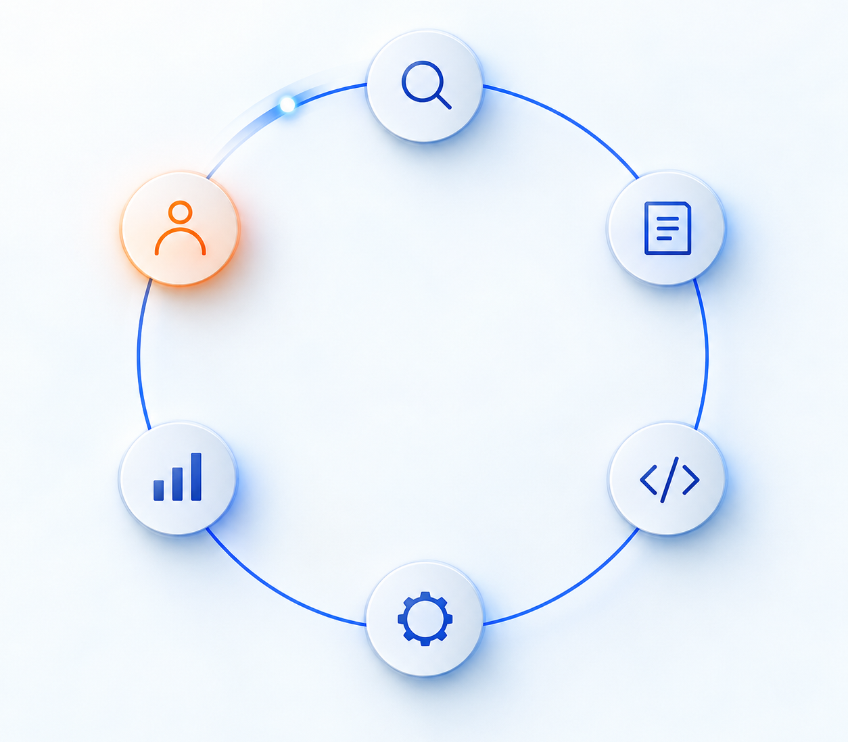
// START HERE · THE LIFECYCLE
0:57–0:58
Six steps to working software
THE SAME LOOP FOR THE WEBSITE AND THE GAME
01
Plan
02
Design
Name the person, the goal, and the finish line.
Map the experience and decide what must stay true.
03
Build
04
Test
Change a safe copy in small increments.
Try the important action and get a fresh look.
05
Deploy
06
Maintain
Publish the checked version to the intended home.
Watch use, fix problems, and plan the next change.
Website first. Game second. Same loop both times.
COMPANION READING Claude’s AI-Native SDLC Playbook ↗
17 / 63
PLAN
DESIGN
BUILD
TEST
DEPLOY
MAINTAIN
Notes:
Start with the lifecycle before account setup. Participants should know why each tool appears before they create the account.
Companion source: Claude by Anthropic, The AI-Native SDLC Playbook. https://claude.com/resources/articles/the-ai-native-sdlc-playbook
The footer, exercises, review slides, and take-home checklist use the source framework consistently: Plan, Design, Build, Test, Deploy, Maintain.
The light lifecycle illustration was generated for this workshop. Use it as a visual mnemonic for repetition, not as a literal product interface.

Slide 18
// BEFORE WE BUILD · TWO STARTING POINTS
0:58–0:59
Two ways to start
LOVABLE · BOLT.NEW · BASE44 · REPLIT · AND OTHERS
PROMPT-FIRST HOSTED BUILDER
REPO-FIRST AGENT + SIX STEPS
Prompt → preview → publish
Brief → repo → check → review → publish
Gets to a convincing first version quickly. Hosting and common services stay close at hand. Many now connect to GitHub too.
Takes a little longer at the start. The brief, files, versions, checks, second look, hosting project, and live URL stay visible.
Builders make the first version fast. The lifecycle makes later changes easier to test, deploy, and recover.
18 / 63
PLAN
DESIGN
BUILD
TEST
DEPLOY
MAINTAIN
Notes:
This is a comparison of typical starting points, not a feature matrix or product ranking. Hosted builders increasingly include planning, testing, code views, checkpoints, deployment controls, and GitHub workflows.
Lovable overview, accessed October 18, 2026: https://lovable.dev/build/no-code-app-builder
Bolt overview, accessed October 18, 2026: https://support.bolt.new/building/intro-bolt
Base44 overview, accessed October 18, 2026: https://base44.com/blog/what-is-base44
Replit version-control overview, accessed October 18, 2026: https://docs.replit.com/replit-workspace/workspace-features/version-control

Slide 19
// START HERE · THE DAY
0:59–1:00
The workshop plan
FOUR PARTS · TWO COMPLETE BUILDS
01
02
03
04
Learn the loop
Set up the homes
Build twice
Show the proof
Use the six steps once so every later screen has a purpose.
Create GitHub and Vercel accounts. Connect them before the first build.
Make a website, then a game. Each project travels through the full loop.
Leave with two repositories, two Vercel projects, and two URLs.
Every exercise starts with what you will learn and ends with a review.
19 / 63
PLAN
DESIGN
BUILD
TEST
DEPLOY
MAINTAIN
Notes:
The website block comes first. The game block repeats the same lifecycle with more visible states and behavior.
Setup and the final demonstration are support structure, not extra exercises.

Slide 20



// SETUP · THE TOOLCHAIN
1:00–1:05
Git, GitHub, and Vercel
THREE JOBS · ONE LIVE URL
Git
GitHub
Vercel
Remembers every deliberate saved version inside the project.
Keeps the files and their history online under your account.
Reads the GitHub project and publishes a web address.
The agent changes files. Git remembers. GitHub holds the project. Vercel publishes it.
20 / 63
PLAN
DESIGN
BUILD
TEST
DEPLOY
MAINTAIN
Notes:
Keep the jobs distinct. If participants can repeat this sentence, the later setup screens have a place in the mental model.
Official Vercel Git deployment documentation, accessed October 18, 2026: https://vercel.com/docs/git

Slide 21
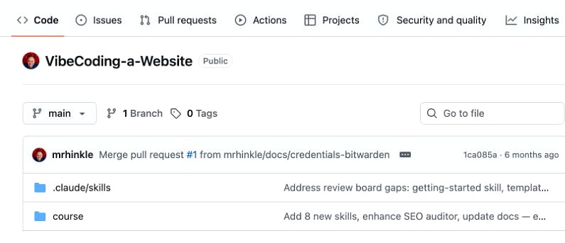
// SETUP · COURSE REPOSITORY
1:05–1:15
Start with the course repo
THE LESSONS · THE STARTERS · THE PROMPT THAT GETS YOU MOVING
github.com/mrhinkle/
Vibe-Coding-for-Non-Technical-Professionals ↗
PASTE THIS INTO YOUR CODING AGENT
Read README.md and AI-START.md. Tell me which files you actually opened.
If the private repo will not load, attach AI-COURSE-PACK.md.
The first proof is simple: the agent names the files it actually read.
21 / 63
PLAN
DESIGN
BUILD
TEST
DEPLOY
MAINTAIN
Notes:
Course repository: https://github.com/mrhinkle/Vibe-Coding-for-Non-Technical-Professionals
Repository access is required. If the course repository does not open for the learner or agent, use the current AI-COURSE-PACK.md instead.
Do not accept a connection badge as proof. Ask the agent to name the exact files it opened.
The screenshot is a sanitized GitHub repository example captured October 18, 2026. The clickable text points to the current course repository.

Slide 22
// SETUP · GITHUB
1:15–1:25
How work moves in GitHub
PROJECT → PROPOSED CHANGE → REVIEW → ACCEPTED VERSION
SETUP Create an account you control · verify the email · turn on two-factor authentication
Repo
Issue
Pull request
Merge
The project files and their saved history.
A named problem, question, or improvement.
A proposed set of changes you can review.
The approved changes join the main version.
STAR
Bookmark it and show interest.
FORK
Make your own copy under your account.
WATCH
Ask GitHub to notify you about updates.
Your questions can become issues. Good fixes can become pull requests. Review decides what merges.
22 / 63
PLAN
DESIGN
BUILD
TEST
DEPLOY
MAINTAIN
Notes:
Keep the nouns tied to visible work. A repository is the project. An issue names work. A pull request proposes changes. A merge accepts them into the main version.
Star, fork, and watch are different actions: bookmark or show interest, create your own copy, and receive notifications.
Use the workshop itself as the example: a participant question may become an issue; the material change is reviewed before it merges.
Official GitHub account and repository guidance: https://docs.github.com/en/get-started/onboarding/getting-started-with-your-github-account

Slide 23
// SETUP · VERCEL
1:25–1:35
Vercel: the publishing home
ONE PROJECT CONNECTS TO ONE GITHUB REPOSITORY
01
Sign up
Use the GitHub sign-in path so Vercel can see your practice repositories.
02
Authorize
Allow only the repositories you intend to use when that choice appears.
03
Check the home
Confirm the correct personal account or team before you create a project.
A project is the home. A deployment is one published version. A URL is how people reach it.
23 / 63
PLAN
DESIGN
BUILD
TEST
DEPLOY
MAINTAIN
Notes:
Official Vercel account documentation, accessed October 18, 2026: https://vercel.com/docs/accounts
Vercel Hobby is restricted to personal, noncommercial use. Official fair-use guidance: https://vercel.com/docs/limits/fair-use-guidelines
Account creation and any plan choice belong to the participant. Do not enter billing information during class.

Slide 24
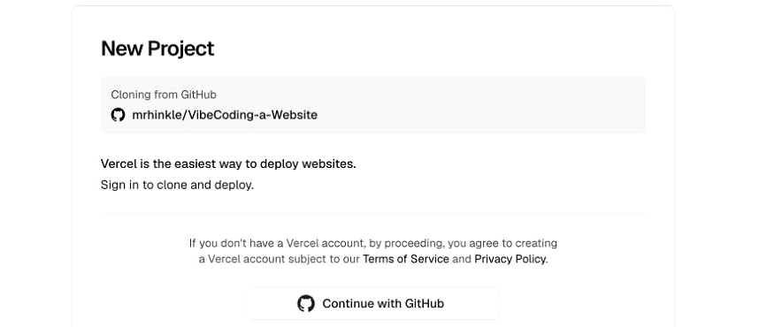
// SETUP · CONNECT THE ACCOUNTS
1:35–1:40
GitHub to Vercel
FIND THE REPOSITORY · CHECK THE DESTINATION
1 Choose New Project
2 Confirm the GitHub account
3 Find my-first-site
4 Choose Import
5 Stop at project configuration
Seeing the repository in Vercel proves the accounts are connected. It does not publish yet.
24 / 63
PLAN
DESIGN
BUILD
TEST
DEPLOY
MAINTAIN
Notes:
Use the live Vercel dashboard during the workshop and rehearse the exact button labels before the event.
Official Vercel Git deployment flow, accessed October 18, 2026: https://vercel.com/docs/git

Slide 25
// SETUP · READY CHECK
1:40–1:45
Ready to build
TWO PROJECTS · SEPARATE HOMES · ONE CLEAR START
01
Your GitHub profile opens and my-first-site belongs to you
02
Your README has the start prompt and the agent names what it actually read
03
Your Vercel dashboard opens and my-first-site appears in the import list
04
You know the game will use my-first-game and a second Vercel project
Blocked? Keep the exact screen or error. Use the course pack, a partner, or an instructor checkpoint.
25 / 63
PLAN
DESIGN
BUILD
TEST
DEPLOY
MAINTAIN
Notes:
This is a setup check, not exercise one. Pair participants before the build if one account path remains blocked.
Students keep credentials private. Helpers can point at the screen but do not take over passwords or authentication codes.
The second project never overwrites the first. The website and game each get a separate folder, repository, Vercel project, live URL, and check record.

Slide 26
// EXERCISE 1 · WEBSITE
1:40–2:30
What you will learn
ONE WORKING PAGE · ONE LIVE URL
Plan
Design
Build
Test
Deploy
Maintain
Name the visitor, goal, and finish line.
Map the page and choose the first change.
Change one complete page in a safe copy.
Try it yourself, then let a partner use it.
Save to GitHub and put it live in Vercel.
Watch one visitor and plan the next change.
You finish with a checked website in my-first-site and its own Vercel project.
26 / 63
PLAN
DESIGN
BUILD
TEST
DEPLOY
MAINTAIN
Notes:
Start every exercise with the learning outcomes. This is the first of exactly two exercises.
The website walkthrough allows about 90 minutes; the slide version uses a prepared starter and instructor checkpoints to fit the workshop block.

Slide 27
// EXERCISE 1 · THE EXAMPLE
1:40–2:30
Website example
ALL THINGS AI: ORBIT · RUNNABLE STARTER
Start with a page that already works.
Change the headline, one section, or the color direction. Keep the main link working. Keep the classroom fan-site label visible.
The starter is a real file, not a screenshot you have to recreate.
27 / 63
PLAN
DESIGN
BUILD
TEST
DEPLOY
MAINTAIN
Notes:
The source starter is website-starters/ata-orbit/index.html. Participants may choose another course starter or a similarly small idea.
Do not ask the class to build from an empty folder unless they explicitly choose that route.

Slide 28
// EXERCISE 1 · PLAN
1:40–2:30
Plan the website
PLAIN LANGUAGE FIRST · NO CODE YET
01
02
03
04
Visitor
Main action
Boundary
Proof
Who should understand this page when they open it?
What is the one link or button they should use?
What should the page never claim, collect, or pretend to do?
What will you click or observe to know the page works?
If you cannot explain the main action without code, the page is still too big.
28 / 63
PLAN
DESIGN
BUILD
TEST
DEPLOY
MAINTAIN
Notes:
Use the learner's own idea or the selected starter. Save the result as a short project brief.
Course source: docs/website-walkthrough.md and templates/website-plan.md.

Slide 29
// EXERCISE 1 · DESIGN
1:40–2:30
Choose the first change
SMALLEST USEFUL PAGE · ONE CHANGE AT A TIME
01
02
03
04
Starting file
Sections
First change
Working proof
Name the actual index.html or starter you are changing.
List the page sections in the order a visitor will read them.
Choose one visible change that fits the brief.
Name the link, layout, or text that must still work afterward.
Approve the plan before the AI edits the file.
29 / 63
PLAN
DESIGN
BUILD
TEST
DEPLOY
MAINTAIN
Notes:
The plan bridges the brief and the build. Ask the AI to inspect the actual current HTML before proposing the change.
Keep forms, payments, accounts, databases, and email outside this first website.

Slide 30
// EXERCISE 1 · BUILD
1:40–2:30
Build one change
READ THE FILE · RETURN THE COMPLETE FILE
01
02
03
04
Copy the starter
Open it first
Ask for one change
Save the result
Put the chosen starter in your own my-first-site folder.
Try the existing main link before changing anything.
Give the AI the actual file, brief, plan, and one request.
Replace the working file only after keeping a checkpoint copy.
Checkpoint: index.html opens in your browser and the page still makes sense.
30 / 63
PLAN
DESIGN
BUILD
TEST
DEPLOY
MAINTAIN
Notes:
The core route uses one self-contained index.html so the class can inspect a real file without installing anything.
A chatbot preview is not the checkpoint. Open the exported file in the browser.

Slide 31
// EXERCISE 1 · TEST
1:40–2:30
Test the page
PASSED · FAILED · NOT TESTED
01
The headline and content match the brief
02
The main link reaches the promised section
03
The page stays readable in a narrow browser
04
Tab and Enter can reach and use the main action
A local file is checked only when you actually opened this exact version.
31 / 63
PLAN
DESIGN
BUILD
TEST
DEPLOY
MAINTAIN
Notes:
Record the browser and exact file. A narrow window is useful but not proof of a real phone test.
Course source: docs/website-walkthrough.md, step 5.

Slide 32
// EXERCISE 1 · TEST
1:40–2:30
A fresh visitor
LET THEM TRY IT · DO NOT COACH
01
02
03
04
Hand it over
Watch the first move
Ask one question
Fix the smallest thing
Give a partner the page and one sentence about the intended visitor.
Notice where they look, click, pause, or guess.
What did you think the page wanted you to do?
Keep the working parts and repair the rough edge.
A second look catches what the maker can no longer see.
32 / 63
PLAN
DESIGN
BUILD
TEST
DEPLOY
MAINTAIN
Notes:
This is a human-use check, not a code review ritual. Watch before explaining.

Slide 33
// EXERCISE 1 · DEPLOY
1:40–2:30
Save the website to GitHub
THE CHECKED FILE · THE RIGHT REPOSITORY
01
02
03
04
Open my-first-site
Upload the files
Name the save
Read it back
Check the owner and repository name before uploading anything.
Put index.html and its supporting files at the expected root.
Use a commit message that says what changed.
Open index.html on GitHub and confirm a distinctive sentence.
GitHub now holds the checked website version under your account.
33 / 63
PLAN
DESIGN
BUILD
TEST
DEPLOY
MAINTAIN
Notes:
Do not upload the ZIP instead of its files. Do not upload the full course repository as the learner website.
Official GitHub file and repository guidance should be rehearsed against the live interface before class.

Slide 34
// EXERCISE 1 · DEPLOY
1:40–2:30
Deploy the website
NEW PROJECT · IMPORT · DEPLOY · OPEN THE URL
01
02
03
04
New Project
Import the repository
Check the settings
Deploy and open
In Vercel, start a project under the intended account or team.
Choose my-first-site. Do not choose the game or the course repo.
For the static starter, use the repository root and no build command.
Wait for Ready, then open the actual website URL.
Repeat the main action at the live URL. Local success is not deployment proof.
34 / 63
PLAN
DESIGN
BUILD
TEST
DEPLOY
MAINTAIN
Notes:
Official Vercel Git deployment guidance, accessed October 18, 2026: https://vercel.com/docs/git
The first deployment is production in this course flow. Later changes should use a branch and preview before merge.

Slide 35
// EXERCISE 1 · MAINTAIN
1:40–2:30
Learn from one visitor
THE LIVE URL · ONE OBSERVATION · ONE NEXT CHANGE
01
02
03
04
Share the URL
Watch quietly
Ask what surprised them
Choose the next change
Use the finished Vercel address, not the local file or chatbot preview.
Notice the first click and any hesitation.
Record their words before suggesting your own answer.
Write one small improvement. Do not rebuild the whole page.
What you learn becomes the next Plan step.
35 / 63
PLAN
DESIGN
BUILD
TEST
DEPLOY
MAINTAIN
Notes:
Maintain closes the loop. The next change begins with a new plan, not an extra feature squeezed into this one.

Slide 36
// EXERCISE 1 · REVIEW
1:40–2:30
Website review
SHOW THE WORK · SAY WHAT YOU LEARNED
01
Open the live website and use its main action
02
Show the my-first-site GitHub repository
03
Show the matching Vercel project and Ready deployment
04
Name one observed result and one next change
If one proof is missing, mark it missing. Keep the working files and exact blocker.
36 / 63
PLAN
DESIGN
BUILD
TEST
DEPLOY
MAINTAIN
Notes:
This closes exercise one. Ask two participants to show evidence, not to narrate the code.

Slide 37

// BREAK · LUNCH
30 MIN
Lunch
Website not live yet? Keep the working file and grab a helper before you leave the room.
After lunch: build a game, publish it as a separate project, and let another person play it.
Back at 3:00.
37 / 63
PLAN
DESIGN
BUILD
TEST
DEPLOY
MAINTAIN
Notes:
The website block ends before lunch. Preserve unresolved work instead of silently switching projects or claiming the deployment succeeded.
The light pathway illustration was generated for this workshop and marks the transition into the second build.

Slide 38
// EXERCISE 2 · GAME
3:00–4:30
What you will learn
ONE COMPLETE ROUND · ONE SEPARATE PROJECT
Plan
Design
Build
Test
Deploy
Maintain
State the player, goal, rules, and finish.
Map the states and what happens next.
Build the board and battle in small parts.
Start, finish, restart, and let a player try it.
Use a new repository and Vercel project.
Watch the first round and plan one repair.
You finish with a playable game in my-first-game and its own Vercel project.
38 / 63
PLAN
DESIGN
BUILD
TEST
DEPLOY
MAINTAIN
Notes:
This is the second and final exercise. The game does not overwrite the website.
Use Alien Tic-Tac-Toe as the featured example. The five-question quiz is the scope-reduction fallback.

Slide 39
// EXERCISE 2 · THE EXAMPLE
3:00–4:30
Game example
ALIEN TIC-TAC-TOE · BATTLE FOR THE SQUARE
Pick a square. Battle for it.
Win the battle and place X. Lose and the alien places O. A complete round must start, finish, and restart without carrying old state.
The rules are the design. Decoration comes after the loop works.
39 / 63
PLAN
DESIGN
BUILD
TEST
DEPLOY
MAINTAIN
Notes:
The image is the featured classroom concept. The exercise builds a small portable static game with no account, database, payment, or external API.
Course source: docs/alien-tic-tac-toe.md.

Slide 40
// EXERCISE 2 · PLAN
3:00–4:30
Plan the game
GOAL · CHOICES · RESULT · RESTART
01
02
03
04
Goal
Choice
Result
Restart
Complete a line of X marks before the alien completes a line of O marks.
Select an empty square, then answer the battle move once.
A battle resolves exactly one selected square as X or O.
Play again clears the board, pending battle, health, and old feedback.
Write the rules before asking the AI to build the game.
40 / 63
PLAN
DESIGN
BUILD
TEST
DEPLOY
MAINTAIN
Notes:
Keep the first version deterministic. The fixed Laser, Shield, Claw sequence makes the battle observable and repeatable.
Course source: docs/alien-tic-tac-toe.md and game-skills/vc-game-brief.

Slide 41
// EXERCISE 2 · DESIGN
3:00–4:30
Map the game states
WHAT THE PLAYER SEES · WHAT THEY CAN DO NEXT
Instructions
Board
Battle
Result
Replay
Goal and Start. Nothing moves yet.
Choose one empty square.
One response changes one health value.
Award the square and check the board.
Clear every old value and begin again.
The next action should be obvious in every state.
41 / 63
PLAN
DESIGN
BUILD
TEST
DEPLOY
MAINTAIN
Notes:
State means the situation the game remembers and the actions it allows. Keep that explanation in plain language.
Course source: docs/alien-tic-tac-toe.md, Plan the states and controls.

Slide 42
// EXERCISE 2 · BUILD
3:00–4:30
Build the board
BOARD FIRST · BATTLE SECOND
The board prototype proves four things
1
2
3
• Only an empty square can be selected
• The board locks while a battle is open
• X and O lines end the board correctly
• Play again clears all nine squares
4
5
6
7
8
9
Keep the working board checkpoint before connecting the battle.
42 / 63
PLAN
DESIGN
BUILD
TEST
DEPLOY
MAINTAIN
Notes:
The board prototype may use temporary win and loss buttons. Remove them from the final game after the real battle is connected.

Slide 43
// EXERCISE 2 · BUILD
3:00–4:30
Build one battle
TWO HEALTH EACH · ONE DAMAGE EVENT PER ANSWER
YOU 2 / 2
ALIEN 2 / 2
Laser
Shield
Claw
Shield
Blast
Dodge
Lock the answer after one choice. If both still have health, show Next exchange.
43 / 63
PLAN
DESIGN
BUILD
TEST
DEPLOY
MAINTAIN
Notes:
Correct answers damage only the alien. Incorrect answers damage only the player. No automatic retaliation or simultaneous damage.

Slide 44
// EXERCISE 2 · BUILD
3:00–4:30
Connect board and battle
ONE SELECTED SQUARE · ONE RESOLVED BATTLE · ONE MARK
Choose a square
Battle
Place X or O
Check the board
Continue or replay
Lock the pending square.
Start with fresh health.
Award it exactly once.
Line first, then draw.
No stale state survives.
A battle result never places a second automatic mark.
44 / 63
PLAN
DESIGN
BUILD
TEST
DEPLOY
MAINTAIN
Notes:
This is the distinctive rule participants often misunderstand. The alien does not take another board turn after the battle.

Slide 45
// EXERCISE 2 · TEST
3:00–4:30
Test the whole game
PASSED · FAILED · NOT TESTED
01
A round does not begin before Start
02
One answer causes one damage event and one battle resolves one square
03
X lines, O lines, and a full-board draw end correctly
04
Play again and Restart game clear the old board and battle
05
Keyboard and phone controls remain reachable
A chatbot preview is not proof. Test the exported file, then repeat the critical checks at the live URL.
45 / 63
PLAN
DESIGN
BUILD
TEST
DEPLOY
MAINTAIN
Notes:
If time is short, switch to the five-question quiz fallback and record the scope change honestly. Do not claim the unfinished game passed.

Slide 46
// EXERCISE 2 · TEST
3:00–4:30
A new player
TWO MINUTES · NO COACHING
01
02
03
04
Give the goal
Watch the first square
Watch the restart
Repair one confusion
Say only: complete a line of X before the alien completes O.
Do they understand that the battle determines the mark?
Can they finish a result and begin a clean round?
Improve the instruction or feedback without changing the rules.
The player should not need your memory of how the game works.
46 / 63
PLAN
DESIGN
BUILD
TEST
DEPLOY
MAINTAIN
Notes:
Ask what they expected when something surprised them. Preserve their words in the game test note.

Slide 47
// EXERCISE 2 · DEPLOY
3:00–4:30
Save the game to GitHub
NEW REPOSITORY · KEEP THE WEBSITE INTACT
01
02
03
04
Create my-first-game
Choose the final files
Name the save
Read it back
Use your account. Do not reuse my-first-site.
Upload the integrated game, not the prototypes or temporary test controls.
Use a commit message that identifies the checked game version.
Open index.html in the game repository and confirm the current instructions.
GitHub now holds a second project with its own history.
47 / 63
PLAN
DESIGN
BUILD
TEST
DEPLOY
MAINTAIN
Notes:
The website repository remains unchanged. Keep board and battle checkpoints outside the final upload folder.

Slide 48
// EXERCISE 2 · DEPLOY
3:00–4:30
Deploy the game
A SECOND VERCEL PROJECT · A SECOND LIVE URL
01
02
03
04
New Project
Import my-first-game
Check the static settings
Deploy and play
Start another Vercel project under the intended account or team.
Confirm the repository name before choosing Import.
Use the repository root and no build command for the single-file game.
Open the finished URL. Complete one battle, one board result, and a restart.
The game and website now have different repositories, projects, and URLs.
48 / 63
PLAN
DESIGN
BUILD
TEST
DEPLOY
MAINTAIN
Notes:
Official Vercel Git deployment guidance, accessed October 18, 2026: https://vercel.com/docs/git
Save the game URL and observed checks in game-release.md or the participant workbook.

Slide 49
// EXERCISE 2 · MAINTAIN
3:00–4:30
Learn from one player
THE LIVE GAME · THE FIRST ROUND · THE NEXT REPAIR
01
02
03
04
Share the game URL
Watch the first move
Watch the ending
Watch replay
Use the deployed version another person can open.
Notice whether the goal and available action are clear.
Can they tell whether the battle or the board finished?
A new round must begin without old health, marks, or feedback.
One confused moment is enough to start the next Plan step.
49 / 63
PLAN
DESIGN
BUILD
TEST
DEPLOY
MAINTAIN
Notes:
A short player observation is more useful than adding a new mechanic before the core loop is understood.

Slide 50
// EXERCISE 2 · REVIEW
3:00–4:30
Game review
SHOW THE ROUND · SHOW THE PROJECT · SHOW THE PROOF
01
Open the live game and explain the goal
02
Complete a battle and show the correct square
03
Finish or restart a round without old state carrying forward
04
Show the my-first-game repository and matching Vercel project
05
Name one player observation and one next repair
If the live version fails, keep the working file and exact error. Do not call it published.
50 / 63
PLAN
DESIGN
BUILD
TEST
DEPLOY
MAINTAIN
Notes:
This closes exercise two. The final demonstration later shows both projects together, but it does not add a third build.

Slide 51
// BREAK · CHECKPOINT
10 MIN
What was different?
WEBSITE
GAME
One page. One main action. The hard part was deciding what belonged.
Several states. A full start-to-finish loop. The hard part was making every transition predictable.
Same lifecycle. Different thing to check.
51 / 63
PLAN
DESIGN
BUILD
TEST
DEPLOY
MAINTAIN
Notes:
Use this checkpoint to compare the projects. The lifecycle stays stable while the important behavior changes.

Slide 52
// OPERATE · SAFE CHANGES
4:40–5:25
Branches and previews
THE NEXT CHANGE SHOULD NOT START ON THE LIVE VERSION
Branch
Change
Preview
Review
Merge
Live
A safe copy in GitHub.
The AI edits the copy.
Vercel gives it a URL.
A person tries the URL.
You approve the change.
Vercel updates production.
The live page changes only after the checked preview is approved.
52 / 63
PLAN
DESIGN
BUILD
TEST
DEPLOY
MAINTAIN
Notes:
Vercel automatically creates preview deployments for branch pushes and production deployments from the production branch. https://vercel.com/docs/git

Slide 53
// OPERATE · RECOVERY
4:40–5:25
Undo first
PROTECT PEOPLE NOW · REPAIR THE SAFE COPY NEXT
01
02
03
04
See the problem
Return to the last good version
Repair the branch
Check and republish
Confirm the live version is wrong before changing anything else.
Use the deployment history so people get the working page back.
Make the smallest permanent fix away from live.
Repeat the important action before approving the repaired version.
Undo buys time. The branch makes the repair last.
53 / 63
PLAN
DESIGN
BUILD
TEST
DEPLOY
MAINTAIN
Notes:
Keep the recovery explanation provider-neutral on the slide. Demonstrate the live Vercel deployment controls only after rehearsing the current interface.

Slide 54
// OPERATE · PRIVATE KEYS
4:40–5:25
Keep keys out of the project
NO REAL KEYS IN CHAT · CODE · SAVED FILES
01
02
03
04
Core exercises
Later projects
Vercel setting
If exposed
The website and game need no secret keys, database, payment, or external API.
Treat every API key like a password. Keep it in the provider account.
Project Settings, then Environment Variables, supplies the value when the site runs.
Revoke it, replace it, and check the repository history.
If a key lands in chat, you made a copy you do not control.
54 / 63
PLAN
DESIGN
BUILD
TEST
DEPLOY
MAINTAIN
Notes:
The core class deliberately avoids secrets. This slide names the boundary before participants build more ambitious projects later.

Slide 55
// OPERATE · HOSTING BOUNDARY
4:40–5:25
The Vercel plan boundary
CLASSROOM PRACTICE · PERSONAL AND FICTIONAL
01
02
03
04
Hobby
Commercial work
During class
Before launch
Vercel restricts the Hobby plan to personal, noncommercial use.
A real business project needs an eligible commercial plan or another host.
Do not enter billing details or choose a paid plan because a tutorial says so.
Check the audience, account, plan, and current provider rules.
The exercise is free practice. A real business launch is a separate decision.
55 / 63
PLAN
DESIGN
BUILD
TEST
DEPLOY
MAINTAIN
Notes:
Official Vercel fair-use guidance, accessed October 18, 2026: https://vercel.com/docs/limits/fair-use-guidelines
Do not quote prices from memory. Plans and limits change.

Slide 56
// OPERATE · OWNERSHIP
4:40–5:25
What you own
FILES · HISTORY · PROJECT SETTINGS · TEST NOTES
01
02
03
04
GitHub repositories
Vercel projects
Check records
Next action
The website and game files plus every deliberate save point.
The deployment history, project settings, and live URLs under your account.
What passed, failed, or was not tested for each project.
One small improvement written in plain language.
Tools can change. Your projects still have a place to go.
56 / 63
PLAN
DESIGN
BUILD
TEST
DEPLOY
MAINTAIN
Notes:
Ownership means the participant can identify the files, source history, hosting project, and observed behavior. It does not mean every external service is portable without work.

Slide 57
// OPERATE · BRING IN HELP
4:40–5:25
When to call a developer
THE RISK CHANGED · THE PROJECT NEEDS A DIFFERENT REVIEW
01
02
03
04
Accounts and permissions
Money
Private information
Business dependence
People sign in or see different information based on who they are.
The project charges, pays, refunds, or makes a financial decision.
Real customer, employee, health, or confidential business data enters the system.
People cannot do their job or serve customers when the project fails.
Bring the brief, working files, failed checks, and live URL. Give the developer something they can evaluate.
57 / 63
PLAN
DESIGN
BUILD
TEST
DEPLOY
MAINTAIN
Notes:
The threshold is risk and dependence, not the participant's identity as a coder or non-coder.

Slide 58
// OPERATE · SAVE THE ROUTINE
4:40–5:25
Your repeatable checklist
USE THE SAME SIX QUESTIONS FOR THE NEXT PROJECT
PLAN
Who is it for, what should happen, and what is the finish line?
DESIGN
What experience and boundaries must stay true?
BUILD
Which safe copy will change, and what is the smallest increment?
TEST
What exact action will you try, and who else will use it?
DEPLOY
Which repository, Vercel project, and URL are correct?
MAINTAIN
What happened in use, and what should change next?
Save the answers with the project so the next AI starts from evidence, not memory.
58 / 63
PLAN
DESIGN
BUILD
TEST
DEPLOY
MAINTAIN
Notes:
This checklist can become a saved skill or project instruction later. The slide keeps the plain-language behavior visible; filenames and installation details belong in the participant guide.

Slide 59
// FINAL DEMONSTRATION
5:25–5:45
Show both projects
TWO URLS · TWO REPOSITORIES · TWO VERCEL PROJECTS
01
Open the website and use its main action
02
Open the game, complete a result, and restart
03
Show the separate GitHub repository behind each project
04
Show the separate Vercel project and Ready deployment behind each URL
05
Name the next small change for one project
The demonstration is the evidence. You do not need to explain the code.
59 / 63
PLAN
DESIGN
BUILD
TEST
DEPLOY
MAINTAIN
Notes:
This is a final demonstration, not a third exercise. Invite short paired demos before asking for one or two room-wide examples.

Slide 60
// WRAP · WHAT LEAVES
5:45–5:55
What leaves with you
THE PROJECTS · THE PROOF · THE NEXT STEP
01
02
03
04
Website
Game
Process
Recovery
my-first-site, its Vercel project, the live URL, and the website check note.
my-first-game, its Vercel project, the live URL, and the game check note.
Plan, Design, Build, Test, Deploy, Maintain.
Working checkpoints and exact blockers for anything that did not finish.
You can continue because the work is in your accounts, not trapped in this room.
60 / 63
PLAN
DESIGN
BUILD
TEST
DEPLOY
MAINTAIN
Notes:
Read the evidence back from participant screens where possible. Keep incomplete items visible.

Slide 61

// WRAP · MONDAY
5:55–6:00
Your first Monday
ONE SMALL LOOP · ONE PROJECT
01
Plan
02
Design
Name one improvement.
Sketch the result and boundary.
03
Build
04
Test
Change a safe copy.
Try it. Give someone the preview.
05
Deploy
06
Maintain
Approve the tested version.
Watch use and plan what is next.
Choose the website or the game. Finish one loop before starting another.
61 / 63
PLAN
DESIGN
BUILD
TEST
DEPLOY
MAINTAIN
Notes:
Do not send participants home with a backlog. Ask for one concrete next loop on one project.
The light working illustration was generated for this workshop and gives the take-home plan a human scale.

Slide 62
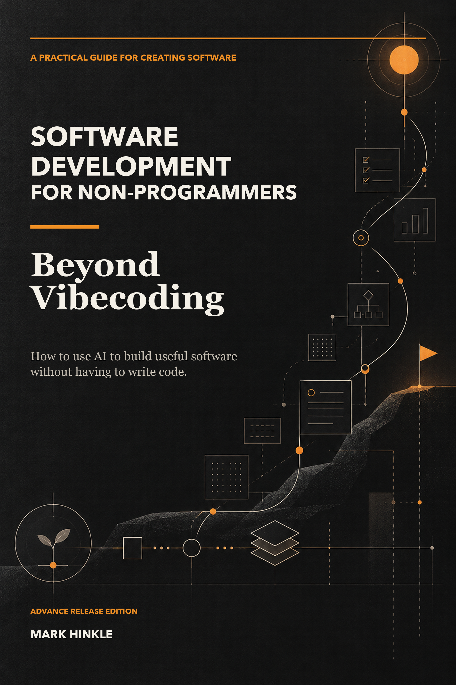

// BONUS · ADVANCE COPY
5:50–6:00
Make the book better
Take an advance copy of Software Development for Non-Programmers.
Read it. Mark it up. Tell me where I lost you.
A useful review beats a polite one. Positive, critical, and mixed reviews are welcome.
Ask me for the advance copy.
62 / 63
Notes:
I wrote this because non-programmers deserve a path from an idea to something they can own.
If you want the advance copy, ask me for one. Read it, mark it up, and tell me where I lost you.
Ask for an honest review. A useful review beats a polite one; do not imply that a favorable review is required.

Slide 63

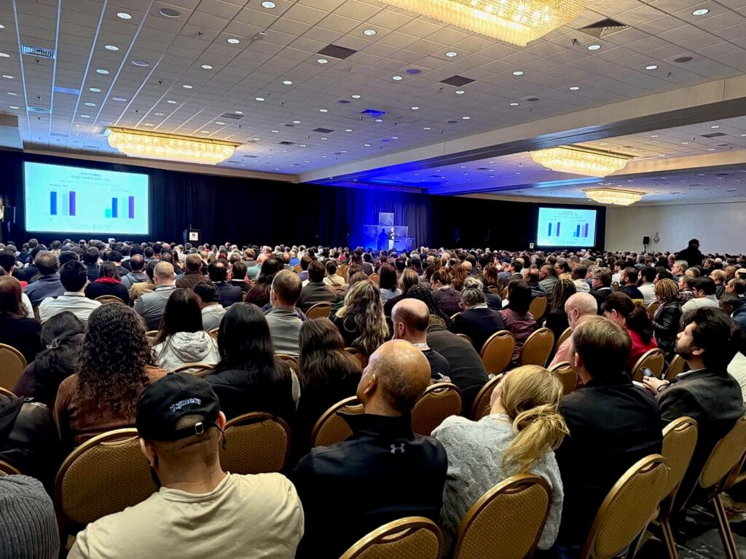

// CLOSE
6:00
You own the work
Six hours ago, the website and game were examples. Now each project has files in your GitHub, a home in Vercel, and a URL another person can open. You can plan the next change, design it, build it, test it, deploy it, and maintain what happens next.
Mark Hinkle · theaienterprise.io · AI Agents & Vibe Coding · All Things Open 2026
The Triangle’s AI business community. April 18–20, 2027, Raleigh.
63 / 63
Notes:
5:50–6:00. Before people leave, ask them to tell the person next to them one thing they learned and one thing they will try next. Take two or three answers out loud.
Offer the advance-release book copy on the preceding slide and ask only for an honest review.
Close with: You don’t have to be a programmer. You do have to own the work.
Then read the evidence back: the repo, domain, deployment history, data, and operating checklist leave with the participant.
VERIFY BEFORE STAGE: confirm the All Things AI April 18–20, 2027 dates and Raleigh location on allthingsai.org.
TRADEMARK NOTICE: Vercel, the Vercel design, Next.js and related marks, designs and logos are trademarks or registered trademarks of Vercel, Inc. or its affiliates in the US and other countries. GitHub and the GitHub logo are trademarks of GitHub, Inc. Git and the Git logo are trademarks of Software Freedom Conservancy, Inc., corporate home of the Git Project.

