Slide 1

(Non-Standard Evaluation)

Slide 2
What do we mean by Evaluation?

Slide 3
Motivating examples ….

Slide 4
Standard evaluation
Names
Values

Slide 5
Standard evaluation bindings
Names
Values
where does r look to find the appropriate bindings?

Slide 6
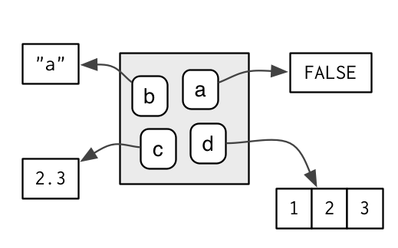
Standard evaluation environments

Slide 7
Like a list Has a parent names unique
Standard evaluation environments

Slide 8
Standard evaluation famous environments
Global Environment – globalenv()
Base Environment – basenv()
Empty Environment – emptyenv()
Current Environment – environment()

Slide 9
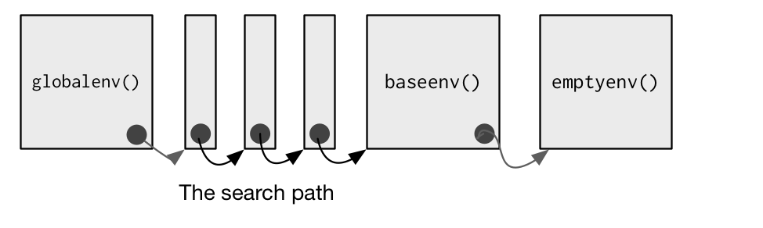
Standard evaluation search path

Slide 10
Standard evaluation functions and environments
Enclosing
Binding
Calling
Executing

Slide 11
Standard evaluation packages and environments
Enclosing = package namespace environment
Binding = package environment

Slide 12
Standard evaluation some Examples …

Slide 13

Not so Standard evaluation dynamic scoping

Slide 14

Non-Standard evaluation promises
EXPRESSION to compute a value
ENVIRONMENT in which to compute it

Slide 15

Non-Standard evaluation substitue + eval
substitute()
Capture expression, sub arguments
eval()
Evaluate an expression,
Select environment

Slide 16

Non-Standard evaluation promises
EXPRESSION
SUBSTITUTE
ENVIRONMENT
EVAL

Slide 17
Non-Standard evaluation substitute – does a bit more
Examines names in expression and:
If variable – replace value
If promise – expression associated with promise
… - use contents of …
Behaves differently in functions and globalenv()

Slide 18
Non-Standard evaluation Eval – does a bit more
Environments like lists
So can use list like objects as environments in eval()
(i.e data.frame, list)

Slide 19
Non-Standard evaluation some examples …

Slide 20


Non-Standard evaluation good or bad

