Slide 1
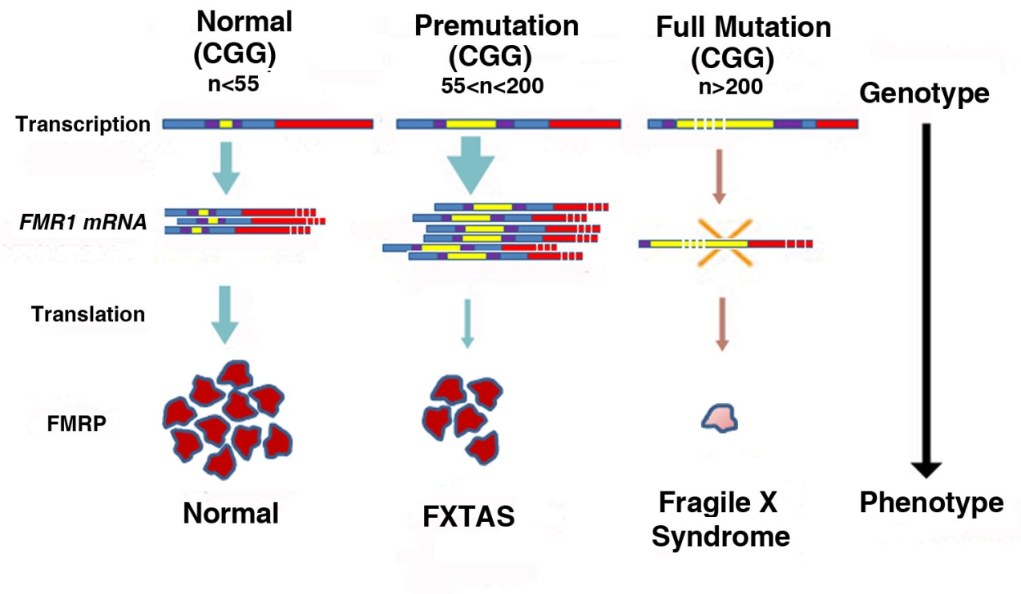
Figure 1. Normal individuals have CGG repeat lengths (yellow segments) on FMR1 between 5-54 CGG repeats. Repeat size in the premutation (PM) range is between 55-200, FMR1 mRNA levels are elevated, FMRP is slightly decreased, and there is increased risk of FXTAS. Repeat size in the full mutation is >200, FMR1 transcription is silenced due to hypermethylation, and the absence of FMRP results in Fragile X syndrome [adapted from Willemsen, et al 2011].

Slide 2
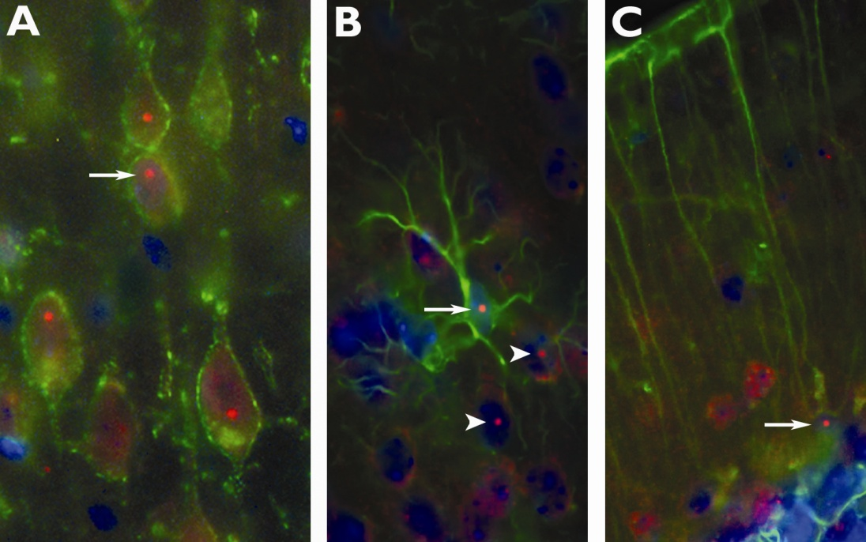
Figure 2. Immunofluorescent photomicrographs of ubiquitin-positive intranuclear inclusions (arrows) immunolabeled red in (A) pyramidal neurons in motor cortex (B) astrocytes and (C) Bergmann glia of CGG KI mice. Neurons (A) were immunolabeled for Kv2.1 potassium channels in the membrane (green), (B) lamina I neocortical astrocytes and (C) Bergmann glia were immunolabeled with GFAP (green). In (B) note several intranuclear inclusions in adjacent neurons (arrowhead). Nuclei were stained with DAPI. (Adapted from Wenzel, et al., 2010).

Slide 3
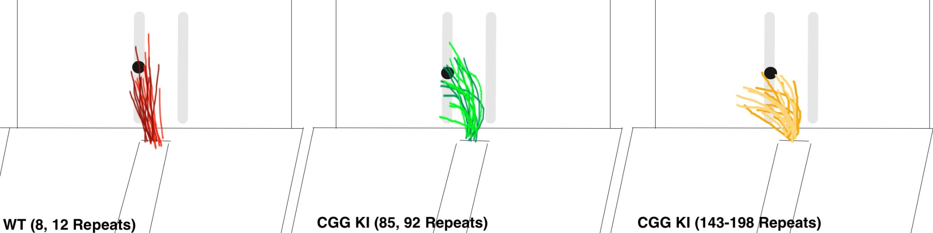
Figure 3: Traces for reaching trajectories over 10 consecutive reaches for 2 wildtype mice (WT), 2 low CGG KI mice (CGG repeats = 85, 92) and 2 high CGG KI mice (CGG repeats = 143, 198). Note the increasingly radial trajectories in mice with expanded CGG repeats compared to WT mice.

Slide 4
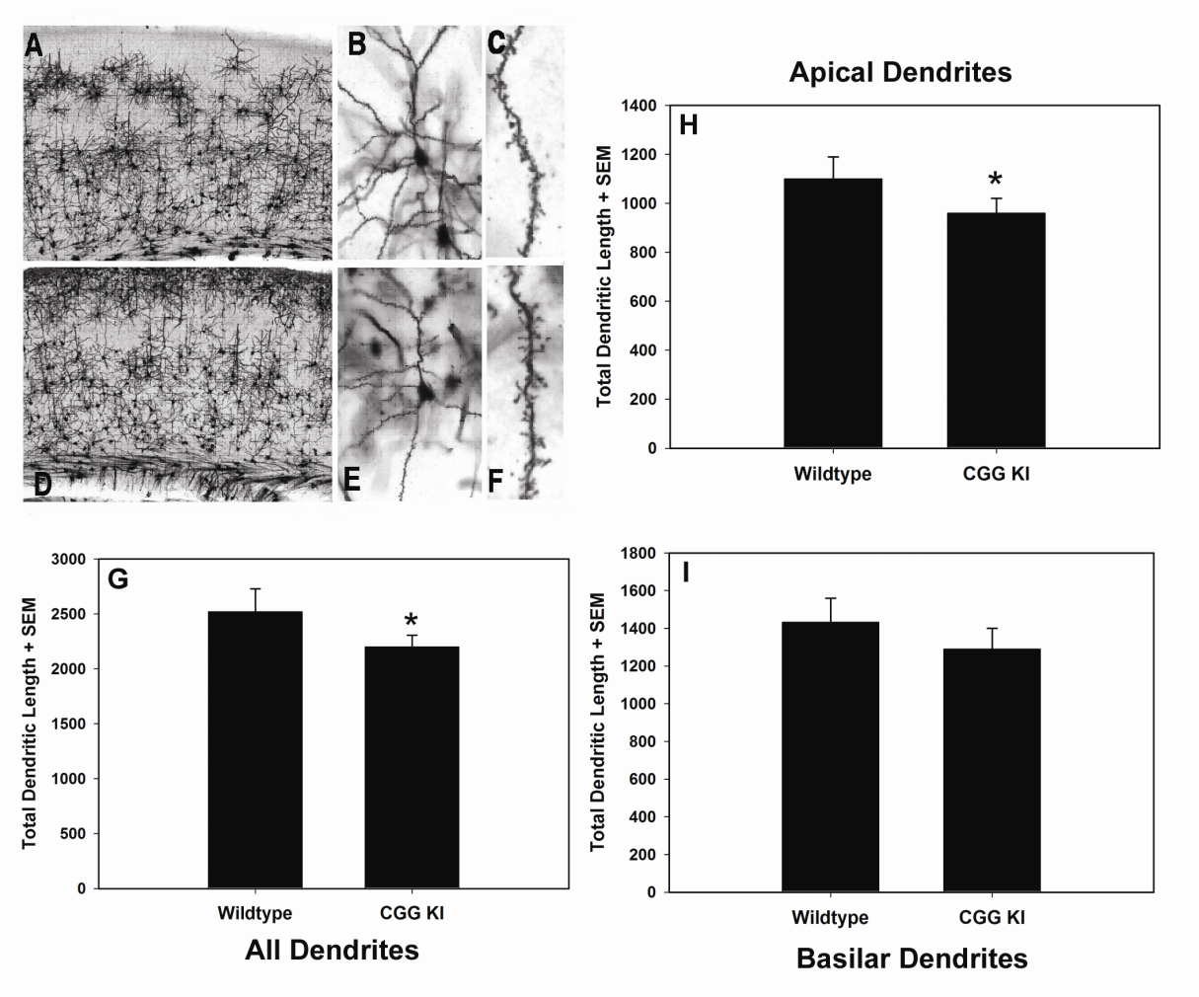
Figure 4. Representative photomicrographs of Golgi-Cox stained pyramidal neurons in layer II/III of primary visual cortex of WT (A, B, C) and CGG KI mice (D, E, F) at progressively higher magnification. Total dendritic length was calculated from reconstructed dendritic arbors using Neurolucida software. Total dendritic length (G) was reduced for all dendrites (p < 0.05), but was only significantly reduced for apical dendrites (p < 0.05) when apical (H) and basilar (I) dendrites were analyzed separately. Magnification: A &D– 4·, B & E – 20·, C & F – 100·. Reprinted with permission Epilepsia ILAE

Slide 5
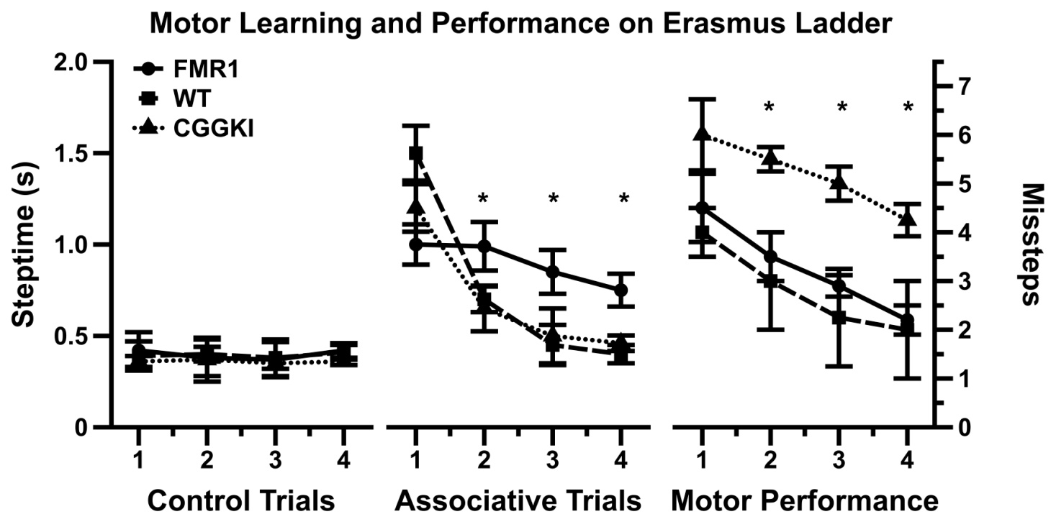
Figure 5: Data redrawn from Cupido (2009) demonstrating the dissociation between motor performance and motor associative learning in CGG KI mice and the Fmr1 KO mouse models of fragile x syndrome.

