Slide 1


Library Management System
By Dharmarlou Bowen & habban Islam

Slide 2
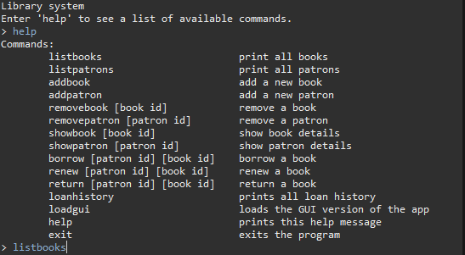
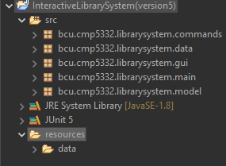
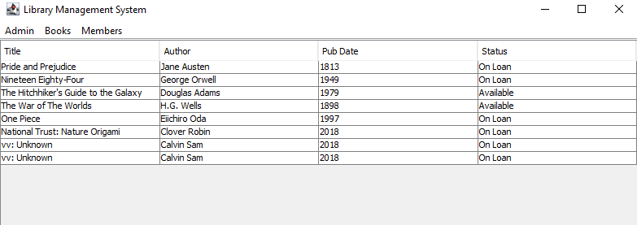
Holistic Overview of Program
The Library Management System serves the purpose of providing an interface for Library staff to add, modify, remove and keep track of books being borrowed by their patrons.
The program provides a Command-Line Interface in additional to an optional Graphical User Interface if the user prefers such an environment.
The program consists of 5 key packages (main, model, data, gui and commands) which each serve a specific purpose in ensuring full functionality of the program.
User & Book Data is stored in text files.

Slide 3
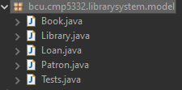
Model Package (Overview)
All the core object classes of the program are stored in this package. There are 3 key classes (Loan, Patron & Book) that are interacted with in addition to one (Library) that is used to provide methods that allow for interactions between them (in association to their respective commands).
Each class has fields about that store appropriate data.

Slide 4
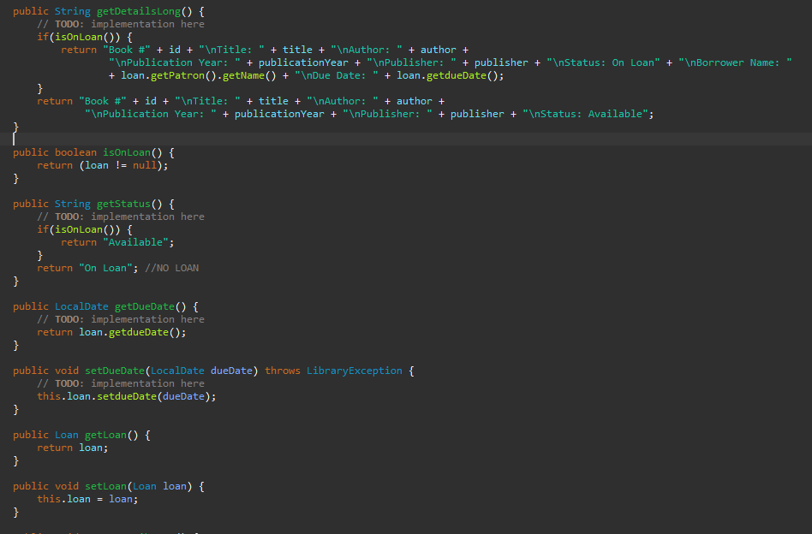
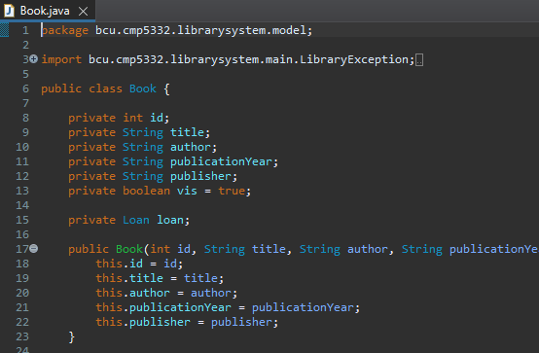
Book Class/Object
Book class models a book in the library.
The book has fields for different book properties such as title and author and has an id field that represents the book's unique id in the library system. In addition, the class has a loan field of type Loan that holds information about a book that is on loan.
The class also offers getter and setter methods to get and set the values of the different properties and methods that change the status of the book when it gets borrowed or returned to the library.

Slide 5
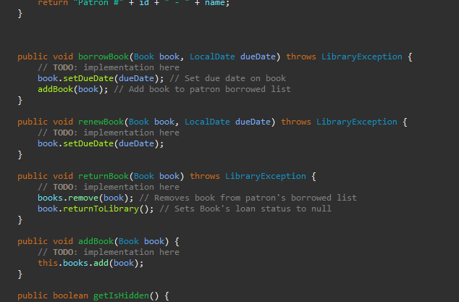
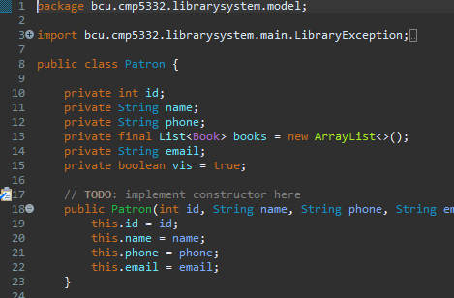
Patron Class/Object
Patron class models a patron (member) of the library.
The class has fields for different patron properties such as name and phone number and has an id field that represents the patron's unique id in the library. In addition, the class has a list of the books that a patron has borrowed.
The class also offers getter and setter methods to get and set the values of the different properties and methods that allow for borrowing, returning and renewing books.

Slide 6
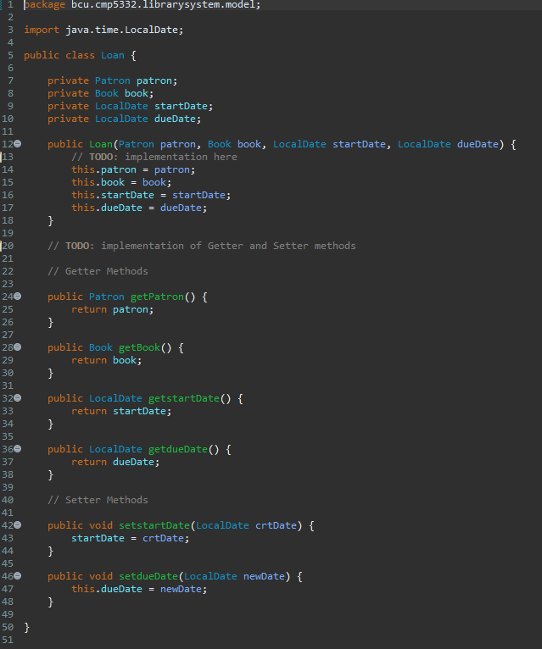
Loan Class/Object
Loan class models an object that holds information about a book that is on loan.
The class has as fields a Patron object which represents the patron that has borrowed the book, a Book object that represents the book that is on loan and two LocalDate objects that represent the date the loan started and its due date.
The class also offers the basic getter and setter methods to get and set the class's different properties.

Slide 7
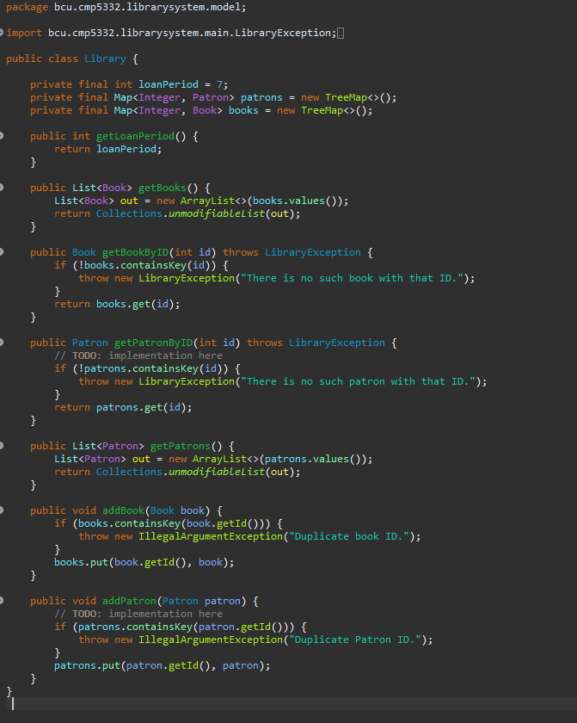
Library Object/Class
Library class models the whole library.
It has a collection of all books and all members (patrons) and can also hold other global library properties such as the maximum loan period in days.
When the application starts, the Main class of the app loads the stored data from the file storage using the LibraryData class and populates the collections holding the patrons and books.
The class offers methods to get all the books and patrons as a list and to get a specific book or patron using their id.

Slide 8
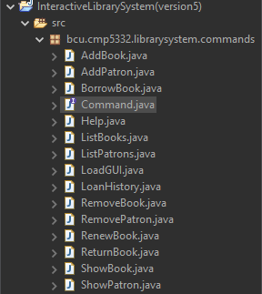
Command Package (Overview)
The command package consists of all the classes used to perform various operations concerning the objects used in the library system.
All of implement a command interface that lets them use the execute() method that is overridden appropriately for each given class.

Slide 9
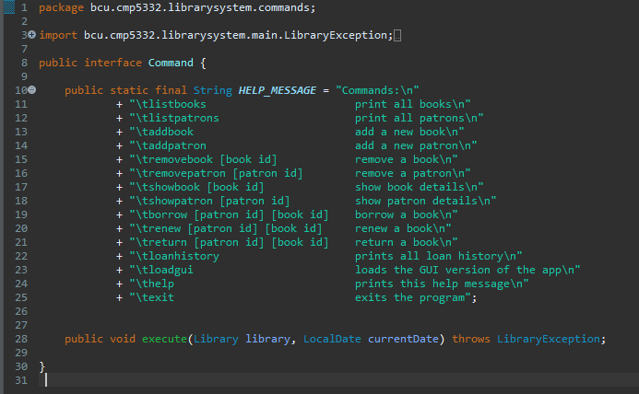
Command Interface
The Command interface models an action that occurs as a result of a command given by the user.
The interface provides the execute(Library, LocalDate) function which must be implemented by all the objects that implement the Command interface.
In addition, all classes that implement this interface, can have a constructor to initialize additional objects (if needed) for the execution of the command.

Slide 10
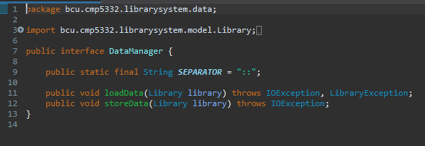
Data Manager Interface Usage
There data manager is implement in many of the commands as well to enable the functionality of data being stored during the execute of the command.
This method of storing data is far more effective than data being store when the user exits the program as the program has to be exited before a new object can be fully interacted without error.

Slide 11
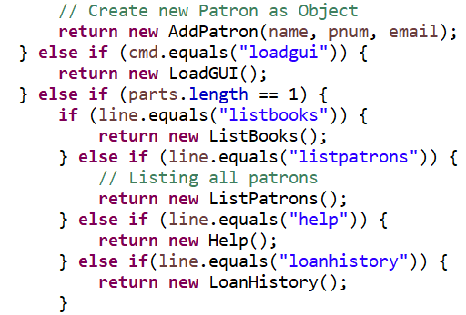
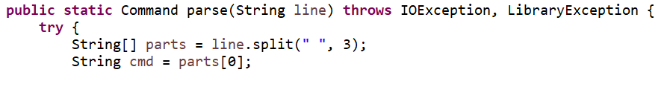
Command parser
Command parser is used to break down each part of code which allows us to display them in txt file line by line
Parser takes input as sequence form and outputs as parser tree
Line.split is used in parser to split the lines

Slide 12
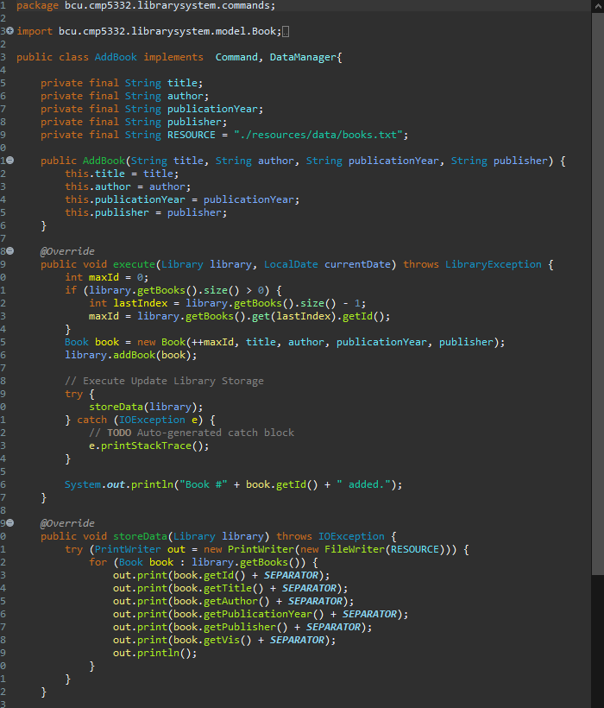
AddBook Command
Adds a new book to the library.
It is an implementation of the Command interface and it execute(Library, LocalDate) method adds a new Book to the library.
It is created and executed by the CommandParser when the "addbook" command is given by the user.
When a new book is being added the library system repository of books are checked for their IDs and an incremented value of the last ID is assigned to a new book

Slide 13
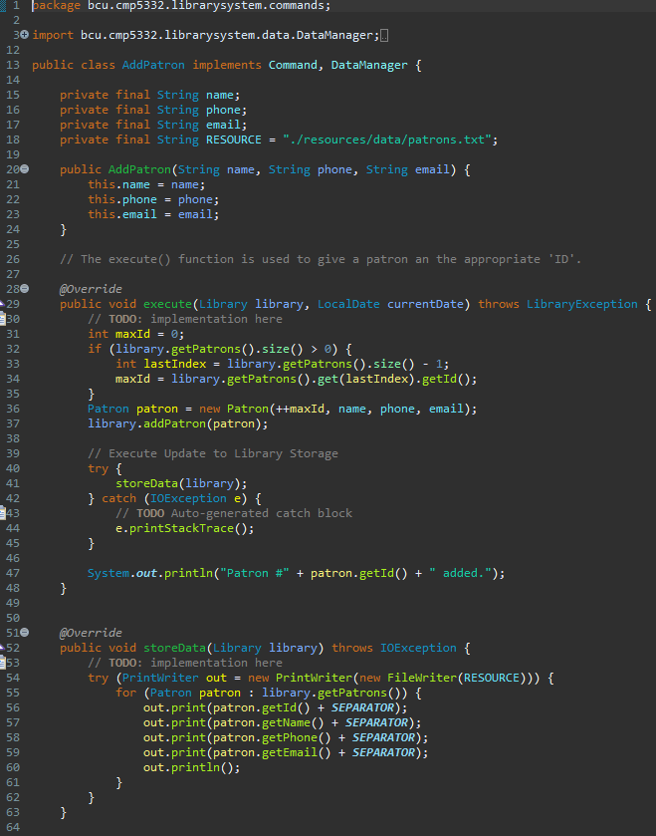
AddPatron Command
Adds a new patron to the library.
It is an implementation of the Command interface and it execute(Library, LocalDate) method adds a new Patron to the library.
It is created and executed by the CommandParser when the "addpatron" command is given by the user.

Slide 14
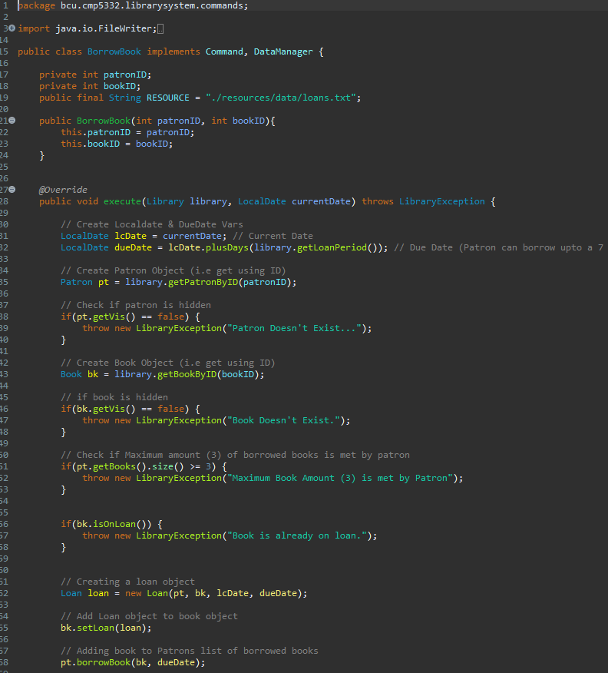
BorrowBook Command
Executes the actions needed to lend a book to a patron.
It is an implementation of the Command interface and it execute(Library, LocalDate) method assigns a Book to a Patron.
It is created and executed by the CommandParser when the "borrow book" command is given by the user.

Slide 15
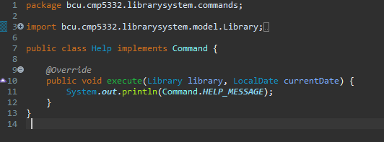
Help command
Displays a help message to the user.
It is an implementation of the Command interface and its execute(Library, LocalDate) method prints the Command.HELP_MESSAGE to the console.

Slide 16
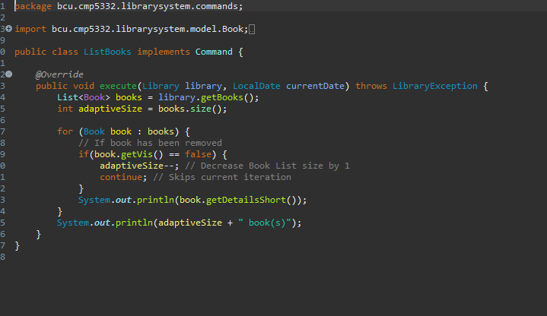
ListBooks command
Shows a list of all library books to the user.
It is an implementation of the Command interface and its execute(Library, LocalDate) method displays a list of the library books to the user. At the end of the list, the total amount of books in the library is also displayed to the user.

Slide 17
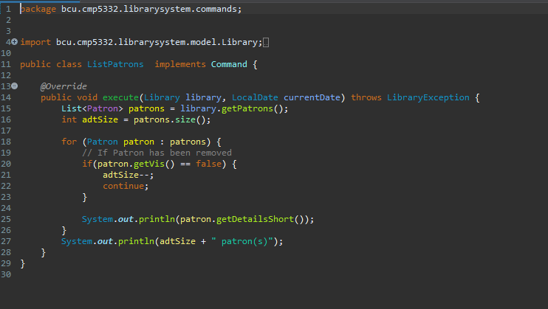
ListPatron Command
Shows a list of all patrons of the library to the user.
It is an implementation of the Command interface and its execute(Library, LocalDate) method displays a list of the library patrons to the user. At the end of the list, the total amount of patrons in the library is also displayed to the user.
It is created and executed by the CommandParser when the "listpatrons" command is given by the user.

Slide 18
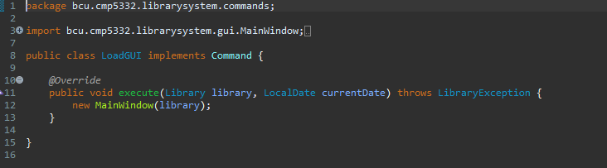
Loadgui command
Starts the GUI of the application.
It is an implementation of the Command interface and its execute(Library, LocalDate) method creates a new MainWindow object that launches the GUI of the application.

Slide 19
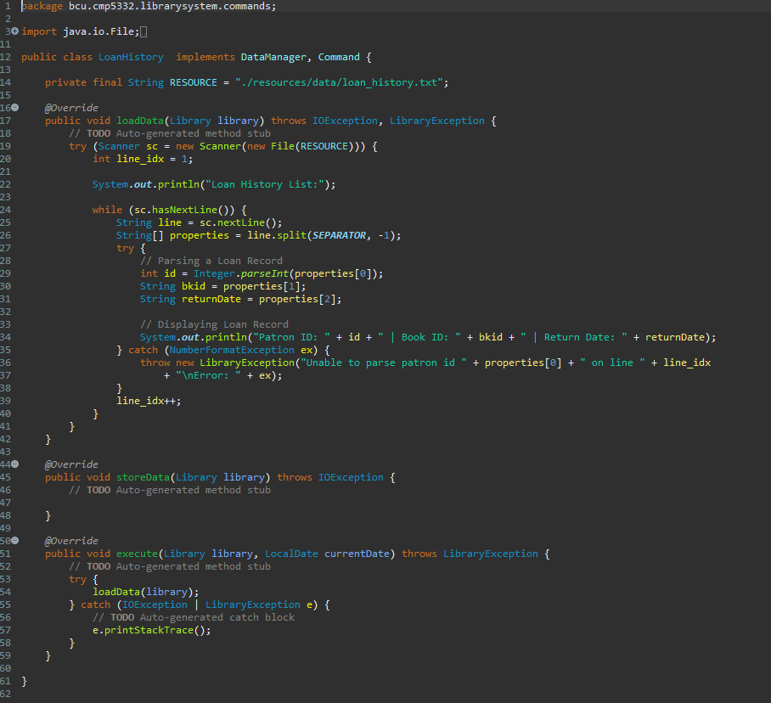
LoanHistory Command
This command is used to display to the user the loan history of books that have been borrowed and then return to the library.
A patron's, book’s ID and return date are stored in a “loan_history.txt” file to be viewed at a later date.
The data is updated every time a book is returned using the return book command.

Slide 20
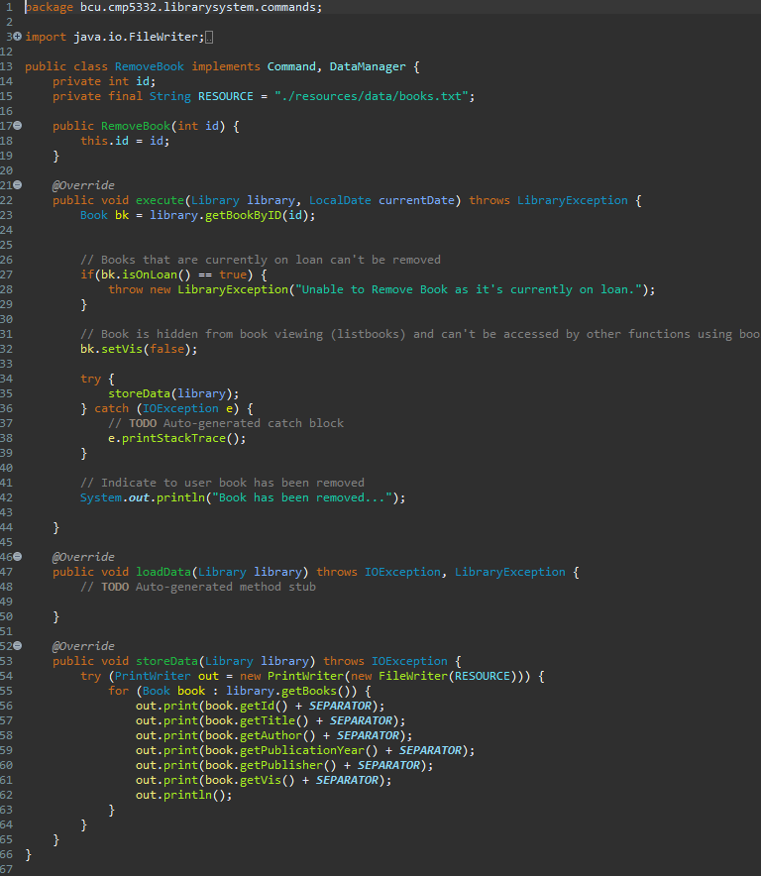
RemoveBook command
This command removed a book by being given a book ID.
When a book is removed it isn’t deleted from the library’s file system but is hidden an is unable to be accessed by functions that previously would be able to interact with a book.
The command sets the “vis” field in a book to false, as it is a Boolean data type.
If the vis field is set to false then the object is now hidden an can not be interacted with, by default it is set to true when an object is created.

Slide 21
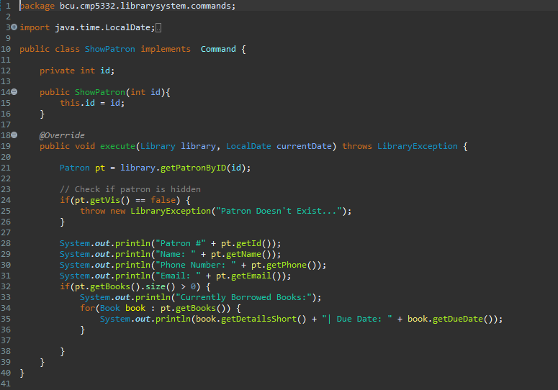
RemovePatron command
This command follows the same process to removing a book, but instead a patron is removed by being given a patron ID.
When a patron is removed it isn’t deleted from the library’s file system but is hidden an is unable to be accessed by functions that previously would be able to interact with the patron.
The command sets the “vis” field in a book to false, as it is a Boolean data type.
If the vis field is set to false then the object is now hidden an can not be interacted with, by default it is set to true when an object is created.

Slide 22
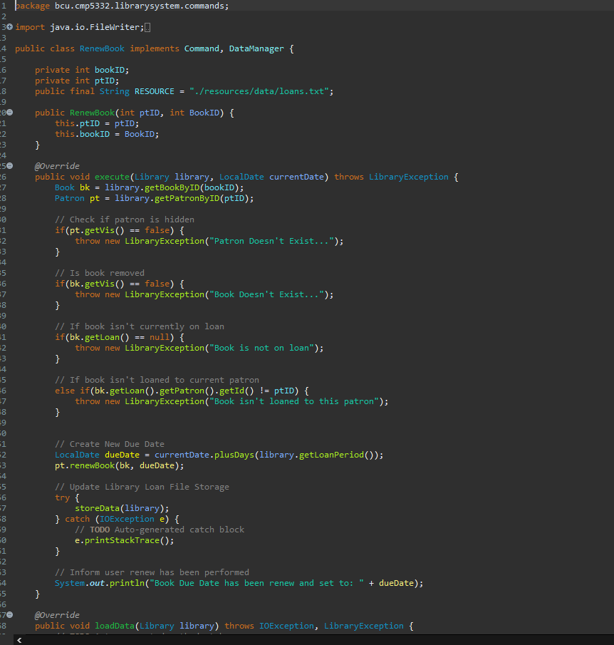
RenewBook command
Renews a book that is already on loan to a patron.
It is an implementation of the Command interface and its execute(Library, LocalDate) method renews (changes) the due date of a Book that is currently on loan to a Patron.
It is created and executed by the CommandParser when the "renewbook" command is given by the user.

Slide 23
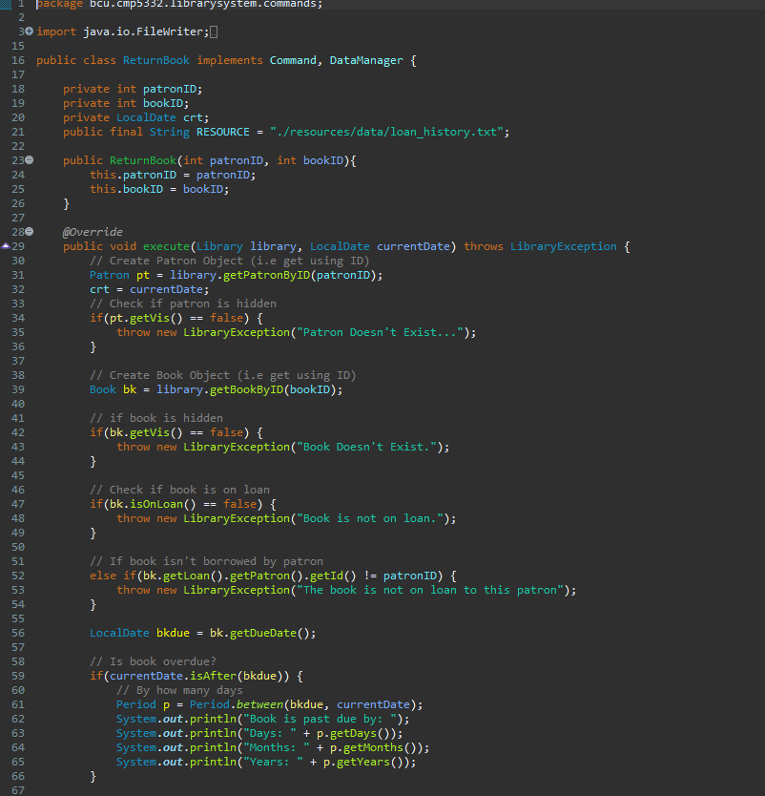
ReturnBook command
Returns a book to the library.
It is an implementation of the Command interface and its execute(Library, LocalDate) method returns a Book (that is currently on loan to a Patron) back to the library.
It is created and executed by the CommandParser when the "returnbook" command is given by the user.
The patron ID, book ID and return data is also written into the library’s loan history storage upon return.

Slide 24
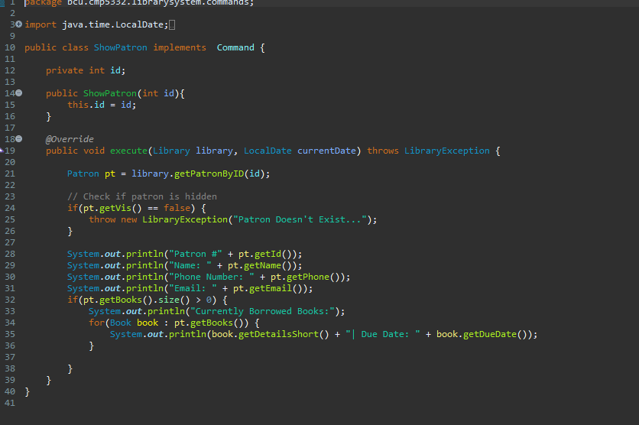
ShowBook command
Shows detailed information about a specific book.
It is an implementation of the Command interface and its execute(Library, LocalDate) method displays detailed information about a Book to the user. If the book is on loan, the method should display information about the patron that has borrowed the book as well as the due date of the loan.
It is created and executed by the CommandParser when the "showbook" command is given by the user.

Slide 25
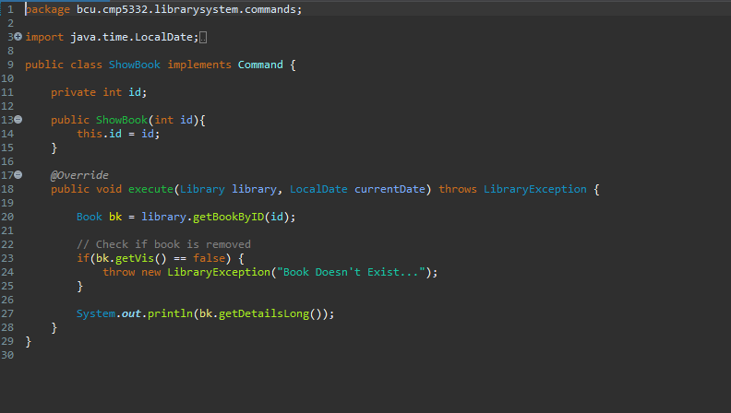
ShowPatron command
Shows detailed information about a specific patron.
It is an implementation of the Command interface and its execute(Library, LocalDate) method displays detailed information about a Patron to the user. If the patron has books on loan, the method should display information about these books as well as the due date for returning each one of them. In addition, the method should return the total number of books that the patron has on loan.
It is created and executed by the CommandParser when the "showpatron" command is given by the user.

Slide 26
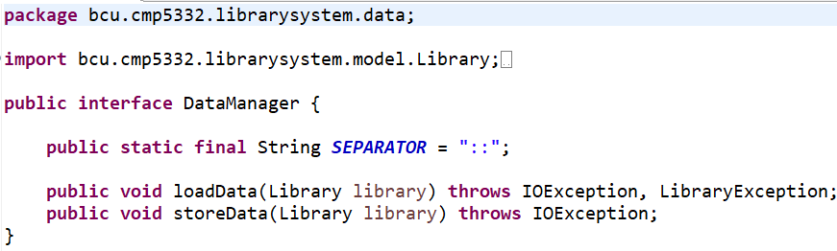
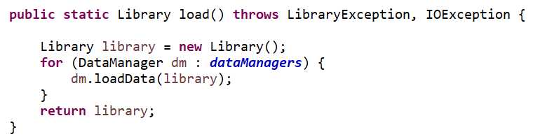
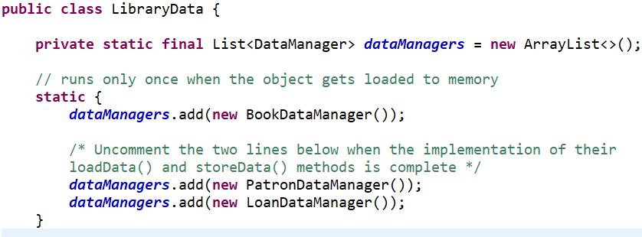
Data Managers (Overview)
Data manager interface contains load and store data constants which is then being used by data managers.
Library, patron, book and load manager implements data manager interface for loading and deleting

Slide 27
Main Package, Main Method
Initialise the loading of data (i.e runs the library data manager)
Uses the command interface for instruction
Uses Buffered reader to read from..
Help class in called out to display all the possible command which users can interact with

Slide 28
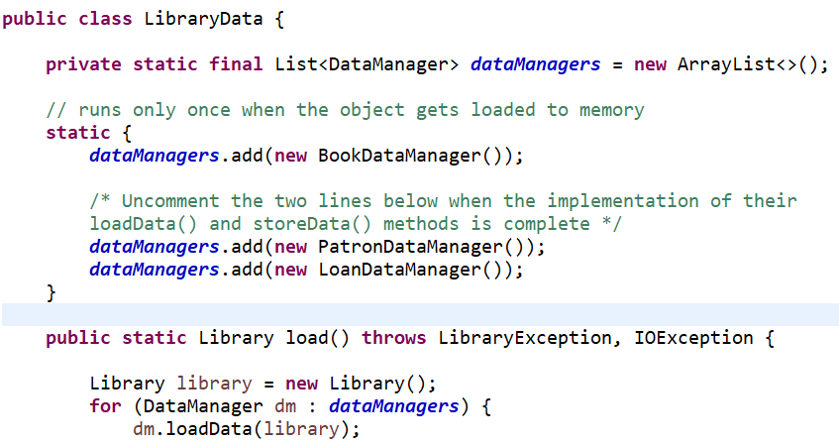
Library Data Manager
Uses a list with name ‘data manager’ to store all the information about patron, loan and book manager
Patron, load and book manager loads and stores data for each individual patron and book
All the manager such as book, patron and load are all combined and added to library data manager

Slide 29
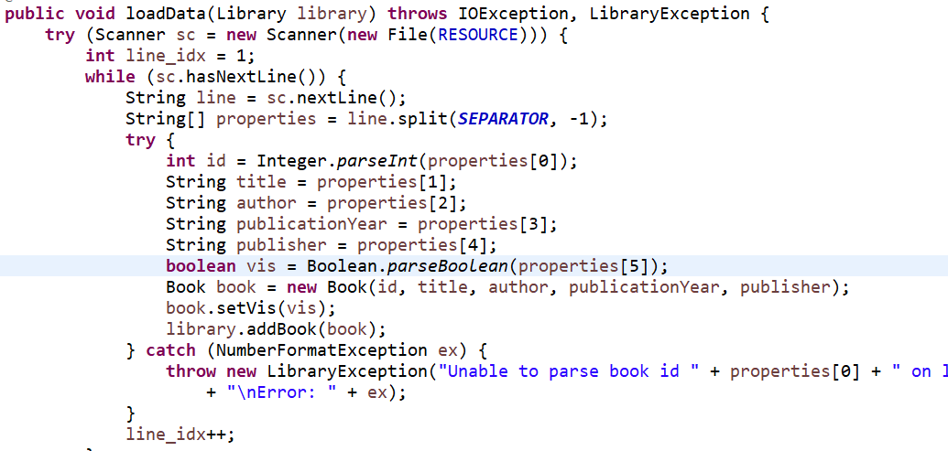
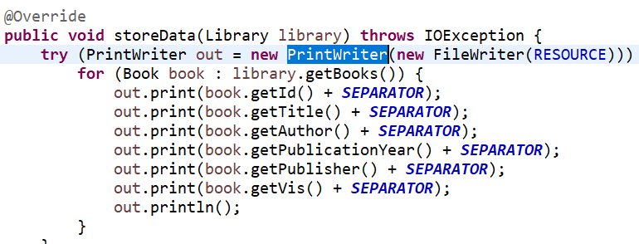
Book Data Manager
Load data and store data method for books are created there
Uses scanner to read for the file
Printwriter is used to store data in the txt file

Slide 30
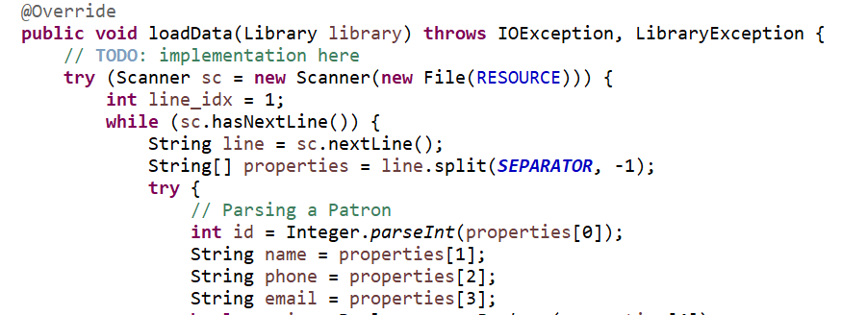
Patron Data Manager
Patron data manager saves all the patron information to a txt file
Data is loaded using scanner
Stored using PrintWrite

Slide 31
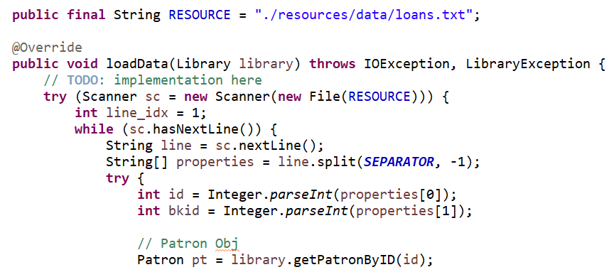
Loan Data Manager
Similarly loan data manager also uses scanner and Printwriter to load and save the data for loan
As other manager loan data manager also save all the loan to a txt file

Slide 32
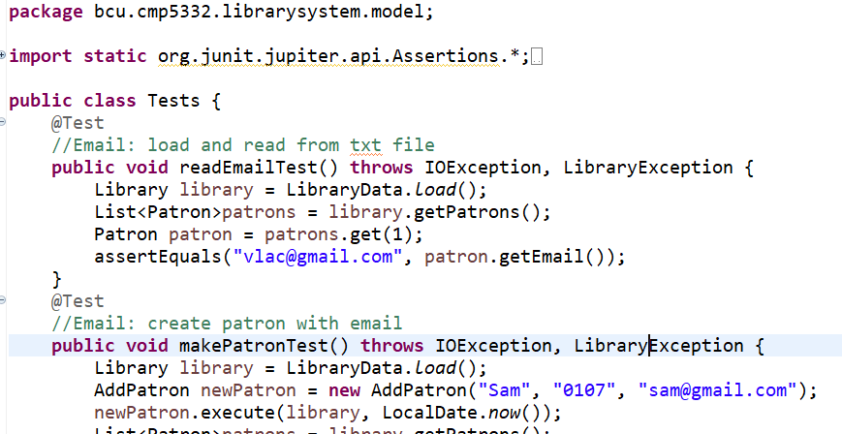
Unit Tests ()
In unit test I have mainly used assertEquals to check if the outcome of result is same as the expected results
I have also used IOException, LibraryException to take over if there is any error occurs during the coding running

Slide 33
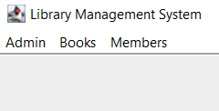
GUI Package (Overview)
Graphical user interface has been included for this project where I have created a nice frame to display all the outcome visually
GUI helps to navigate and get easier understanding of the project as all the out comes and results are displayed nicely
GUI have been created with 3 tabs admin, books and members where all the information can be easily understood

Slide 34
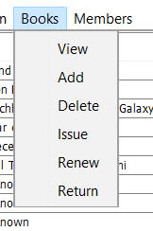
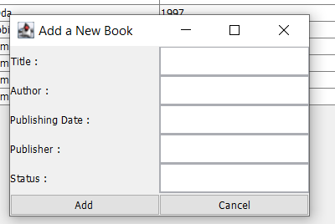
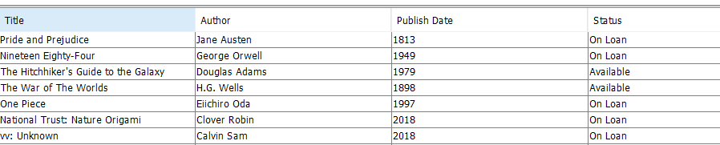
Book Tab GUI
It has 6 drop down lists view, add, delete, issue, renew and return
These dropdown menus can be used for specific purposes like view will display all the information about the book; it’s title, author, publish date and status
Other dropdowns like add will let us add books to the list of books

Slide 35
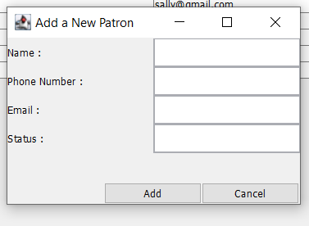
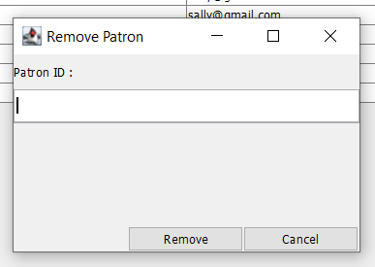
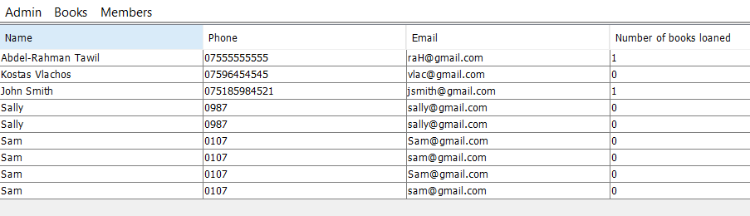
Member Tab GUI
Member tab also has drop down list which consists of view, add and delete
View allows us to see all the list of patrons and their information like name, phone etc
Add and delete helps to add new patron to the list of patrons or delete any specific patron using patron ID

