Slide 1


MACHINE LEARNING PROJECT
BOSTON HOUSING
PRICE PREDICTOR
An end-to-end machine learning project that estimates a home's market value from its property and neighborhood characteristics — from raw data, to a trained model, to a live interactive web app.
Presented By Moaz Riad
Boston Housing Price Predictor
1

Slide 2

01 · OVERVIEW
WHAT THIS PROJECT DOES
THE PIPELINE, IN SHORT
1
Collect & clean the data
The goal is simple: given information about a house and its neighborhood — how many rooms it has, the crime rate nearby, the pupil-teacher ratio at local schools, and more — predict what the home is worth. It turns a classic statistics dataset into a full, working data-science pipeline: cleaning data, engineering features, training a model, evaluating it honestly, and shipping it as a tool anyone can use in their browser.
2
Engineer new features
3
Train & compare LR vs GB models
4
Evaluate on held-out data
0.89
≈ $2,400
16
5
Deploy as a Streamlit web app
MODEL ACCURACY (R²)
AVG. PREDICTION ERROR
ENGINEERED FEATURES
6
Publish on GitHub
Boston Housing Price Predictor
2

Slide 3

02 · THE DATA
THE BOSTON HOUSING DATASET
A classic dataset from the 1970s covering 506 census tracts around Boston, each with 13 features describing the property and its surroundings, plus MEDV — the median home value we're trying to predict.
RM
LSTAT
CRIM
DIS
Average rooms per dwelling
% of population classed as lower status
Per-capita crime rate by town
Distance to Boston employment centers
PTRATIO
NOX
TAX
CHAS
Pupil-teacher ratio by town
Nitric oxide concentration
Property tax rate per $10,000
Borders the Charles River (yes/no)
+ 5 more features (ZN, INDUS, AGE, RAD, B) rounding out the full 13-column profile of each tract.
Boston Housing Price Predictor
3

Slide 4

03 · PREPROCESSING
CLEANING THE DATA BEFORE MODELING
Remove capped prices
Rows where MEDV = 50 are a known artifact of the original survey (values were top-coded), so they're dropped to avoid teaching the model a fake ceiling.
1
Log-transform skewed columns
CRIM, DIS, and LSTAT are heavily right-skewed. Applying log1p() compresses their long tails so the model can learn from them more effectively.
2
Split into train / test sets
80% of the data trains the model; the remaining 20% is held out purely for honest evaluation, using a fixed random_state for reproducibility.
3
Boston Housing Price Predictor
4

Slide 5

04 · FEATURE ENGINEERING
THREE NEW FEATURES, HAND-CRAFTED
Beyond the 13 original columns, three interaction features were engineered to help the model capture relationships the raw columns miss on their own.
RM × LSTAT
TAX ÷ RM
DIS ÷ RAD
RM_LSTAT
TAX_per_room
DIS_RAD
Combines room count with neighborhood status — a spacious home in a lower-status area prices differently than the two facts would suggest alone.
Normalizes tax burden by house size, giving a per-room tax rate rather than a flat neighborhood number.
Balances distance from employment centers against highway accessibility — being far away matters less if access is easy.
Boston Housing Price Predictor
5

Slide 6

05 · MODEL TRAINING
GRADIENT BOOSTING REGRESSOR
The final model is a scikit-learn GradientBoostingRegressor — an ensemble of shallow decision trees, each one correcting the errors of the last. It's a strong, reliable choice for structured tabular data like this.
train_model.py
df = df[df.MEDV < 50]
df.CRIM = log1p(df.CRIM)
df.DIS = log1p(df.DIS)
df.LSTAT = log1p(df.LSTAT)
model = GradientBoosting
Regressor(
n_estimators=300,
max_depth=3,
learning_rate=0.05,
random_state=42)
model.fit(x_train, y_train)
n_estimators
300 trees
max_depth
3 (shallow, to avoid overfitting)
learning_rate
0.05
random_state
42 (reproducible results)
Boston Housing Price Predictor
6

Slide 7

05 · MODEL COMPARISON
CHOOSING THE BETTER MODEL
Before settling on Gradient Boosting, a Linear Regression baseline was trained on the same data. It's fast and interpretable, but assumes straight-line relationships — Gradient Boosting captures the curves the data actually has, and that's why it won out.
compare_models.py
lr = LinearRegression()
lr.fit(x_train, y_train)
gb = GradientBoosting
Regressor(n_estimators=300,
max_depth=3,
learning_rate=0.05,
random_state=42)
gb.fit(x_train, y_train)
r2_score(lr) = 0.74
r2_score(gb) = 0.89
mae(gb) < mae(lr) -> GB wins
R² (test set)
Gradient Boosting: 0.89 vs Linear Reg: 0.74
MAE (error)
Gradient Boosting: ~$2,400 vs Linear Reg: ~$3,600
Non-linear fit
Only Gradient Boosting captures curved relationships
Final pick
Gradient Boosting — selected as the final model
Boston Housing Price Predictor
7

Slide 8

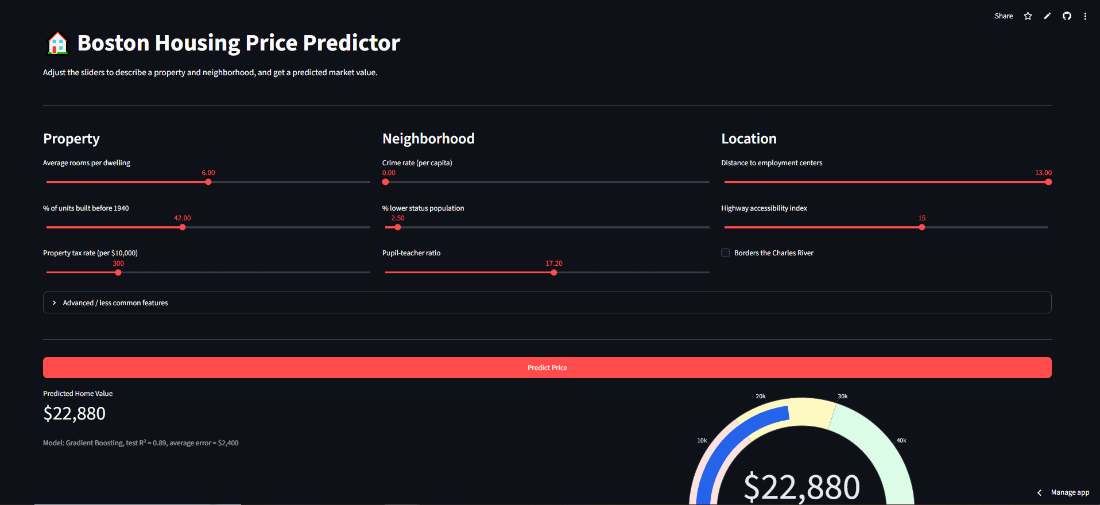
06 · THE WEB APP
AN INTERACTIVE STREAMLIT APP
The trained model is wrapped in a Streamlit app where anyone can move sliders for rooms, crime rate, distance, taxes and more, then get an instant predicted price with a live gauge and a breakdown of what drove it.
Boston Housing Price Predictor
8

Slide 9
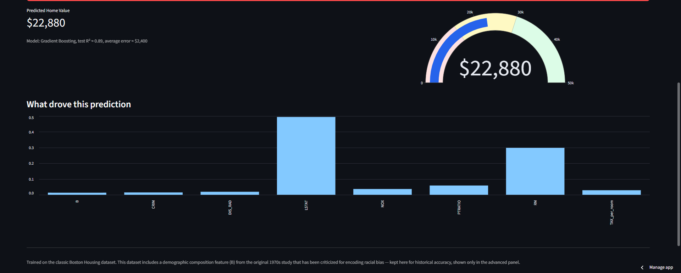
07 · MODEL PERFORMANCE
WHAT DROVE EACH PREDICTION
On held-out test data, the model reaches an R² of about 0.89 with an average error near $2,400. The gauge and feature-importance chart below — pulled straight from the live app — show a real prediction and the factors that shaped it. LSTAT (neighborhood status) and RM (room count) dominate, matching real-world housing intuition.
Boston Housing Price Predictor
9

Slide 10

08 · PIPELINE & STACK
FROM RAW DATA TO LIVE APP
boston.csv
(raw data)
→
train_model.py
(clean + train)
→
model.pkl
(saved model)
→
app.py
(Streamlit UI)
→
Streamlit Cloud
(public URL)
→
dashboard.xlsx
(Excel insights)
TECH STACK
Python
pandas / NumPy
scikit-learn
Streamlit
Plotly
GitHub
Streamlit Community Cloud
Excel
The workflow is simple and reproducible: train_model.py builds and saves the model once, app.py loads that model at runtime, and the whole folder is pushed to GitHub, where Streamlit Community Cloud deploys it as a public, no-login web app. A companion Excel dashboard mirrors the same insights for offline, spreadsheet-native sharing.
Boston Housing Price Predictor
10

Slide 11
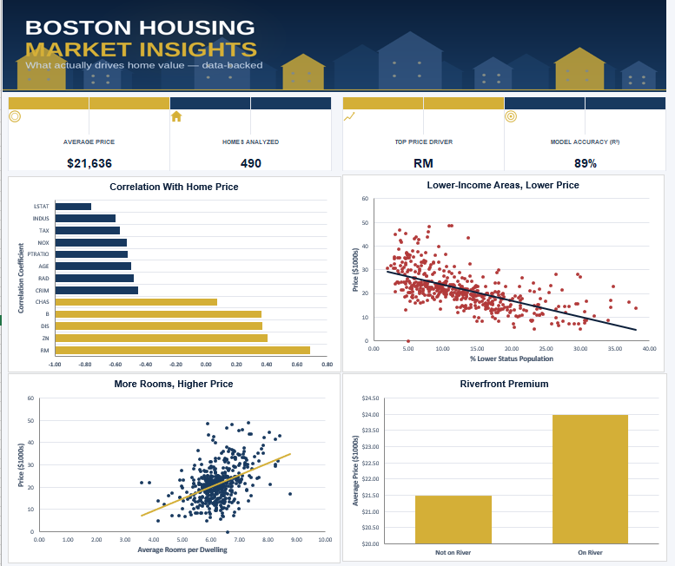
KEY INSIGHTS
THE STORY BEHIND THE NUMBERS
A quick-look dashboard — built entirely in Excel — summarizing the dataset: more rooms mean higher prices, lower-status neighborhoods trend lower, and homes on the Charles River carry a clear premium.
BUILT IN MS EXCEL
Thank you — Presented By Moaz Riad
Boston Housing Price Predictor
11

Slide 12

TRY IT YOURSELF
Everything above is live and open — explore the code, or make your own prediction.
LIVE WEB APP
bostonhouseprediction-xcvrykfektvw8acxuarrhq.streamlit.app
SOURCE CODE
github.com/moaz-riad/boston-housing-predictor
Presented By Moaz Riad
12

