Slide 1


Slide 2
Fedora: Thoughts, experiences and love!
F19 Release Party Peru
Universidad Alas Peruanas Filial Cusco 20/07/2013
Marcel Ribeiro Dantas mribeirodantas@fedoraproject.org
Fedora Ambassador/Translator

Slide 3


What is Fedora?

Slide 4


  An idea
What is Fedora?
Who is Fedora?
Why does Fedora matter?
How do you join the open source movement?

Slide 5

Free (Libre)
        As in Free Speech!

Slide 6

> 28000 Contributors
> 550 Ambassadors
> 600 Translators
Marketing/Packaging/Infrastructure/Freemedia..

Slide 7

Technical Excellence
  Upstream && Cutting Edge

Slide 8

Cutting edge
“We lead, never follow”
Release cycle

Slide 9
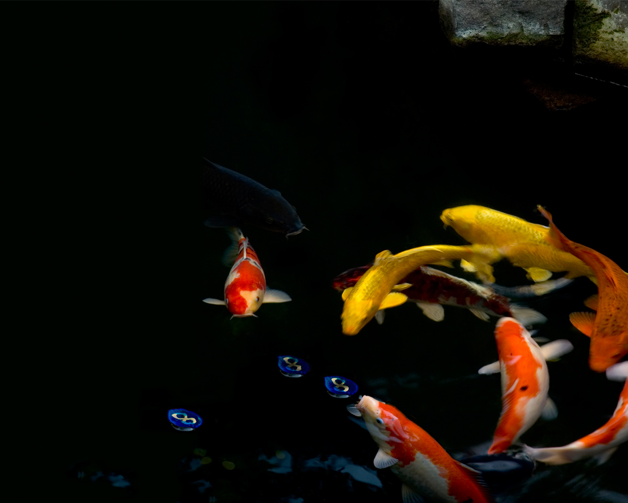
Welcome to Fedora Family!
The free side of the force :)

Slide 10
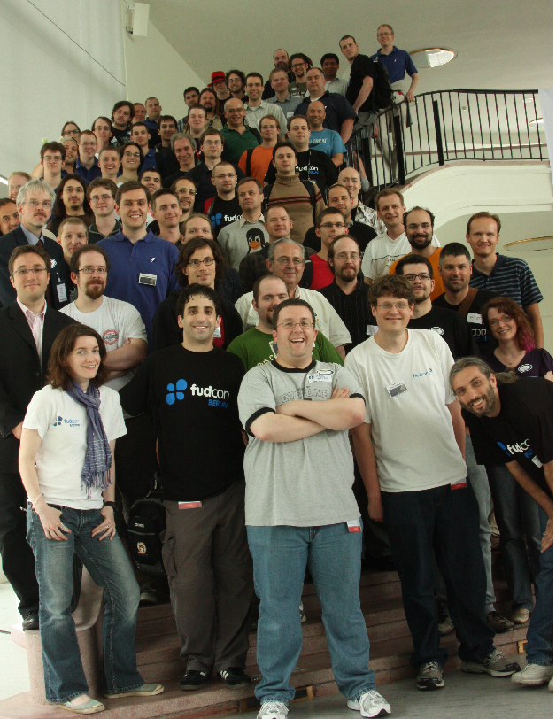

Slide 11

How can I join the family?

Slide 12






Documentation
Design
Marketing
Development
Translation
Web Development and Infrastructure

Slide 13
Is this idea important?

Slide 14

Fedora is important for..
OLPC
RHEL / CentOS
Moblin
AsterixNOW

Slide 15
But that's not what I'm talking about!

Slide 16
I'm talking about...
Freedom
Friends
Ethics
Building a community

Slide 17
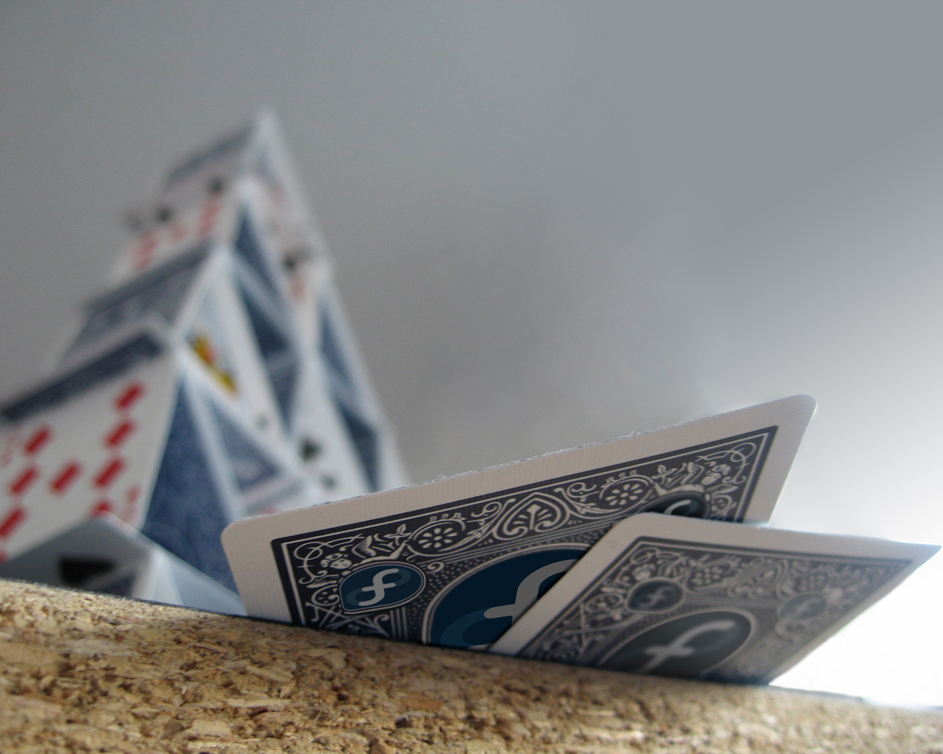
LATAM Community
  FAmSCo – Fedora Ambassadors Steering Committee
    Alejandro Perez
    Luiz Basan
  Ambassadors in Brazil scattered over 17 states
    =~45 Active Ambassadors

Slide 18
Mailing list
  https://lists.fedoraproject.org/mailman/listinfo/latam-users
  https://fedoraproject.org/wiki/Overview/es
Website
  http://fedoraproject.org
  http://ask.fedoraproject.org
Meetings:
  #fedora @ Freenode
  Wednesdays at 7:30pm #fedora-meeting

Slide 19

Web: http://mribeirodantas.fedorapeople.org
Mail: mribeirodantas@fedoraproject.org
IRC: mribeirodantas @ irc.freenode.net
Channels: #fedora-LATAM #fedora-ambassadors #fedora-br #fedora #fedora-l10n
Questions?

