Slide 1


Slide 2

Marcel Ribeiro Dantas
Fedora Ambassador
mribeirodantas@fedoraproject.org
X Latinoware
October 2013
Fedora: Sharing thoughts, experiences and passion.

Slide 3

What is an Ambassador?

Slide 4


Slide 5

A set of packages!
      Free Software (FSF)
      Open Source (OSI)
      Official repositories

Slide 6

Fedora helps us to value it!

Slide 7

> 20.000 Contributors
> 550 Ambassadors
> 600 Translators
Companies: Red Hat, IBM, Intel, Dell..
Community

Slide 8

You are NOT alone!

Slide 9

Make new friends!

Slide 10
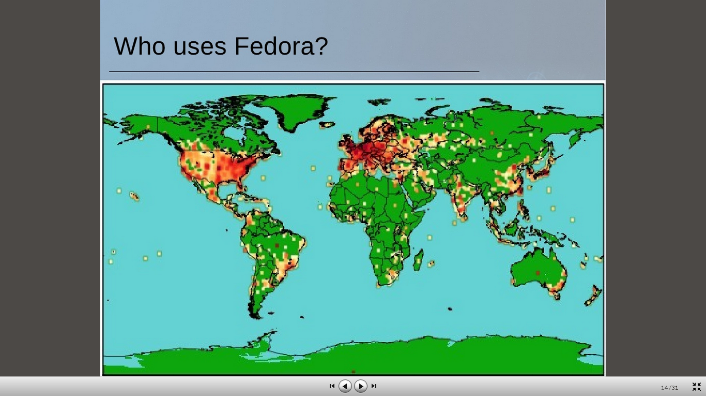
Enlarge your network!
2009

Slide 11

General Purpose OS
Fedora Games
Fedora KDE
Fedora LXDE
Fedora Xfce
Fedora Elec Lab
Fedora Design
Fedora Security
Pidora

Slide 12

“We lead, never follow”
One year update
Often release cycle
Upstream / Cutting edge

Slide 13


Slide 14


  Fedora Project
What is Fedora?
Who is Fedora?
Why does Fedora matter?
How do you join the open source movement?

Slide 15
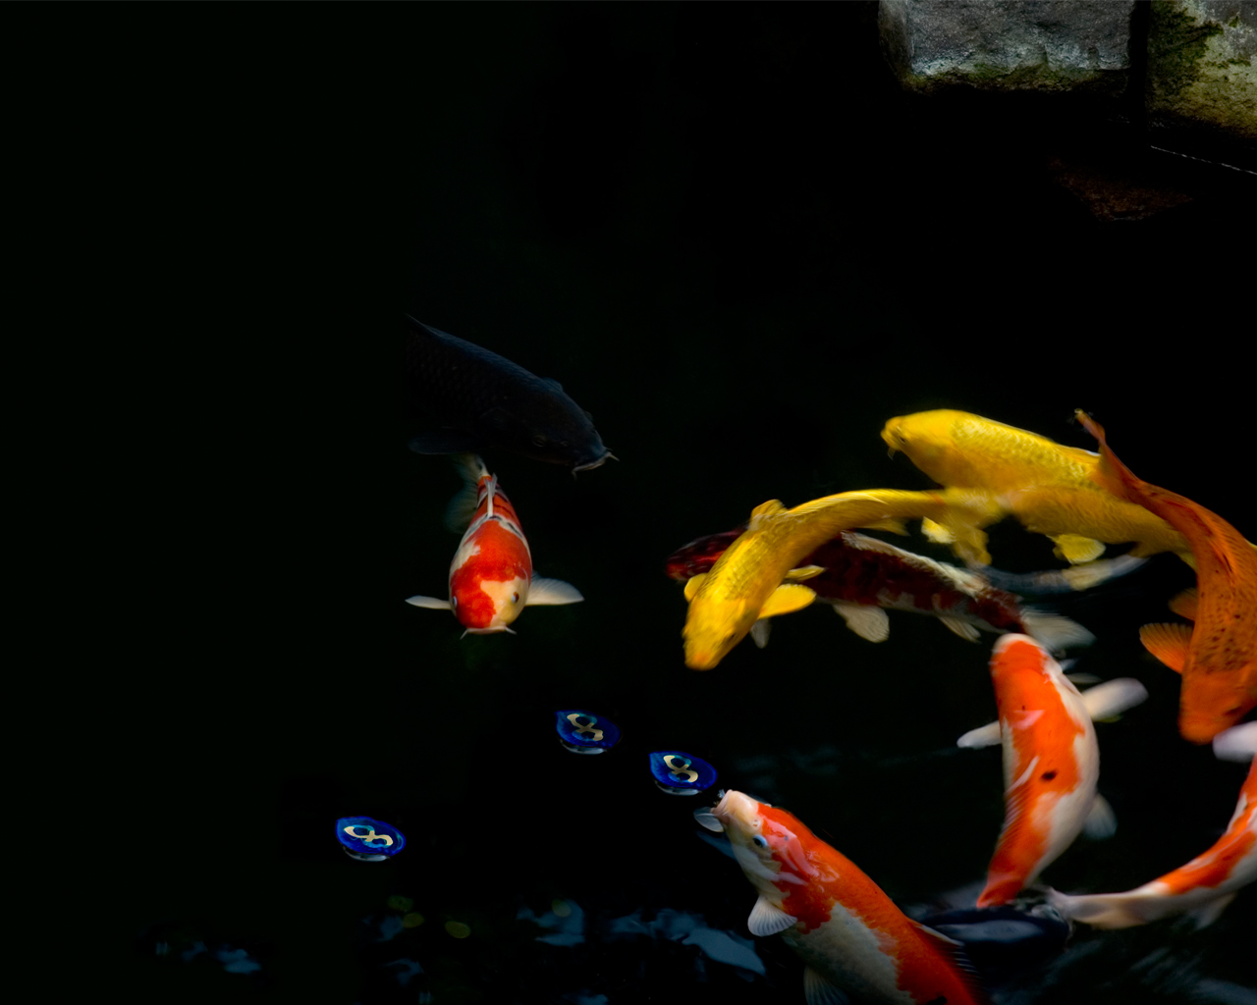
Who is Fedora?

Slide 16
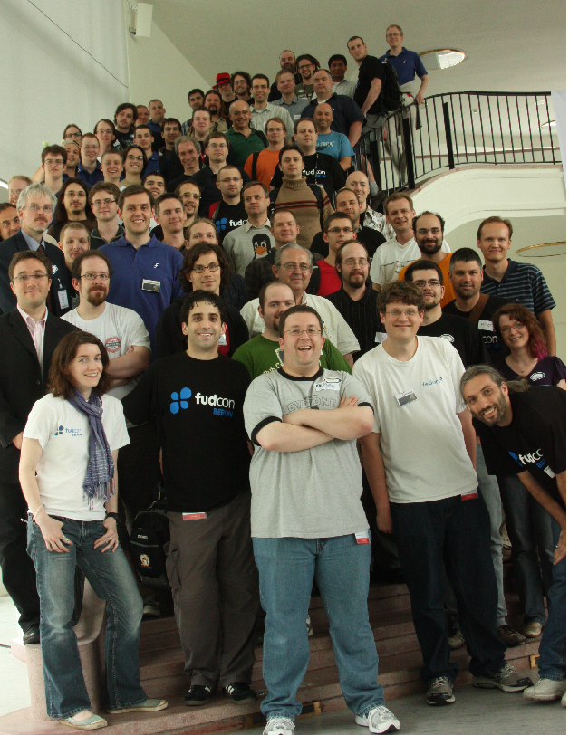

Slide 17
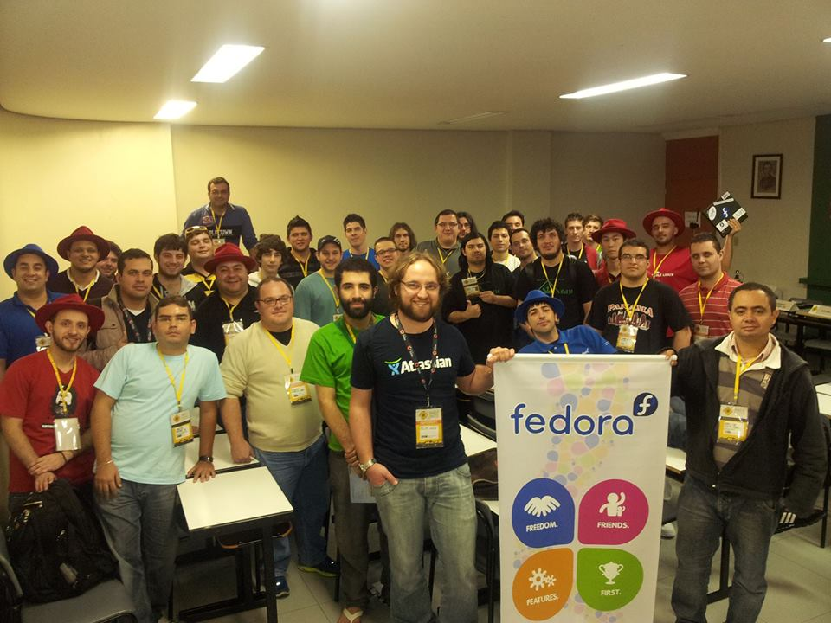

Slide 18






Fedora Teams
Documentation
Design
Marketing
Development
Public Relations
Globalization

Slide 19

Fedora's DNA
Packagers
vs
Developers

Slide 20

SIGs
Special Interest Groups
Cloud
Desktop
EPEL
Games
Gnome/KDE/LXDE/Xfce/...
Fedora Medical
Fedora Join

Slide 21

Significant Contributions

Slide 22
Linux
SELinux
Gnome e Xorg
Wayland
OLPC (SoaS)
Transifex
Nouveau / Radeon

Slide 23
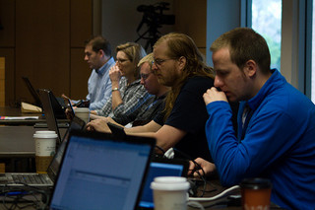
Who uses Fedora?

Slide 24
Linus Torvalds (?)
John Maddog Hall (?)
Some systems at NASA
Lots of Super Computers in the World
Evo Smart Console
Over a hundred of GNU/Linux based distros like Red Hat Enterprise Linux, Cent OS, BLAG and others.
~85% wikipedia servers, kernel.org, sourceforge.net

Slide 25
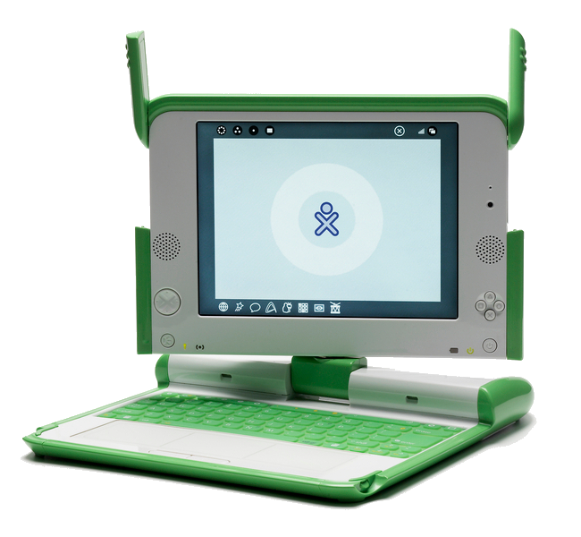
Importance of Fedora
OLPC
RHEL / CentOS
Moblin
AsterixNOW
Lots of others

Slide 26
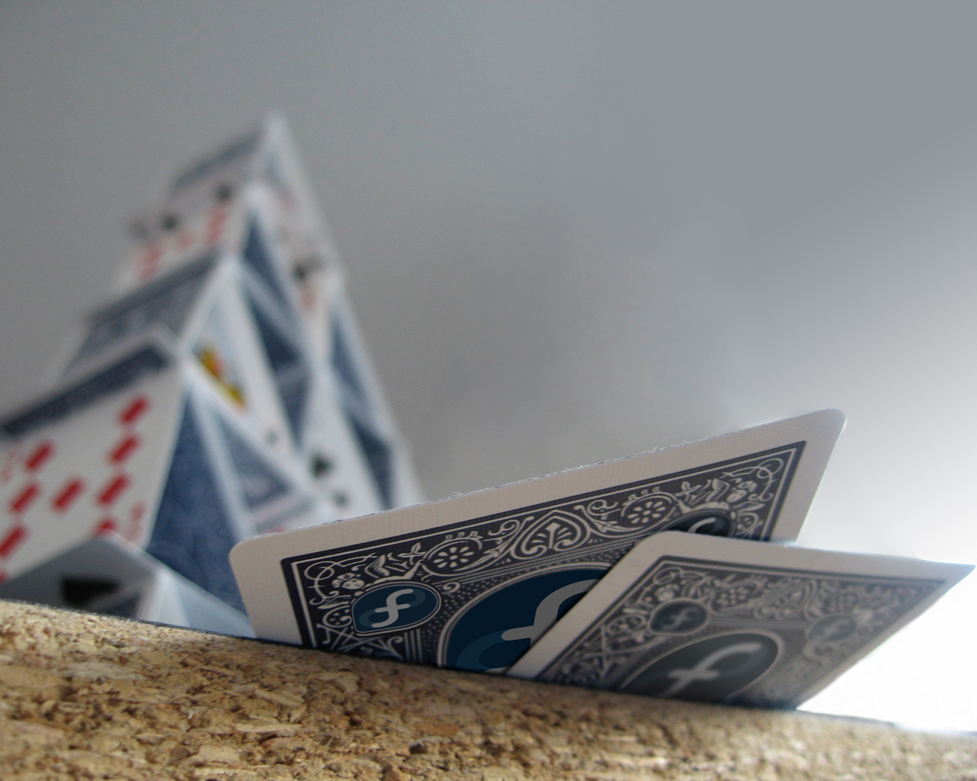
LATAM Community
  FAmSCo Fedora Ambassadors Steering Committee
    Alejandro Perez
    Luiz Basan
  Ambassadors in over 17 states
  45 ambassadors

Slide 27
Contact
Mailing list
  https://admin.fedoraproject.org/mailman/listinfo/br-users
  https://fedoraproject.org/wiki/Fedora_Project_Wiki
Website
  http://fedoraproject.org
Meetings:
  #fedora-br @ Freenode
  Wednesdays at 7:30pm #fedora-meeting

Slide 28
Web: http://mribeirodantas.fedorapeople.org
Mail: mribeirodantas@fedoraproject.org
IRC: mribeirodantas @ irc.freenode.net
Channels: #fedora-LATAM #fedora-ambassadors #fedora-br #fedora-mktg #fedora #fedora-l10n #fedora-admin #software-livre #potilivre
Questions?

