Slide 1
First Sprint group 15
Sprint Backlog
Updated Product Backlog
Burndown Chart
Sprint Review
Sprint Retrospective
First Sprint Release
Second Sprint Planning
Petagna Mario
Muro Lorenzo
Riccardi Mario
Lodato Gabriele

Slide 2
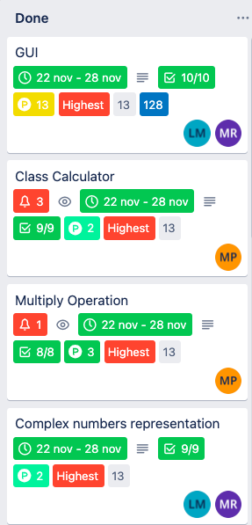
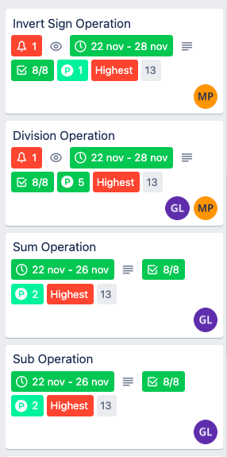
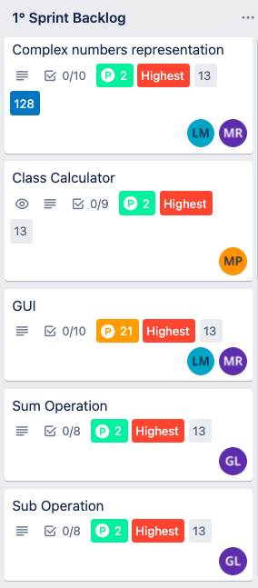
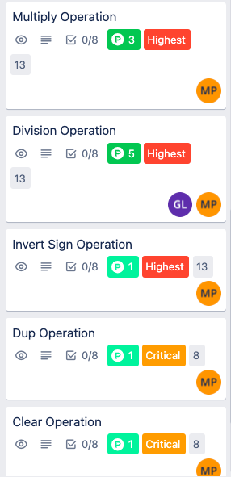
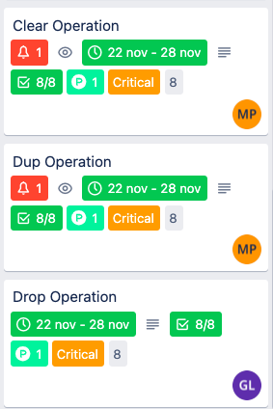
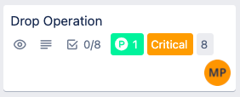
Sprint Backlog/Updated Product Backlog
Almost all user stories have been completed
The GUI user story has been divided in two cards
The Stack Creation card has been reinserted in the product backlog and reistimated
Estimated Velocity: 41 SP
Effective Velocity: 33 SP

Slide 3

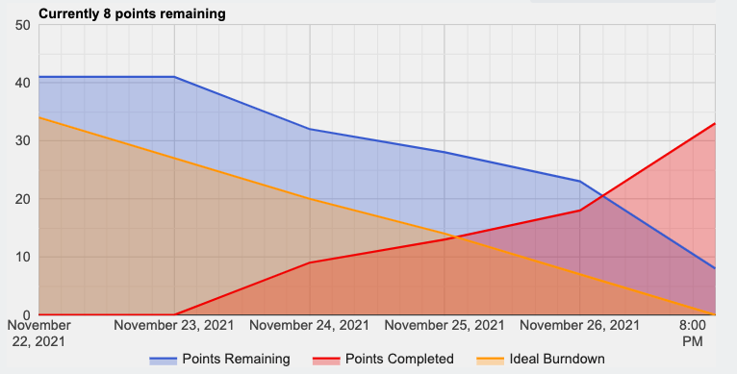
Burndown Chart
Burdown Chart Story Point / Days
The progress curve has always been above ideal
The curve of the Story points remaining at the end of the sprint does not coincide with the ideal one because of the last card not completed
We must increase our speed!

Slide 4
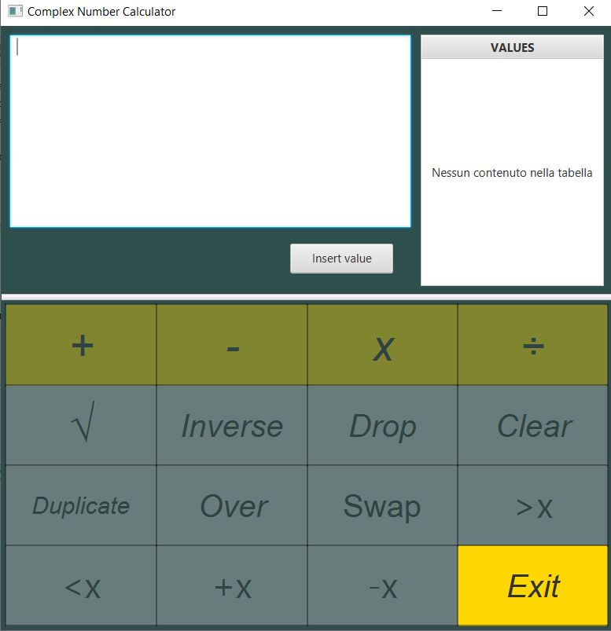
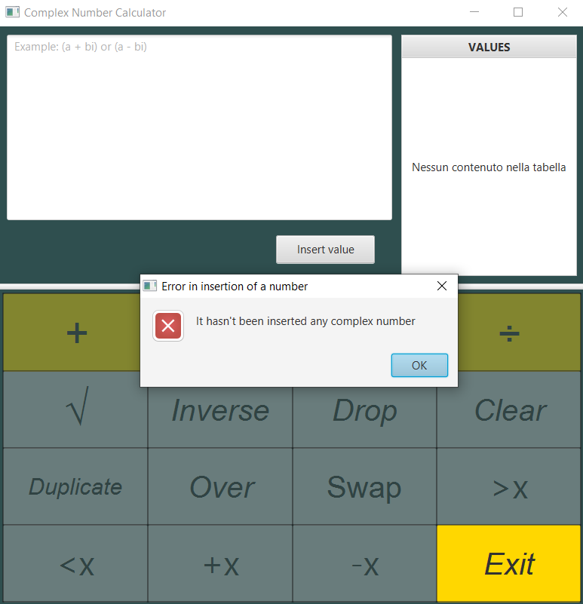
First Sprint Release: an EXAMPLE --1
Sprint Goal: correctly functioning graphical user interface with main operations such as addition, subtraction, multiplication and division.
When the user clicks the insert button but has not written a number in the text-area then this alert is showed

Slide 5
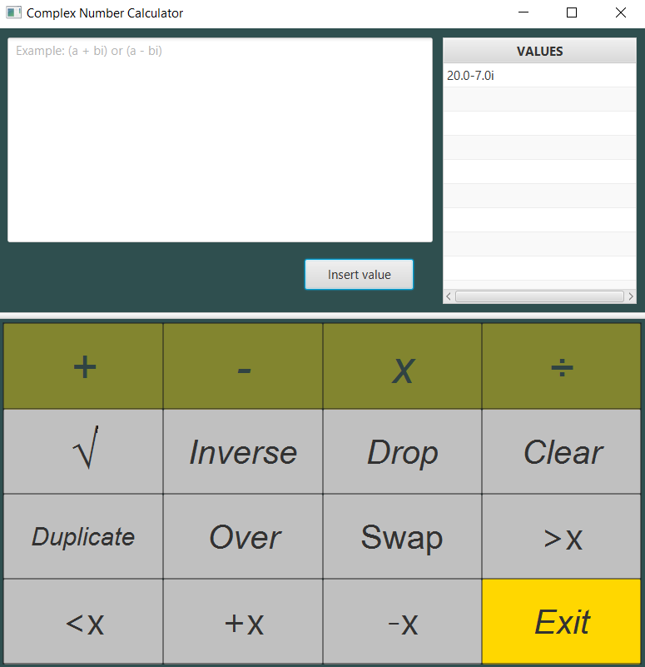
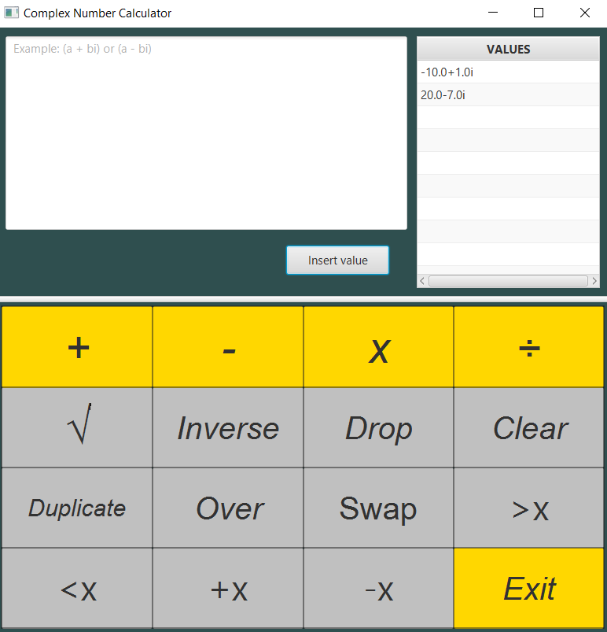
First Sprint Release: an EXAMPLE --2
When the user enters one number, the gray buttons are activated (left photo), when he enters two or more numbers, the orange buttons are also activated (right photo)

Slide 6
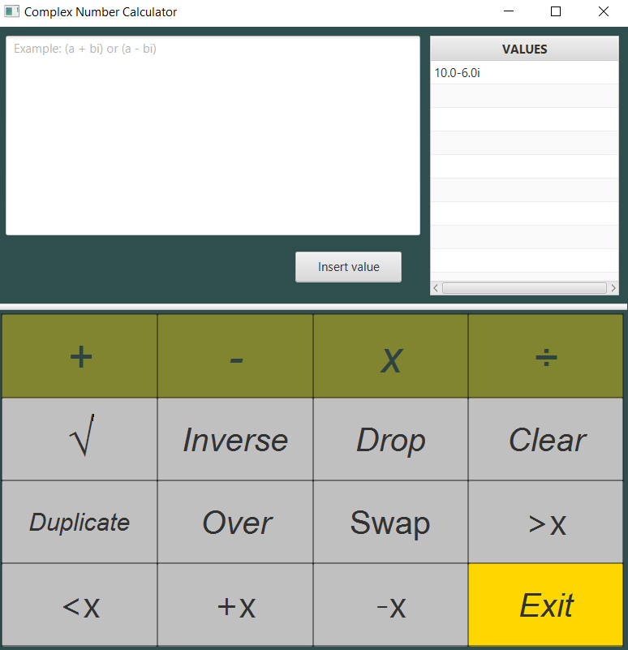
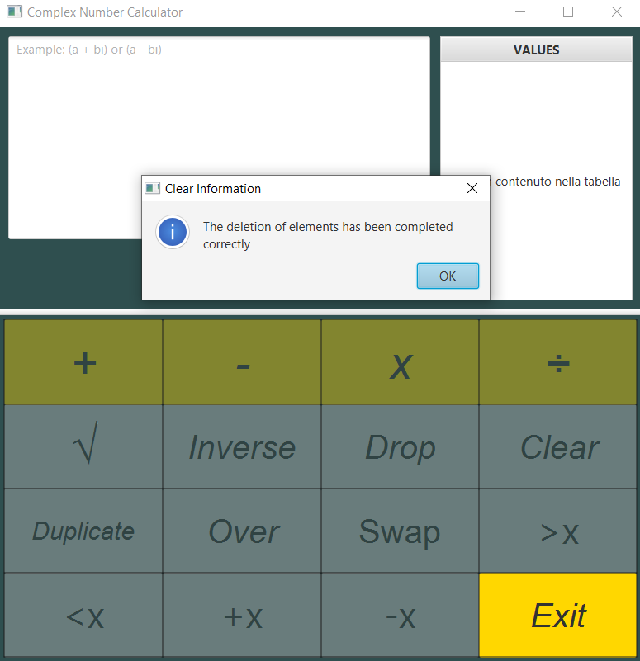
First Sprint Release: an EXAMPLE --3
When the user presses the '+' button he sees on the screen the sum of the numbers he had previously inserted (left photo), when he presses the 'Clear' button he deletes all the values used up to that moment (right photo)

Slide 7
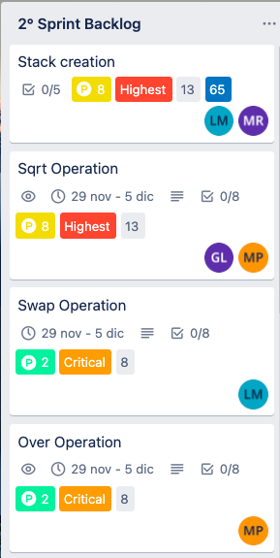
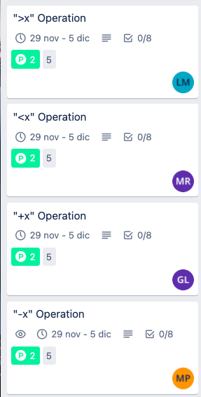

Second Sprint Planning
Sprint Pianification using Trello
Product Backlog Update
New Items from User Stories
Time estimation (Story Point)
Value estimation (Value Point)
Sprint Backlog Composition
Tasks Assignment
Previous Velocity Check
Velocity Estimation

