Slide 1
Second Sprint group 15
Sprint Backlog
Burndown Chart
Sprint Review
Sprint Retrospective
Second Sprint Release
third Sprint Planning
Petagna Mario
Muro Lorenzo
Riccardi Mario
Lodato Gabriele

Slide 2
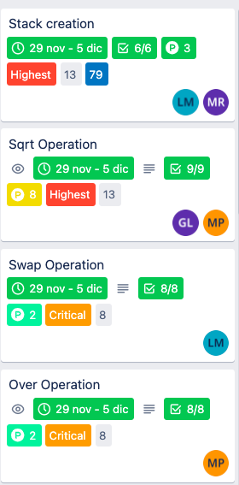
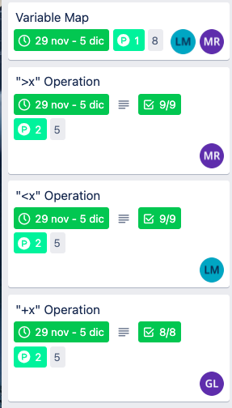
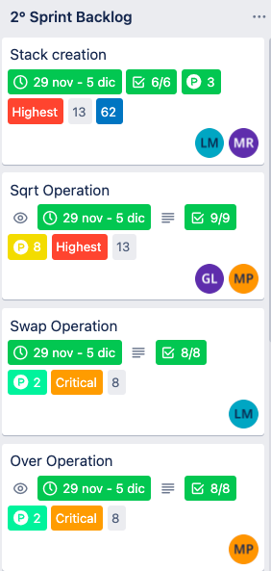
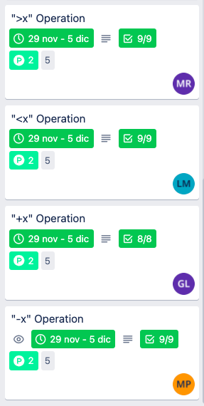
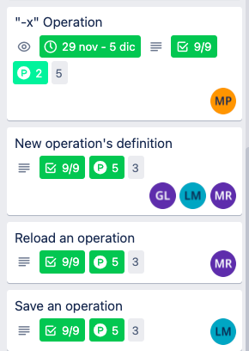
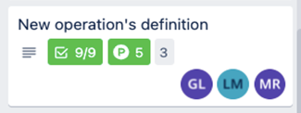
Sprint Backlog/DONE
All user stories have been completed.
GUI’s features have been improved a lot compared to the first sprint release.
As the team finished the work early, two user stories were added to the sprint backlog.
Re-evaluation of the story points of the user stories for overestimation.
Estimated Velocity: 28 SP
Effective Velocity: 39 SP

Slide 3

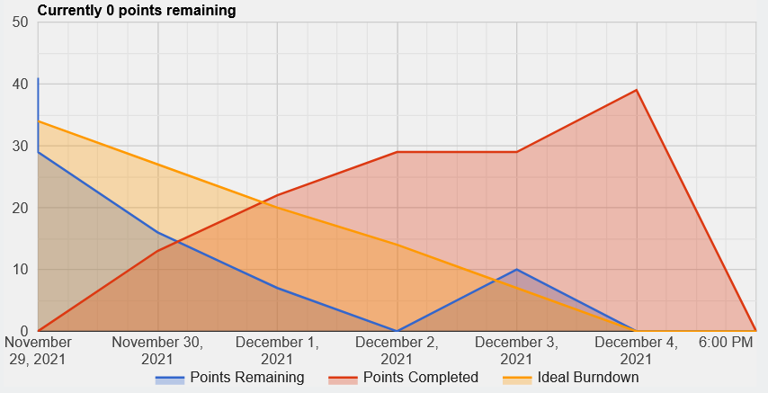
Burndown Chart
Burndown Chart Story Point / Days
The progress curve has always been under ideal.
The work was even finished two days before the end of the sprint!

Slide 4
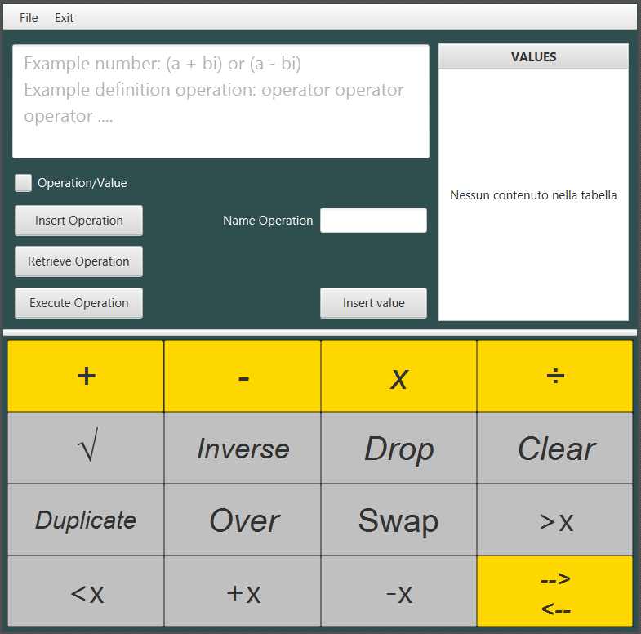
Second Sprint Release: an EXAMPLE
The sprint goal has been achieved as all tasks and more have been completed.
Since there are too many functionalities, the example will be shown on the screen.

Slide 5
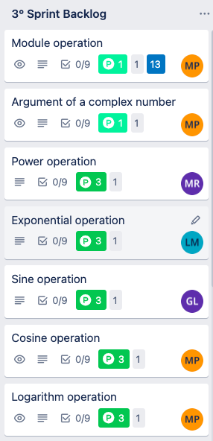
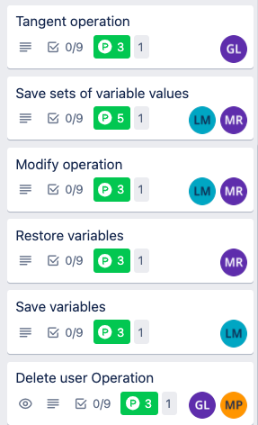
THIRD Sprint Planning
Sprint Pianification using Trello
Sprint Backlog Composition
Tasks Assignment
Previous Velocity Check
Velocity Estimation

