Slide 1
Pre-game project group15
Petagna Mario
Muro Lorenzo
Riccardi Mario
Lodato Gabriele
Requirements Analysis
Architectural and detailed Design
First Sprint Planning

Slide 2
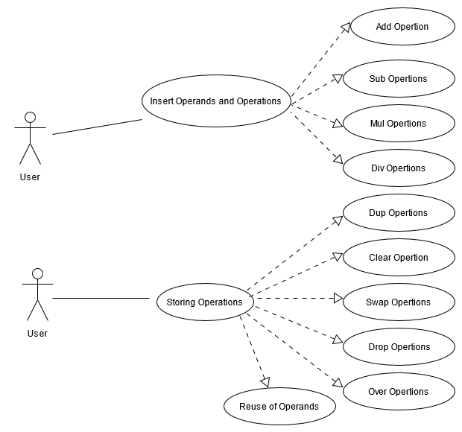
Requirements Analysis
Specifics Analysis
Use Cases Diagram
User Stories
Initial Product Backlog
Most Important, or Critical, Functionalities
An example of User Story with its Acceptance Criteria
As a user
I want to add two or more complex numbers
So that I can do my math exercises
--------------------------------------
Given I do the sum of two or more numbers
When I insert two or more complex numbers
Then I want to have the correct result

Slide 3
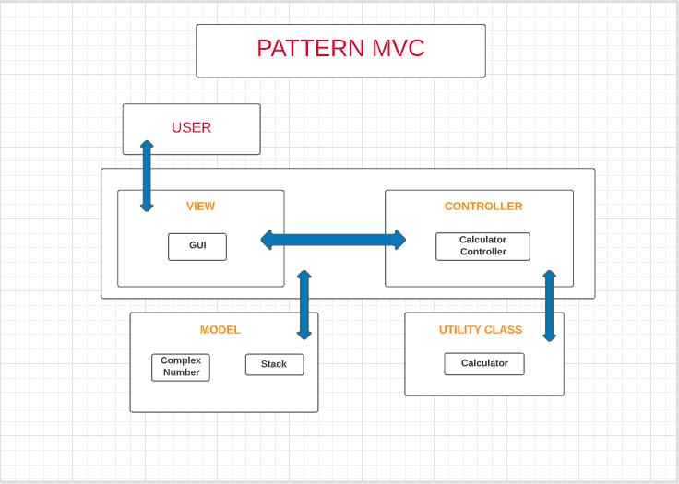
Architectural AND DETAILED design
System Architecture (Pattern MVC)

Slide 4
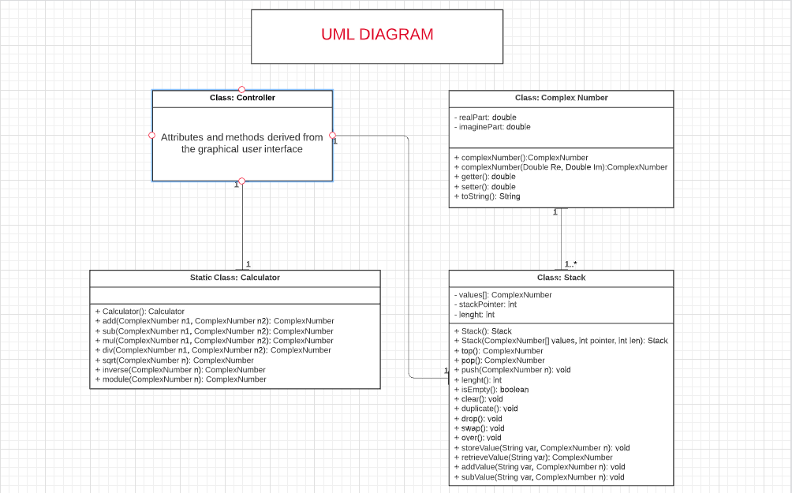
Architectural AND DETAILED design
UML Diagram of Class

Slide 5
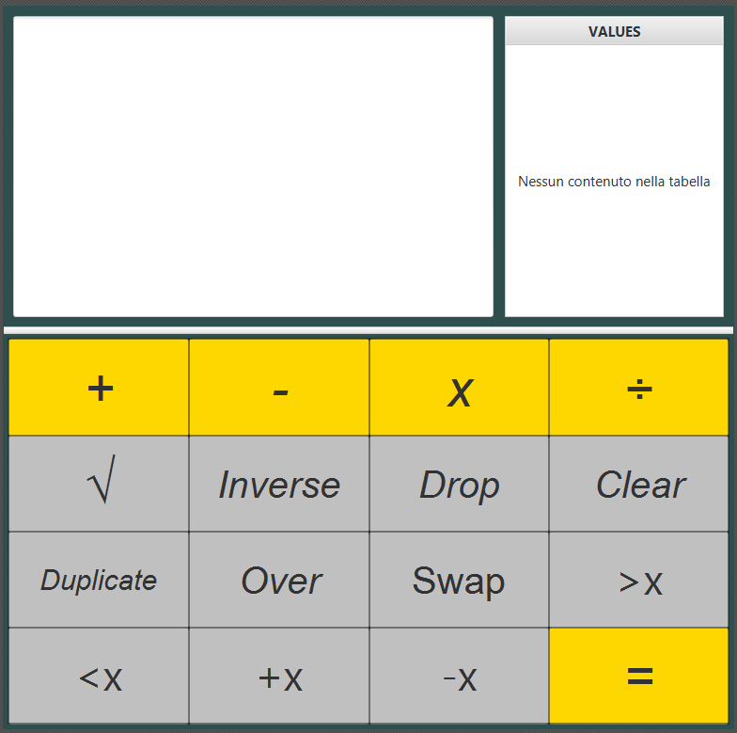
Architectural AND DETAILED design
Grafical User Interface
An example of a possible GUI for the user interaction with the Complex Number Calculator.
Represents all the critical requested functionalities.

Slide 6
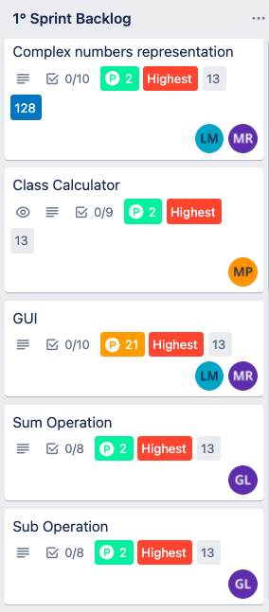
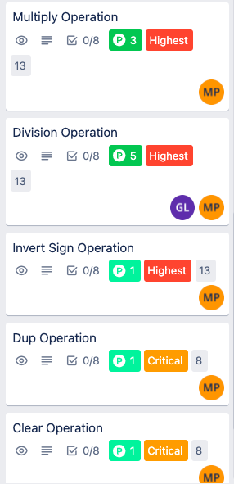
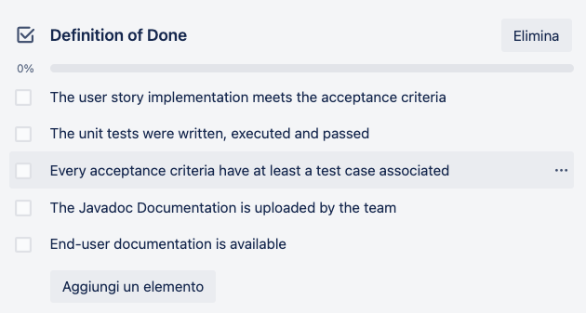
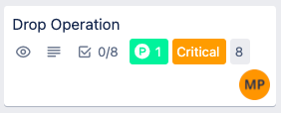
FIRST SPRINT PLANNING
Sprint Pianification using Trello
Product Backlog Composition
Items from User Stories
Time estimation (Story Point)
Value estimation (Value Point)
Sprint Backlog Composition
Tasks Assignment
Velocity Estimation
Definition of Done

