Slide 1

G2M insight for Cab Investment firm
Company Name : XYZ Location: US Team: Data Science Date: 21-JULY-2023

Slide 2

Agenda
Executive Summary
Problem Statement
Approach
EDA
EDA Summary
Hypothesis Testing
Recommendations

Slide 3
Description:
XYZ is a private firm in US. Due to remarkable growth in the Cab Industry in last few years and multiple key players in the market, it is planning for an investment in Cab industry and as per their Go-to-Market(G2M) strategy they want to understand the market before taking final decision.
Areas to investigate:
Which company has maximum cab users at a particular time period?
Does margin proportionally increase with increase in number of customers?
What are the attributes of these customer segments?

Slide 4
Data Preparation:
There are 4 datasets:
Cab_Data.csv – this file includes details of transaction for 2 cab companies
Customer_ID.csv – this is a mapping table that contains a unique identifier which links the customer’s demographic details
Transaction_ID.csv – this is a mapping table that contains transaction to customer mapping and payment mode
City.csv – this file contains list of US cities, their population and number of cab users

Slide 5
EXPLORATORY
DATA
ANALYSIS

Slide 6
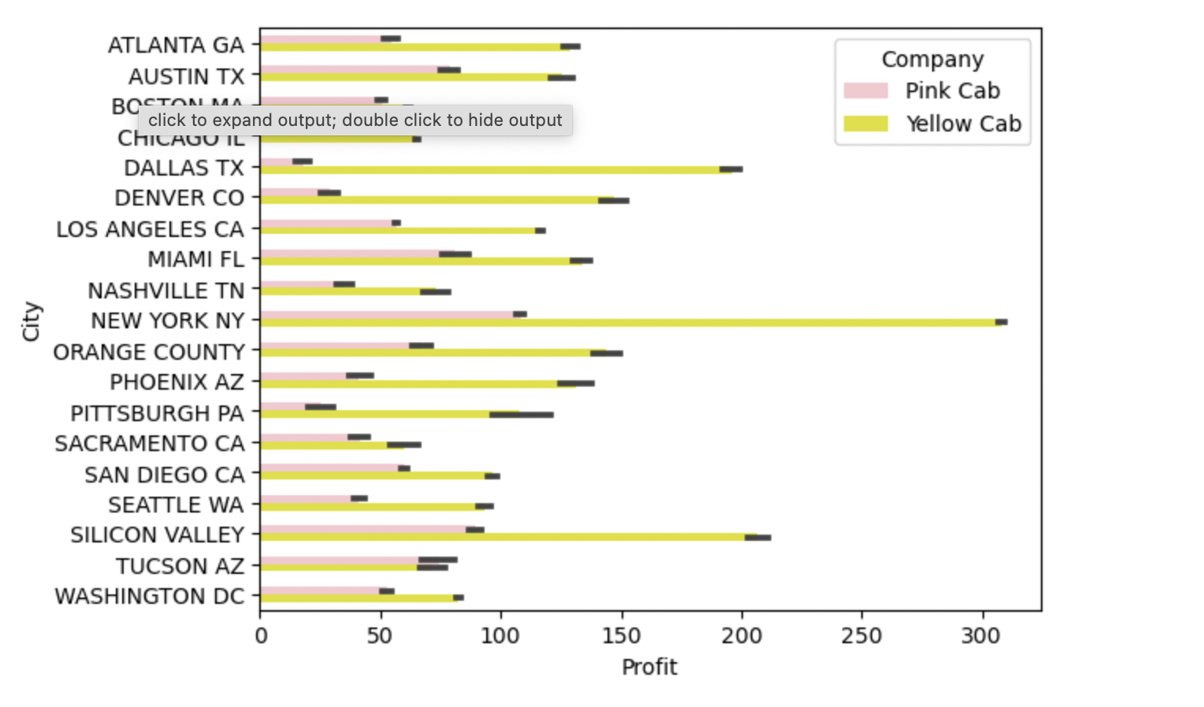
Distribution of profit for both cabs according to the city.
From the above graphs, we can see that the yellow cab is earning higher profits in terms of majority of cities.

Slide 7
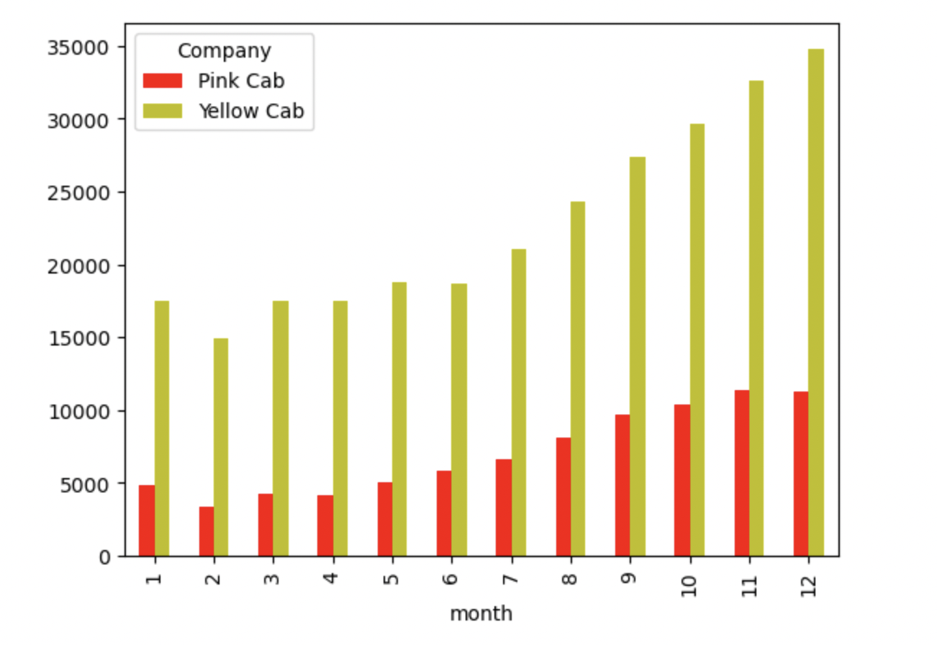
Bar plot for No.of transactions happening for each month
Here we can see that number of cab services increase during the month december because it is a holiday season. Hence its the peak time of the year.

Slide 8
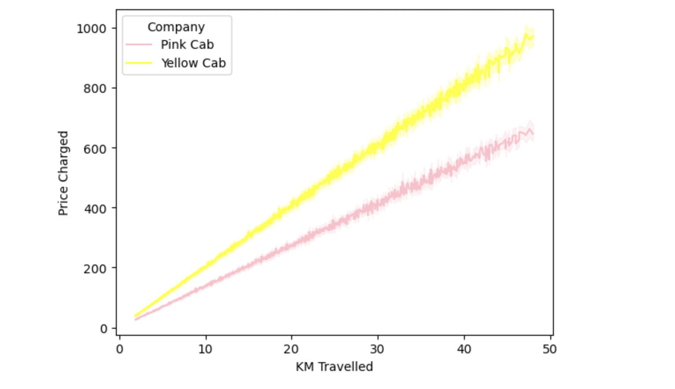
Comparison of price charged by each cab with same distance travelled:
Yellow Cab is charging more compared to pink can when the same distance are travelled. This could mean that yellow cab is providing more high end luxurious cab services.

Slide 9
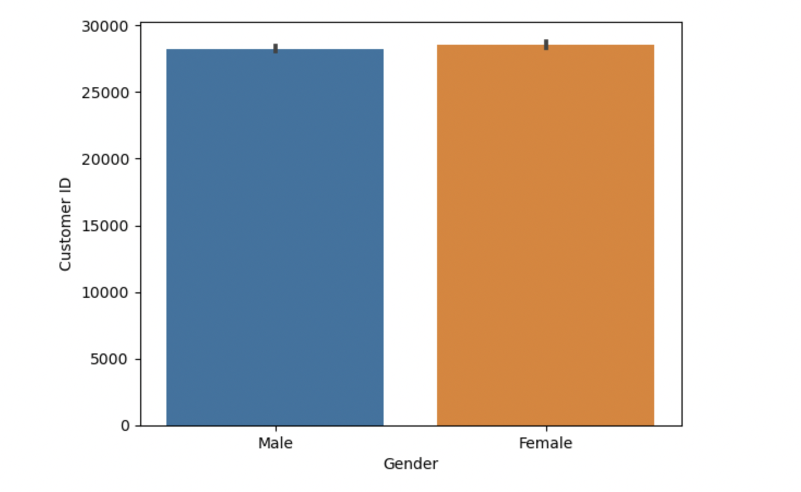
Distribution of customer based on gender:
From the graph it shows that there is no significant difference between the contribution of gender to the cab service frequency.

Slide 10
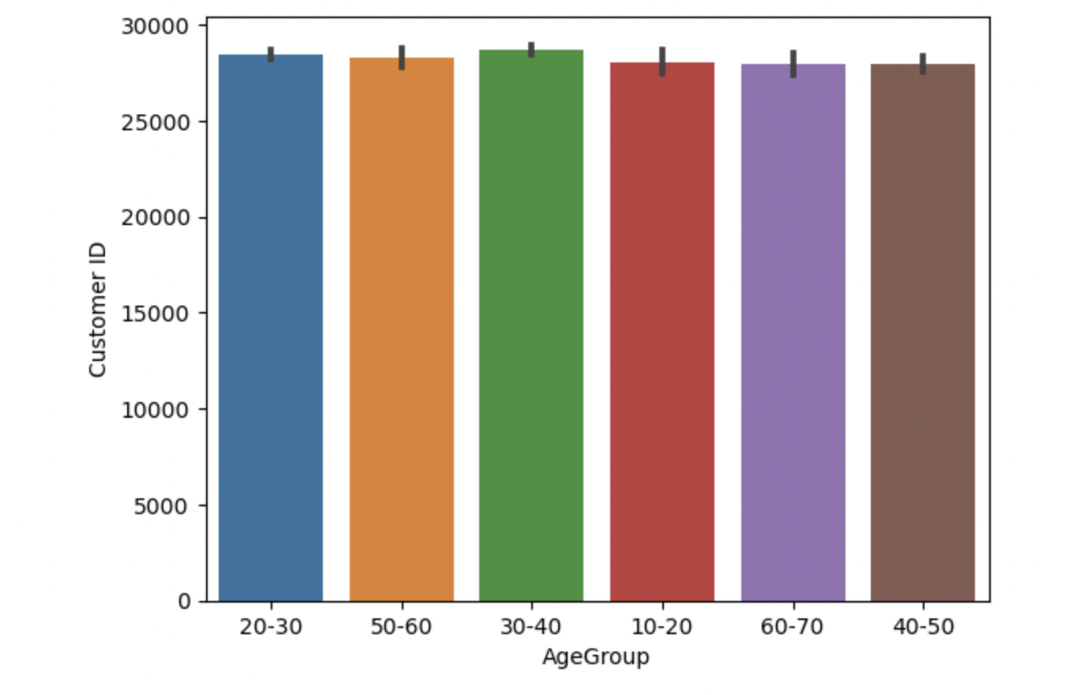
Similarly for the age group:

Slide 11
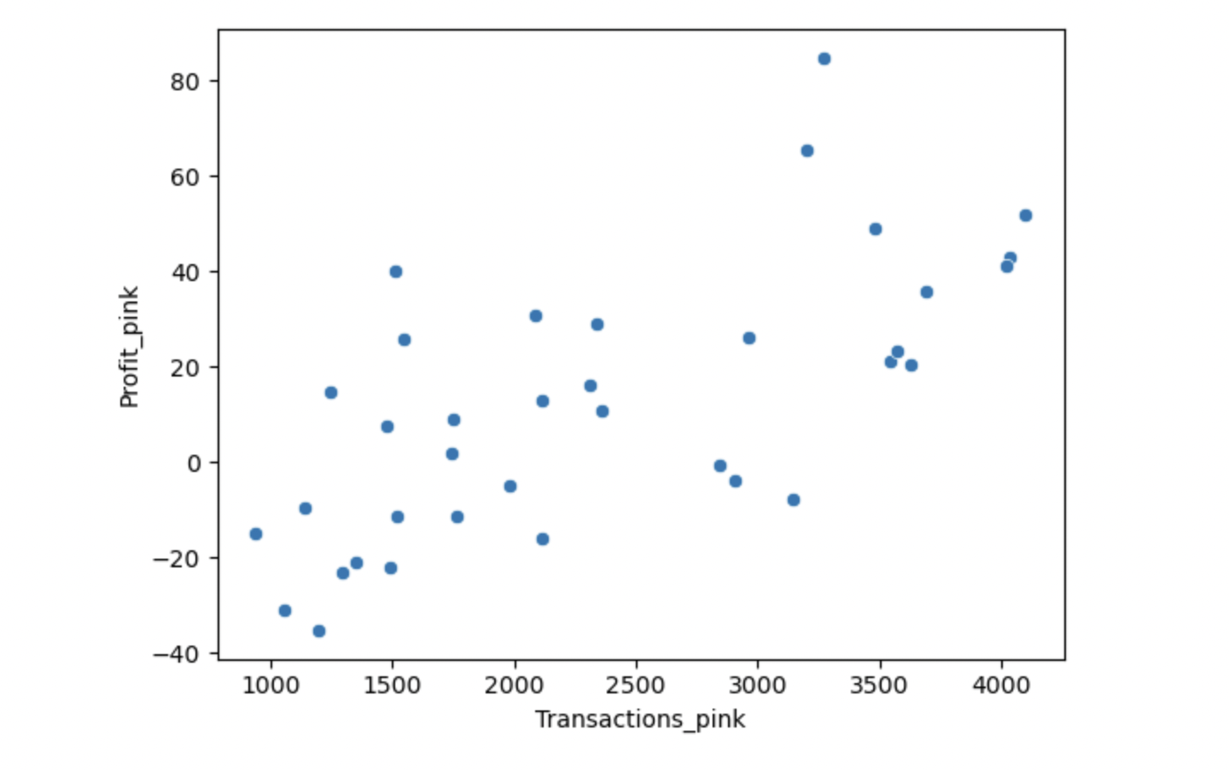
Pink Cab: Profit in Dallas vs no.of transaction.
We can see that the profit is somewhat positively correlated to the no.of transactions. Meaning profits increase when transactions are increased.

Slide 12
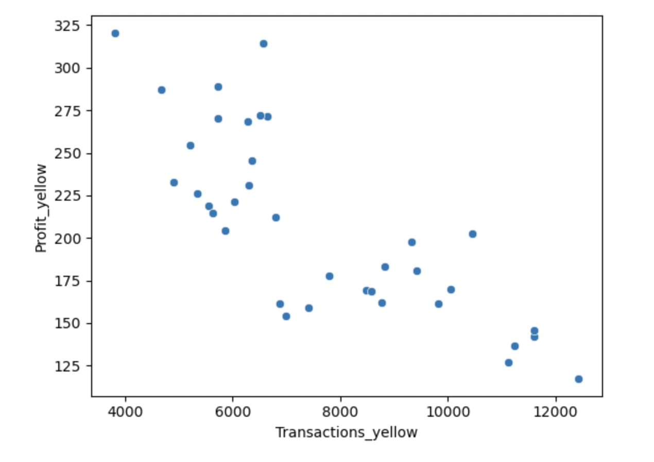
Yellow Cab: Profit in Dallas vs no.of transaction.
We can see that the profit is somewhat negatively correlated to the no.of transactions.
Meaning profit margin decreases when transactions are increased.

Slide 13
EDA SUMMARY

Slide 14


Profit Margin is low each year (2016-2018) compared to Yellow Cab.
Profit Margin is high each year (2016-2018) compared to Pink Cab.
Pink Cabs increase margins with increase in number of Transactions.
Yellow Cab decrease Margins with the increase in Transaction.
All the cities have the same increase in price charge with increase in distance.
In New York City the Price charged for Yellow Cab is more in comparison to the other cities.

Slide 15
Hypothesis Testing

Slide 16


Null Hypothesis: There is no Difference in profit in comparison to male and female Users

Slide 17
Recommendation
Transaction per year: For Yellow Cab Transaction per year from 2016 to 2018 is almost double than Pink Cab.
Margin per Gender: For Yellow Cab there is difference in Margin between Male and Female Customers due to which Female Customer percentage is higher in Yellow Cab in comparison to Pink Cab.
Profit Margin: For Yellow Cab the Profit Margin is higher per year from 2016 to 2018 in comparison to Pink Cab.
On the basis of the above points and graphs as shown , Yellow Cab is recommended for investment since it is showing a better profit range in all the cities .

Slide 18
Submitted By:
Richa Mishra
Thank You

