Slide 1
Alibaba
Overview
Business Segments
Company Leadership
Competition
Risk Factors
Model
Investment Thesis
Chase Johnson
Alex Kramer
Georquel Goodwin
James McDowell
Sources from: Sec.gov, Alibaba.com, & Wallstreetmojo.com

Slide 2
The mission of Alibaba is to make it easy to do business anywhere.
The company’s founders started the company to champion small business through the internet in competition to legitimize a chance to a level “playing field” for enterprises to grow and compete more effectively in the domestic and global economies with innovation and technology.
The vision of Alibaba is to build the future infrastructure of commerce. We envision that our customers will meet, work and live at Alibaba, and that we will be a company that lasts at least 102 years.
Overview -
The Mission Statement, Vision, and Values

Slide 3
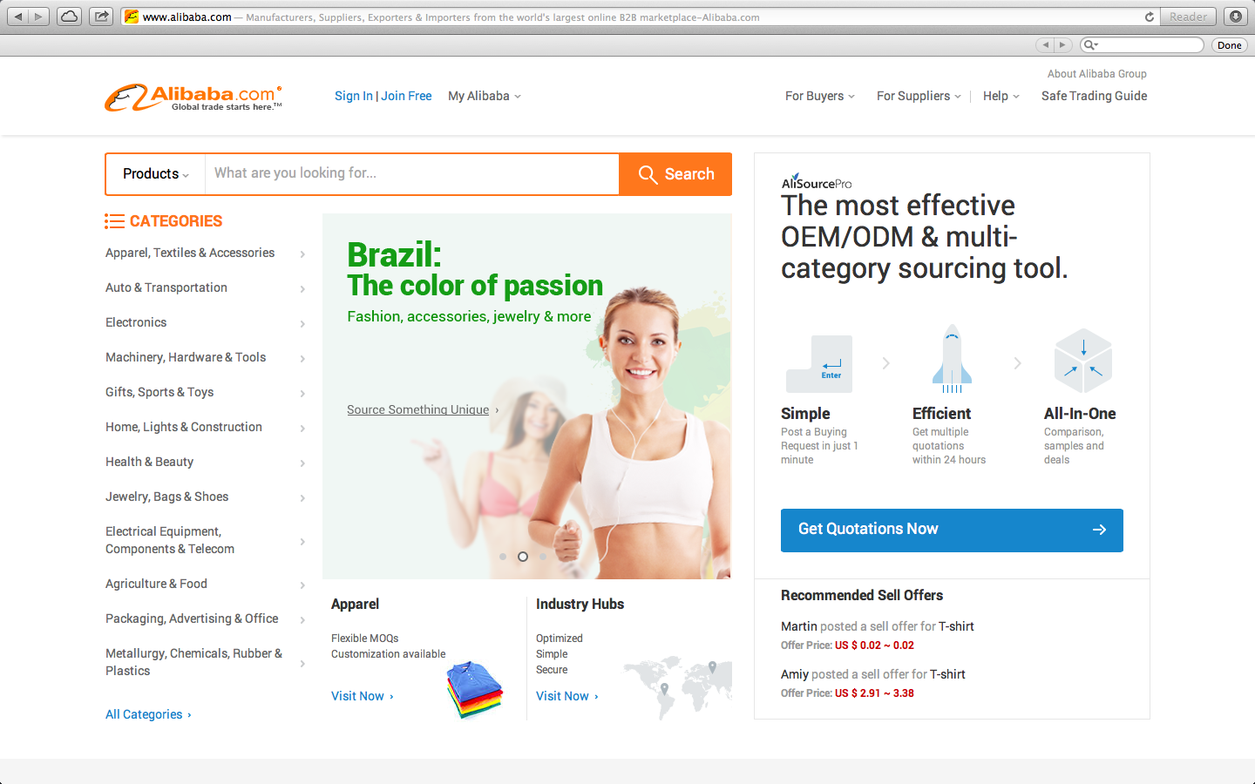
Be Passionate about BABA

Slide 4
Business Segment
Largest mobile commerce company worldwide, operating their marketplace as a platform for 3rd parties. (However, they do not engage in direct sales, compete with merchants or hold inventory.)
BABA operates:
Taobao Marketplace - China’s largest online shopping destination.
Tmall - China’s largest third-party platform for brands and retailers.
Juhuasuan - China’s most popular group buying marketplace.
1688.com - A tremendously active Chinese wholesale shopping resort.
With these three marketplaces the company generated $296 billion in 2013.
In addition to their retail marketplaces they operate:
Alibaba.com - China’s global wholesale marketplace in 2013 by revenue.
Aliexpress - their global consumer market place, providing cloud computing services as well.

Slide 5
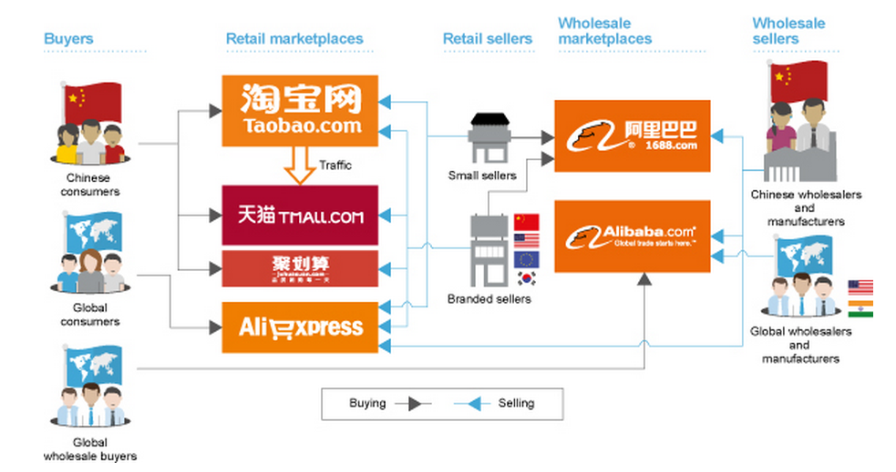
Business Segments

Slide 6
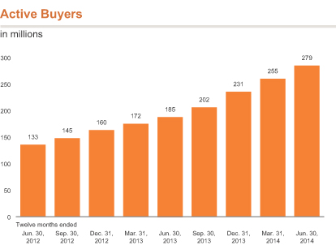
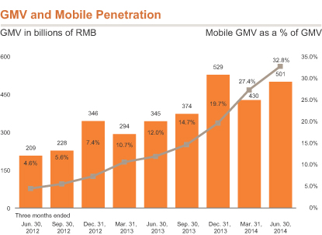
Sources of Cash Flow

Slide 7
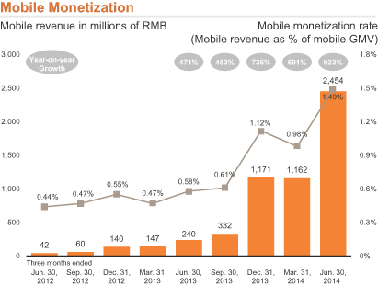
Mobile Monetization 1RMB = .16USD

Slide 8
Cloud Computing
Alibaba offers:
Cloud computing services
Elastic computing
Database services, storage, and large scale cloud computing
Their large scale computing allows the integration of their platforms, and platforms of others, to enter their ecosystem. (Like Alipay)
Users of this interface: sellers to their marketplace, third-party customers, start-up companies in mobile applications, internet gaming, digital entertainment, consumer electronics, financial services, mobile communications, internet infrastructure services, healthcare, and education.

Slide 9
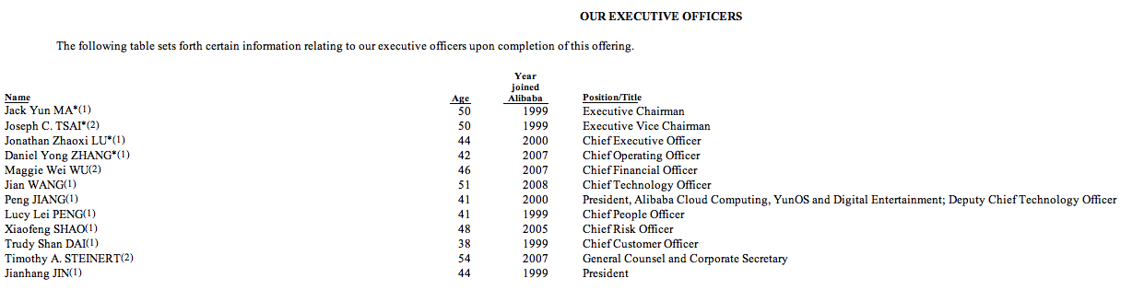
Company Leadership

Slide 10
Jack Yun Ma - Executive Chairman
Graduated from Hangzhou Teacher’s institute majored in English Education
Lead Founder - Founded Alibaba in 1999.
Serves on Board of SoftBank corp.
(A major shareholder & a Japanese corporation listed on the Tokyo Stock Exchange)
Mr. Ma is also a director of Huayi Brothers Media Corp.
(An entertainment group in China listed on The Shenzhen Stock Exchange)
Mr. Ma is also the chair of The Nature Conservancy's China board of directors and a director of its global board of directors.

Slide 11
Joseph C. Tsai - Vice Chairman
Graduated from East Asian Studies from Yale College - majored in Econ.
Went on to receive his juris doctor (JD) from Yale Law School.
Joined Alibaba in 1999 as a member of the Alibaba founding team.
Also served as CFO.
1995-1999, Worked in Hong Kong with Investor AB
(Investment vehicle of Sweden’s Wallenberg family)
(Responsible for Asian private equity investments)
Before that he was vice president and general counsel of Rosecliff, Inc.
(A management buyout firm based in New York)
1990 - 1993, Worked as associate attorney in the tax group of Sullivan & Cromwell LLP.

Slide 12
Peng Jiang - President & Chief Deputy Technology Officer
Joined company in 2000 and held senior positions in the Alibaba.com technology development department.
Has been president of YunOS and Digital Entertainment.
Responsible for oversight of data business group of Alibaba as well.
August 2009 - 2012, he was vice pres. of Taobao’s consumer business department.
Served in various management positions in Taobao’s technology development from 2005 to 2009.

Slide 13
Competition in China-Tencent
Tencent currently has the lead over Alibaba in mobile through their WeChat app, giving them an advantage in mobile e-commerce
WeChat: service enables users to do things like buy emoticons, pay for game apps, invest their money in a fund, hail a taxi and buy goods. Individuals can set up stores on the platform, just as they can create merchant accounts on Alibaba's Taobao or Tmall e-commerce sites.

Slide 14
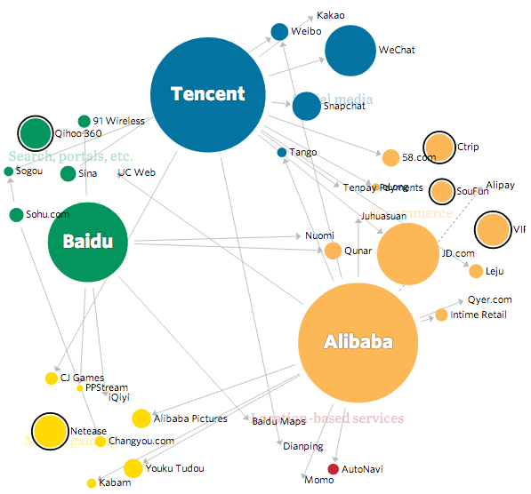
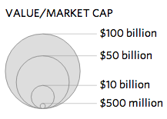
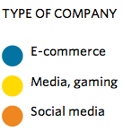
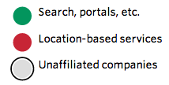

Slide 15
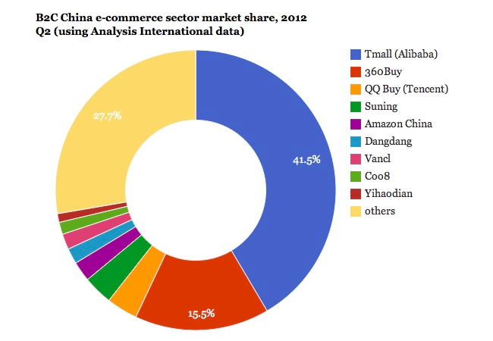

Slide 16
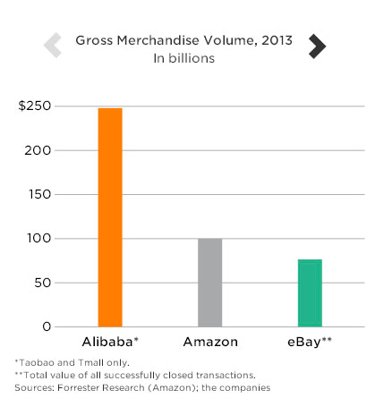
American Competition
Not much

Slide 17
Risk Factors
Alibaba must maintain their strong ecosystem in China or both their reputation and their financial system would take a major hit.
Inability to improve their mobile platform. This point came up often in their F-1, which might raise a red flag. They listed:
User behavior on mobile devices is rapidly evolving, and if we fail to successfully adapt to these changes, our competitiveness and market position may suffer.
We may not be able to successfully monetize traffic on our mobile platform, which could have a material adverse effect on our business.
Alipay, which they use for all their payment processing, is highly regulated, and if something were to be restricted, their business would be severely impacted.
Long-goal oriented philosophy, so Alibaba is more focused on growing the company and enhancing the user experience rather than making short-term investors happy.

Slide 18
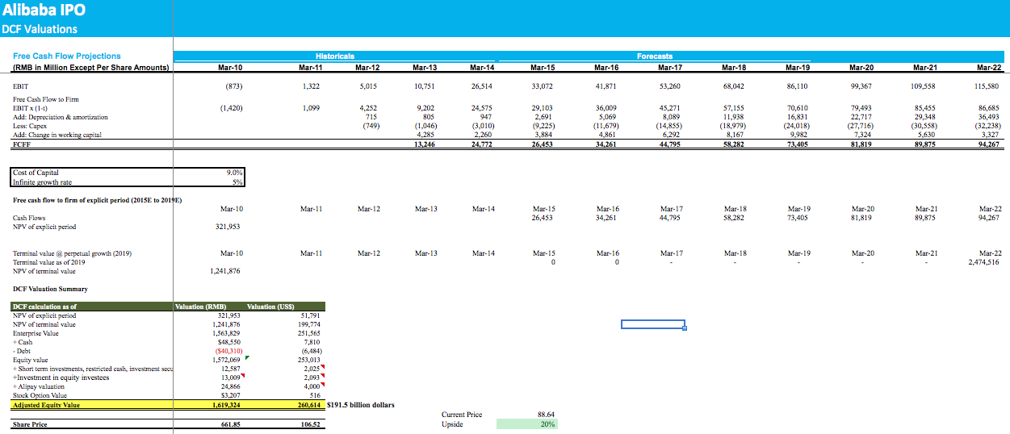
Model

Slide 19
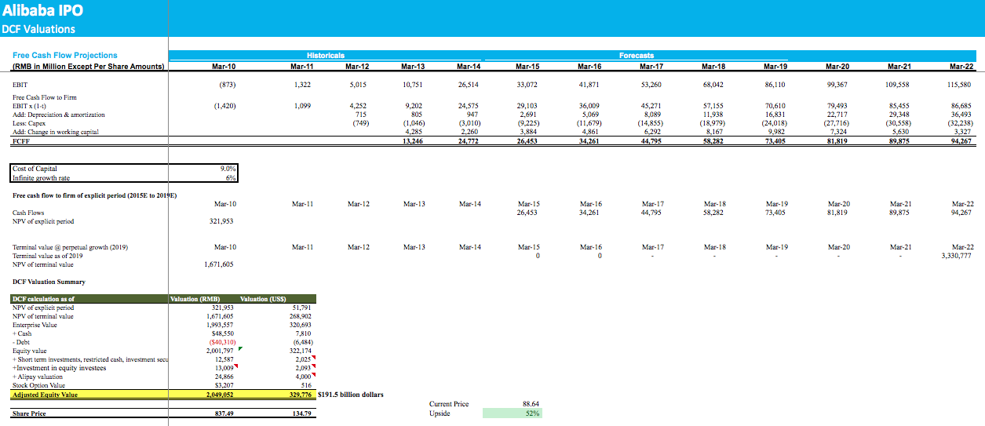
Model

Slide 20
Investment Thesis
The investment positives include:
China’s ecommerce economy is booming. “For an emerging economy, China has strong broad band and wireless infrastructure with weak brick-and-mortar retail infrastructure,” says Rob Sanderson, a managing director and analyst at MKM Partners with a 12 month price target of $125
Alibaba holds a dominant market position. Although there are many fast-growing competitors, Alibaba has maintained 50% to 90% market share in the retail categories it serves, and conducts about 70% of the overall ecommerce business in China.

Slide 21
Investment Thesis
Despite the enormous scale, market penetration remains low. The number of active buyers, at 279 million, is still growing, driven by the mobile business. There were 1.3 billion wireless subscribers in China.
Alibaba’s business model is highly profitable. The company takes no inventory risk, and does not bear the burden of building fulfillment capabilities. Operating margin was 43% in June, a multi-quarter low, and has been as high as 51%. In comparison, Amazon said second-quarter operating profit margin was a negative 0.1%, compared with a positive 0.7% in the first quarter.

Slide 22
Investment Recommendation
We are advocating a 1.5% stake in BABA, taken from XLK
Sell ~163 shares of XLK (~$39.71)
Buy ~73 shares of BABA (~$88.30)

