Slide 1

“Taking on the world’s toughest energy challenges”
Furman Investment Club
March 20, 2013

Slide 2
Who We Are: Business Lines, Supply Chain, and Management Team

Slide 3
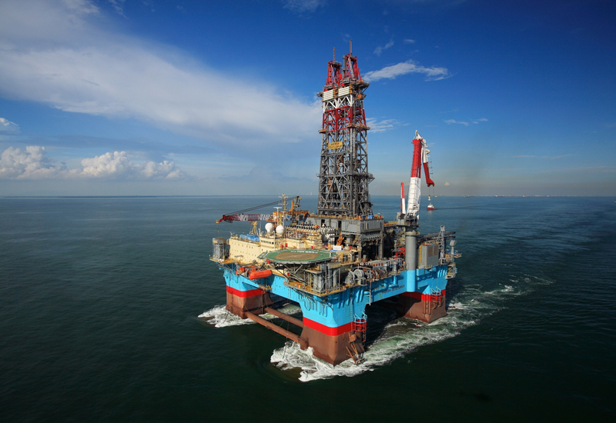
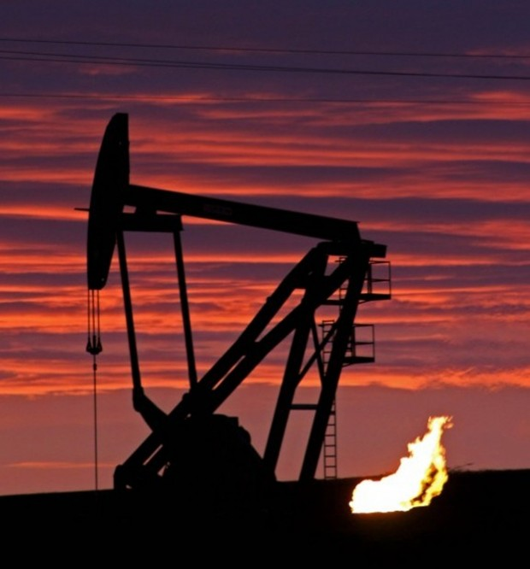
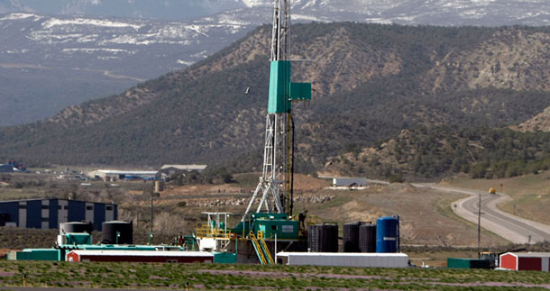
Business Lines
Exploration and Production (Upstream): Exploration for and extraction of crude oil and natural gas

Slide 4

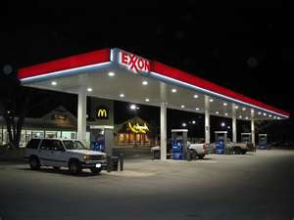
Business Lines (Continued)
Refining and Marketing (Downstream): Refining crude oil into marketable products such as petroleum, gasoline, kerosene, gas oil, lubricating oil, and fuel oil

Slide 5
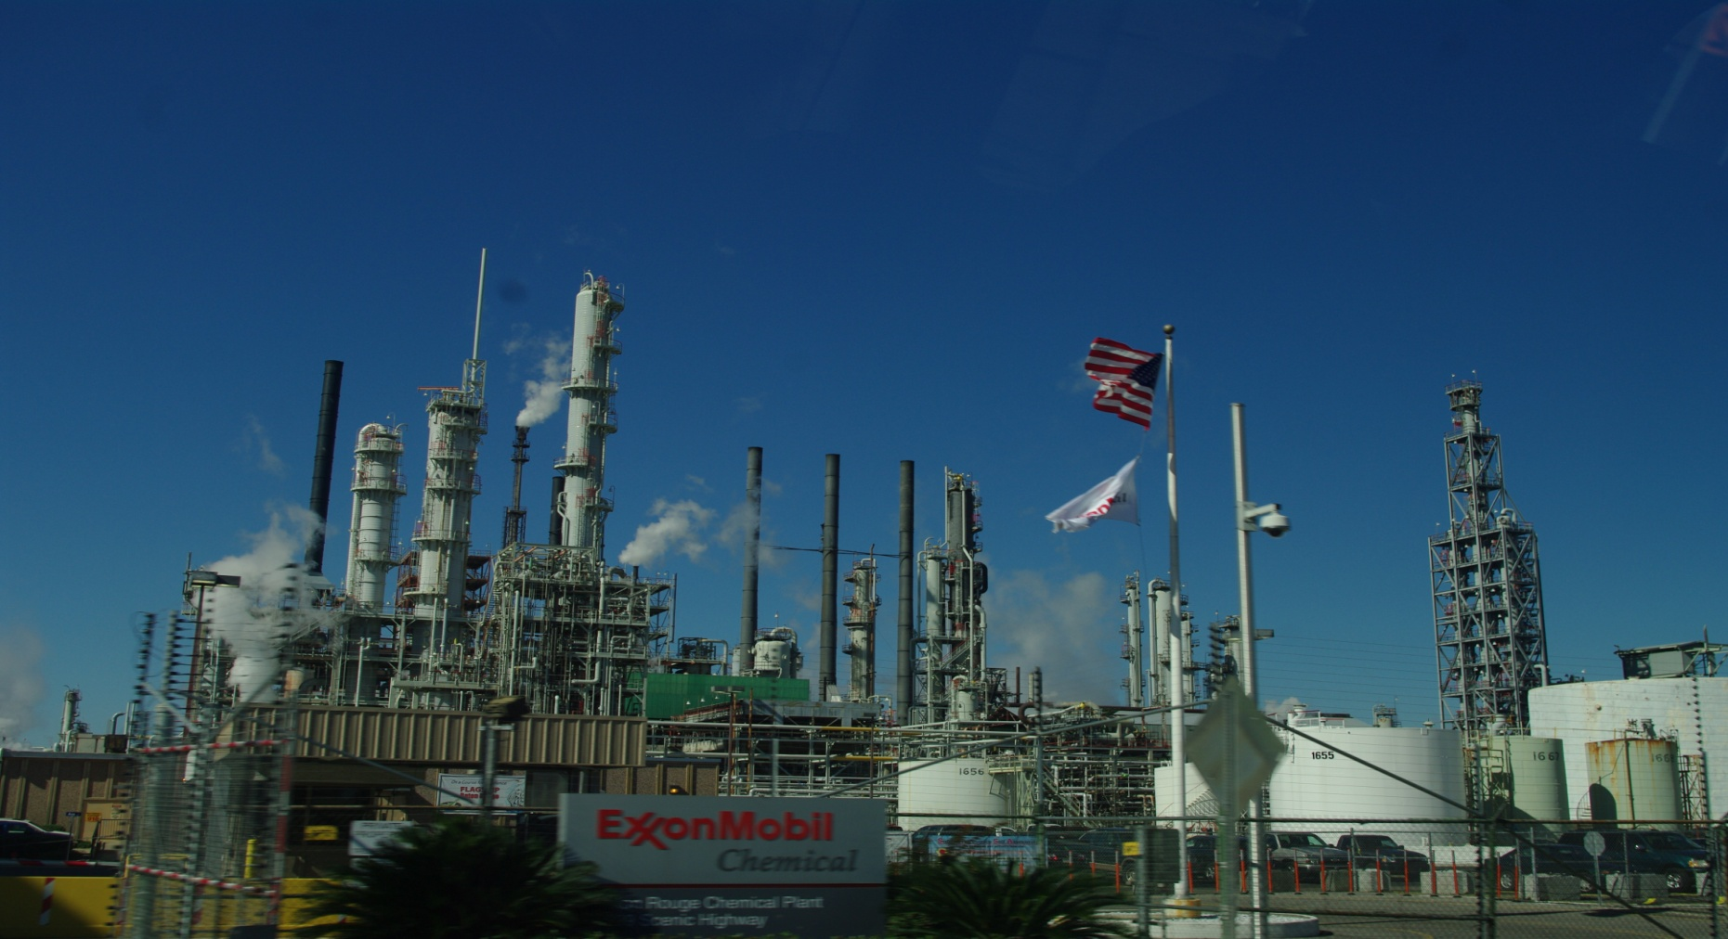
Business Lines (Continued)
Petrochemical (Chemical): Producing marketable chemical products derived from petroleum such as paint, ink, dye, food additives, adhesives, packaging materials, and cleaning agents

Slide 6
Business Lines Composition
Average Capital Employed
Capital and Exploration Expenditures
Source: Company filings
Data as of 12/31/12

Slide 7
Supply Chain: Customers
Source: Bloomberg Financial
Data as of 12/31/12

Slide 8
Supply Chain: Suppliers
Source: Bloomberg Financial
Data as of 12/31/12

Slide 9


Management Team
Rex W. Tillerson – Chairman and CEO
B.S. Civil Engineering
1975 – Production Engineer at Exxon
Upstream activities before executive leadership
Executive committee and former chairman of American Petroleum Institute (API)
Member National Petroleum Council and Business Roundtable
Andrew P. Swiger – SVP and CFO
B.S. Petroleum Engineering
1978 – Operations Engineer at Exxon
1996 – Managerial (Refining and Petrochemical)
1999 – Managerial (Upstream)
2001 – Vice President for African Operations
2003 – Production VP for EU and Russia
Source: Company documents

Slide 10


Management Team (Continued)
Mark W. Albers – SVP
B.A. Petroleum Engineering
1979 – Exxon
Has held a variety of managerial positions before joining the executive leadership, including responsibilities at headquarters, Africa, and Australia
Michael J. Dolan – SVP
B.S. Chemical Engineering; M.B.A
1980 – Engineering and Refining at Mobil
1993 – Petrochemicals at Mobil
Has held variety of managerial positions within the chemicals and refining segments before joining executive leadership
Source: Company documents

Slide 11
What We’ve Done: Properties, Production, Profits

Slide 12
Oil and Gas Reserves
Proved Reserves: Crude Oil
7.152 billion barrels (Total)
4.663 billion barrels (Developed)
2.489 billion barrels (Undeveloped)
Proved Reserves: Natural Gas
74.091 trillion cubic feet (Total)
50.257 trillion cubic feet (Developed)
23.834 trillion cubic feet (Undeveloped)
Proved Reserves: Natural Gas Liquids
1.505 billion barrels (Total)
1.133 billion barrels (Developed)
0.372 billion barrels (Undeveloped)
Proved Reserves: Barrel of Oil Equivalent (BOE)
25.164 billion barrels (Total)
15.314 billion barrels (Developed)
9.850 billion barrels (Undeveloped)
Source: Company filings
Data as of 12/31/12

Slide 13
Oil and Gas Reserves (Continued)
Proved Reserves
Reserve Replacement Ratio
Proved Developed Reserves (% of Total Proved)
Source: Bloomberg Financial
Data as of 12/31/12

Slide 14
Production
Production (Millions of BOE per day)
Source: Bloomberg Financial
Data as of 12/31/12

Slide 15
Financial Analysis: Profitability
Profit Margin
Return on Assets
Return on Total Capital
Return on Common Equity
Source: Bloomberg Financial
Data as of 12/31/12

Slide 16
Financial Analysis: Credit and Liquidity
Total Debt / Total Assets
Total Debt / Total Capital
Operating Cash Flow / Total Liabilities
Source: Bloomberg Financial
Data as of 12/31/12

Slide 17
Financial Analysis: Cash Flow
Free Cash Flow to Firm
Free Cash Flow to Equity
Operating Cash Flow / Net Income
Operating Cash Flow / Capital Expenditures
Source: Bloomberg Financial
Data as of 12/31/12

Slide 18
Where We’re Going: On the Horizon

Slide 19
The Drivers of Energy
Supply and Demand
Crude Oil Supply: OPEC, Non-OPEC, and Technology
OPEC: Projected OPEC supply declines by 300,000 bbl/day in 2013, rising by 300,000 bbl/day in 2014
Non-OPEC: Non-OPEC supply increases by 1.2 million bbl/day in 2013 and by 1.4 million bbl/day in 2014
Non-OPEC: U.S. projected to surpass Saudi Arabia in crude oil production by 2020
Technology: Horizontal Drilling and Hydraulic Fracturing
Crude Oil and Natural Gas Demand: Economic Growth
Demand for crude oil and natural gas are driven by the demand for their refined products, which are tied to global economic growth
Economic Outlook through 2014:
United States
Europe
China
Emerging Markets
Source: U.S. Energy Information Administration

Slide 20
Drivers of Energy (Continued)
Historical Prices: Crude Oil
Historical Prices: Natural Gas
Source: U.S. Energy Information Administration

Slide 21
Drivers of Energy (Continued)
Historical Prices: Gasoline
Historical Prices: Diesel
Historical Prices: Heating Oil
Historical Prices: Jet Fuel
Source: U.S. Energy Information Administration

Slide 22
Short-Run Energy Outlook
Price Forecast: WTI and Brent Crude
Price Forecast: Natural Gas
Source: U.S. Energy Information Administration

Slide 23
Short-Run Energy Outlook (Continued)
Price Forecast: Gasoline
Price Forecast: Diesel
Price Forecast: Heating Oil
Price Forecast: Jet Fuel
Source: U.S. Energy Information Administration

Slide 24
Short-Run Energy Outlook (Continued)
Price Forecast: Industrial (Natural Gas)
Price Forecast: Commercial (Natural Gas)
Price Forecast: Residential (Natural Gas)
Source: U.S. Energy Information Administration

Slide 25
Long-Run Energy Outlook
U.S. Energy Information Administration: Annual Energy Outlook 2013 (Looking to 2022)
Crude oil production increases significantly over the next 10 years, largely drive by increased onshore crude oil production, specifically from shale and other tight oil formations
Natural gas uses for industrial and electricity generation purposes continues to increase over the next 10 years
ExxonMobil: Long-Term Business Outlook (Looking to 2040)
Estimated 30% energy demand growth (2010-2040) with largest increases concentrated in developing countries
Crude oil demand estimated to increase 25% (2010-2040)
Global natural gas demand estimated to increase 60% (2010-2040), particularly as a result of growth in power demand (expected to increase 80% (2010-2040))
2040 Estimated Energy Mix – 40% Oil, 25% Natural Gas, 20% Coal, 15% Renewable
Source: U.S. Energy Information Administration and Company filings

Slide 26
Long-Run Energy Outlook (Continued)
Consumption Forecast: Industrial
Consumption Forecast: Commercial
Consumption Forecast: Residential
Source: U.S. Energy Information Administration

Slide 27
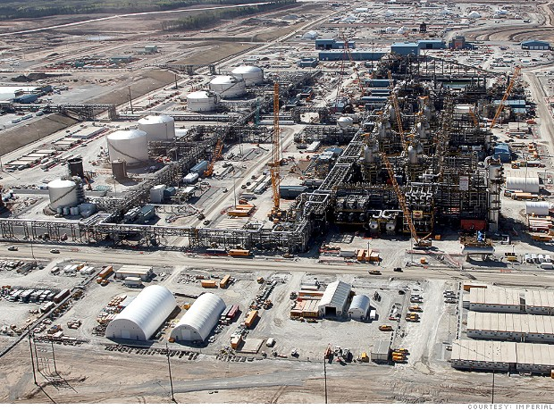
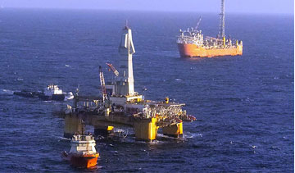
Meeting Global Energy Demand: Major Projects
Kearl Project
Joint venture to extract oil sands – began producing in 2012
29.04% stake with Imperial Oil Limited (69.6% controlled by ExxonMobil) holding 70.96%
Covers 48,000 acres in Athabasca oil sands deposits in Alberta, Canada
Hebron Project
Joint venture to extract heavy undersea crude oil – controlling stake of 36%
Priced off Brent Crude index – 700 million total reserves worth estimated $77.8 billion
Expected production – 2017 (150K barrels per day)
Source: Company filings and Bloomberg Research

Slide 28
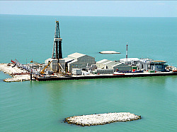
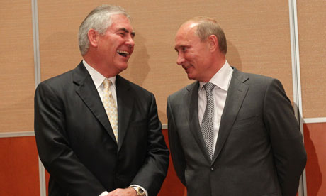
Major Projects (Continued)
Kashagan Project
Field discovered in July 2000 – estimated 13 billion barrels of recoverable reserves – 2013 expected production start
Developed by a group of partners including ExxonMobil, Shell, Total, and ConocoPhillips
ExxonMobil has share of largest stake of 16.8% with 4 other energy companies
ExxonMobil – Rosneft SCA
Expanded access to Russian offshore and arctic fields in Black Sea and Kara Sea– 36 billion barrels of recoverable reserves
Highlights XOM advantage in drilling technology
Source: S&P Research, Bloomberg, New York Times, and Offshore-Technology

Slide 29
Valuation Analysis

Slide 30
Competitive Analysis: Oil and Gas Reserves
Proved Reserves
Reserve Replacement Ratio
Proved Developed Reserves (% of Total Proved)
Source: Bloomberg Financial
Data as of 12/31/12

Slide 31
Competitive Analysis: Production
Production (Millions of BOE per day)
Source: Bloomberg Financial
Data as of 12/31/12

Slide 32
Competitive Analysis: Profitability
Profit Margin
Return on Assets
Return on Capital
Return on Common Equity
Source: Bloomberg Financial
Data as of 12/31/12

Slide 33
Competitive Analysis: Credit and Liquidity
Total Debt / Total Assets
Total Debt / Total Capital
Operating Cash Flow / Total Liabilities
Source: Bloomberg Financial
Data as of 12/31/12

Slide 34
Competitive Analysis: Cash Flow
Free Cash Flow to Firm
Free Cash Flow to Equity
Operating Cash Flow / Net Income
Operating Cash Flow / Capital Expenditures
Source: Bloomberg Financial
Data as of 12/31/12

Slide 35
Earnings Multiple Model: Assumptions

Slide 36
Earnings Multiple Model: Price Target ¹
⁽¹⁾ Based on most-likely case assumptions

Slide 37
DCF Model: Assumptions

Slide 38
DCF Model: Price Target ¹
⁽¹⁾ Based on most-likely case assumptions

Slide 39
Concluding Remarks
Diverse Business Lines
Proven Management Team
Positive Outlook for Energy
Consistent Outperformance of Peers
Attractive Price Targets

