Slide 1

Welcome to SGA!
October 23, 2023

Slide 2
Agenda
Guest speaker(s): Ron Thompson and Curtis Nash
Officer, class, & at-large reports
Committee reports
Old business
New business
Open forum & announcements

Slide 3
Guest Speaker
Allison Diaz

Slide 4
Exec Reports

Slide 5
Dean Cassidy
I hope everyone had a terrific Fall Break!
Encourage your peers to complete the Gallup Student Survey. Takes about 12 minutes to complete and students get $5. This data is used to inform decisions.
Another flu shot clinic is scheduled for Tuesday, Oct. 31, 12-3 p.m. DH upstairs.
Trone Center for Mental Fitness dedication is Saturday, Nov. 11 @ 10:30 a.m. Please RSVP by Nov. 1 at DonorRelations@furman.edu.
Happy Homecoming Week!

Slide 6
Meredith Ervin
It’s HOCO Week!!! Super excited! Banner Painting Monday night after council!
Please support Andrew and Lydia during HAVOC! It is truly admirable <3
Class email decision: A LOT of conversation has been going on about what the best option is. We have been trying to decide on a new plan, but as a result the SB has not been getting emails. (Side note: SGA is funding SyncDin which should have all the info we send in class emails anyways). Exec would still like to transition to a better system/solution, but for now, Carly will send weekly emails to the SB. Class reps still are able to send emails to their class when needed, but hopefully this will make things a bit easier/more structured. I appreciate y’all’s feedback on this. I know great things are coming, we just need to work out some of the logistics first!
After this crazy week I would like to have a few things happen:
A strengths session for exec and each group of class reps. Shoutout to Tate for helping SGA with this.
A fun/bonding event/night. I sent a poll in our meme chat about some ideas, but will definitely talk some more about this later too. If you have additional ideas, feel free to text them to me :)
Since we are about halfway through the semester, I would like to hear in more detail how everyone is doing with their individual projects/goals. I will likely be reaching out next week to offer to call/meet up to help in any way I can. I’m so proud of the hard work I’m seeing!

Slide 7
Yaseen Echekki - VeePee
BOT Meeting: Student Experience and Outcomes
Some things we talked about: Pathways, Greek Life, Play at Furman, Covid and Student Orgs, Gallup Surveys, Belonging @Furman
Welcoming Experience
Happy HoCo Week!

Slide 8
Andrew Cooter
Financial Health BOT meeting was cool
Working on finding a way to get more funding to groups outside of SGA (i.e. club sports)
Raising money for Greenville Humane Society - would appreciate any and every donation!

Slide 9
Carly Gillis
enjoyed the external affairs BOT meeting, things that came up were outreach to potential students, sense of belonging, and the Furman image. Jason Donnelley gave a great presentation
starting rep highlights next week on the Instagram. I am a perfectionist and it must be perfect :’)
sending out emails, one with the HOCO schedule before 10am Monday
NEDA DH alert system was scratched, RIP! but we adjust and adapt! Hoping to meet with Tony McGuirt to discuss body/food positive language in the next two weeks. Operation sticky note in NV next week. Not going to NYC NEDA gala but in lieu hoping to do a little tabling event!
Also only one club has done the social media interest form after sending it out again (very sad :( so I’m just picking clubs at this point that are smaller-ish
Hoping to get Jason Donnelly to come and speak but we have some more senior administration members coming in
SECRET SANTA?????
Cheer for gameday series part two!
will be taking lots of videos for HOCO week!
SUPPORT ANDREW AND LYDIA!!!!!!!!!!!!

Slide 10
Lydia McCarty
Board of Trustees Investment Committee meeting: Why should students care about how the endowment is being managed?
Much of the revenue goes to student scholarships.
Interesting information: the committee is projecting the endowment will reach $1 billion between 2033 and 2037
Personal News
I am participating in HAVOC and would appreciate your support! I am raising money for the High Atlas Foundation, specifically to provide relief from the earthquake in Morocco, where I spent the summer.
I will be accepting cash donations as well as donations via Venmo Lydia-McCarty-1

Slide 11
Tatyana Gonzalez

Slide 12
Representative Reports

Slide 13
Sydney Beraho
Flu Shot Clinics were a success!
200+ people
Thank you Lindsay Swaim ‘24 for the graphic and support
All prizes have arrived - Raffle Winners picked soon
Senior Class Gift Launch Party was also a success!

Slide 14
Leah Manning
Senior Class Gift Launch Party! :)
As of Sunday morning: 36 Donors (12% of 300 donor goal)
Let’s beat the class of 2023!!! (54% participation)
Give a total of $75 by December 31, 2023 and have brick by the Bell Tower by commencement
Click here to give! You choose where your money goes!

Slide 15
Alex Murray

Slide 16
Kelsey Sumter

Slide 17
Mary Boucher
Still working on trying to get in contact with someone in student life to work on getting the used textbook thingy on Syncdin or something similar to Facebook, where students can post their listings in ISO
(Do you guys think students use Facebook enough to make a page to sell textbooks?)
Comment for Class E-Mails: can we make sure in the email from carly to link SyncDin? This is a HUGE cost for SGA and students aren't really using it… I think linking it in the emails will help, as well as encouraging orgs to post their events!

Slide 18
Adara Briceño

Slide 19
Deen Deovic

Slide 20
Jennifer Woollery
in contact w/Andrea Byrd about potential change to course registration policy
planning to meet w/Health Science dpt. about helping provide accurate nutrition information to dh menu items
yay
working w/Tate on condoms

Slide 21
Caroline Cousar
Instead of buying more whiteboards for the lib, thoughts about adding adhesive whiteboard paper to a few tables in the lib???
Come learn more about the doctors who take care of your pets at the veterinary CLP I’ve been planning! It’s this Tuesday at 6:30 p.m. in Patrick Hall!

Slide 22
Tate Denham
Condoms are AGO!
Met w Matt Riddle for like an hour. He rocks!
D200, Manly base, and Townes!
(at one point I had 700 condoms in my possession)
HOCO IS AGO GO!
so excited. PLEASE HELP.
Gauge Interest - Strengths session for SGA?

Slide 23
Kobby Frempong
Waiting on response emails from Dean Boyd and Dr Ron Thompson on collaborations for a better student support system for educational needs and providing detergents in the laundry room, respectively.
Clothes Drive is still ongoing. Please donate any old clothes you have for the homeless community.
Tuesdays free coffee in the library??
Is there a system at Barnes & Nobles that provides kids with affordable Furman shirts to purchase?

Slide 24
Mariam Nguyen

Slide 25
Libby Adams

Slide 26
Caroline Orr

Slide 27
Danyaal Sharif

Slide 28
Curtis Wilson
Still in the process of working on logistics of the
“SOHO Mental Health Check In”
Happy HOCO

Slide 29
At- Large Reports

Slide 30
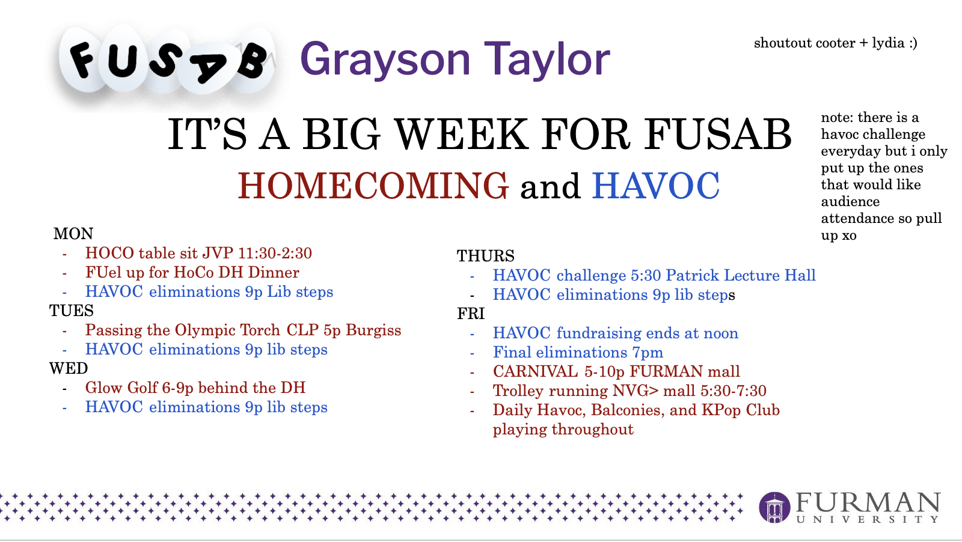

FUSAB - Grayson Taylor

Slide 31

RLC- Jeff Mclane

Slide 32
Religious Council - Ruthie Richardson
Theological Education Fair on Nov. 2 from 12-4pm in the Watkins Room

Slide 33
Campus Rec - Eva Brooks
IM's - Soccer regular season ends today. Playoffs start Wednesday.
Clubs - Rugby went to Charleston, no update. Ultimate went to Boone, no update. Men's volleyball went to Duke, no update.

Slide 34

Abijah Leamon

Slide 35
Panhel - Katherine Murphy

Slide 36
ROTC- Luke Stewart
Ranger Challenge

Slide 37
FUOC- Adrian Gonzalez
New Officer interviews

Slide 38
Paladin - Colin Brake

Slide 39
Committee Reports

Slide 40
Finance

Slide 41
PR

Slide 42
New Business
Library Patio Outlet Proposal

Slide 43
Old Business
FU MENA Voting

Slide 44
Open Forum
All the fun stuff:
announcements, discussions, and more!

