Slide 1

Welcome to SGA!
October 30, 2023

Slide 2
Agenda
Guest speaker(s): Susan Maddux, Vice President of Finance and Administration and Ron Thompson/Curtis Nash
Officer, class, & at-large reports
Committee reports
Old business
New business
Open forum & announcements

Slide 3
Guest Speaker
Susan Maddux
Vice President for Finance and Administration
Ron Thompson and Curtis Nash
Housing & Residence Life

Slide 4
Exec Reports

Slide 5
Dean Cassidy
Homecoming was a lot of fun! Congrats to Lydia on HAVOC!
Congrats to football, cross country and men’s and women’s golf! Tough losses for volleyball and men’s and women’s soccer - proud of them though.
Response rate on Gallup survey is behind last year. Please complete!
Flu shot clinic on Tuesday, 12-3 p.m. – DH upstairs
Please be safe on Halloween!

Slide 6
Meredith Ervin
Please text me this week to update me on your projects and any concerns/issues you may need help with. 618-203-1676 I would love to call/meet with anyone who needs some help!
Working with exec to plan a fun night for council! Stay tuned.
Super proud of everyone’s hard work this past week.
P.S. (I got engaged ahhh <3)

Slide 7
Yaseen Echekki- VeePee
Meeting with Jordan King tomorrow to talk about VP role
Clubs are going through financial onboarding (Thanks Andrew)
Potentially sending an email to ask about new furniture on G-field.
Wench-seen

Slide 8
Andrew Cooter
Voting on Library outlet funding in OB
Introducing First Responders NM request in NB
Trying to get a convo with Club Sports council folks to see if they’d allow club sports teams to receive some funding from the SGA pot
Music Festival is still happening (would someone like to help me out with marketing???)
s/o Tate, you’ve just been killing it overall lately

Slide 9
Carly Gillis
partnering with PHOKUs

Slide 10
Lydia McCarty

Slide 11
Tatyana Gonzalez
Mindfulness CLP Thursday 11/9: 5:30-6:30pm!
also-
A freshman reached out to be with desire to implement more relaxing & de-stressing little activities/pops ins. I would like to maybe do a coloring pop-in or something alongside Palamind (mindfulness org). If anyone has any ideas or an org would like to help out with doing some of these throughout the year please let me know!

Slide 12
Representative Reports

Slide 13
Sydney Beraho

Slide 14
Leah Manning
42 donors (14% participation)
Let’s beat C.O. ‘23 (53%)
YOU choose where your gift goes
Click here to give!
Have a fun and safe Halloween!

Slide 15
Alex Murray

Slide 16
Kelsey Sumter

Slide 17
Mary Boucher
I decided I am going to make the used textbook facebook. Stay tuned….
I need one person form each class who has facebook and wants to be on the used textbook committee. text me! (803)-900-1197

Slide 18
Adara Briceño

Slide 19
Deen Deovic

Slide 20
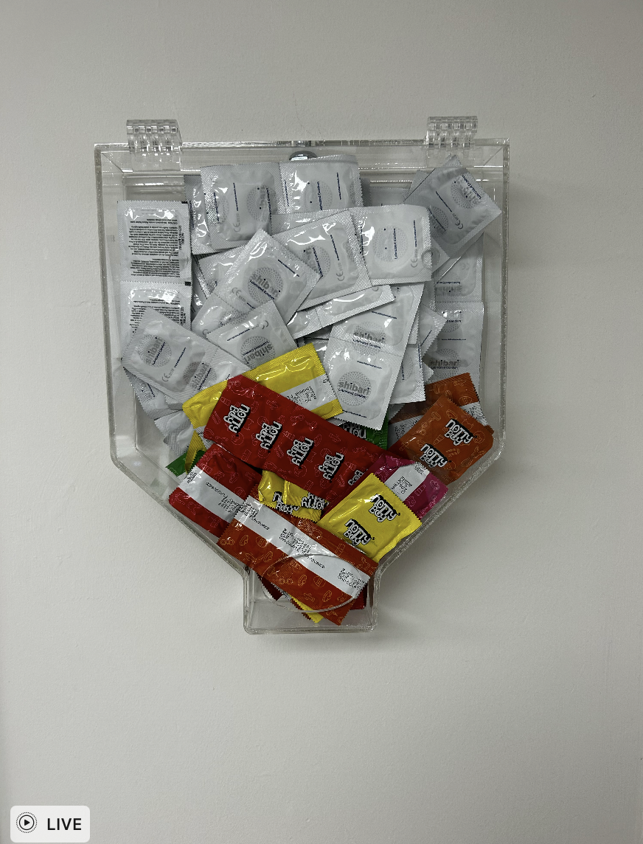
Jennifer Woollery
we did it joe

Slide 21
Caroline Cousar
Planning to meet with Allison Diaz early next week to propose ideas for more whiteboards in the lib!
I hope everyone had a great Homecoming!!

Slide 22
Tate Denham
Condoms phase 1 is all done ! Kosak has been made proud. Next steps? We look at results…
Thx to Jenny 4 her help!
Met w Rick Shosky (Director of facilities) ab some oncoming projects… results?
Kim Keefa & I and in kahoots ab SGA Strengths (StrengthsGA)
Quick strengths poll
Paddock Trivia / Furman Fridays are next….
lets chat if u wanna get involved
I really appreciate everyone who helped w HOCO! Y’all ended up showing up which was nice!
ALSO ! PMA & SAI ROCK & WE LOVE THEM!

Slide 23
Kobby Frempong

Slide 24
Mariam Nguyen
Nothing to report!

Slide 25
Libby Adams

Slide 26
Caroline Orr

Slide 27
Danyal Sharif

Slide 28
Curtis Wilson
No Updates from me!

Slide 29
At- Large Reports

Slide 30

FUSAB - Grayson Taylor
THANK U ALL FOR SUCH HIGH ENGAGEMENT WITH BIGGGGG FUSAB WEEK
FALL MARKET IS THIS SUNDAY!!!!!!!!! 10am-noon behind the LIBBBB, free coffee, live music flowers, epicness
why commute downtown when you can wake up at the market you know??
also if anyone ever wants to cospo with FUSAB LET A GIRL KNOWWW

Slide 31
RLC- Jeff McLane

Slide 32
Religious Council - Katie Jobe
\

Slide 33

Campus Rec - Eva Brooks
IM's: Table tennis (this weekend)
*hiring IM officials - apply through IG bio*
Clubs: Rugby @ Elon (11/04)
Tennis @ Rome, GA (next weekend)
@FurmanCRW

Slide 34
Pool back open!!!!
TYPO
Thurs Barre class starts @ 12:15

Slide 35

-Abijah Leamon
SDC Event, partnered with SLBC, FUGE, and Purple Diamonds
Pumpkin Patch Party
October 30th, 2023 from 6-8 PM
Trone Atrium
Making care packages for Miracle Hill Ministries
Upcoming Events for SDC Organizations
SLBC - Let the Ghoul Times Roll Skate Night (October 31st)
FUISA - International Fashion Show (November 10th)

Slide 36
Panhel: Katherine Murphy
DHOP is November 2nd from 7-9:30 pm in Watkins

Slide 37
ROTC- Luke Stewart

Slide 38
FUOC- Adrian Gonzalez

Slide 39
Paladin - Colin Brake

Slide 40
Committee Reports

Slide 41
Finance

Slide 42
PR

Slide 43
New Business
First Responders!

Slide 44
Old Business
Outlets!

Slide 45
Open Forum
All the fun stuff:
announcements, discussions, and more!

