Slide 1

Welcome to SGA!
November 13, 2023

Slide 2
Agenda
Guest speaker(s):
Officer, class, & at-large reports
Committee reports
Old business
New business
Open forum & announcements

Slide 3
Guest Speaker

Slide 4
Exec Reports

Slide 5
Dean Cassidy
I will miss y’all again tonight. I’m at the Associated Colleges of the South meeting at the University of Richmond. I’ll be back in the office on Thursday. Have a great week!
Congratulations to the football team. SoCon champs! Go Dins!
Response rate on Gallup survey is still behind last year. Please complete! Deadline is 11/22.

Slide 6
Meredith Ervin
Tailgate seemed to be a success! Will definitely keep registering SGA for things like this!
After council, exec will be finalizing plans for our strengths workshop!

Slide 7
Yaseen Echekki
Met with Jordan King last week
Email to club presidents about gallup survey
Met with Ron Thompson and gang last week
FUISA International Fashion show was awesome

Slide 8
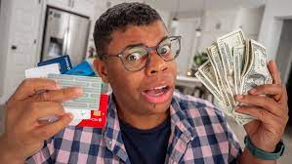
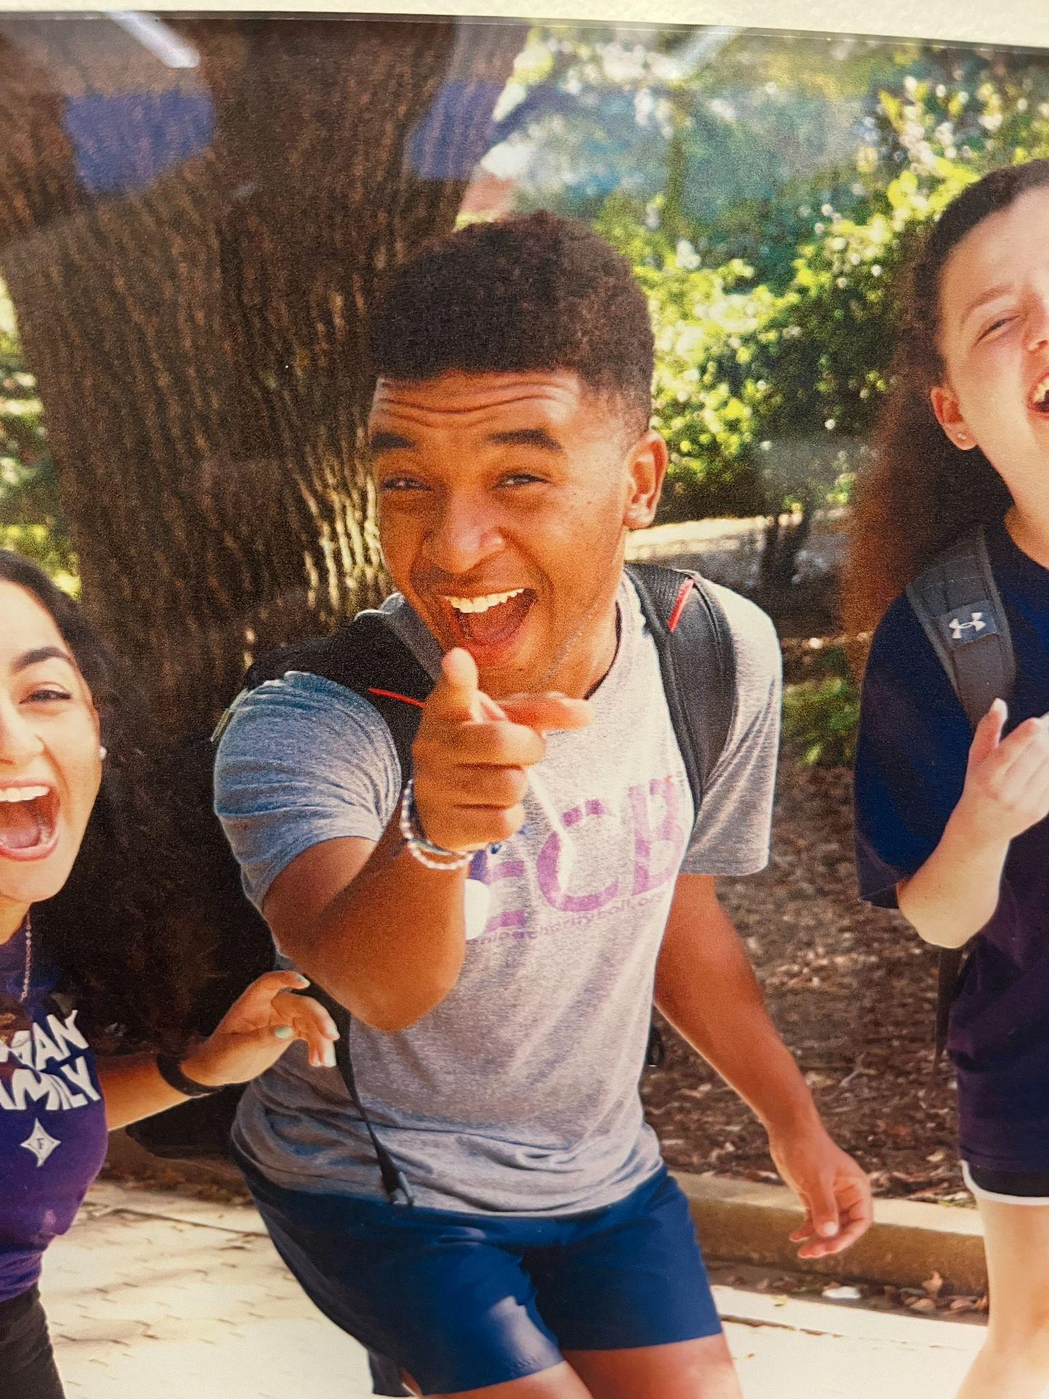
Andrew Cooter
MONEY!? WHATS UP WITH THAT??
Burnout Music Festival is THIS SATURDAY 4-7PM!! Thanks to RLC, The Paladin, and FUSAB (pending vote) for helping out! It’s gonna be amazing so BE THERE!!
Thanks to those who came to the SGA tailgate! Hoping for another one before the end of the year.
Met with treasurers and advisors of SDC, Religious Council, and Club Sports for a super interesting convo on similarities and differences between the councils!

Slide 9
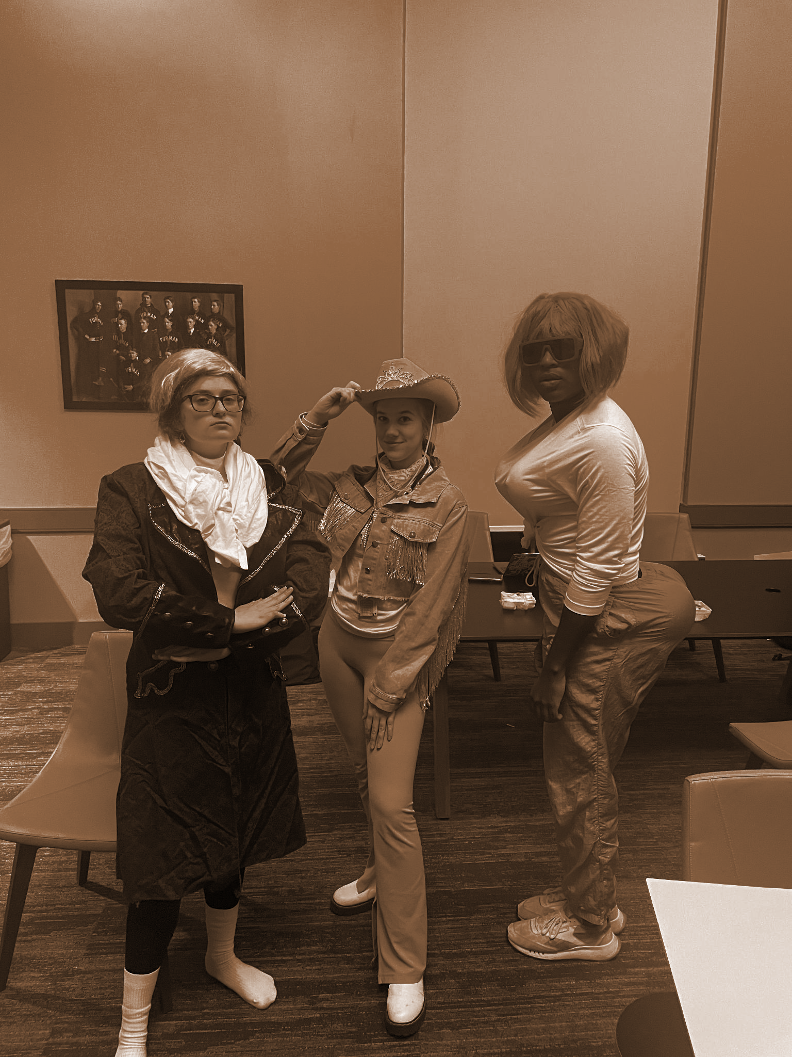
Carly Gillis
Had the most AMAZING time in NYC!
met with PHOKUS on Wednesday and with a few members of their exec very soon!
zoom call with WFMH on Friday at 5am
long awaited rep highlights, just had difficulty on organizing as not everyone submitted a rep highlight and it was scattered throughout the classes
HUGE thanks to Caroline Cox for the gameday takeover

Slide 10
Lydia Mc(pLAYBOI)Carty

Slide 11
Tatyana Gonzalez

Slide 12
Representative Reports

Slide 13
Sydney Beraho
Senior Class Gift: 17%!!!
lauren says hi from basketball band woohoo roll dins!!!

Slide 14

Leah Manning
Keep those gifts coming! Great work!
Even if you aren’t a senior, be reminding your senior friends about the class gift and perks associated with giving!
$75 by DECEMBER 31 for a personalized brick!!! Don’t miss out!

Slide 15
Alex Murray

Slide 16
Kelsey Sumter

Slide 17
Mary Boucher
Still need a Freshman and a Sophomore for the used textbook committee!!!
G-Pavillion Music (quiet hours?)
Project idea for someone: talk to someone about getting printers in Furman Hall?

Slide 18
Adara Briceño
NEW COFFEE MACHINES OTW

Slide 19
Deen Deovic

Slide 20
Jennifer Woollery

Slide 21
Caroline Cousar
Happy World Kindness Day!
Updates:
-Working with the Asian Studies Department this week on times to open the Place of Peace for student use.
-Lib whiteboard project is underway… working on budgets currently!

Slide 22
Tate Denham
No big updates - staying safe
Kobby & I found the condom box in CMC empty while on rounds… omg
BASKETBALL IS CRAY CRAY
yaseen
SGA <3 the new microwave in the TCFMF
FF is chatting/OSI - plan for next semester is in creation
Paddock Trivia meeting was pushed…
Swing Set is going through Jberk next…

Slide 23
Kobby Frempong

Slide 24
Mariam Nguyen
Shoutout Tate! The condoms have been all used up in Townes!
Ultimate Frisbee on the 29th! I’ll text in our group chat
still meeting with dining staff to discuss vegan ice cream in DH and acai/smoothies in the PDEN! Can’t wait

Slide 25
Libby Adams
Follow the freshman Instagram @Sga_Furman_Freshman_27 !!!
Looking for our first freshman friday highlight
Rep intros will start soon!
Input form has had a request for period products in SOHO bathrooms
Have a happy thanksgiving break!

Slide 26
Caroline Orr

Slide 27
Danyal Sharif

Slide 28
Curtis Wilson
SOHO mental health check-in event is going to be hosted the week before finals to ensure students are doing well physically and mentally. Students will have the opportunity to take part in a variety of different activities. We will have therapy dogs, yoga, snacks, and more. Additionally, we are planning to do a give-away during this event. So please share this and encourage your freshman friends to attend this event.
Also check out the new Freshman SGA Instagram that Libby created!

Slide 29
At- Large Reports

Slide 30

FUSAB - Grayson Taylor
its fusab business season!!
elections are tomorrow
we are passing motions soon!
COMEDY CLUB THIS THURSDAY!!!! Ian Lara (as seen on Jimmy Fallon and Comedy Club- so its gonna be electric) 7PM DANIEL RECITAL HALL and improv club is opening!!
stay tuned for cabin fever (winter wonderland) info soon!!

Slide 31
RLC- Jeff McLane <3

Slide 32
Religious Council - Ruthie Richardson
MSA is holding a CLP on the Israeli-Palestinian with Dr. Malici on Nov 14

Slide 33

Campus Rec - Eva Brooks
IM's: Table tennis (last weekend)
*hiring IM officials - apply through IG bio*
Ultimate Frisbee after Thanksgiving
Clubs: Tennis @ Rome, GA (last weekend)
Equestrian Club Show (last weekend)
Charles Howden Golf Ntn’l Champ Comp (last weekend)
@FurmanCRW

Slide 34

Abijah Leamon >:)

Slide 35
Panhel - Katherine Murphy
Super busy Wednesday:
Tabling outside of Trone from 11:45 am - 1:15 pm to promote recruitment registration. Candy will be available.
Pizza and Pickleball at the NV courts starting at 7 pm.
Also, most chapters have wrapped up their election processes, and Panhel held their interviews this past Sunday. The slate will be presented at the Panhellenic Council meeting this Wednesday, and a vote will be held Wednesday the 22nd via Zoom.

Slide 36

International Reps
Dining Hall Food
Trivia Night - International Education Week
Nov 15, (7:30-8:30) at Watkins

Slide 37
Paladin- Colin Brake

Slide 38
Committee Reports

Slide 39
PR

Slide 40
Finance

Slide 41
New Business

Slide 42
Old Business

Slide 43
Open Forum
All the fun stuff:
announcements, discussions, and more!

