Slide 1

Welcome to SGA!
October 2, 2023

Slide 4
Agenda
Guest speaker(s): Beth Pontari and Connie Carson
Officer, class, & at-large reports
Committee reports
Old business: Club Voting
New business
Open forum & announcements

Slide 5
Guest Speakers
Connie Carson
Provost Pontari

Slide 7
Exec Reports

Slide 11
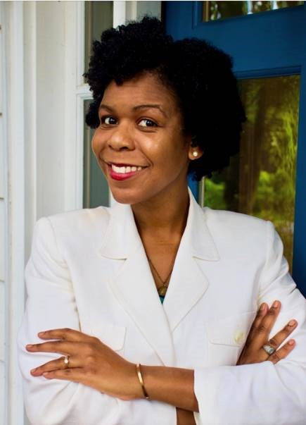

Dean Cassidy
Please join me in welcoming our new associate chaplain, Alexis Carter Thomas. Alexis is an ordained minister and ministry consultant. She earned a Master of Divinity from the Divinity School at Duke University and a Doctor of Ministry degree with a concentration in Women's Religious Leadership from Drew University Theological School. Alexis’ doctoral research and work bridged the loving and liberating power of womanist theology in the academy with the everyday lives of Black women in the pews. As a 2019 recipient of the Reflective Leadership Grant, awarded through Leadership Education at Duke Divinity, she conducted research on the flourishing of Black clergywomen.
Alexis’s professional experience includes work in higher education and congregational ministry. She has worked on five different college campuses in areas ranging from residential life to student affairs. Previous roles have included: serving as a pastor of discipleship on staff at a congregation while teaching Supervised Ministry at Phillips Theological Seminary in Tulsa, Oklahoma; developing an Introduction to the Hebrew Bible course at Lander University; and working as the Head Manager of Duke Women’s Basketball. Since 2021, Alexis has served as the Program Director for The Vinery, a Lilly Endowment Thriving Congregations Initiative. She serves as the chair of the board for the Rebuild Women’s Hope Foundation—an organization that seeks to empower and improve the quality of life for women in the Democratic Republic of the Congo through coffee production and entrepreneurship training. She believes that beloved community is possible.
You can welcome Alexis directly at Alexis.thomas9@furman.edu. She will began her tenure at Furman on September 25.

Slide 12
Meredith Ervin
Sorry I am missing today, still feeling sick :(
Retreat was wonderful! Thank you so much to everyone for really being engaged! I was told this is SGA’s first off campus retreat in 5 years!
Our hoco theme is March Madness!!! Please brainstorm ideas!!!

Slide 13
Yaseen Echekki

Slide 14
Andrew Cooter
Leslie is working on revising the budget request forms on SyncDin, and I will send out budget emails once that’s done so that there’s no confusion on how the forms work!
Need folks on Finance and Traffic/Parking committee

Slide 15
Carly Gillis
gameday series starting this weekend!
starting rep highlights, remember to fill out the google doc and send me your preferred picture!
club takeover is paladin ink

Slide 16
Lydia McCarty
.

Slide 17
Tatyana Gonzalez

Slide 18
Representative Reports

Slide 19
Sydney Beraho
Flu vaccine clinic collaboration with Earle Student Health Center - raffle & increased advertisement
Successful Senior Class Gift Program of course :)

Slide 20
Leah Manning

Slide 21
Alex Murray

Slide 22
Kelsey Sumter

Slide 23
Mary Boucher
Creating a platform to buy/sell used textbooks

Slide 24
Adara Briceño

Slide 25
Deen Deovic
Downtown Trolly
Textile Recycling Program

Slide 26
Jennifer Woollery
utilize our athletic teams as a means of promoting unity and participation in our campus community
add relevant nutrition information to DH menus
relevant = nutrient density/content and explanation of positive effect on physical wellbeing; collab w/Health Science Dpt.
make amendments to course registration policy
make contact this semester (I am aware this will probably take more than a few weeks)
get panini press for gluten free section of DH

Slide 27
Caroline Cousar
Goals for the semester:
– Small trash cans in dorm restroom stalls for feminine hygiene product disposal.
– Whiteboards faculty/students can checkout from the library for outdoor classes/study sesh with friends.
– Working with the Asian Studies Department to utilize the Place of Peace as a space “occasioning deep reflection, meditation, calmness, and connection” for students to use & enjoy.

Slide 28
Tate Denham
Yo yo yo!
Swingset meeting this week… hopefully
Sustainability idea came to me… chatting w exec soon!
PINS BABEY!!!
Voting in New Business!
My goal this year: add more outdoor
fun & create more playtime on
Furman campus.

Slide 29
Kobby Frempong

Slide 30
Mariam Nguyen
follow up meeting with Tony McGuirt (vegan ice cream and soft serve)
SGA in co-ed intramurals?
Planning SGA shirts with new logos to wear to our events/future tailgates! Thoughts?
My goal for this year is to benefit student health/wellness by making food/housing cater student needs

Slide 31
Libby Adams
Find a way for sick students to get food to their dorms while they are under the weather/quarentined

Slide 32
Caroline Orr

Slide 33
Danyal Sharif

Slide 34
Curtis Wilson
“Don’t give up. The beginning is always the hardest. Life rewards those who work hard at it.” – Unknown
No updates from me!
I am still currently working on goals set at the beginning of the academic year

Slide 35
At- Large Reports

Slide 36

FUSAB Grayson Taylor
FUSAB’s Vice President of Administration, Russell Richards, is here on my behalf!
HAVOC APPS ARE OPEN ON SYNCDIN!!!!!! Happening week of October 22-27 (also Homecoming week so stay tuned for those events!!)
Haunted Trail is October 20!! Stay tuned for theme :)

Slide 37
RLC- Jeff McLane

Slide 38
Religious Council - Ruthie Richardson
The Office of Spiritual Life has hired a new Associate Chaplain, Alexis Carter Thomas
She’s super nice and everyone is happy she’s here :)

Slide 39
Campus Rec - Eva Brooks

Slide 40
SDC- Abijah Leamon

Slide 41

Panhel - Katherine Murphy
Fall Philanthropy Festival is October 5th from 5-7 pm on the mall

Slide 42
ROTC- Luke Stewart

Slide 43
FUOC- Adrian Gonzalez

Slide 44
Paladin- Colin Brake

Slide 45
Committee Reports

Slide 46
JEDI

Slide 47
Finance

Slide 48
PR

Slide 49
New Business

Slide 50
Old Business
Voting on our three new clubs

Slide 51
Open Forum
All the fun stuff:
announcements, discussions, and more!

