Slide 1

Welcome to SGA!
September 18, 2022

Slide 2
Agenda
Guest speaker(s): Melissa Nichols
Officer, class, & at-large reports
Committee reports
Old business
New business
Open forum & announcements

Slide 3
Guest Speakers
Melissa Nichols

Slide 4
Exec Reports

Slide 5
Dean Cassidy

Slide 6
Meredith Ervin
FRESHMEN ELECTIONS!!!!!!! We have 14 candidates running which is an amazing number! Make sure we are encouraging a positive campaign atmosphere!
Filmed a few videos for Furman donors last week and will be doing a “day in the life” tik tok for Furman!
Finalizing retreat details. Once I hear back from a few people I will send out finalized schedule :)

Slide 7
Yaseen Echekki

Slide 8
Andrew Cooter
“It may not work out how you think it will, or how you hope it does. But it will all work out.” -Ted Lasso
SGA’s allocation from the Student Government fee is expected to be coming in early this week! Once we know how much money we have from the fee, I’ll propose the organization budgets (in New Business), and we’ll vote to approve them the following week (in Old Business). In the meantime, if you or someone you know would like to know the budget for your organization, let me know and I can provide the projected budget that they will have for the year.
Come to my office hours (Tues/Thurs 9:30-11am) if you’d like more info!
Meeting with Dr. Cassidy & Chief Milby on Thursday to discuss increasing FUPO presence in Trone Student Center
This is you if you join the finance committee
for legal reasons, this is a joke
(864)423-3288 is my number; text me if
you’d like to join!
Chanson de la semaine:

Slide 9
Carly Gillis
ARK takeover on the Instagram this Thursday
sending out email to club leaders again (just forwarding OG 8/21 email)
freshman election tiktok will be posted on either late Monday/Tuesday, have had lots of fun helping out with elections
Office hours are from 2-3:30 on Tuesday and common hour Friday 🤭
PR COMMITTEE ‼️ want at least 2-3 people text at (864)-590-4898 if you’re interested and like social media
at large reps: let me know how I can promote your events! :)
personal news: was invited to the NEDA gala in NYC and will be judging the PMA talent show on 10/7 @ 8pm. ED prevention plan will pick up in October with basic outline complete as of now. Presenting research on 9/29 as well :)
Also if you’re inducted into any honor societies, go to any special events, etc. send me details so we can highlight you on our socials! Reps support Reps 🫶🫶🫶 I’ll be at the Sigma Tau Delta induction and the Cookies and Conversation already so meet me for pics if you’re at these events!

Slide 10
Tatyana Gonzalez

Slide 11
Lydia McCarty

Slide 12
Representative Reports

Slide 13
Sydney Beraho

Slide 14
Alex Murray

Slide 15
Kelsey Sumter
Friday’s video shoot was a success
Still looking for senior volunteers to help with class gift stuff
Voter registration drive on Tuesday: 10am-2pm
Football game vs Mercer @ home Saturday 9/23, come watch the Purple Diamonds perform → Kickoff 2pm

Slide 16
Leah Manning
Senior Class Gift video filmed on Friday – Thank you to everyone who showed up and participated! :)

Slide 17
Mary Boucher

Slide 18
Deen Deovic

Slide 19
Adara Briceno
Nothing to add :)

Slide 20
Jennifer Woollery

Slide 21
Tate Denham
UPDATES!
We working on them condoms !
Swingset is in COMMS

Slide 22
Mariam Nguyen
Meeting with Tony McGuirt this week to discuss soft serve in DH and vegan ice cream coolers!

Slide 23
Caroline Cousar
I hope everyone had a wonderful weekend!!!
Ideas/goals for the semester in the works:
– Small trash cans in dorm restroom stalls for feminine hygiene product disposal.
https://www.hercampus.com/school/furman/destigmatizing-feminine-hygiene-one-step-at-a-time-fighting-for-the-tiny-trash-can/
– Whiteboards faculty/students can checkout from the library for outdoor classes/study sesh with friends.
– Working with the Asian Studies Department to utilize the Place of Peace as a space “occasioning deep reflection, meditation, calmness, and connection” for students to use & enjoy.
Link to Place of Peace - Interesting Facts

Slide 24
Kobby Frempong

Slide 25
At- Large Reports

Slide 26

FUSAB - Grayson Taylor
FALL BALL THIS FRIDAY!!!!!!!
POSES AND MIMOSAS NEXT SATURDAY!!!!!!!!!!

Slide 27
RLC- Jeff McLane
Met and discussed the idea of bringing a food truck on campus sometime
Discussed putting furniture on the balconies of Lakeside so people could enjoy them
Ron Thompson will be at next meeting and will discuss this
Adding 15 new members this week! Got rid of some older members who no longer attend meetings.

Slide 28
Religious Council - Ruthie Richardson
Tentative budgets have been sent out by Myla (our treasurer)
Nothing else :)

Slide 29
Campus Rec - Eva Brooks
FREE!!!
Club Sports
Last Weekend
Men’s Soccer v Kennesaw St
Women’s Soccer v GA South
Powerlifting W
Next Weekend
Men’s Soccer v GA Tech - SUN
Women’s Soccer v USC - FRI
Women’s Soccer v Coastal - SAT
Intramurals
Last week of regular season flag football

Slide 30
SDC- Abijah Leamon
NAACP is having a Voter Registration Drive!
Please encourage students to come out and find out information for voting! This event is for all Furman students, not just Furman students that live in South Carolina!

Slide 31

Panhel- Katherine Murphy
September 18th - 22nd: Acts of Random Kindness (ARK) Week
Quick Stop Event: Sticky Note Project; 6:00-7:30pm on September 21st in Watkins
September 21st: DG and Adpi Panhellenic Night
pop-up outside of Trone
making vision boards from 5-7 pm.
September 25th - 29th: Stop the Hazing week
purple ribbon-making with FUPO on the 27th from 7 -8pm outside the DH
Upcoming Philanthropy Events
September 21st: Dezign your Dough
hosted by Zeta Tau Alpha
edible cookie dough bar on the steps of the James B. Duke library
raising money for breast cancer education and awareness
September 24th-27th: Wish Week
*more details to come*
Chi Omega
in support of the Make-A-Wish foundation

Slide 32
ROTC- Deanna Hoyos
I

Slide 33
FUOC- Adrian Gonzalez
look behind you

Slide 34
Committee Reports

Slide 35
JEDI

Slide 36
Leadership

Slide 37
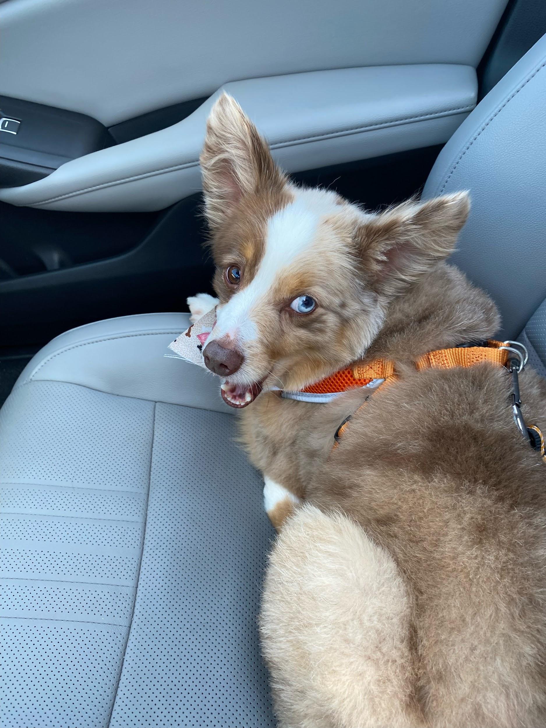
PR
text carly at 864-590-4898 to join

Slide 38
Finance

Slide 39
Food

Slide 40
New Business

Slide 41
Old Business

Slide 42
Open Forum
All the fun stuff:
announcements, discussions, and more!

