Slide 1

Welcome to SGA!
September 11th, 2023

Slide 2
Agenda
Guest speaker(s): – John Milby, Furman Police Chief
Main Points of the Week
Committee reports
Old business
New business
Open forum & announcements

Slide 3
Guest Speaker

Slide 4
Exec Reports

Slide 5
Dean Cassidy - Student Life
Piloting the Wellbeing Program (WBP) this semester.
Thefts in P-Den are not cool. Cameras will be installed soon.
Student protests/demonstrations must be registered with Student Life. Guidelines available at https://catalog.furman.edu/content.php?catoid=24&navoid=1355#space

Slide 6
President
Freshmen Elections:
Monday, September 11 by 5pm: Candidate Forms due on syncDIN
Tuesday, September 12: Speeches posted to syncDIN, campaigning begins
Wednesday, September 20-Thursday, September 21: Elections
Monday, September 25: First council meeting
Parliamentarian and Elections Chair have been voted on by exec:
Tatyana Gonzalez and Jaeyden Hill-Mims YAYYY
Tatyana will need to be affirmed by the council and sworn in!

Slide 7
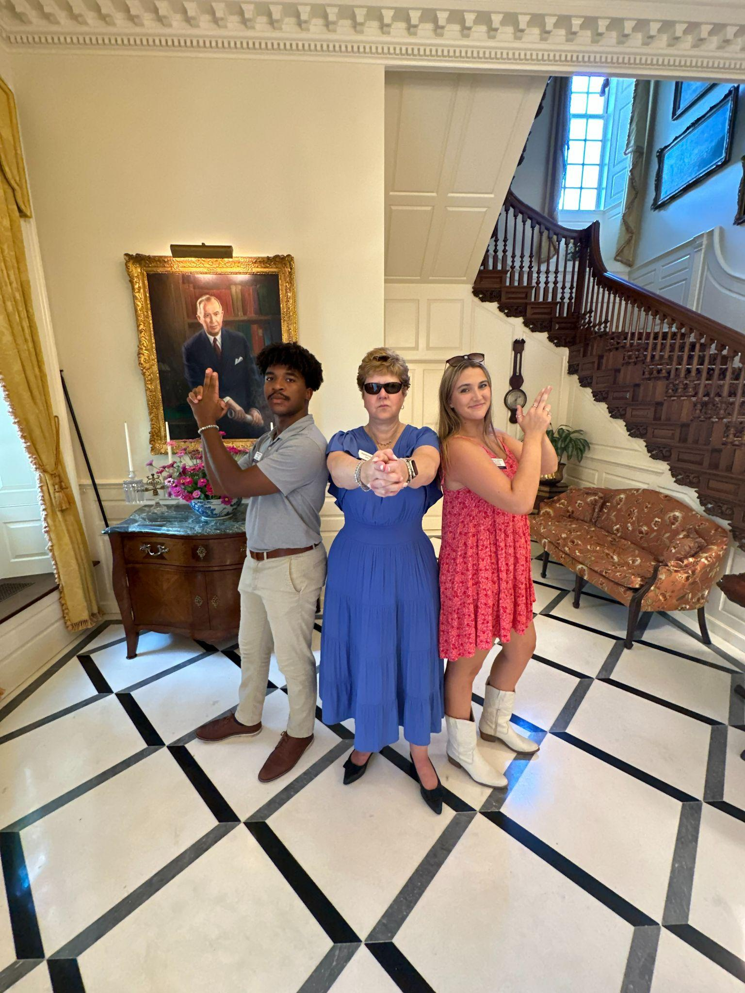


VeePee
Office Hours: WF:10:30-11:30. But I can be reached at any point in time or space via phone (919)561-9453
Huge Congrats to new additions to the fam

Slide 8
Treasurer
Office Hours: Tuesday/Thursday 9:30-11! Come visit if you/someone you know has questions about the Treasury, or if you just wanna hang out
In search of Finance Committee members (one from each class) - come chat to find out more!
Meeting with Chief Milby last week…discussed establishing a secondary FUPO office in Trone so that an officer can be there to answer questions/respond to threats

Slide 9
Secretary
Office Hours: Tuesdays from 12:00-2:00pm in the SGA office
Starting the club promotion project next week with FPA….Jordan King sending out the rest of the forms this week.
Charity of the Month Iniative……starting with NAMI as it’s suicide awareness month. Graphic to come
Keep posting on photocircle and join if you haven’t already!
Tiktok is @furman.sga

Slide 10
Parliamentarian

Slide 11
Academic Affairs
-Updates on pass/no pass
-Updates on wellness programs
-Coffee with the Dean
- Junior and Senior Reps: Can you all coordinate and provide me with 3 hour long times in the month of October that would be good for your classes to have “coffee with the Dean” aka Dean Longest of Academic Affairs

Slide 12
Representative Reports

Slide 13
Kelsey Sumter

Slide 14
Alex Murray

Slide 15
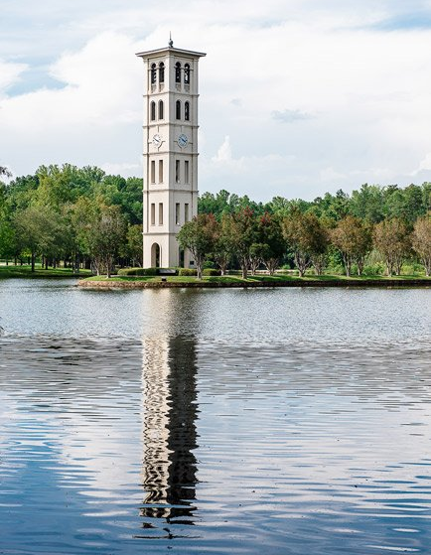
Sydney Beraho
Preparing the Class of 2024 Senior Class Gift Program!
If you know any seniors that are looking to be involved on campus (low commitment), send them our way. :)

Slide 16
Leah Manning
working on getting Senior Class Gift Officers!
Senior Class Gift Video shoot Friday afternoon at the library 1-3:30!

Slide 17
Mary Boucher
My main project/goal for this year is to come up with some sort of program/platform for students to buy and sell used textbooks!

Slide 18
Deen Deovic
The main goal is to
bring back the
downtown trolly
Secondary goal is to create
a shoe/textile
recycling program

Slide 19
Jennifer Woollery
utilize our athletic teams as a means of promoting unity and participation in our campus community
add relevant nutrition information to DH menus
relevant = nutrient density/content and explanation of positive effect on physical wellbeing; collab w/Health Science Dpt.
make amendments to course registration policy
make contact this semester (I am aware this will probably take more than a few weeks)
get panini press for gluten free section of DH

Slide 20
Adara Briceno
-Nothing to add :)

Slide 21
Tate! Denham!
HELLO!
FIND ME!
Improv!
FUOC
Tour Guide
Strengths dude
RA Judson 300!
(pull up lets hang)
What we doin?
Swingset!
SGA Pins SOON
School Spirit!
Study Room App
Slip n’kickball
Voter Turn up!
SOTW: Daybreak by Michael Haggins

Slide 22
Caroline Cousar
I hope everyone had a wonderful weekend!!!
Ideas/goals for the semester:
– Small trash cans in dorm restroom stalls for feminine hygiene product disposal.
https://www.hercampus.com/school/furman/destigmatizing-feminine-hygiene-one-step-at-a-time-fighting-for-the-tiny-trash-can/
– Whiteboards faculty/students can checkout from the library for outdoor classes/study sesh with friends.
– Working with the Asian Studies Department to utilize the Place of Peace as a space “occasioning deep reflection, meditation, calmness, and connection” for students to use & enjoy.
Link to Place of Peace - Interesting Facts

Slide 23
Kobby Frempong
The primary focus is to start a Go-Fund-Me - primarily for sophomores - to help meet the needs of students who require assistance for education-related activities.
A secondary focus would be to establish a system of providing washing and cleaning detergents for sophomore students to help reduce the number of times students have to ply the road for these products.

Slide 24
Mariam Nguyen
-SOOO excited for this year!
-Met with Tony McGuirt last week to discuss bringing back ice cream in the DH!
-We are having a follow up meeting this week!
-Vegan ice cream/cooler w to-go treats and snacks in DH

Slide 25
Freshmen Reps
coming soon hehe

Slide 26
At- Large Reports

Slide 27

FUSAB
Grayson Taylor
Currently not here because I’m in FUSAB INTERVIEWS!!!!!!!!!!!!!!!!!!! WOOHOO
SAB updates: We have our retreat this weekend at YMCA Blue Ridge Assembly (Woop Woop) (Big things coming)
SAVE THE DATES::
09/23 FALL BALL!!!!! at the South Wind Ranch in TR (like Winter Ball for those who know but semi-formal and SOUTHERN) WILL BE AWESOME
09/30- Poses and Mimosas: Come get some mimosas (if you’re of age) and mocktails (if you’re not) and take a yoga lesson from a Soul Yoga instructor!!!

Slide 28

RLC- Jeff McLane
Just had first meeting didn’t plan anything.DO SOMETHING JEFFERSON

Slide 29
Religious Council - Ruthie Richardson
(Most) orgs have had their first meetings
Exec is meeting tomorrow to finalize tentative budgets for our organizations

Slide 30
Campus Rec - Eva Brooks
Club Sports
Last Weekend
Men’s Soccer v Emory
Women’s Soccer v Clemson
Next Weekend
Powerlifting @ Furman - Sat.
Men’s Soccer @ UGA - Fri.
Men’s Soccer v Kennesaw State - Sun.
Jordan Cox
Assistant Director of Competitive Sports
@FurmanCRW
Intramurals
Tomorrow 9/12
Cornhole @ 6 outside of DH
All are welcome!!!

Slide 31

SDC- Abijah Leamon
Social Media
Instagram - @furmansdc
Organization of SDC
Executive Board, Advisor, Organizations
First Meeting Recap
Notes:
shoutout to sdc for the muffins and coffee while chalking <3
-LP

Slide 32

Panhel - Katherine Murphy
September 18th - 22nd: ARK Week
Panhel is collaborating with the Acts of Random Kindness club
Sisters will post an ARK and challenge 3 other sisters to do the same by tagging them
Quick Stop Event: Sticky Note Project; 6:00-7:30pm on September 21st in Watkins
September 25th - 29th: Stop the Hazing week
beer goggle challenge with FUPO for a chance to win a free golden parking pass
“wear purple and win a free donut” day
cup stacking
purple ribbon-making with FUPO on the 27th from 7 -8pm outside the DH
September 21st:
*1st Panhellic Night*
DG and Adpi will be having a pop-up outside of Trone.
making vision boards from 5-7 pm.

Slide 33
ROTC

Slide 34
FUOC- Adrian Gonzalez
Turtleback good
Tubing this weekend
New trip restrictions from campus rec, working on that
sign up/payment on Fusion now

Slide 35
International Student Rep

Slide 36
Committee Reports

Slide 37
JEDI

Slide 38
Finance

Slide 39
Leadership Committee

Slide 40
New Business

Slide 41
Old Business

Slide 42
Open Forum
All the fun stuff:
announcements, discussions, and more!

