Slide 1

Customer Shopping Behavior Analysis
Uncovering spending patterns, segments, and preferences from 3,900 transactions to guide strategic decisions.

Slide 2
Dataset at a Glance
3,900
18
Purchases
Features
37
$59.76
Missing Values
Avg. Purchase
Review Rating only
Demographics · Purchase details · Shopping behavior · Subscription status

Slide 3

Data Preparation in Python
01
Load & Explore
pandas, df.info(), .describe()
02
Clean
Median imputation for Review Rating; snake_case columns
03
Engineer
age_group, purchase_frequency_days; dropped promo_code_used
04
Load to DB
PostgreSQL integration for SQL analysis

Slide 4
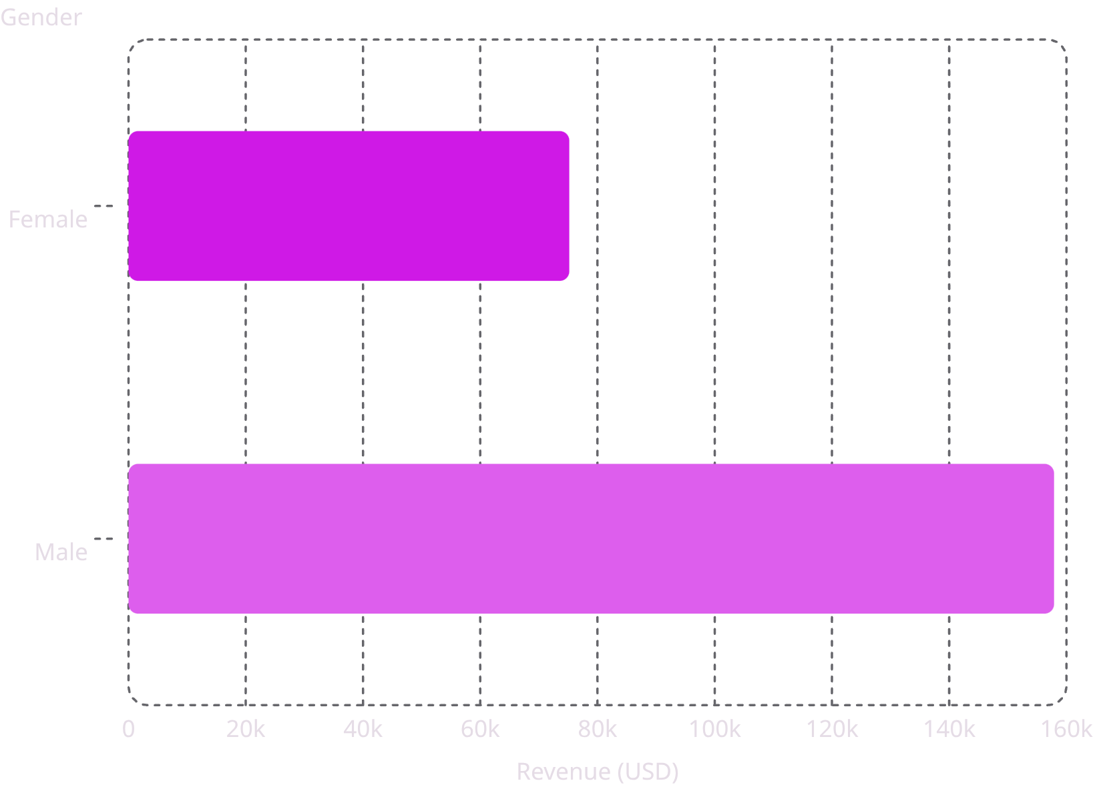

Revenue by Gender
Key Finding
Male customers generated 2.1× more revenue than female customers.
Male
Female
$157,890 — 68% of total
$75,191 — 32% of total

Slide 5
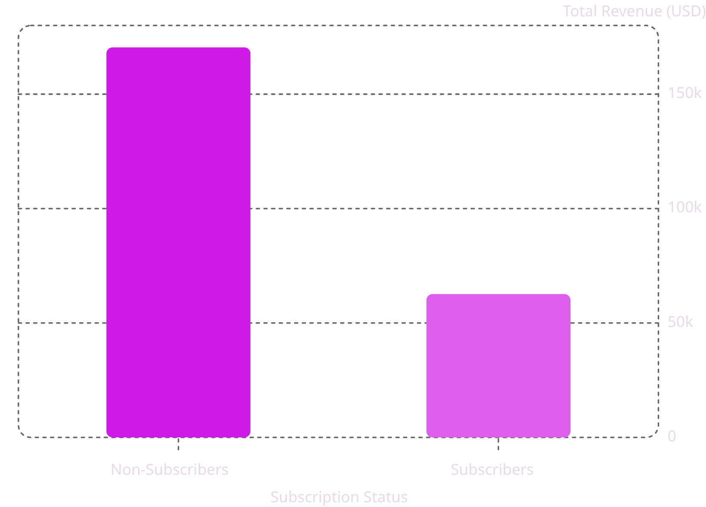
Subscribers vs. Non-Subscribers
Insight
Non-subscribers drive 73% of customers and most revenue — a major growth opportunity.
Non-Subscribers
Subscribers
2,847 customers · $59.87 avg spend
1,053 customers · $59.49 avg spend

Slide 6
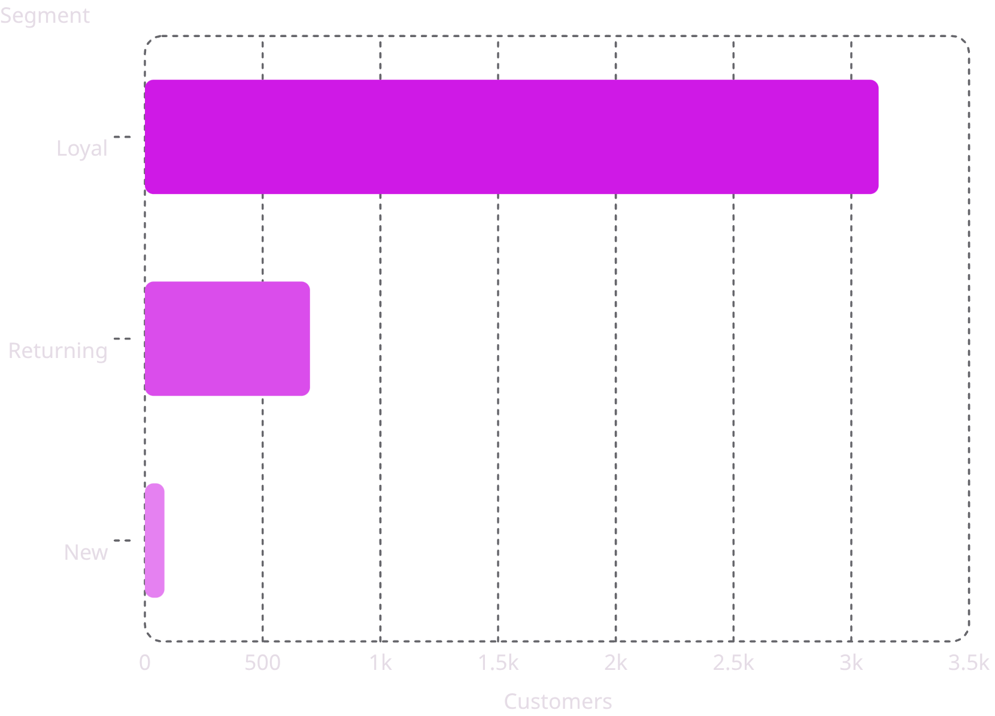
Customer Segmentation
Segment Breakdown
Based on purchase history — New, Returning, and Loyal customers.
Loyal
3,116 customers — dominant segment
Returning
701 customers — growth potential
New
83 customers — acquisition focus

Slide 7
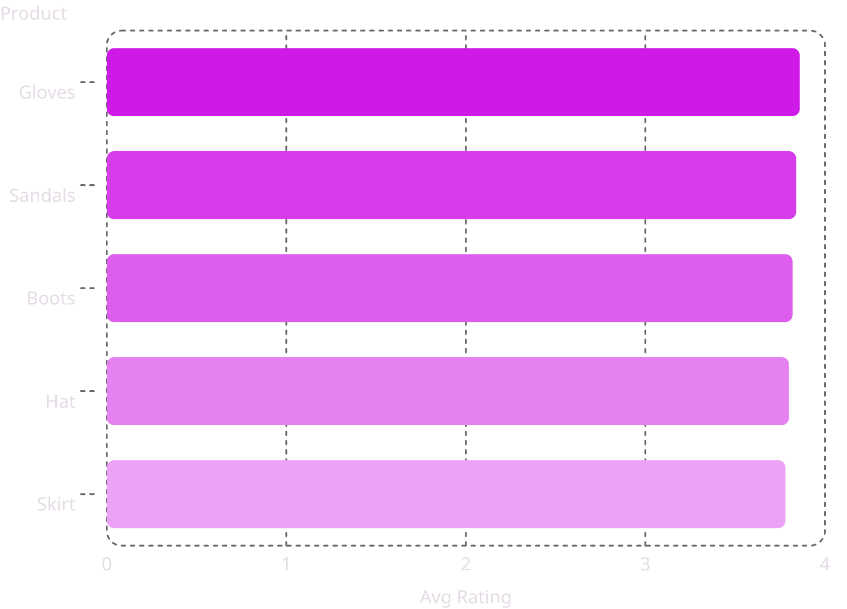
Top Products & Discount Trends
Top 5 Products by Rating
Highest Discount Rates
Hat — 50.00%
Sneakers — 49.66%
Coat — 49.07%
Sweater — 48.17%
Pants — 47.37%
839 customers used discounts and spent above average.

Slide 8
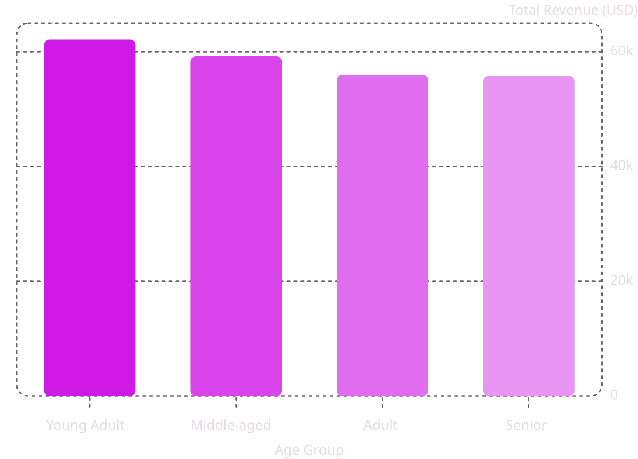

Revenue by Age Group
Key Insight
Young Adults lead revenue contribution. Revenue is relatively balanced across all age groups.
Average customer age: 44 years (range 18–70)

Slide 9

Power BI Dashboard
3.9K
$59.76
Customers
Avg Purchase
3.75
Avg Rating
Filters: Subscription Status · Gender · Category · Shipping Type

Slide 10

Business Recommendations
Boost Subscriptions
Promote exclusive subscriber benefits
Loyalty Programs
Reward repeat buyers → Loyal segment
Review Discount Policy
Balance sales boosts with margin control
Targeted Marketing
Focus on high-revenue age groups & express-shipping users

