Slide 1
Introduction to Gene Expression- II
Mridula Nandakumar [Mri-du-la]
Doctoral student, Department of Biology,
Lund University, Sweden
mridula.nandakumar@biol.lu.se
Computer Science in Modern Biology Workshop
01.08.2023

Slide 2
Workshop overview
1st day
Introduction to transcriptome sequencing
Execute pipeline for transcriptome analysis with 1 sample: download data, quality control, index and map reads
Primarily in terminal (shell based)
Installations of required programs
2nd day
Introduction to data analyses commonly used in RNA-seq
Analysis of differential gene expression using Deseq2
Interpretation of different plots and tools for DGE
Primarily in R
Installation of required R packages

Slide 3
Recap
Setting up: special attention to Windows users
Download necessary data
Trim adapter sequences with cutadapt
Quality check with FastQC
Index reference transcriptome with kallisto
Pseudoalign reads with kallisto

Slide 4
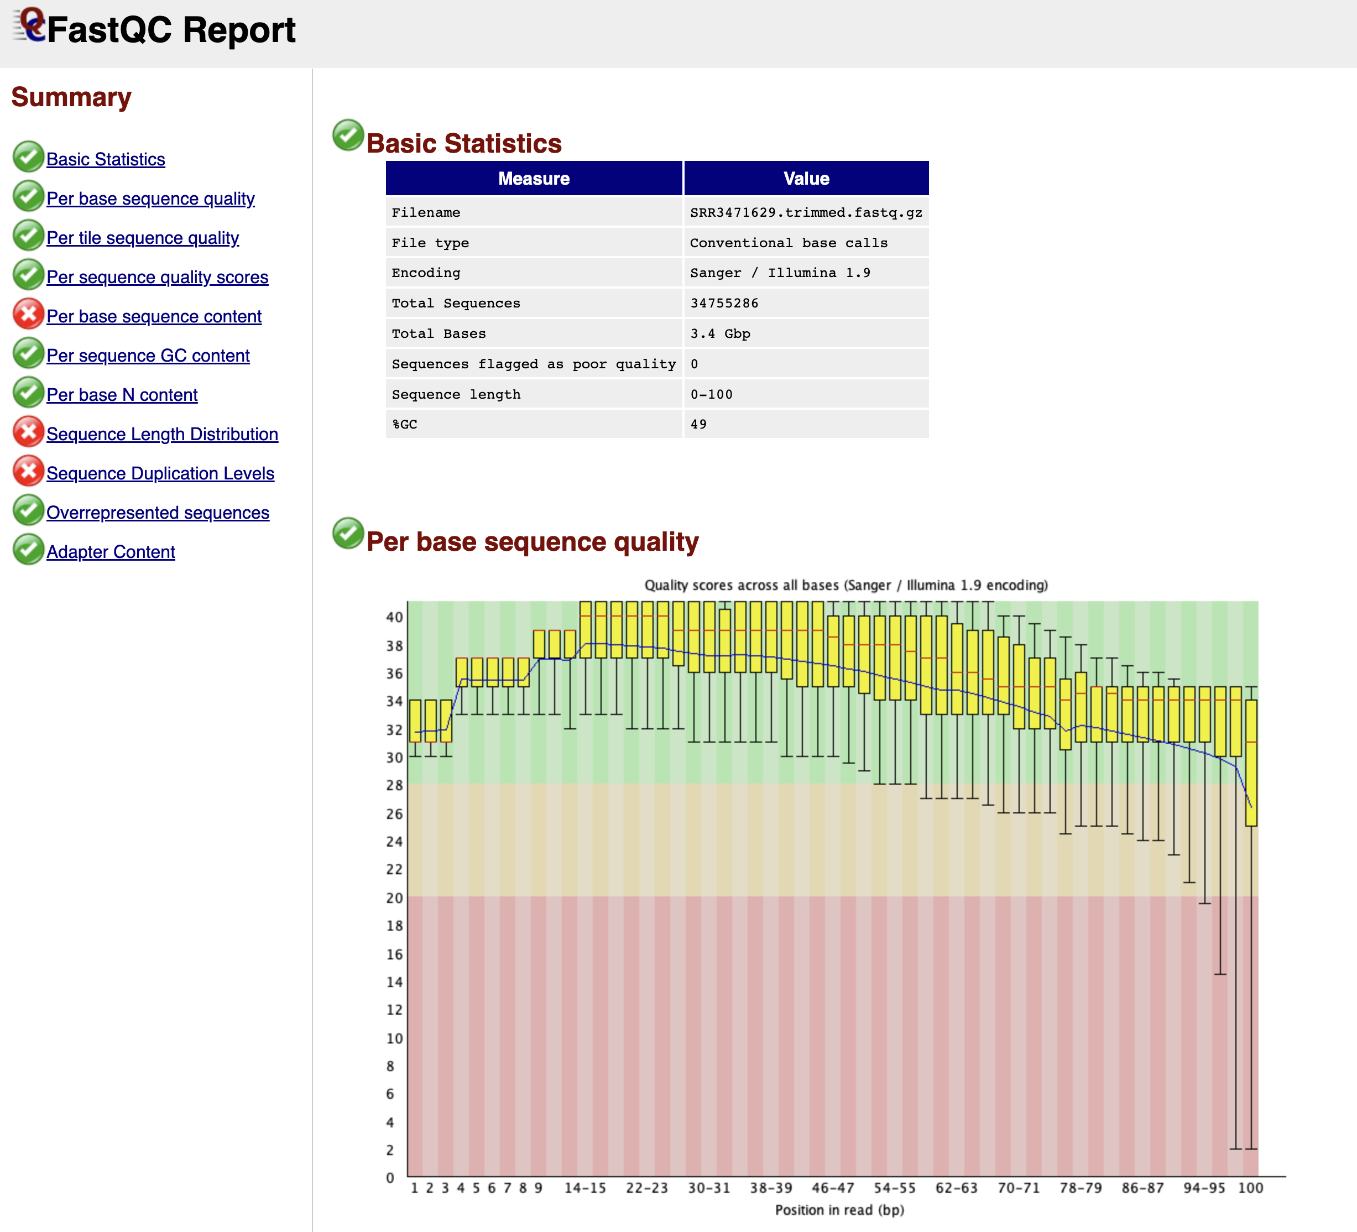
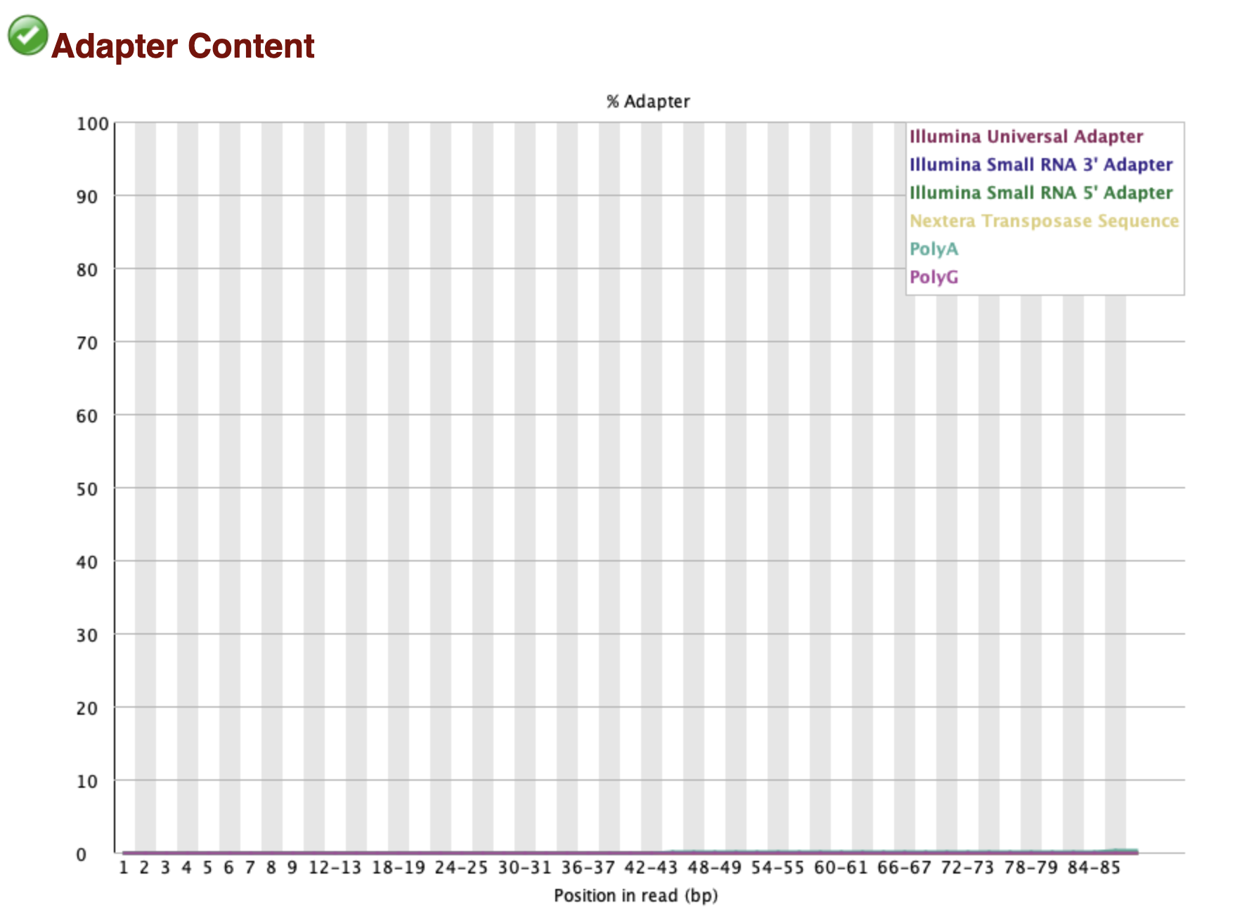
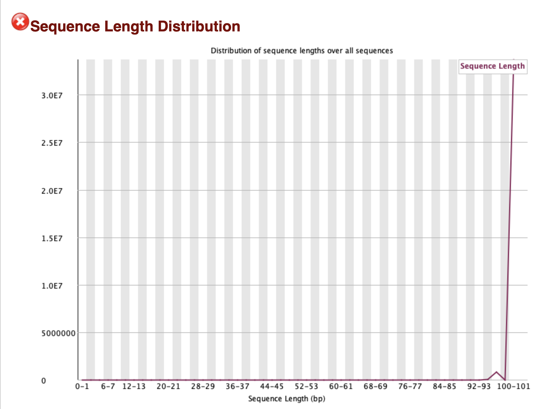
FastQC

Slide 5
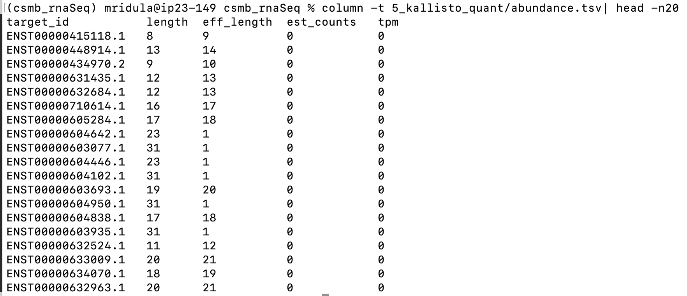
What we have: transcript abundance file

Slide 6
Expression level vs differential expression
Within sample comparison: high expression genes vs low expression genes
Between sample comparison: up-regulated genes vs down-regulated genes

Slide 7
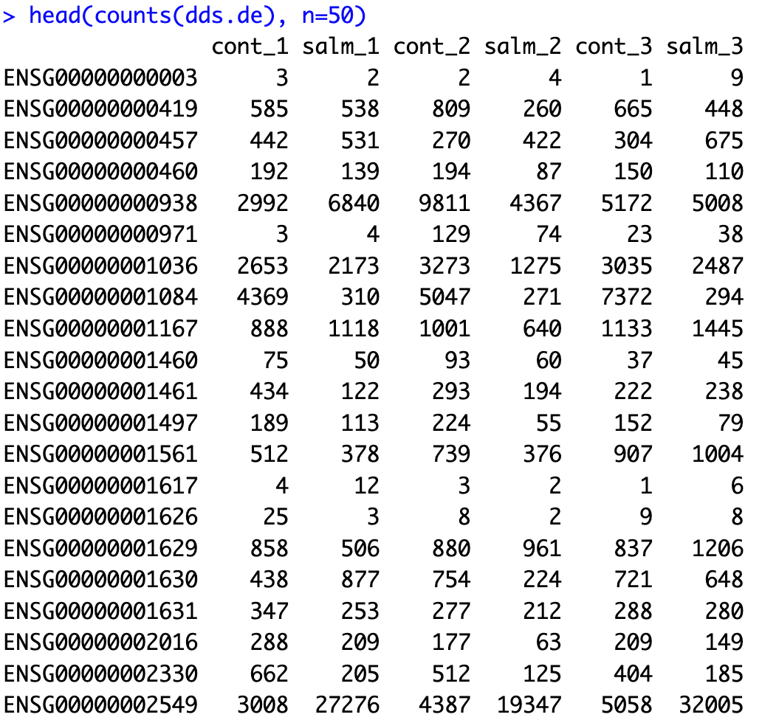
What we need: gene count matrix

Slide 8
What’s the question?
What genes are being differentially expressed between salmonella stimulated macrophages and unstimulated control?
What biological processes are affected?

Slide 9
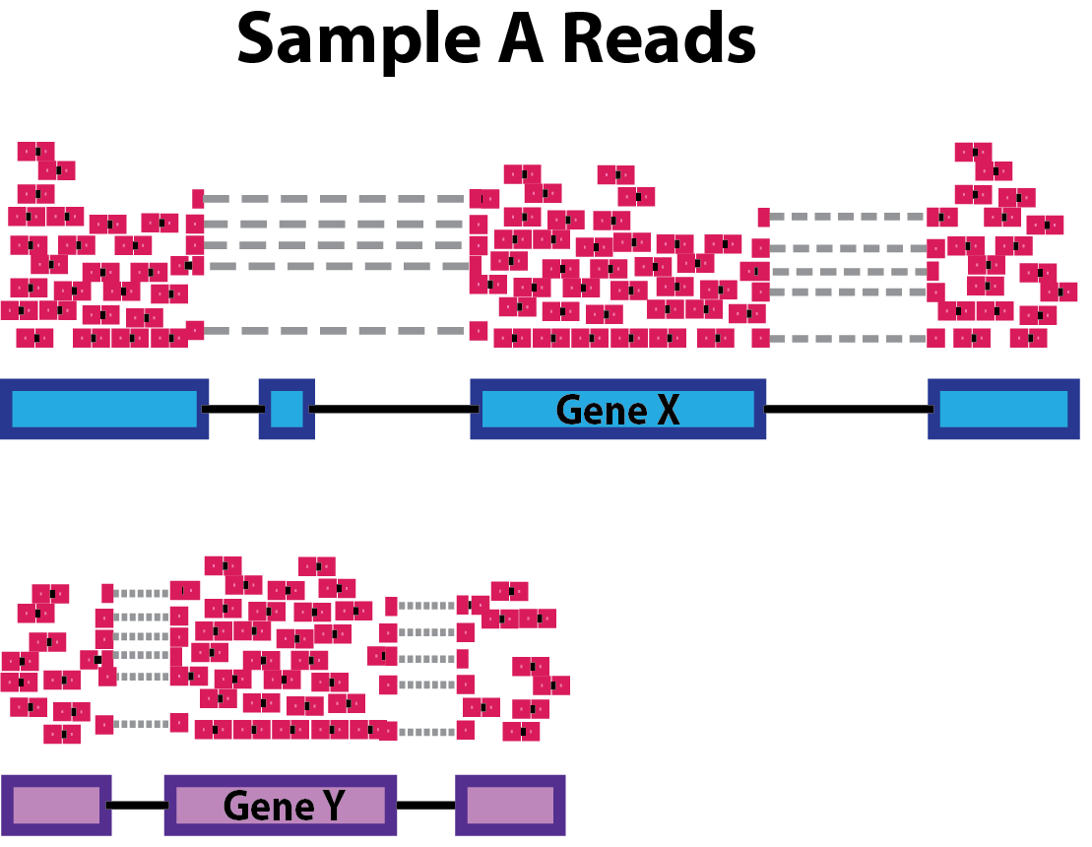
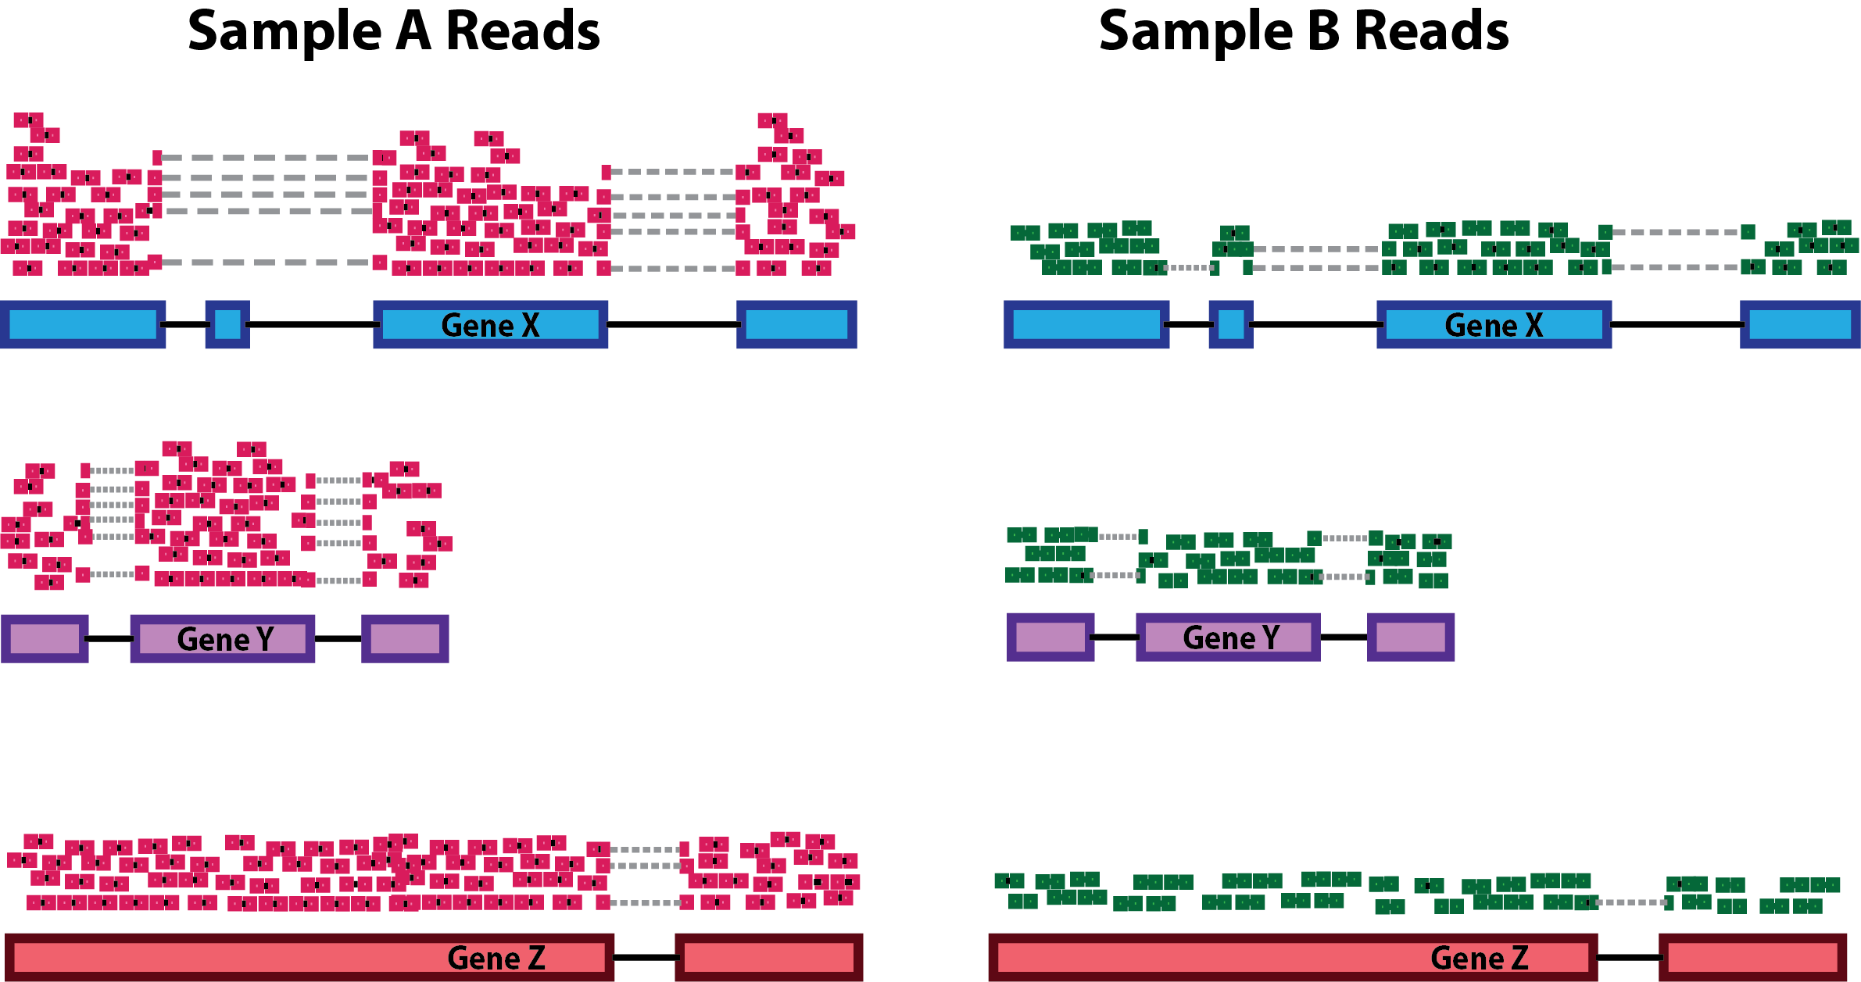
Normalisation
A method to reduce variability in the data
Evens out any differences in the number of reads accouting for a gene due to purely technical reasons like gene length, sequencing depth and RNA composition
Gene length: longer genes will have more reads
Sequencing depth: samples sequenced more will have more reads
RNA composition: prevents bias caused by highly differentially expressed genes (DE genes)
Many ways to normalise: FPKM, TPM, median of ratios
Which method to use?
Within sample comparison?
Between sample comparison?
Both?
https://hbctraining.github.io/DGE_workshop/lessons/02_DGE_count_normalization.html

Slide 10
Example – normalisation
TPM (transcripts per million)
Gene length and sequencing depth
T= total reads mapped to gene * 10³/gene length (bp) -> length normalisation
TPM=T * (1/𝝨T) *10⁶ ->sequencing depth normalisation
Gene name | Length (bp) | Sample A | Sample B | T_{A} | T_{B} | TPM_{A} | TPM_{B}
Gene 1 | 4000 | 100,000 | 50,000 | 25,000 | 12,500 | 50,000 | 50,000
Gene 2 | 2000 | 50,000 | 25,000 | 25,000 | 12,500 | 50,000 | 50,000
 |  |  |  | 𝝨T_{A}=50,000 | 𝝨T_{B}=25,000
Gene name | Length (bp) | Sample A | Sample B | T_{A} | T_{B} | TPM_{A} | TPM_{B}
Gene 1 | 4000 | 100,000 | 50,000 | 25,000
Gene 2 | 2000 | 50,000 | 25,000
 |  |  |  | 𝝨T_{A} | 𝝨T_{B}
Gene name | Length (bp) | Sample A | Sample B | T_{A} | T_{B} | TPM_{A} | TPM_{B}
Gene 1 | 4000 | 100,000 | 50,000 | 25,000
Gene 2 | 2000 | 50,000 | 25,000 | 25,000
 |  |  |  | 𝝨T_{A}=50,000 | 𝝨T_{B}
Gene name | Length (bp) | Sample A | Sample B | T_{A} | T_{B} | TPM_{A} | TPM_{B}
Gene 1 | 4000 | 100,000 | 50,000 | 25,000 | 12,500
Gene 2 | 2000 | 50,000 | 25,000 | 25,000 | 12,500
 |  |  |  | 𝝨T_{A}=50,000 | 𝝨T_{B}=25,000

Slide 11
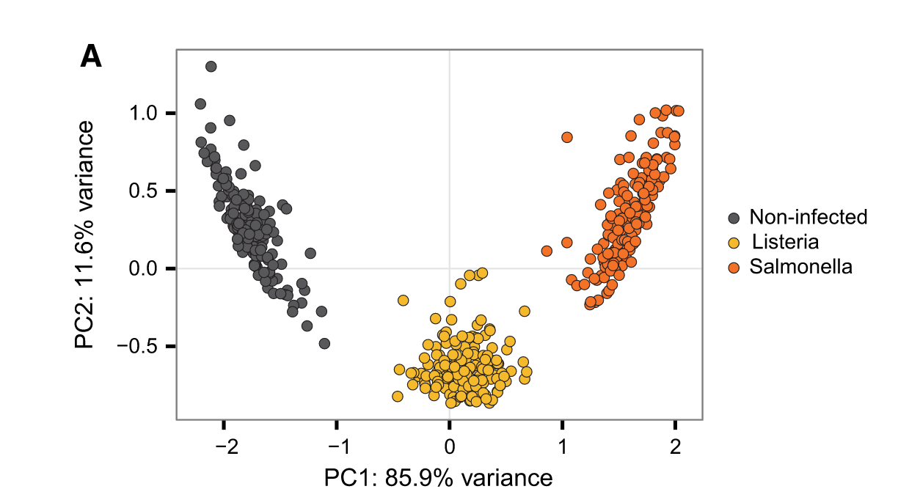
Prinicpal component analysis (PCA)
Quality check to see if data behaves like expectation
Similarly treated samples should cluster together
Reduces the number of dimensions
http://dx.doi.org/10.1016/j.cell.2016.09.025

Slide 12
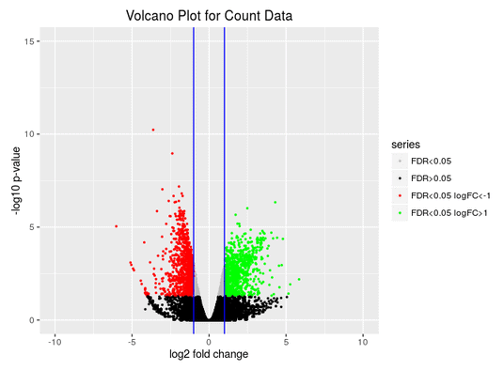
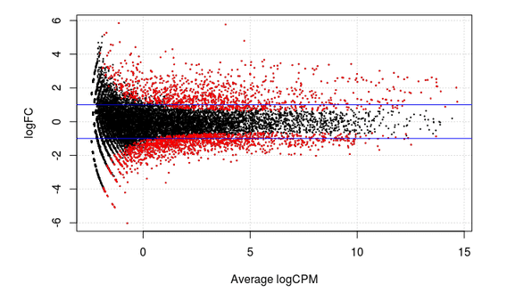
Summary plots – MA plot vs volcano plot
M (log ratio) and A (mean average) scales
Up-regulated genes
Down-regulated genes
Low to high expression
https://www.biobam.com/differential-expression-analysis/

Slide 13
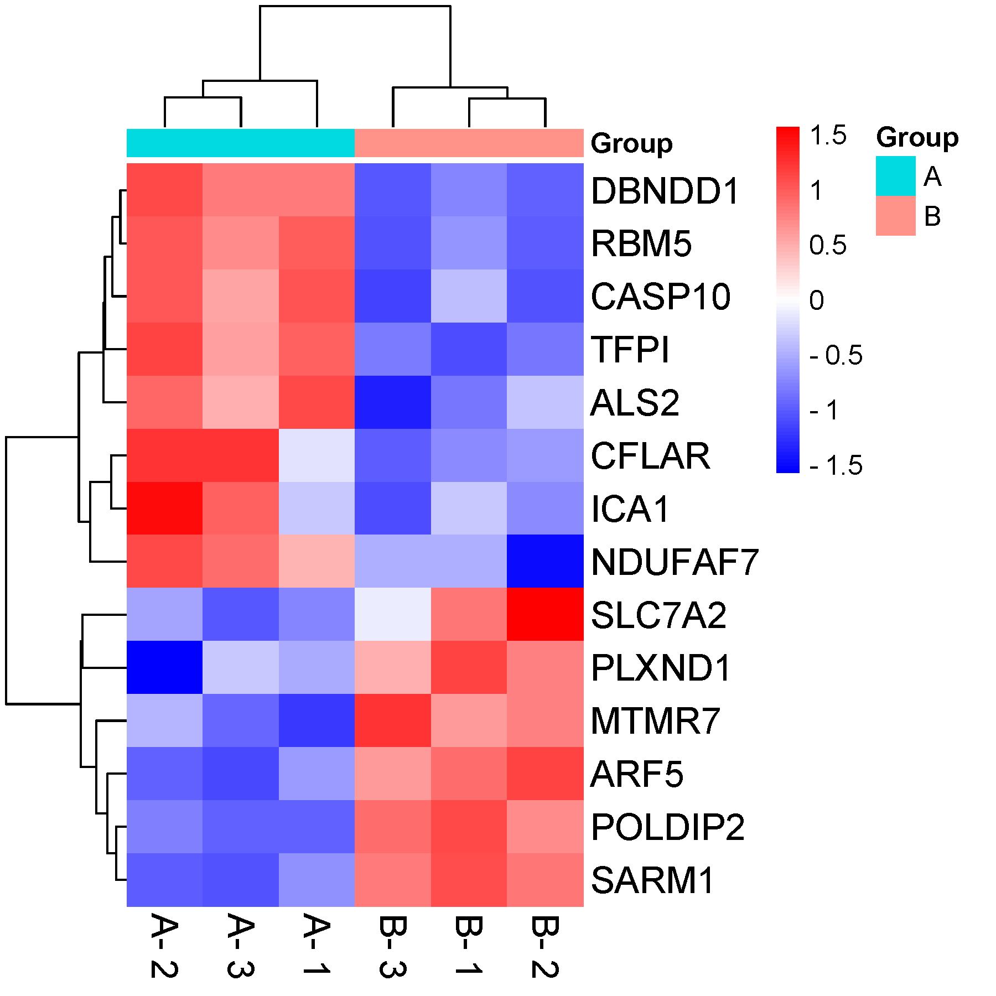
Heatmaps
Clusters samples based on similar expression profiles
Colours indicate higher than mean (red) or lower than mean (blue) expression for a gene
https://www.bioinformatics.com.cn/plot_basic_cluster_heatmap_plot_024_en

Slide 14
Gene Ontology (GO)
Describes the function a gene is involved in
Gene products are associated with three levels of annotation:
Molecular Function: molecular activity associated with gene product (eg: kinase activity, nucleotide binding, etc )
Cellular component: where in the cell gene products localise to (nuclear envelope, lysosome, etc)
Biological process: pathways and processes a gene product is associated with (glucose homeostasis, epidermis development, etc)

Slide 15
Time to start!
https://github.com/mridna/csmb2023_RNASeq/day2

