Slide 1
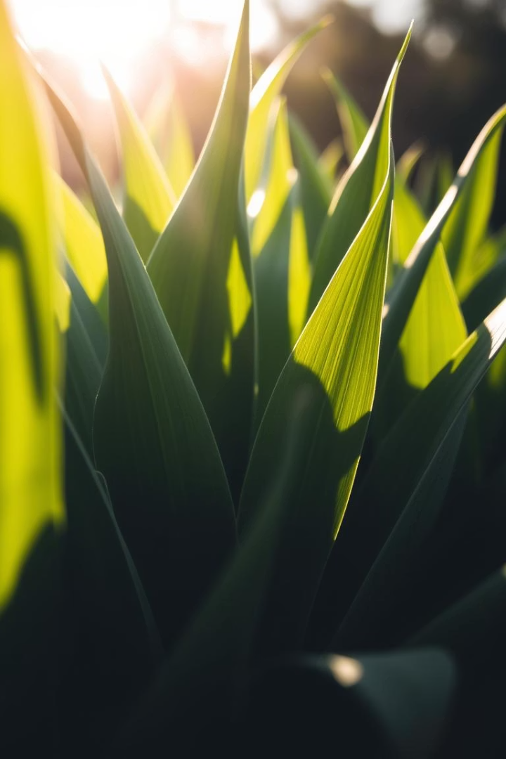
NutriPlant: AI-Based Plant Disease and Nutrient Deficiency Diagnosis
An AI-driven project using leaf images for rapid plant health diagnosis.

Slide 2


Identifying the Challenge
Problem
Traditional Methods
Our Goal
Farmers lack quick and reliable diagnosis tools for plant diseases.
Require experts and take valuable time for accurate identification.
Leverage AI to provide fast diagnosis from simple leaf photos.

Slide 3
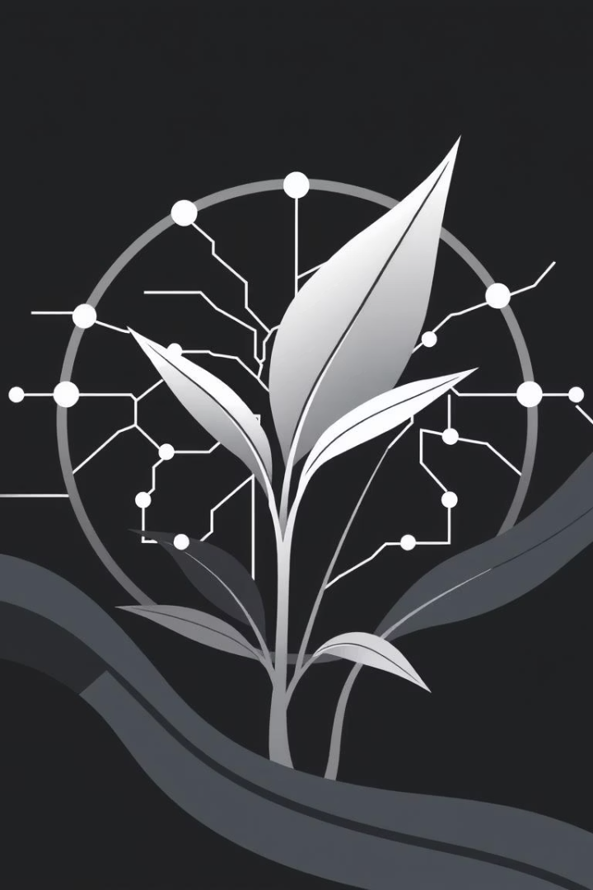
Project Goals
Deep Learning Model
Lightweight Backend
Classify plant diseases and nutrient deficiencies effectively.
Implement Flask backend for fast, scalable prediction serving.
Accessible Frontend
Build an intuitive Streamlit app for real-time user interaction.

Slide 4
Data and Preprocessing
Dataset Size
Image Preprocessing
Over 70,000 training images with 38 different classes.
Resized images to 128×128 RGB for uniformity and efficiency.
Used automated directory-based loading with accurate labeling.

Slide 5




Model Design
Convolutional Blocks
Regularization
Five blocks combining Conv2D, ReLU activation, and MaxPooling.
1
2
Dropout layers prevent overfitting during training.
Training Setup
Output
4
3
Adam optimizer with categorical crossentropy loss function.
Softmax layer classifies into 38 disease and deficiency classes.

Slide 6
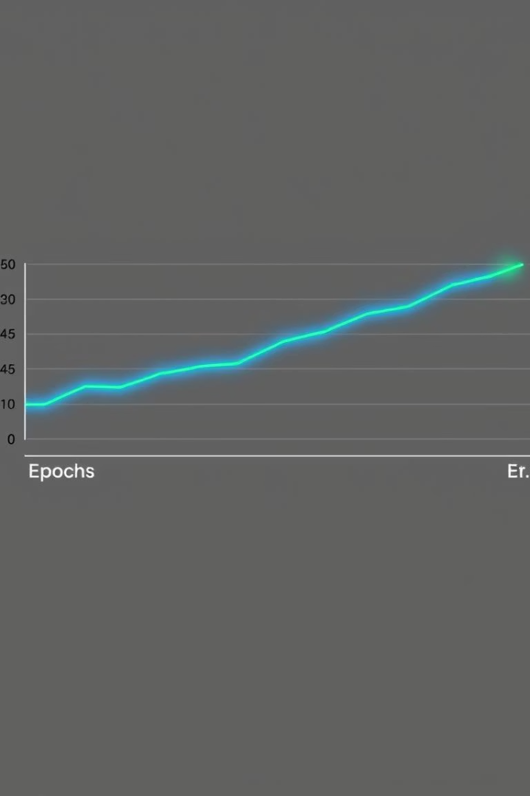
Model Training & Results
Accuracy
Training Time
Achieved 96.6% training and 94.6% validation accuracy.
Trained efficiently over 10 epochs on a large dataset.
Performance
Strong generalization with minimal signs of overfitting.

Slide 7

Backend Infrastructure
Scalability
API Endpoint
Optimized to handle multiple inference requests smoothly.
Model Hosting
Receives image input and returns disease predictions quickly.
Loaded .keras model once on Flask server for efficiency.

Slide 8
User Interface with Streamlit
User Friendly
Real-Time Output
Custom Styling
Simple upload for leaf images with instant diagnosis feedback.
Displays disease and nutrient deficiency results immediately.
CSS animations and themes enhance user engagement visually.

Slide 9

Key Takeaways
End-to-End Solution
High Accuracy
Interactive Frontend
From model training to deployment in user-accessible format.
Robust CNN model delivers reliable plant health classification.
An intuitive app facilitates rapid, easy diagnostics for users.

Slide 10
Future Directions & Conclusion
Expand Crop Coverage
1
Add more plant species and disease classes.
Severity & Treatment
2
Integrate damage severity detection and care recommendations.
Edge Optimization
3
Optimize model for devices like Raspberry Pi and mobile phones.
NutriPlant showcases AI's impact on precision agriculture and sustainability.

