Slide 1
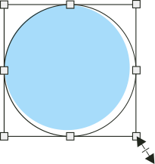













CHESSEYE

Slide 2

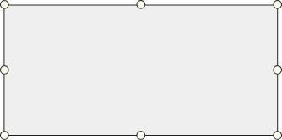
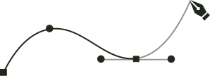

ChessEYE
Automated FEN Notation from Real-World Chessboards
By: Aaditya Bir Singh & Chhaveesh Manocha

Slide 3

Introduction
1.
Chessboard digitization is essential for bridging physical games with digital platforms.
ChessEYE automates this using Computer Vision.
2.
Manual input of board states is tedious and error-prone.
Need an efficient method for real-time, accurate digitization.

Slide 4





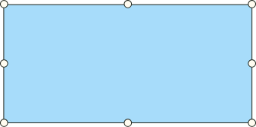

Motivation
Increase speed and accuracy of chess game recording.
Enable assistive tech for players and educators.
Pave the way for AI-powered chess analysis tools.

Slide 5
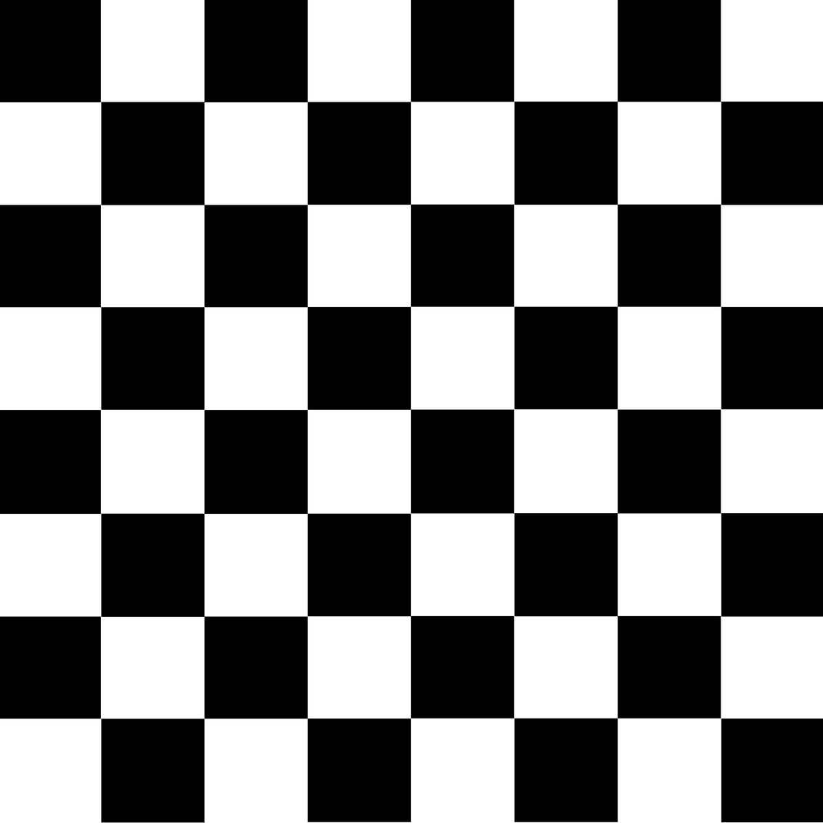
Objectives
Detect chessboards in real-world images.
Enable manual labeling of squares for dataset creation.
Train a model to recognize square contents and generate FEN.

Slide 6

Tech Stack
Programming: Python
Libraries: OpenCV, NumPy, Matplotlib
Labeling: label_squares.py
Training: train_model.py

Slide 7

Methodology
Detect chessboards via corner finding.
Extract each square as a Region of Interest (ROI).
Preview and manually label squares in real-time.
Organize labeled images into structured folders. ( Use this data for further detection)

Slide 8
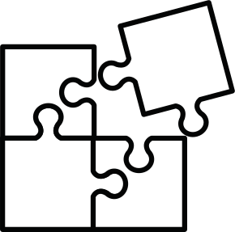

Challenges Faced
Ambiguous corners in skewed or blurred images.
Maintaining GUI responsiveness during labeling.
Managing and cleaning corrupted square ROIs.

Slide 9

Conclusion & Future Scope
Achieved functional board recognition and FEN generation.
Future:
Real-time tracking from webcam.
Integration with Lichess, Chess.com APIs.
Move-by-move live commentary.

Slide 10


Thank You
Now we are open to questions.

