Slide 1
PRESENTATION TOPIC: Modern City OPENGL Project
Group Members
RIFAT AHMED (19-41107-2)
EMON, MEDEDI HASAN (19-41118-2)
MRIDUL KUMAR ROY (20-43517-1)
SIMUR AHAMED SEZAN (20-43473-1)
Section: L
Course Teacher : ANEEM AL AHSAN RUPAI

Slide 2
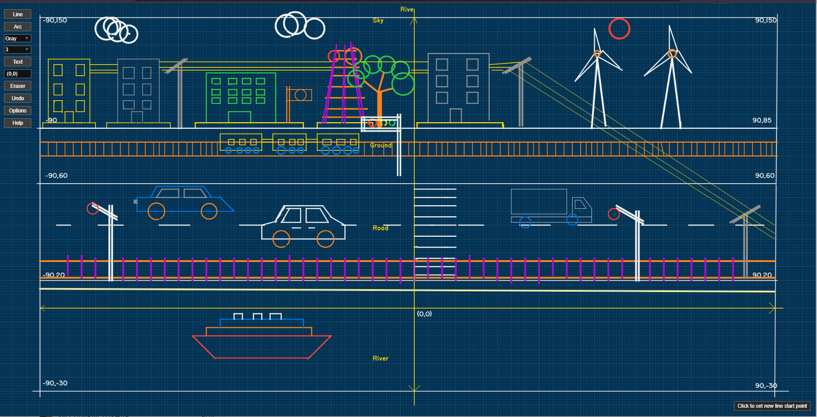
Schematic Diagram

Slide 3
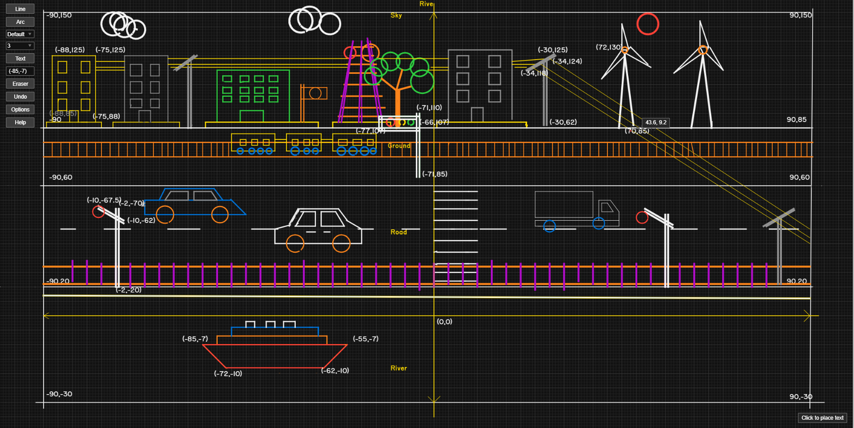
Measurement of Schematic Diagram

Slide 4
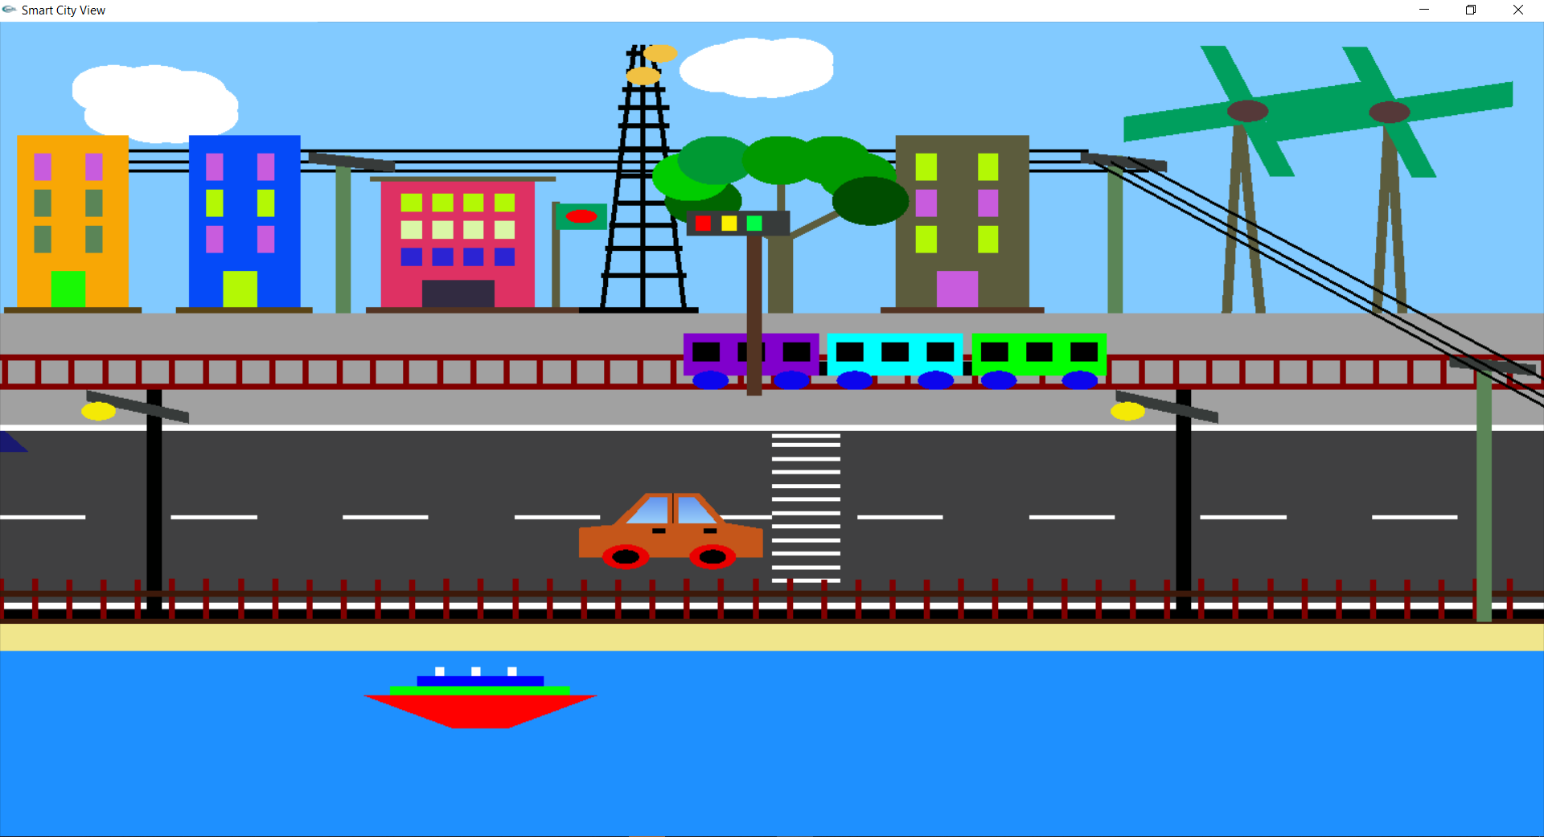
Day view

Slide 5
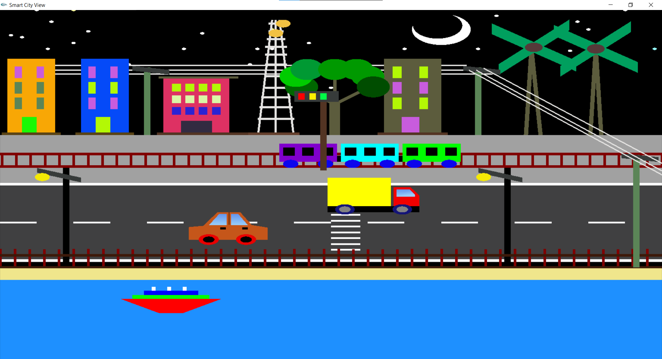
Night view

Slide 6
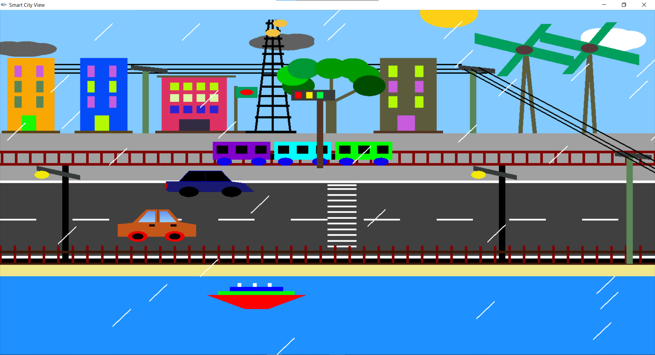
Rainy view [Day]

Slide 7
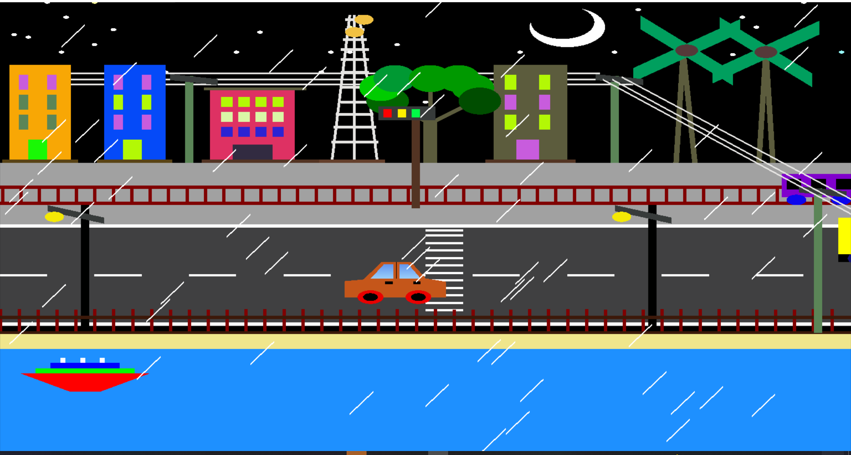
Rainy view [Night]

