Slide 1
Ready by March: Planning for Both Quiet and Extreme Iceberg Years
ACT I · THE SETTING
How Newfoundland's 4 offshore oil rigs spot, tow, and dodge icebergs together
PRESENTED BY TEAM 5
Mitchell Delaney • Fayez Faruk • Rakib Hossain • Varvara Korotnytska
Notes:
SUGGESTED SPEAKER: Mitchell. Hook in the first 30 seconds: a 10,000-ton iceberg, 350 km east-southeast of St. John's, and $16.6M of oil output per day at stake.
Say "we" throughout. We are the team that turned regional iceberg chaos into one synchronized operating plan for Newfoundland and Labrador's four oil installations.
Removed from slide (say aloud): The Immovable Guardians (GBS): Hibernia, Hebron. The Agile Vessels (FPSO): Terra Nova, White Rose. Our mandate: the NL Ice Management Working Group.

Slide 2
Two Rig Types: Stand Fast or Sail Away?
ACT I · THE CHARACTERS
86.85%
of Daily Oil ($14.4M/day)
Fixed Concrete Rigs (GBS): Hibernia • Hebron
Anchored to seafloor: cannot move
Defense: spot early & tow icebergs away
13.15%
of Daily Oil ($2.2M/day)
Floating Ship Rigs (FPSO): Terra Nova • SeaRose
Can unhook from wells & sail away
Defense: timed countdown to unhook safely
Notes:
SUGGESTED SPEAKER: Mitchell. Introduce the two characters (share of basin output).
GBS (86.85% of output): Hibernia and Hebron concrete platforms. Anchored to the seabed forever. Daily stake: $14.41M combined output. Survival strategy: spot early and tow the berg away.
FPSO (13.15% of output): Terra Nova and SeaRose (White Rose). The escape hatch: they can disconnect and leave station. Daily stake: $2.18M combined output. Survival strategy: staged T-time disconnect readiness.
Note: daily values = 2025 barrels x $69.14/bbl Brent price (gross revenue, not profit).

Slide 3
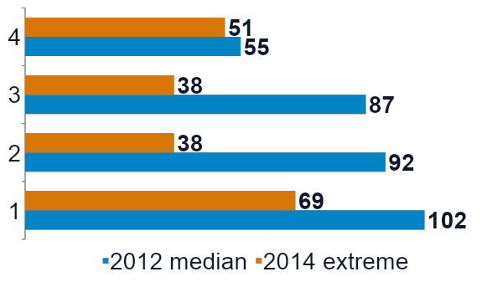
More Icebergs in the Ocean ≠ More Near the Rigs
ACT II · PLOT TWIST #1
154
close calls (<50 km) in 2012
('Average' year: 499 in region)
111
close calls (<50 km) in 2014
('Extreme' year: 1,546 in region)
Notes:
SUGGESTED SPEAKER: Mitchell. The planning trap: 7 of 25 production-era seasons saw under 50 bergs (breeding complacency), while 2014 unleashed 1,546.
The twist: crossing 48°N does not mean hitting a rig. In 2014, 1,546 bergs crossed 48°N but only 111 came within 50 km. In "median" 2012 (499 gate bergs), 154 invaded the 50 km zone.
Bars show icebergs near each installation, 2012 (median year) vs 2014 (extreme year). Currents and melt filter what reaches the basin.
Footnotes: Quiet year 2006 recorded 1 berg near White Rose and 0 elsewhere. Hebron achieved first oil in late 2017, so the 2012/2014 counts reflect site coordinates.
Historical context table: 1900-1996 median 317 bergs (range 0 in 1966 to 2,202 in 1984; 16 of 97 years under 50). 1997-2021 median 499 (range 0 in 2006 to 1,546 in 2014; 7 of 25 years under 50).

Slide 4
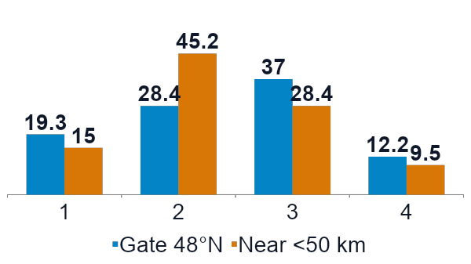
Danger Near the Rigs Peaks in April, One Month Before the Ocean Peak
ACT II · SHARED DANGER
581
times the same iceberg threatened
Hebron & Terra Nova on the same day
(Just 8.2 km apart: Terra Nova can sail away, Hebron cannot)
Notes:
SUGGESTED SPEAKER: Fayez. If operators wait for the May (37.0%) regional peak at 48°N, they are too late: closest approaches inside 50 km peak in April (45.2%).
Monthly shares (Gate | Near): March 19.3% | 15.0%. April 28.4% | 45.2% (platform peak). May 37.0% | 28.4% (gate peak). June 12.2% | 9.5%. Chart labels are rounded to whole percents.
Two neighbors, one iceberg: Hebron (GBS) and Terra Nova (FPSO) sit just 8.2 km apart; 581 times the exact same berg threatened both on the same day.
Other pairs sharing a berg (<50 km): Hebron + Hibernia (31.6 km) 382; Hebron + White Rose (46.1 km) 378; Terra Nova + White Rose (49.9 km) 341.

Slide 5
05:20 AM: What Happens When a Tow Rope Slips?
ACT III · THE CLIMAX · DAY 4
02:30
MONITOR
Iceberg tracked miles out
03:40
MANAGE
Boat readies tow rope
04:32
PREP
Wells shut off; ready to unhook in 15 min
05:20
SLIP
Tow rope slips, 10 min out
05:30
CLEAR
Drifts past safely
Lesson: Prepare to unhook while towing—never wait until a tow rope fails
Notes:
SUGGESTED SPEAKER: Fayez. Walk the bridge on Day 4, after three days of tracking. This is an illustrative case that shows step order; it is not a critique of current operator practice.
02:30 MONITOR: berg tracked a few nautical miles out. 03:40 MANAGE: support vessel readies the floating towline. 04:32 PREP: wells shut in; FPSO paused at 15-min T-time. 05:20 SLIP: rope slips off 10 minutes before closest point. 05:30-06:00: passes without contact; confirmed clear.
The moral of Day 4: because the FPSO paused at 15-min T-time at 04:32, it survived the 05:20 rope slip. Never wait on a tow to prep disconnect.

Slide 6
1 in 5 Tow Ropes Slip—Who Makes the Final Call?
ACT III · RULES OF ENGAGEMENT
22%
of tow ropes slip off
86% deflect the iceberg
(99% avoid downtime)
Rig Boss
Offshore Manager (OIM)
makes sole call to unhook;
onshore team only advises
All 4 Rigs
Share one live iceberg map
and support ships; each rig
sets its own safety zones
Notes:
SUGGESTED SPEAKER: Fayez. Source: Rudkin et al. (2005). A tow is an open status: 86% change course, 22% slip ropes.
OIM sole call: one voice in command. The OIM orders the disconnect; onshore advises only.
4-way pool: share eyes, not triggers. Pool the map and ships across the four installations, but keep zone triggers local.

Slide 7
41% of Nearby Icebergs Had Zero Prior Tracking in the Log
ACT III · PLOT TWIST #2
1,555
unique icebergs entered the 50 km zone near rigs
38.3 hrs
typical tracking time from first record to closest point
40.6%
the very first record we have is already their closest point.
Notes:
SUGGESTED SPEAKER: Rakib. The blind spot in the fog.
1,555 intruders: unique bergs entering the 50 km radius in the sighting file.
38.3 h median tracking span: first dataset record to closest point (not a zone warning time).
40.6% zero prior tracking: 653 bergs were first logged at their closest approach (0 hours).

Slide 8
Why All-Weather Satellites Matter—And What to Share
ACT III · PUSHING BACK THE HORIZON
13.6%
spotted by satellite in 2021
(Near zero before 2017;
sees through fog & clouds)
1 Keep on each rig (In-House)
24/7 radar, lookouts & manager's call to unhook
2 Rent for spring ice season
Spotter planes, radar satellites & towboats
3 Share across all 4 rigs
One shared iceberg map, joint flights & boat pool
Notes:
SUGGESTED SPEAKER: Rakib. Why historical satellite data misleads: near-zero before 2017, jumping to 13.6% in 2021. It provides cloud-independent wide screening before ships arrive.
Historical sighting shares (<50 km of facility): radar + visual combined 83.4%; radar only 9.0% and visual only 5.5% (14.5% together); historical satellite (high + low confidence) 1.8%.
1. Own in-house (each installation): 24/7 marine radar, platform lookouts, stage triggers, OIM authority.
2. Contract seasonally (scalable): fixed-wing recon flights, commercial SAR satellite imagery, extra tow vessels.
3. Hold in common (working group): single shared basin tracking map, joint flight/SAR procurement, pooled vessels.

Slide 9
Leaving Station vs. Staying Put
ACT IV · THE STAKES
Field | Can leave? | Gross / day
Hebron | No | $9.5M
Hibernia | No | $4.9M
Terra Nova | Yes | $1.5M
SeaRose (2 fields) | Yes | $0.66M
Basin total |  | $16.6M
Notes:
SUGGESTED SPEAKER: Rakib. The price of leaving station vs. the price of staying. 2025 basin value at $69.14/bbl Brent. Value = price x barrels (gross revenue, not profit).
Detail (2025 barrels/day; 1-day gross value): Hebron GBS 137,714; $9,521,546. Hibernia GBS 70,711; $4,888,959. Terra Nova FPSO 22,050; $1,524,537. White Rose (SeaRose FPSO) 7,074; $489,096. North Amethyst (subsea satellite, via SeaRose) 2,435; $168,356. Total basin 239,984 bbl/d; $16,592,494.
A SeaRose disconnect halts White Rose + North Amethyst ($657,452/day, shown as SeaRose on the slide). A Terra Nova disconnect halts $1,524,537/day. The basin is 86.85% fixed and 13.15% floating; 31,559 bbl/d is disconnectable.

Slide 10
1,513 Icebergs. Production Held.
ACT IV · THE PROOF · 2014
225.8K
spring 2014 avg,
bbl/d
211.5K
rest-of-year avg,
bbl/d
153.6K
ice-free August:
planned turnarounds
Notes:
SUGGESTED SPEAKER: Varvara. Testing the worst-case spring (2014): 1,513 spring icebergs, and production did not blink.
The Mar-Jun 2014 average of 225.8K bbl/d beat the rest-of-year average (211.5K). The real dip came in ice-free August (153.6K bbl/d) for planned turnarounds, which shows ice management works.
2014 spring monthly profile: March 243,212 bbl/d, 268 bergs. April (peak ice) 203,757 bbl/d, 541 bergs. May (peak ice) 233,386 bbl/d, 532 bergs. June 222,682 bbl/d, 172 bergs.

Slide 11
March 31: Choose the Iceberg Response
ACT V · THE RESOLUTION
Use the number of icebergs crossing 48°N by March 31 to plan spring resources.
QUIET YEAR
Fewer than 10 icebergs
Share one tracking map
and one support vessel.
UNCERTAIN YEAR
10–199 icebergs
Keep surveillance flights
and tow vessels on standby.
EXTREME YEAR
200+ icebergs
Coordinate radar-satellite
monitoring and flights;
pool support vessels.
Share tracking and vessels.
Each offshore manager keeps the final say on disconnecting.
Notes:
SUGGESTED SPEAKER: Varvara. The March 31 decision playbook: read the gate count on March 31 to beat the April surge.
Golden rule: share the map and vessel pool across all four installations; keep OIM disconnect authority strictly on the installation.
QUIET (<10 bergs by Mar 31), baseline readiness: shared basin map; 1 shared vessel; 1 FPSO disconnect drill.
UNCERTAIN (10-199 by Mar 31), scalable standby: normal operations plus call-off flights and tow vessels on standby.
EXTREME (200+ by Mar 31), full surge mode: joint SAR/flights; pooled fleet prioritizing GBS; early FPSO prep.
Close with the core takeaway, with passion: the problem is shared, so the map is shared; the decision stays local.

Slide 12
Questions & Discussion
NL OFFSHORE ICE MANAGEMENT WORKING GROUP
Mitchell Delaney • Fayez Faruk • Rakib Hossain • Varvara Korotnytska
Notes:
ALL FOUR SPEAK. Q&A is typically 10 minutes. Give direct, concise, specific answers, and rotate who answers so no one person dominates. Listen closely and respond thoughtfully.
Suggested owners: Mitchell (setting, characters, 48°N twist), Fayez (April peak, Day 4, rules of engagement), Rakib (blind spot, sensors, stakes), Varvara (2014 proof, playbook).

