Slide 1
Database System for Manufacturing Operation Optimization
Presented By
Asifur Rahman Mridul
Roll: 1909024

Slide 2
Introduction:
In a dynamic and competitive manufacturing landscape, the continuous improvement of operational processes and resource management is essential for achieving sustainable success.
This project is aimed at enhancing the manufacturing operations of a company through Database System.

Slide 3
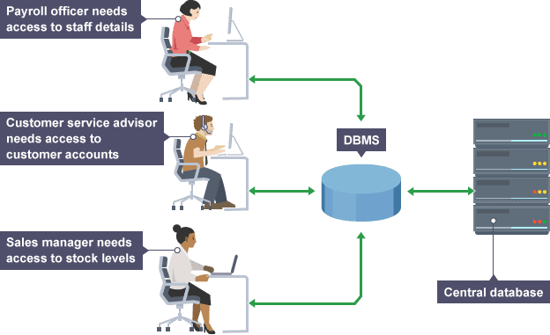
Introduction:

Slide 4
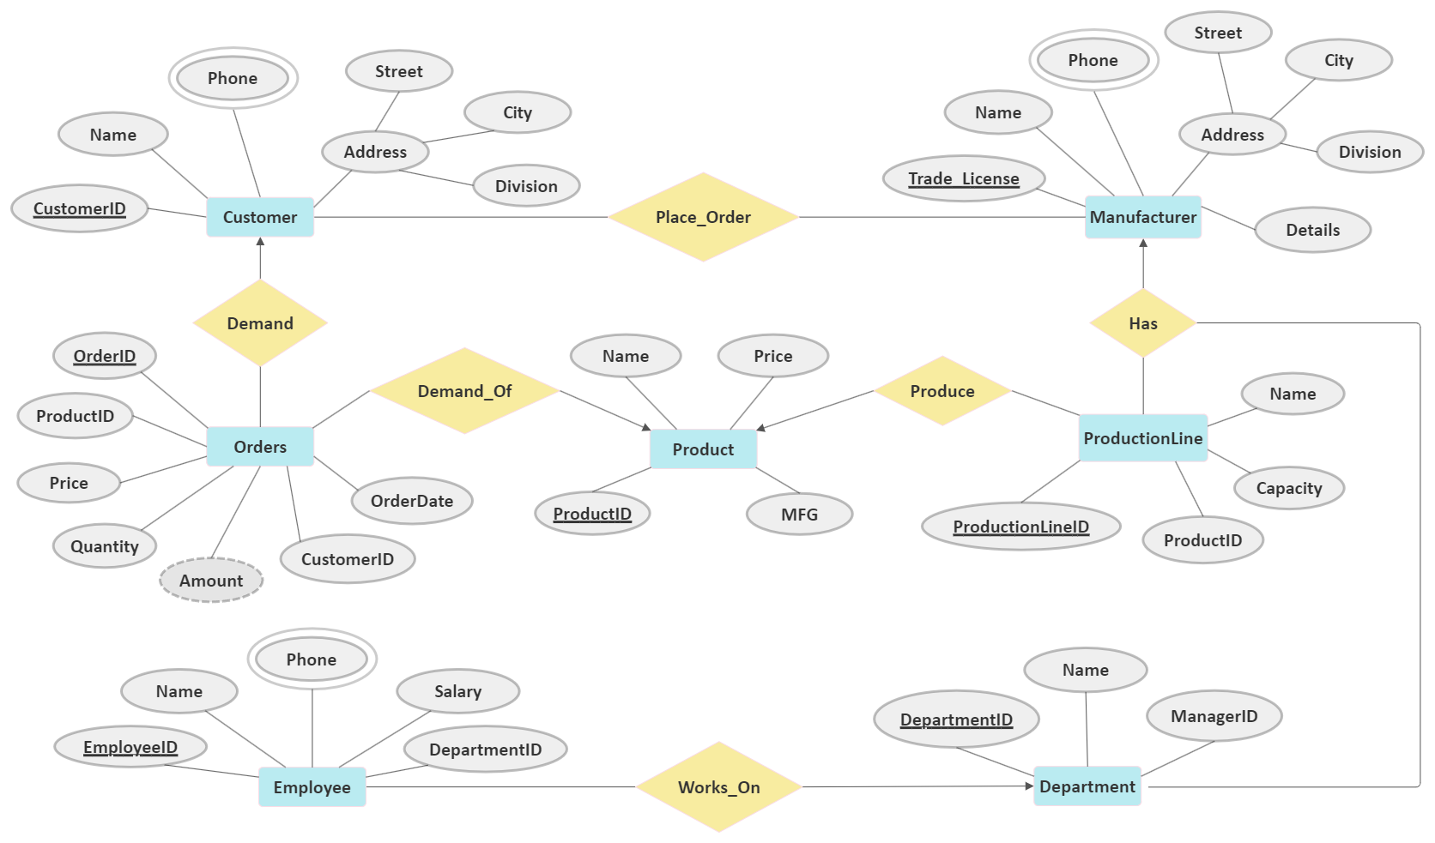
E-R Diagram

Slide 5
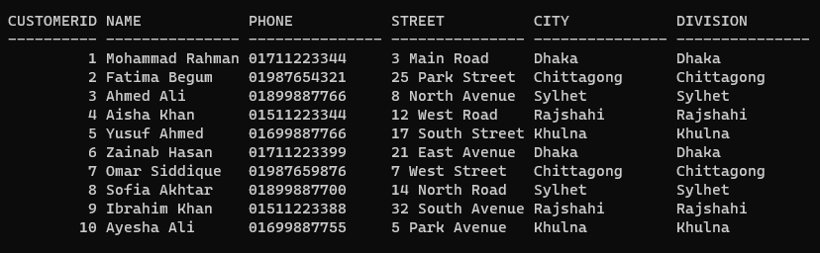
Customer Table:

Slide 6
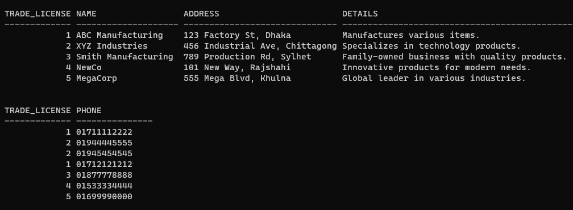
Manufacturer Table:

Slide 7
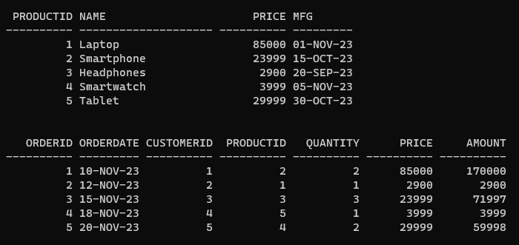
Product & Orders Tables:

Slide 8
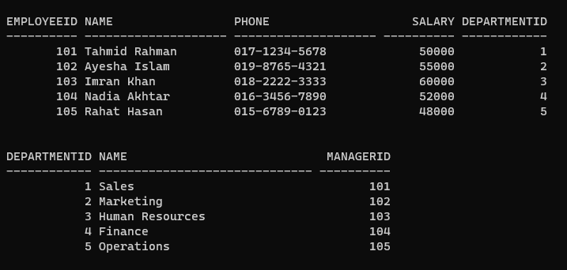
Employee & Department Tables:

Slide 9
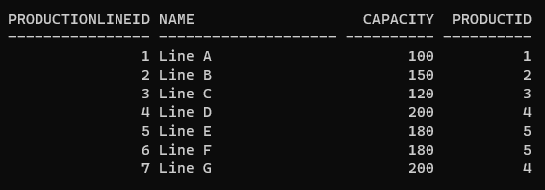
Production Line Table:

Slide 10
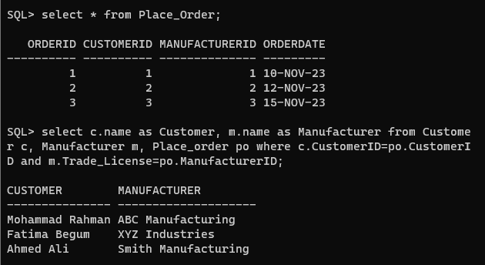
Relation between Customer and Manufacturer:

Slide 11
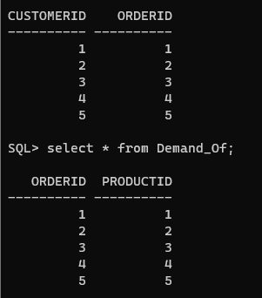
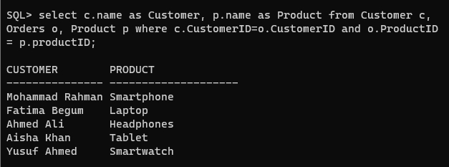
Relations between Customer and Order and between Order and Product:

Slide 12
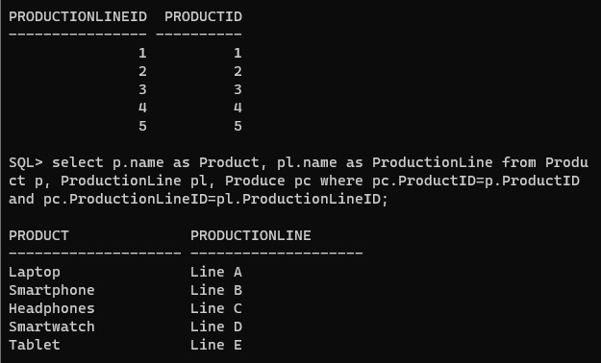
Relation between Production Line and Product:

Slide 13
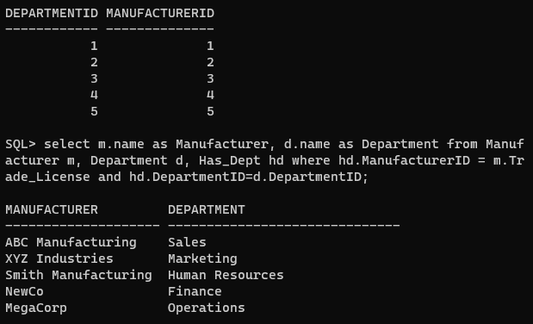
Relation between Manufacturer and Department:

Slide 14
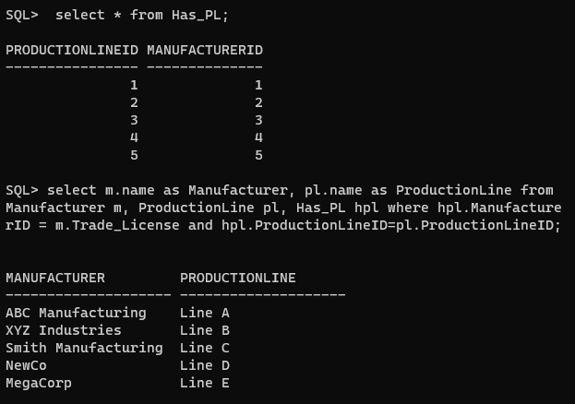
Relation between Manufacturer and Production Line:

Slide 15
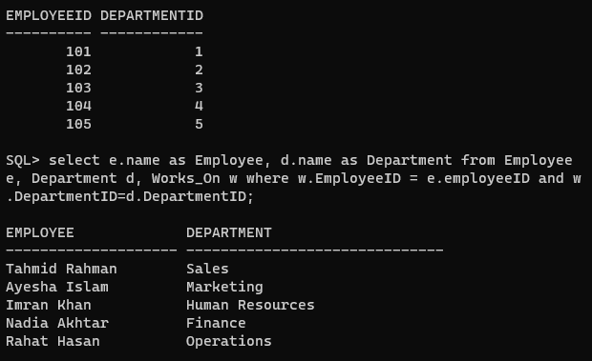
Relation between Employee and Department:

Slide 16
The End
.

