Slide 1

Chapter 8 Local Ratio
II. More Example
This ppt is editored from a ppt of
Reuven Bar-Yehuda.
Reuven Bar-Yehuda

Slide 2
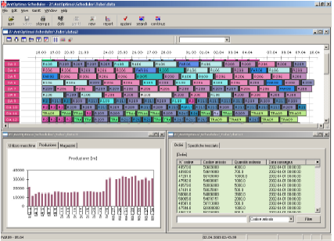
Local Ratio for Scheduling Problems

Slide 3

Profit Maximization

Slide 4
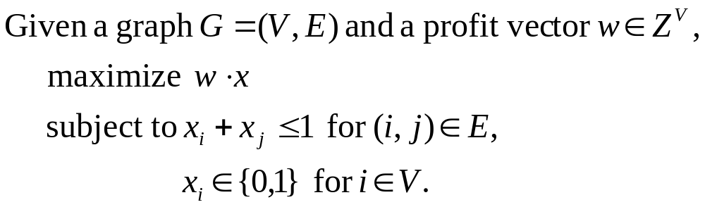
Maximum Independent Set

Slide 5




Applications
Computer Vision/Pattern Recognition
Information/Coding Theory
Map Labeling
Molecular Biology
Scheduling

Slide 6
Independent Set in Interval Graphs
Activity 9
Activity 8
Activity 7
Activity 6
Activity 5
Activity 4
Activity 3
Activity 2
Activity 1
time
We must schedule jobs on a single processor with no preemption.
Each job may be scheduled in one interval only.
The problem is to select a maximum weight subset of non-conflicting jobs.

Slide 7
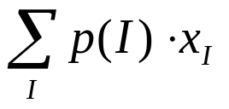

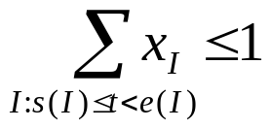
Independent Set in Interval Graphs
Slide from http://www.cs.technion.ac.il/~reuven/STOC2000.ppt
Activity9
Activity8
Activity7
Activity6
Activity5
Activity4
Activity3
Activity2
Activity1
time
Maximize
s.t.
For each instance I
For each time t

Slide 8
Maximal Solutions
We say that a feasible schedule is I-maximal if either it contains instance I, or it does not contain I but adding I to it will render it infeasible.
Activity9
Activity8
Activity7
Activity6
Activity5
Activity4
Activity3
Activity2
Activity1
I₂
I₁
time
The schedule above is I₁-maximal and also I₂-maximal

Slide 9
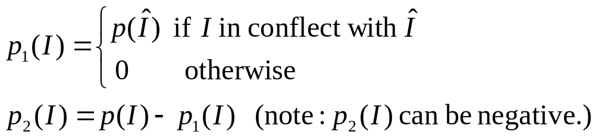
An effective profit function
Slide from http://www.cs.technion.ac.il/~reuven/STOC2000.ppt
Activity9
Activity8
Activity7
Activity6
Activity5
Activity4
Activity3
Activity2
Activity1
P₁=0
P₁= P(Î)
P₁=0
P₁=0
P₁=0
P₁= P(Î)
P₁=0
P₁= P(Î)
P₁= P(Î)
Î
Let Î be an interval that ends first;

Slide 10
An effective profit function
Slide from http://www.cs.technion.ac.il/~reuven/STOC2000.ppt
Activity9
Activity8
Activity7
Activity6
Activity5
Activity4
Activity3
Activity2
Activity1
P₁=0
P₁= P(Î)
P₁=0
P₁=0
P₁=0
P₁= P(Î)
P₁=0
P₁= P(Î)
P₁= P(Î)
Î
For every feasible solution x: p₁ ·x ≤ p(Î)
For every Î-maximal solution x: p₁ ·x ≥ p(Î)
Every Î-maximal is optimal.

Slide 11
Independent Set in Interval Graphs:
An Optimization Algorithm
Slide from http://www.cs.technion.ac.il/~reuven/STOC2000.ppt
Algorithm MaxIS( S, p )
If S = Φ then return Φ ;
If ∃I ∈ S p(I) ≤0 then return MaxIS( S - {I}, p);
Let Î ∈ S that ends first;
∀I ∈ S define: p1 (I) = p(Î) × (I in conflict with Î) ;
IS = MaxIS( S, p- p1 ) ;
If IS is Î-maximal then return IS else return IS ∪ {Î};

Slide 12
Running Example
Slide from http://www.cs.technion.ac.il/~reuven/STOC2000.ppt
P(I₅) = 3 -4
P(I₆) = 6 -4 -2
P(I₃) = 5 -5
P(I₂) = 3 -5
P(I₁) = 5 -5
P(I₄) = 9 -5 -4
-5
-4
-2

Slide 13
Interval Scheduling
Activity 9
Activity 8
Activity 7
Activity 6
Activity 5
Activity 4
Activity 3
Activity 2
Activity 1
time
Each job consists of a finite collection of time intervals during which it may be scheduled.
The problem is to select a maximum weight subset of non-conflicting intervals, at most one interval for each job.

Slide 14
Single Machine Scheduling with Release and Deadlines
Activity 9
Activity 8
Activity 7
Activity 6
Activity 5
Activity 4
Activity 3
Activity 2
Activity 1
time
Each job has a time window within which it can be processed.

Slide 15
Single Machine Scheduling with Release and Deadlines
Activity 9
Activity 8
Activity 7
Activity 6
Activity 5
Activity 4
Activity 3
Activity 2
Activity 1

Slide 16
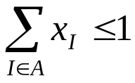
Single machine scheduling
Slide from http://www.cs.technion.ac.il/~reuven/STOC2000.ppt
Activity9
Activity8
Activity7
Activity6
Activity5
Activity4
Activity3
Activity2
Activity1
Maximize
s.t.
For each instance I
For each time t
For each activity A

Slide 17
A ½-effective profit function
Slide from http://www.cs.technion.ac.il/~reuven/STOC2000.ppt
Activity9
Activity8
Activity7
Activity6
Activity5
Activity4
Activity3
Activity2
Activity1
P₁=1
P₁=0
P₁=1
P₁=0
P₁=0
P₁=0
P₁=0
P₁=0
P₁=0
P₁=0
P₁=1
P₁=0
P₁=1
P₁=0
P₁=1
P₁=0
P₁=1
P₁=1
P₁=1
P₁=1
Î
Let Î be an interval that ends first;

Slide 18
A ½-effective profit function
Slide from http://www.cs.technion.ac.il/~reuven/STOC2000.ppt
Activity9
Activity8
Activity7
Activity6
Activity5
Activity4
Activity3
Activity2
Activity1
P₁=1
P₁=0
P₁=1
P₁=0
P₁=0
P₁=0
P₁=0
P₁=0
P₁=0
P₁=0
P₁=1
P₁=0
P₁=1
P₁=0
P₁=1
P₁=0
P₁=1
P₁=1
P₁=1
P₁=1
Î
For every feasible solution x: p₁ ·x ≤ 2 p(Î)
For every Î-maximal solution x: p₁ ·x ≥ p(Î)
Every Î-maximal is ½-effective.

Slide 19
Single Machine Scheduling with Release and Deadlines
Activity 9
Activity 8
Activity 7
Activity 6
Activity 5
Activity 4
Activity 3
Activity 2
Activity 1

Slide 20
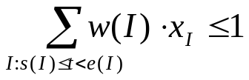
Bandwidth Allocation
Slide from http://www.cs.technion.ac.il/~reuven/STOC2000.ppt
Activity 9
Activity 8
Activity 7
Activity 6
Activity 5
Activity 4
Activity 3
Activity 2
Activity 1
time
Maximize
s.t.
For each instance I
For each time t
For each activity A

Slide 21
Bandwidth Allocation
Activity 9
Activity 8
Activity 7
Activity 6
Activity 5
Activity 4
Activity 3
Activity 2
Activity 1
time
Bandwidth
time

Slide 22
Outline of the algorithm
To approximate this problem, we first consider the following two special cases.
Case 1. All instances are wide, that is, w(I ) > 1/2 for all I .
Case 2. All activity instances are narrow, that is, w(I ) ≤ 1/2 for all I .
In the case of wide instances, the problem reduces to interval scheduling since no pair of intersecting instances may be
scheduled together. Thus, we can use Algorithm MaxIS to find a 1/2-approximate schedule.
In the case of narrow instances, we find a 1/3-approximate schedule by a variant of MaxIS as described in the following.

Slide 23
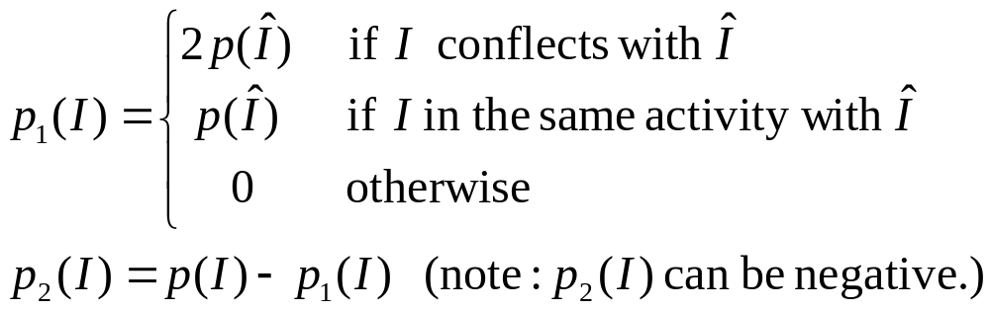
An effective profit function for w ≤ 1/2
Slide from http://www.cs.technion.ac.il/~reuven/STOC2000.ppt
Activity 9
Activity 8
Activity 7
Activity 6
Activity 5
Activity 4
Activity 3
Activity 2
Activity 1
Î
Let Î be an interval that ends first;

Slide 24
An effective profit function for w ≤ 1/2
For every feasible solution x: p₁ ·x ≤ 3 p(Î)
For every Î-maximal solution x: p₁ ·x ≥ p(Î)
Every Î-maximal is 1/3-effective.

Slide 25
Bandwidth Allocation
The 5-approximation for any w ≤ 1
Slide from http://www.cs.technion.ac.il/~reuven/STOC2000.ppt
w > ½
w > ½
w > ½
w > ½
w > ½
w > ½
w > ½
w > ½
w > ½
Algorithm:
GRAY = Find 1/2-approximation for gray (w>1/2) intervals;
COLORED = Find 1/3-approximation for colored intervals
Return the one with the larger profit
Analysis:
If GRAY* ≥ 40%OPT then GRAY ≥ 1/2(40%OPT)=20%OPT else
COLORED* > 60%OPT thus COLORED > 1/3(60%OPT)=20%OPT

Slide 26
The Local Ratio Technique
Slide from http://www.cs.technion.ac.il/~reuven/APPROX-SEMINAR/spr06/LR.ppt
  Applications to some optimization algorithms (r = 1):
  ( MST) Minimum Spanning Tree (Kruskal)
  ( SHORTEST-PATH) s-t Shortest Path (Dijkstra)
  (LONGEST-PATH) s-t DAG Longest Path (Can be done with dynamic programming)
  (INTERVAL-IS) Independents-Set in Interval Graphs Usually done with dynamic programming)
  (LONG-SEQ) Longest (weighted) monotone subsequence (Can be done with dynamic programming)
  ( MIN_CUT) Minimum Capacity s,t Cut (e.g. Ford, Dinitz)
  Applications to some 2-Approximation algorithms: (r = 2)
  ( VC) Minimum Vertex Cover (Bar-Yehuda and Even)
  ( FVS) Vertex Feedback Set (Becker and Geiger)
  ( GSF) Generalized Steiner Forest (Williamson, Goemans, Mihail, and Vazirani)
  ( Min 2SAT) Minimum Two-Satisfibility (Gusfield and Pitt)
  ( 2VIP) Two Variable Integer Programming (Bar-Yehuda and Rawitz)
  ( PVC) Partial Vertex Cover (Bar-Yehuda)
  ( GVC) Generalized Vertex Cover (Bar-Yehuda and Rawitz)
  Applications to some other Approximations:
  ( SC) Minimum Set Cover (Bar-Yehuda and Even)
  ( PSC) Partial Set Cover (Bar-Yehuda)
  ( MSP) Maximum Set Packing (Arkin and Hasin)
  Applications Resource Allocation and Scheduling :
  ….

Slide 27
“Standard” Local Ratio
The standard local ratio approach is to use a weight decomposition that guarantees that the solution constructed by the algorithm will be r-approximate with respect to w₁.
The analysis consists of comparing, at each level of the recursion, the solution found in that level, and an optimal solution for the problem instance passed to that level, where the comparison is made with respect to w₁ and with respect to w₂.
Thus, in each level of the recursion, there are potentially two optima (one with respect to w₁, and one with respect to w₂) against which the solution is compared, and in addition, different optima are used at different recursion levels.

Slide 28

Fractional Local Ratio Theorem
(for maximization problems)
Let w = w₁ + w₂ . Let x∗ and x be solutions such that x is r-approximate relative to x∗ with respect to w₁, and with respect to w₂. Then, x is r-approximate relative to x∗ with respect to w as well.
P
R
O
O
F
:
F
w
(
x
)
¸
r
¢
w
(
x
¤
)
1
1
F
w
(
x
)
¸
r
¢
w
(
x
¤
)
2
2
!
w
(
x
)
=
w
(
x
)
+
w
(
x
)
¸
r
¢
w
(
x
¤
)
1
2
Note that the theorem holds even when negative weights are allowed.

Slide 29


Thanks, end.

