Slide 1
Eut+ Project
Ravindu Buddhila Danthasinghe
Mridul Mukherjee
Menelaos Menelaou
Marios Pirikki

Slide 2
Power Systems Planning end-term assignment
Overview:
This project is to investigate the connection of distributed energy resources (DER) into the distribution grid. It is split into three parts:
Scenario-based analysis, separate for the MV and LV level
Time series analysis, combined for MV and LV level
Optimization using innovative planning and operation schemes

Slide 3
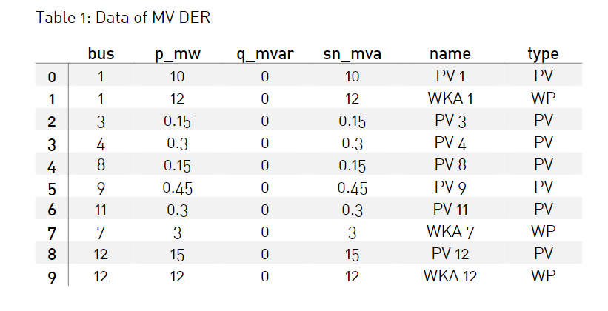
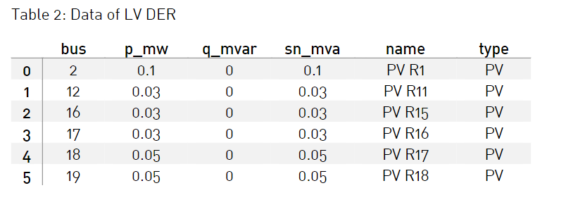
Network
MV LEVEL :
LV LEVEL :

Slide 4
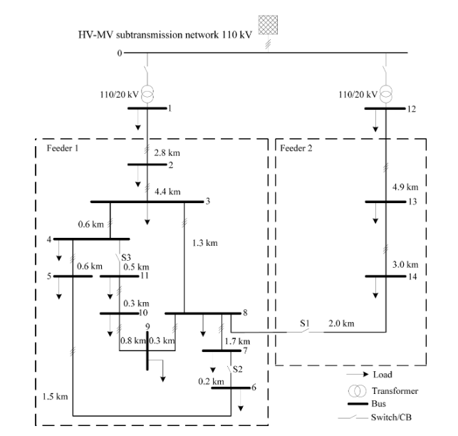
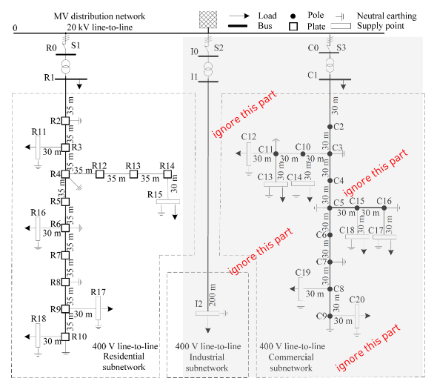
Figure 1: Single-Line Diagram of the MV network [1].
Figure 2: Single-Line Diagram of the LV network [1].

Slide 5
Scenario-based analysis
What extreme scenarios must be analysed before deciding if the connection of DER is permissible?
Testing according to DIN EN 50160: −
Maximum load & minimum generation at all voltage levels.
Minimum load ¹⁾ & maximum generation at all voltage levels.
¹⁾ Value for the load depends on the times, when maximum DER feed-in occurs (e.g. for PV between 10 am and 4 pm)
What tap-changer position (set-point value for voltage regulation on MV side) should be assumed for the HV/MV transformer depending on the scenario?
Maximum load & minimum generation at all voltage levels, minimum tapping (within control range) at HV / MV transformer.
Minimum load 1) & maximum generation at all voltage levels, maximum tapping (within control range) at HV/MV transformer.

Slide 6
What is the maximum permissible voltage rise (in % of nominal voltage) for the MV and LV level during normal operation? How does this threshold change during n-1 contingency conditions?
Testing according to technical connection rules during normal conditions: −
MV level (bdew): voltage change when all DER are connected (compared to the case without any DER)
LV level (VDE AR 4100 and 4105): voltage change when all DER are connected
During normal operation (continuous voltage fluctuation)
Maximum voltage deviation at PCC (Point of Common Coupling)
− LV: -5% to +10%
− MV: -5% to +5% Defined for 95% of the time, measured over one week
During fault conditions (n-1 case, single outage):
− LV: -8% to +10%
− MV: -10% to +10%
After reactive actions (e.g., stepping of on-load tap-changer):
− MV: -8% to +8%

Slide 7
What is the maximum permissible line loading under normal conditions for the MV and LV level?
Testing according to technical connection rules:
− Maximum load & minimum generation at all voltage levels, minimum tapping (within control range) at HV / MV transformer
− Minimum load ¹⁾ & maximum generation at all voltage levels In both cases, minimum tapping at HV / MV transformer
¹⁾ Value for the load depends on the times, when maximum DER feed-in occurs (e.g. for PV between 10 am and 4 pm).
For the current limits, the maximum steady-state loading is limited to 100 % of the long-term assets capacity. Some DSOs make exceptions, e.g., allowing a temporarily loading of 130 % of maximum steady-state loading for MV/LV stations.

Slide 8
Based on the results for high load conditions, is the network n-1 secure? Which measures would you recommend for ensuring n-1 security?
For LV high load, low DER condition, it is not n-1 secure. We got line 9 as critical node.
Measures: Add a parallel line || Add parallel source feed in the system
Repeat the power flow calculation for light load, very high PV conditions. What difference do you notice?
More bus voltage increment because we have light load but more DER gen.
Extra DER gen. is feed to all grid systems (HV, MV, LV).
Compare the voltage drop / voltage rise with the permissible bandwidth. Is the network well designed?
During normal operation (continuous voltage fluctuation)
Maximum voltage deviation at PCC (Point of Common Coupling)
− LV: -5% to +10%
− MV: -5% to +5% Defined for 95% of the time, measured over one week .
The MV network is not well-defined while for high load low DER gen. we have from (Bus 3 – Bus 11) – min bus voltage < 0.95 p.u. and for low load high DER gen. we have from (Bus 3 – Bus 11) – max bus voltage > 1.05 p.u.
The LV network is not well-defined while for high load low DER gen. we have from (Bus 6 – Bus 19) – min bus voltage < 0.95 p.u.

Slide 9
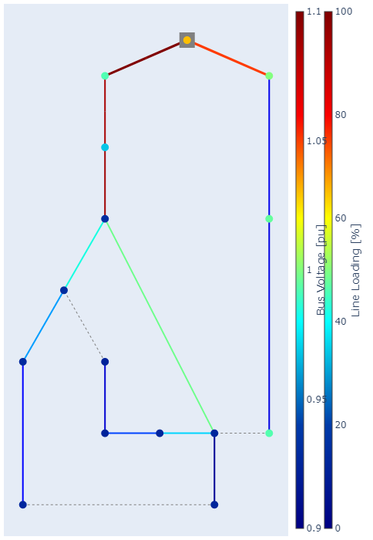
Results
Maximum load & minimum generation - MV

Slide 10
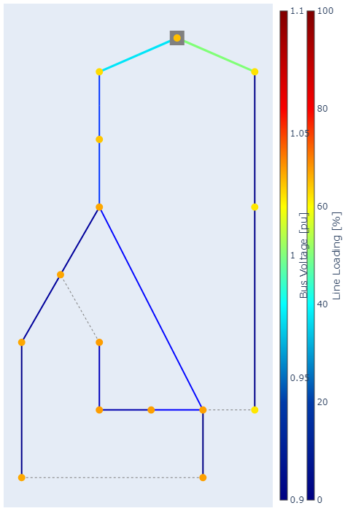
Results
Minimum load & maximum generation - MV

Slide 11
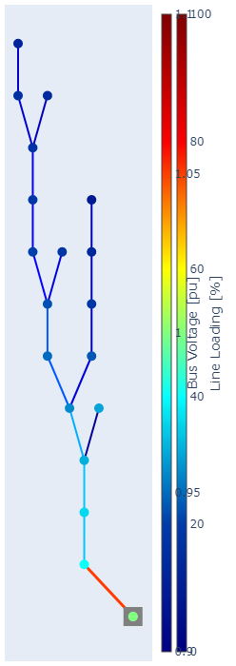
Results
Maximum load & minimum generation - LV

Slide 12
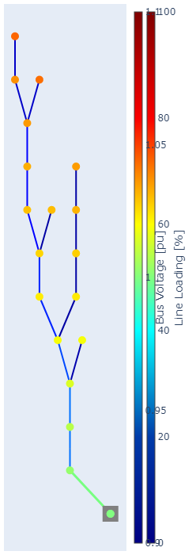
Results
Minimum load & maximum generation - LV

Slide 13
Which annual consumptions is assumed for the H0 load profile? How do you scale the profile for different levels of consumption?
Scaling - We divide all the load with the max load of all time.
Annual Consumption was assumed to be 1000KWh.

Slide 14
Load Profile for HO - Winter
Day Peak
Werktag – 135,4 W
Samstag - 169,4 W
Sonntag - 211,8 W
Evening Peak
Werktag – 188,9 W
Samstag – 213,2 W
Sonntag - 179,1 W

Slide 15
Load Profile for HO - Sommer
Day Peak
Werktag – 162,3 W
Samstag – 182,1 W
Sonntag - 212,8 W
Evening Peak
Werktag – 170,4 W
Samstag – 181,8 W
Sonntag - 161,4 W

Slide 16
Load Profile for HO - Spring
Day Peak
Werktag – 152,3 W
Samstag – 183,9 W
Sonntag - 213,5 W
Evening Peak
Werktag – 176,5 W
Samstag – 199,4 W
Sonntag - 164,0 W

Slide 17
Load Profile Data for GO
Winter | Sommer | Spring
Day Peak Werktag – 240,4 W Samstag – 208,3 W Sonntag - 80,5 W | Day Peak Werktag – 208,8 W Samstag – 185,5 W Sonntag - 78,5 W | Day Peak Werktag – 220,5 W Samstag – 194,5 W Sonntag - 83,2 W
Evening Peak Werktag – 205,5 W Samstag – 94,6 W Sonntag - 94,4 W | Evening Peak Werktag – 178,2 W Samstag – 90,0 W Sonntag - 88,5 W | Evening Peak Werktag – 183,6 W Samstag – 91,6 W Sonntag - 88,6 W

Slide 18
In which time of the year do you expect the peak household consumption? Is this the same for all countries, or rather specific to Germany?
- Winter. During the winter due to the heavy electrical usage (like heaters) it shows the maximum peak household consumption
- Depend on the climate

Slide 19
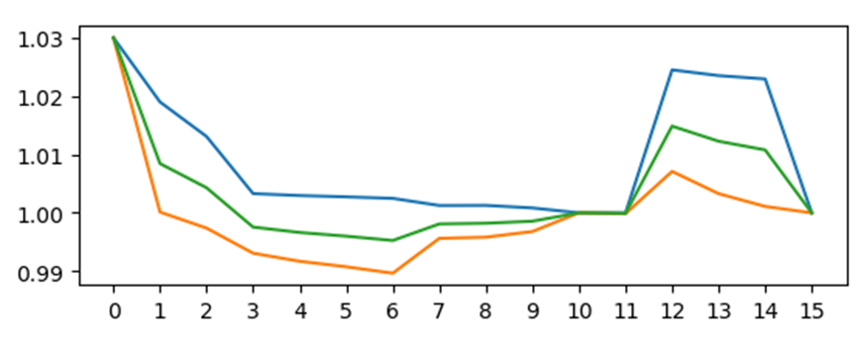
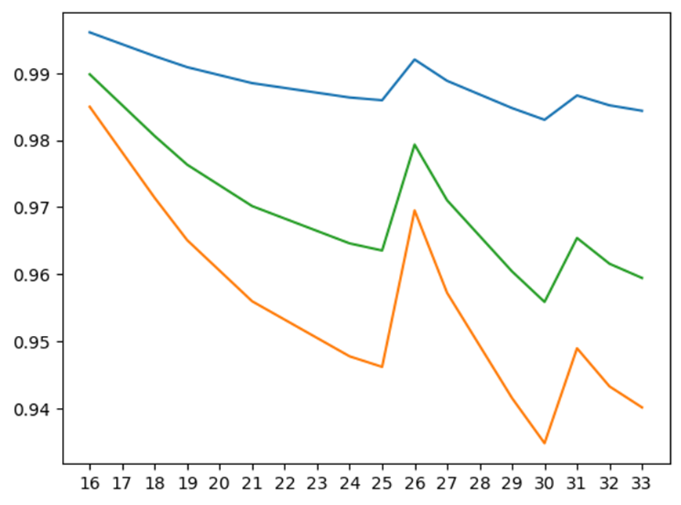
Time Series Analysis Without DER
Results
Weekday in Summer: Residential Case (H0)
Maximum, mean, and minimum voltage of the buses at MV voltage level
Maximum, mean, and minimum voltage of the buses at LV voltage level

Slide 20
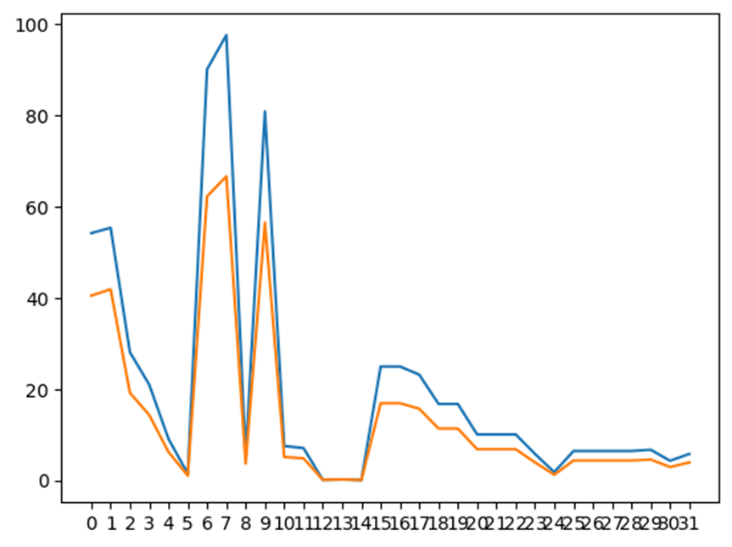
Results
Mean and maximum line loading over time

Slide 21
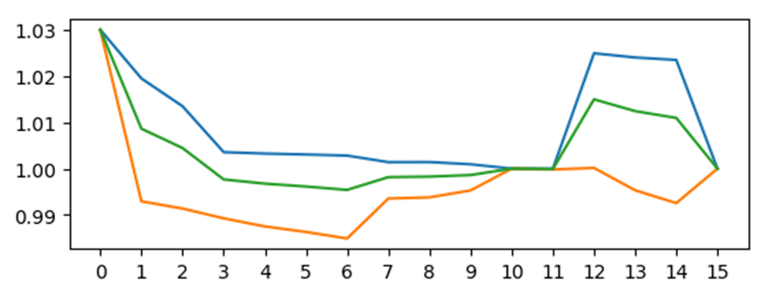
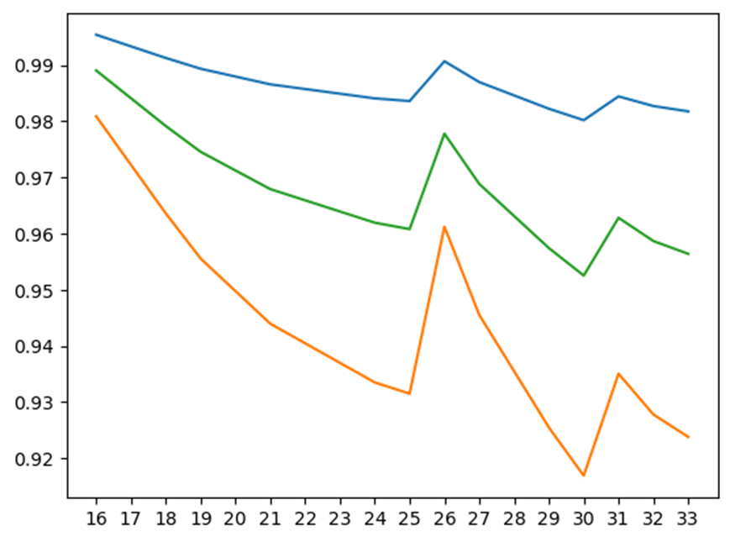
Results
Sunday in Spring : Residential Case (H0)
Maximum, mean, and minimum voltage of the buses at MV voltage level
Maximum, mean, and minimum voltage of the buses at LV voltage level

Slide 22
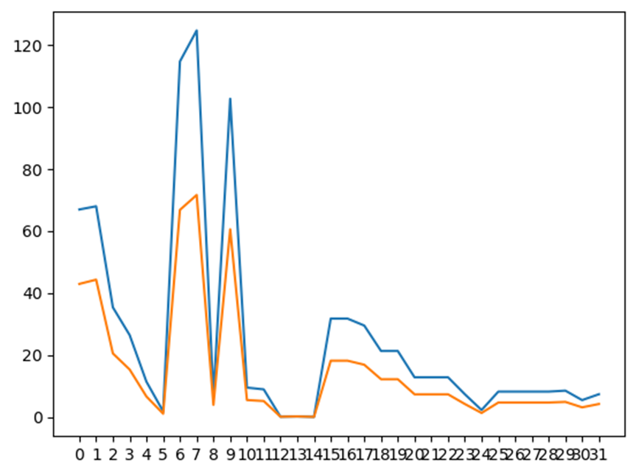
Results
Mean and maximum line loading over time

Slide 23
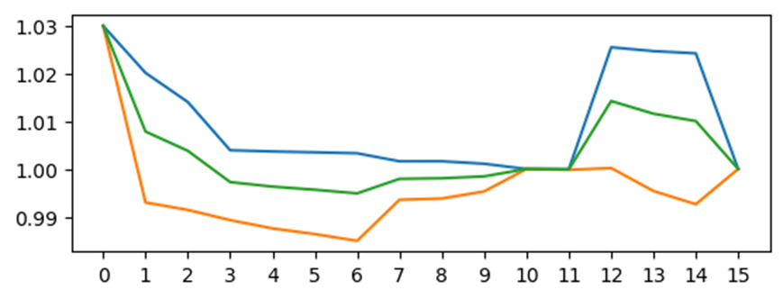
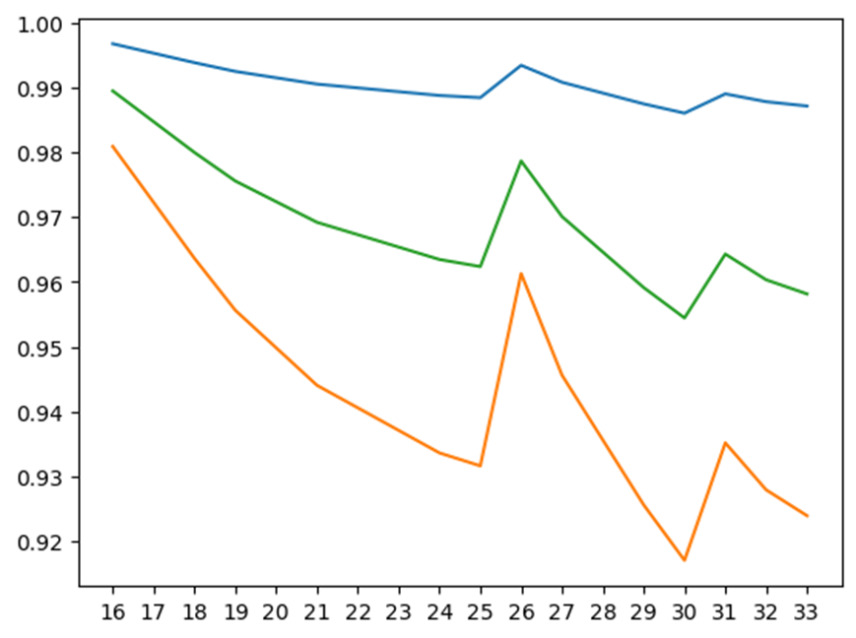
Results
Saturday in Winter: Residential Case (H0)
Maximum, mean, and minimum voltage of the buses at MV voltage level
Maximum, mean, and minimum voltage of the buses at LV voltage level

Slide 24
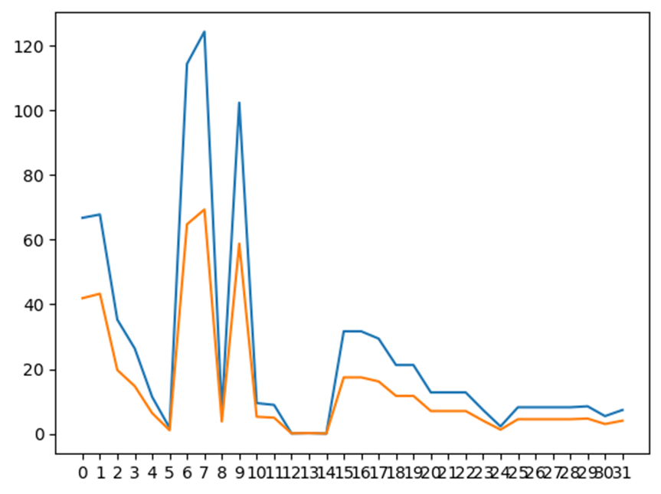
Results
Mean and maximum line loading over time

Slide 25
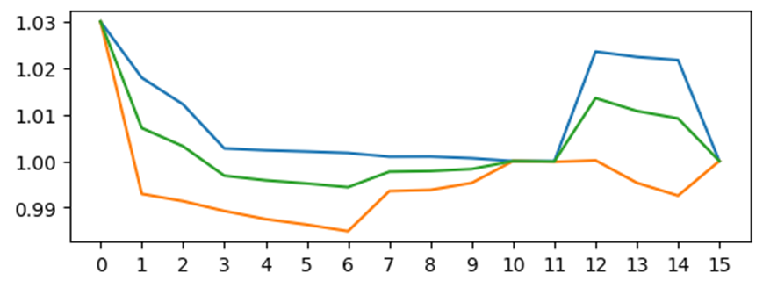

Results
Weekday in Summer: Commercial Case (G0)
Maximum, mean, and minimum voltage of the buses at MV voltage level
Maximum, mean, and minimum voltage of the buses at LV voltage level

Slide 26

Results
Mean and maximum line loading over time

Slide 27
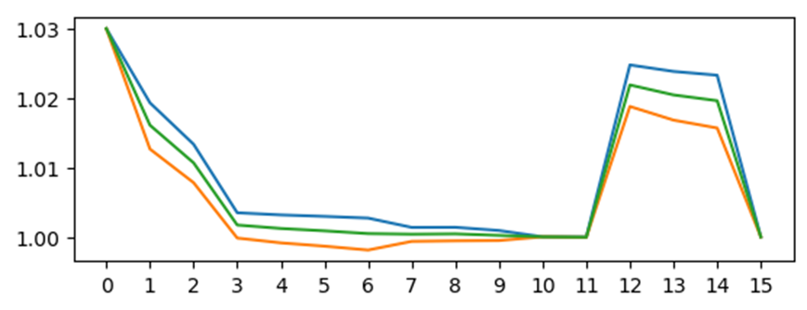
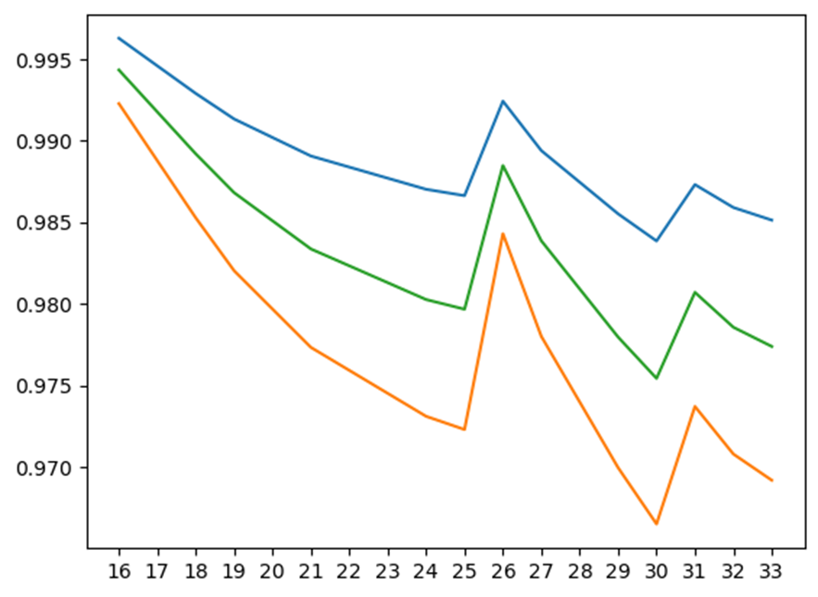
Results
Sunday in Spring : Commercial Case (G0)
Maximum, mean, and minimum voltage of the buses at MV voltage level
Maximum, mean, and minimum voltage of the buses at LV voltage level

Slide 28
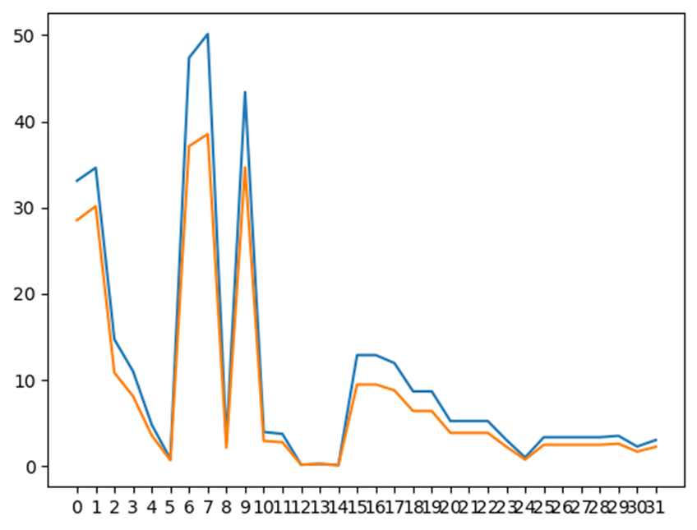
Results
Mean and maximum line loading over time

Slide 29
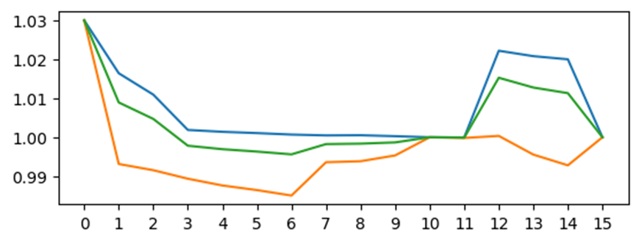
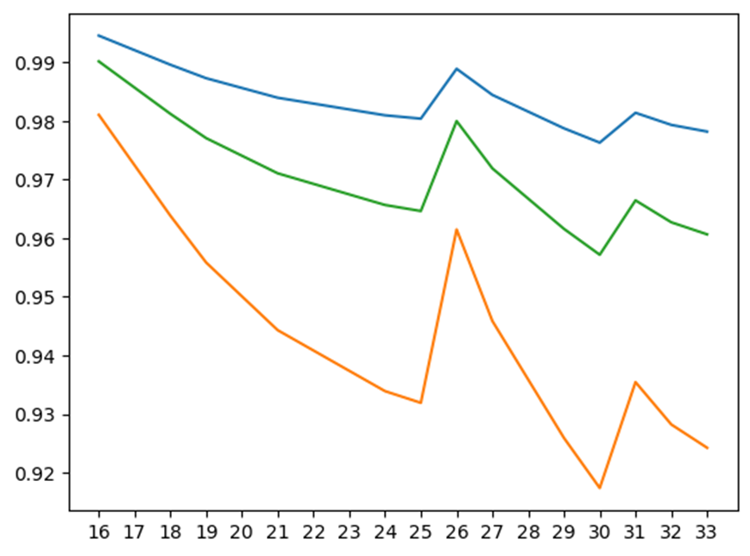
Results
Saturday in Winter : Commercial Case (G0)
Maximum, mean, and minimum voltage of the buses at MV voltage level
Maximum, mean, and minimum voltage of the buses at LV voltage level

Slide 30
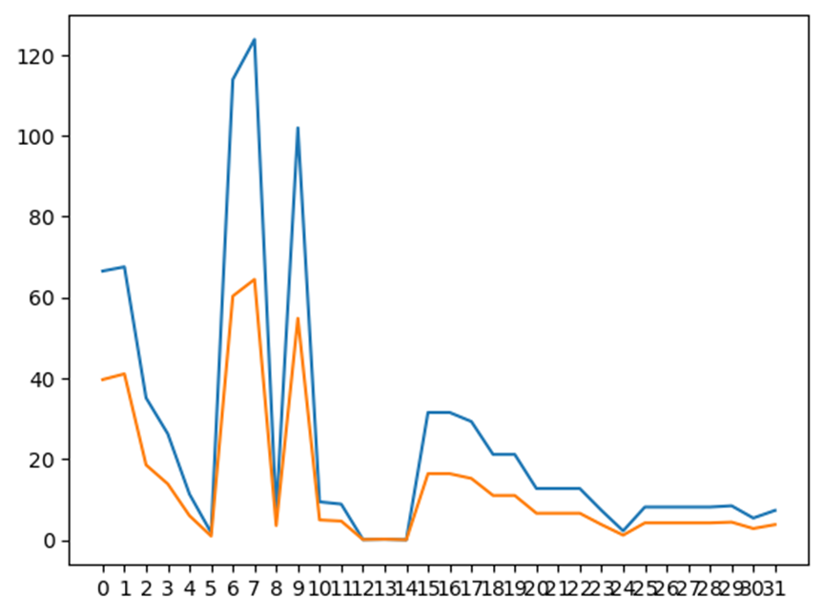
Results
Mean and maximum line loading over time

Slide 31
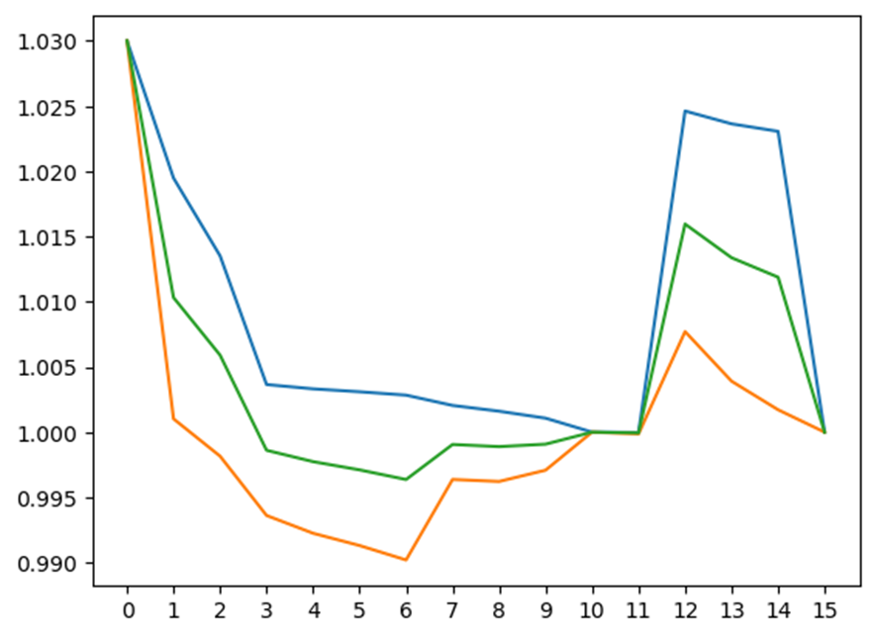
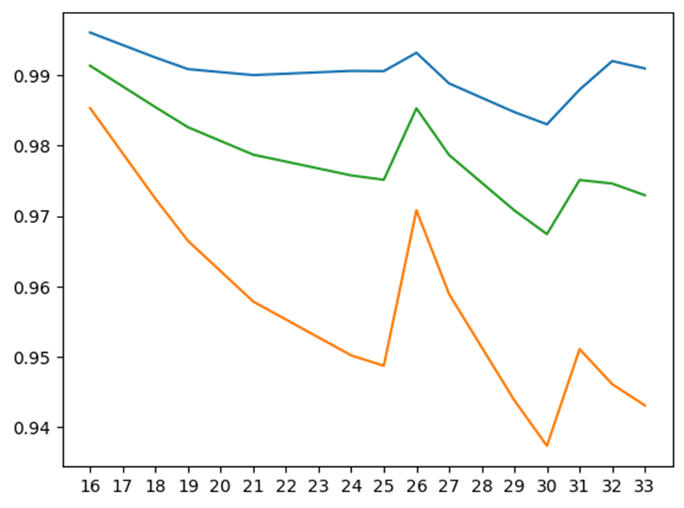
Time Series Analysis with DER (Active power)
Results
Weekday in Summer: Residential Case (H0)
Maximum, mean, and minimum voltage of the buses at MV voltage level
Maximum, mean, and minimum voltage of the buses at LV voltage level

Slide 32
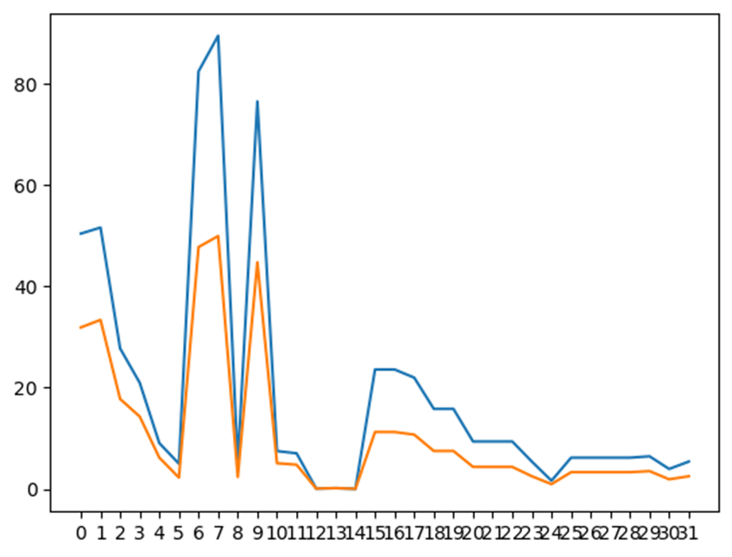
Results
Mean and maximum line loading over time

Slide 33
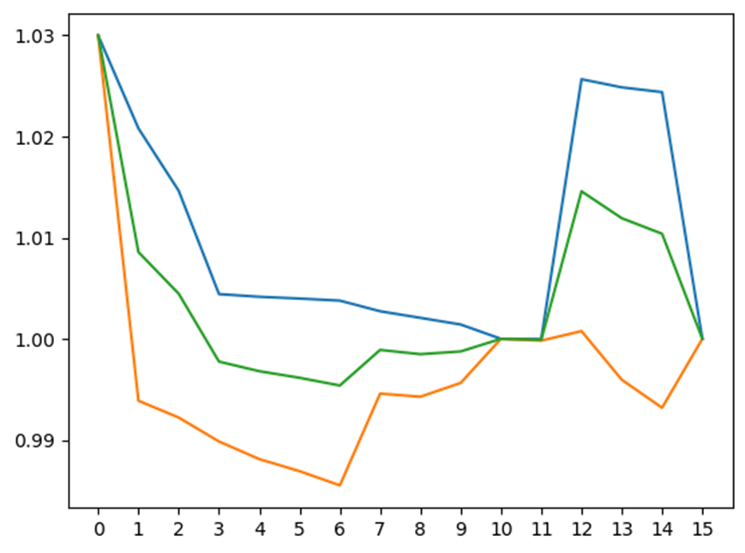
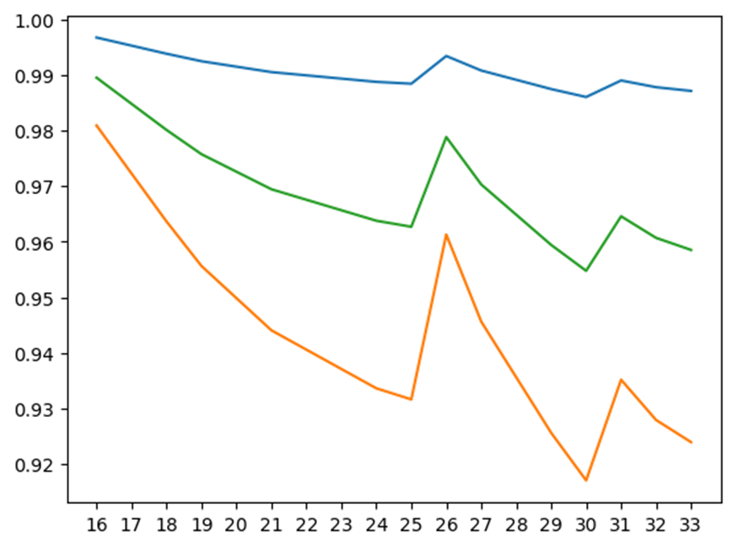
Results
Saturday in Winter: Residential Case (H0)
Maximum, mean, and minimum voltage of the buses at MV voltage level
Maximum, mean, and minimum voltage of the buses at LV voltage level

Slide 34
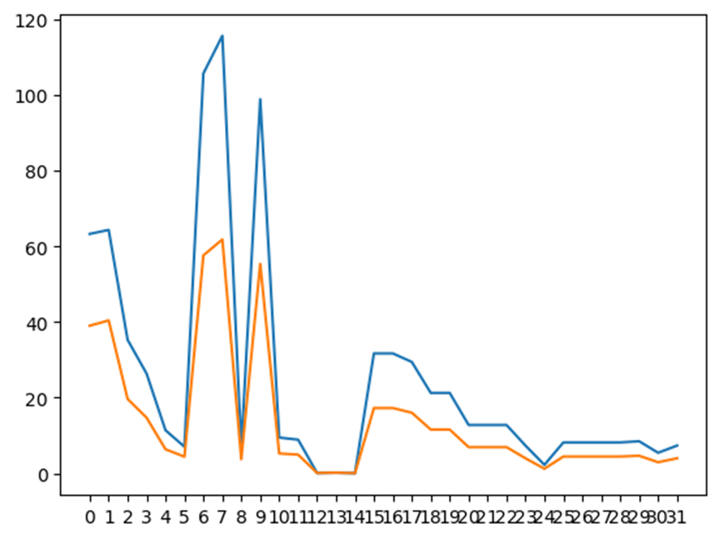
Results
Mean and maximum line loading over time

Slide 35
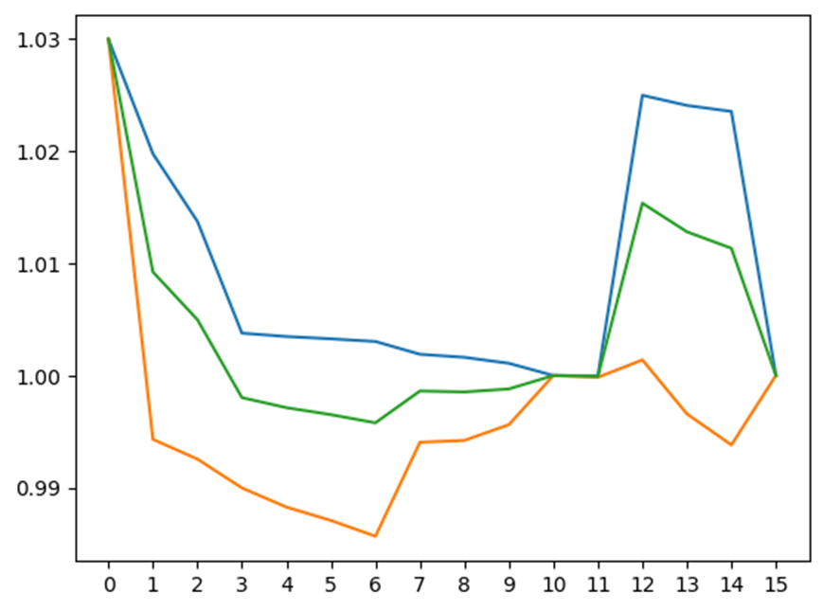
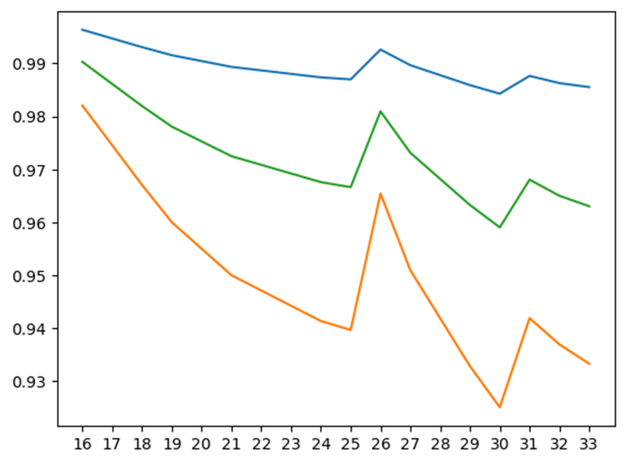
Results
Sunday in Spring : Residential Case (H0)
Maximum, mean, and minimum voltage of the buses at MV voltage level
Maximum, mean, and minimum voltage of the buses at LV voltage level

Slide 36

Results
Mean and maximum line loading over time

Slide 37
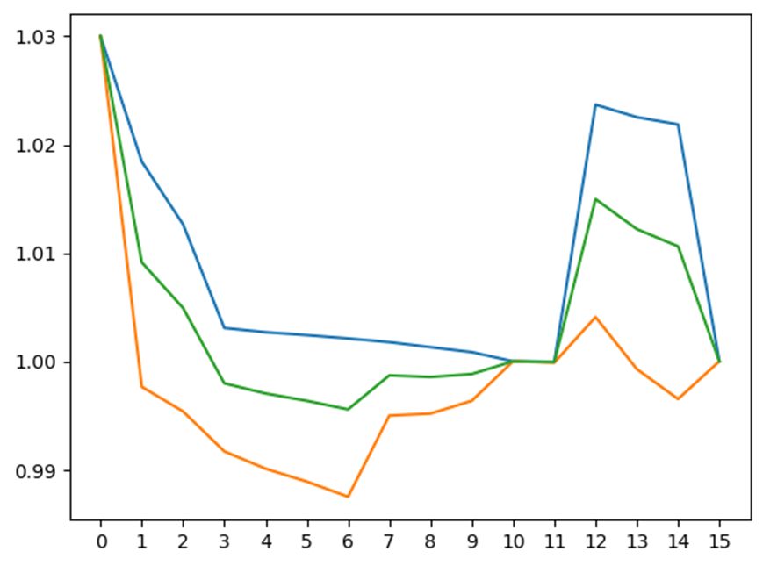
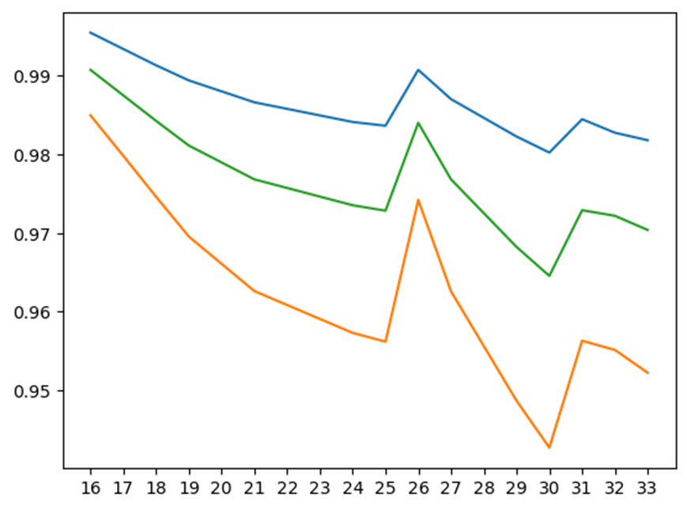
Results
Weekday in Summer: Commercial Case (G0)
Maximum, mean, and minimum voltage of the buses at MV voltage level
Maximum, mean, and minimum voltage of the buses at LV voltage level

Slide 38
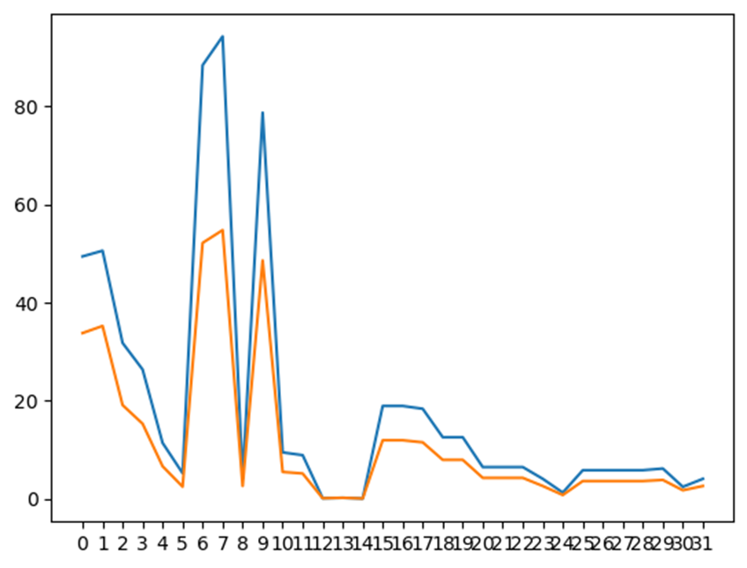
Results
Mean and maximum line loading over time

Slide 39
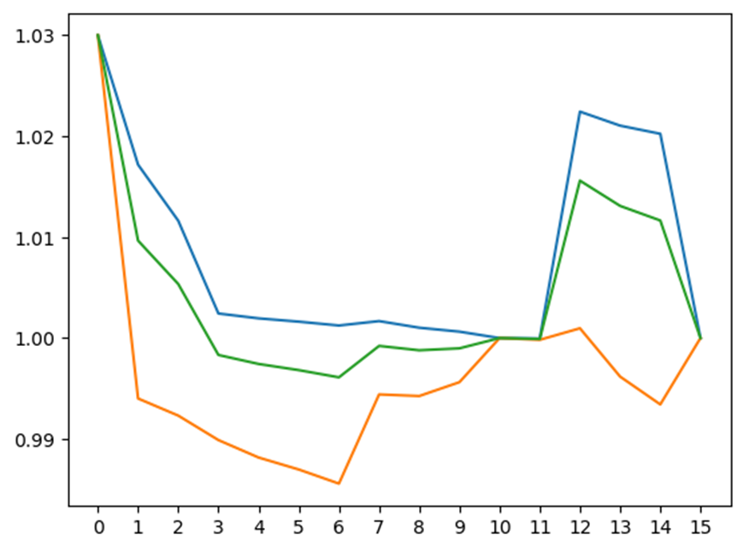
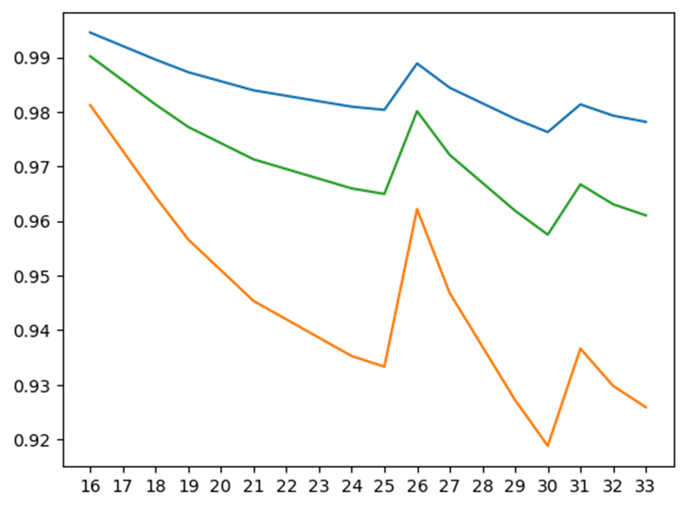
Results
Saturday in Winter : Commercial Case (G0)
Maximum, mean, and minimum voltage of the buses at MV voltage level
Maximum, mean, and minimum voltage of the buses at LV voltage level

Slide 40

Results
Mean and maximum line loading over time

Slide 41
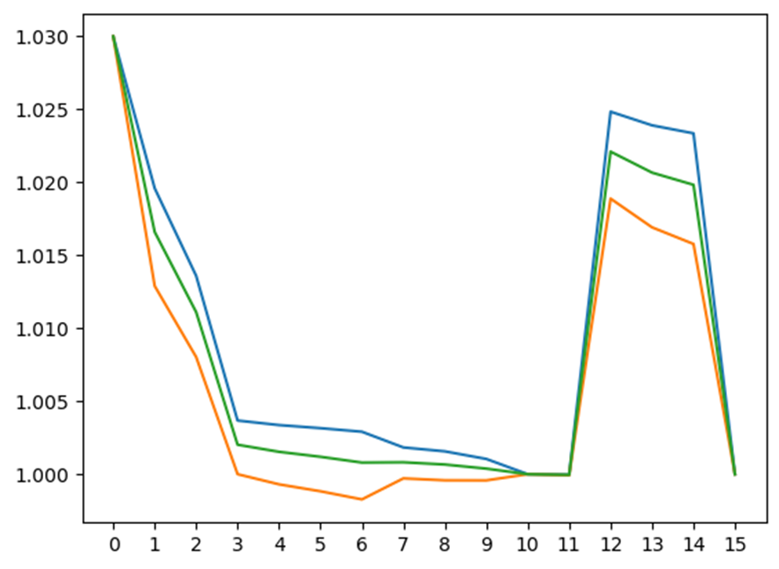
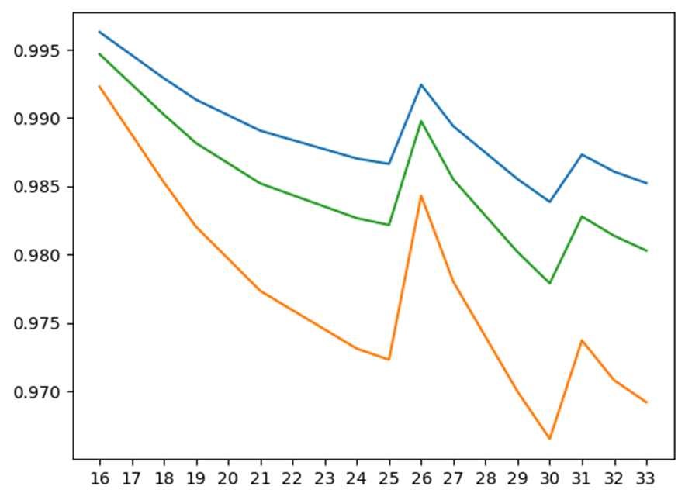
Results
Sunday in Spring : Commercial Case (G0)
maximum, mean, and minimum voltage of the buses at MV voltage level
maximum, mean, and minimum voltage of the buses at LV voltage level

Slide 42
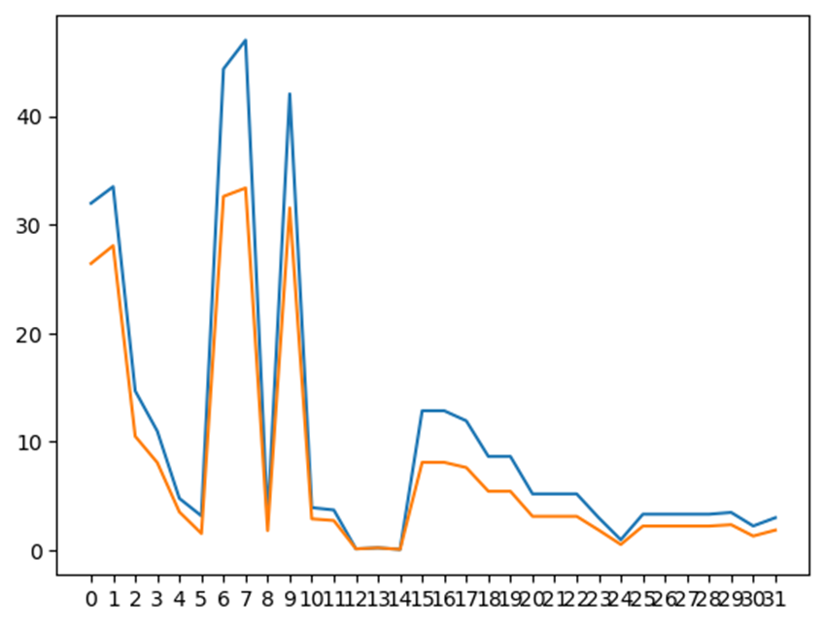
Results
Mean and maximum line loading over time

Slide 43
Compare the maximum voltage drop/rise in the MV and LV network as well as the maximum line loading to the results from section 3. Which approach (scenario-based or time series) yields more onerous results?
Since we did not use the time series analysis more onerous is scenario-based analysis. We found out that the values for bus voltages are exceeding the permissible limits in Scenario based analysis.
Exercise 5
Network | Measurements |  | Scenario MV |  | Scenario LV |  | Scenario Combined | Time Series
 |  |  | High load, low DER gen. | Low load high DER gen. | High load, low DER gen. | Low load high DER gen. |  | H0 |  |  | G0
 |  |  |  |  |  |  |  | Sum | Win | Spr | Sum | Win | Spr
MV | Bus Voltage | min | 0.902 | 1.02 |  |  | 0.902 | 0.99 | 0.99 | 0.99 | 0.99 | 0.99 | 0.99
 |  | max | 1.03 | 1.06 |  |  | 1.06 | 1.03 | 1.03 | 1.03 | 1.03 | 1.03 | 1.03
 |  | mean | 0.937 | 1.04 |  |  | 0.99 | 1.00 | 1.00 | 1.00 | 1.00 | 1.00 | 1.00
 | Line Loading | max | 99.88 | 64.30 |  |  | 99.98 | 89.4 | 115 | 115 | 94.2 | 116 | 47
 |  | mean | 27.44 | 17.58 |  |  | 22.51 | 17.3 | 20.8 | 20.1 | 18.8 | 19.4 | 12.2
LV | Bus Voltage | min |  |  | 0.91 | 1.0 | 0.91 | 0.97 | 0.92 | 0.93 | 0.94 | 0.92 | 0.97
 |  | max |  |  | 1.0 | 1.04 | 1.04 | 1.02 | 0.99 | 0.99 | 0.99 | 0.99 | 0.99
 |  | mean |  |  | 0.94 | 1.02 | 0.98 | 0.99 | 0.97 | 0.97 | 0.97 | 0.97 | 0.98
 | Line Loading | max |  |  | 32.52 | 22.53 | 32.52 | 23.6 | 31 | 27.3 | 19 | 30.8 | 12.8
 |  | mean |  |  | 18.83 | 18.83 | 18.83 | 5.06 | 7.6 | 6.7 | 5.2 | 7.13 | 3.5

