Slide 1
Technical Use Cases
Mridula Prasad

Slide 2
Outline
Dashboard screenshot
Data Model
Key KPIs
Data analysis
DAX formulas for important KPIs
Business insights

Slide 3
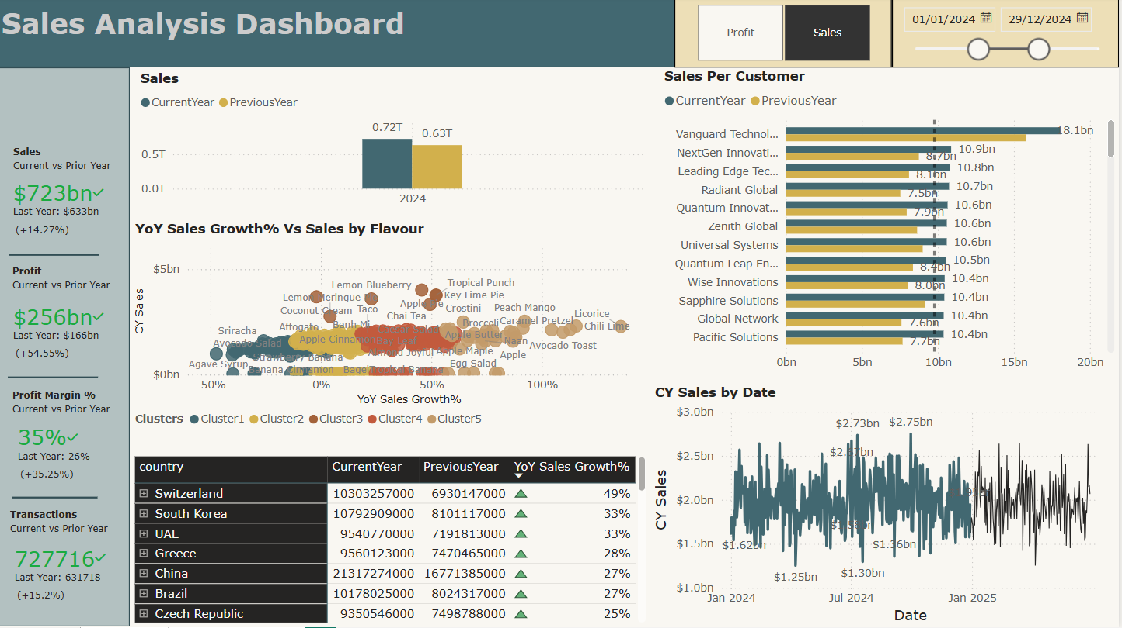
Dashboard 1

Slide 4
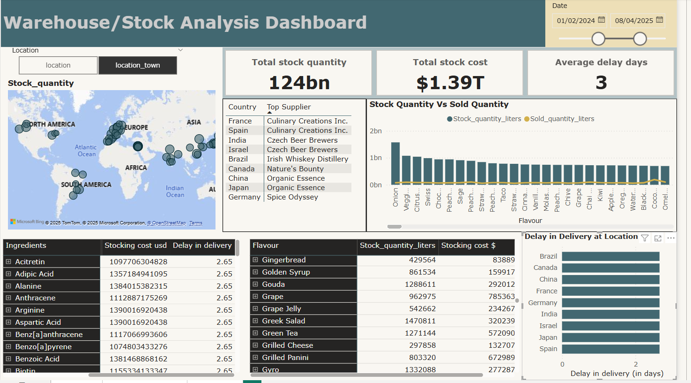
Dashboard 2

Slide 5
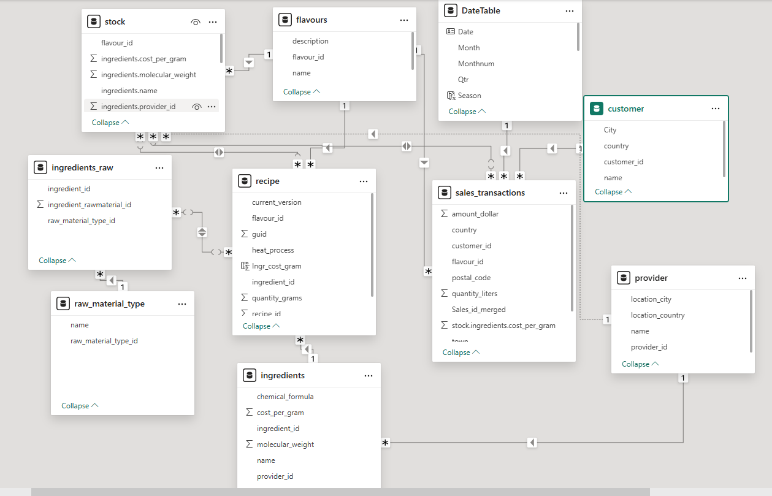
Data Model

Slide 6
Key Performance Indicators
Sales Analysis Dashboard
Sales (in USD) Profit (in USD) Profit Margin % YoY Sales Growth %
Stock Analysis Dashboard
Stock quantity (in liters) Stock cost (in USD) Delay in delivery (in days)

Slide 7
Data Analysis
Tool: Power BI
Key Highlights from Data Analysis:
A new ‘Date Dim’ table was created and linked to other relevant tables.
Key Performance Indicators (KPIs) were calculated using DAX formulas.
A new Date column was added to the Stock table, derived from the transaction date in the Sales_Transaction table. The two tables were then joined using flavour_id, location, and location_town.
The Total Cost of Stock was calculated by multiplying Stock Quantity Per Day by Ingredients.Cost.
The Ingredients.Cost column from the Recipe table was integrated into the Stock table using the ‘Merged Queries’ function in Power Query.
Stock Quantity Per Day was calculated as: Stock[‘Stock Quantity in Liters’] / 365.

Slide 8
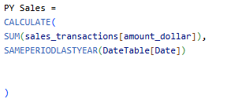


DAX formulas for important KPIs : Sales Analysis Dashboard
Sales
YoY Sales Growth %
Profits
Profit Margin

Slide 9
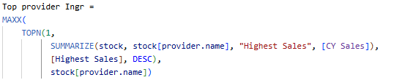
DAX formulas for important KPIs : Stock Analysis Dashboard
Total stock quantity
Total stock cost
Delay in delivery
Top supplier

Slide 10


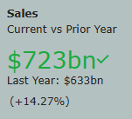
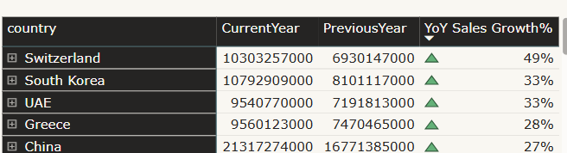
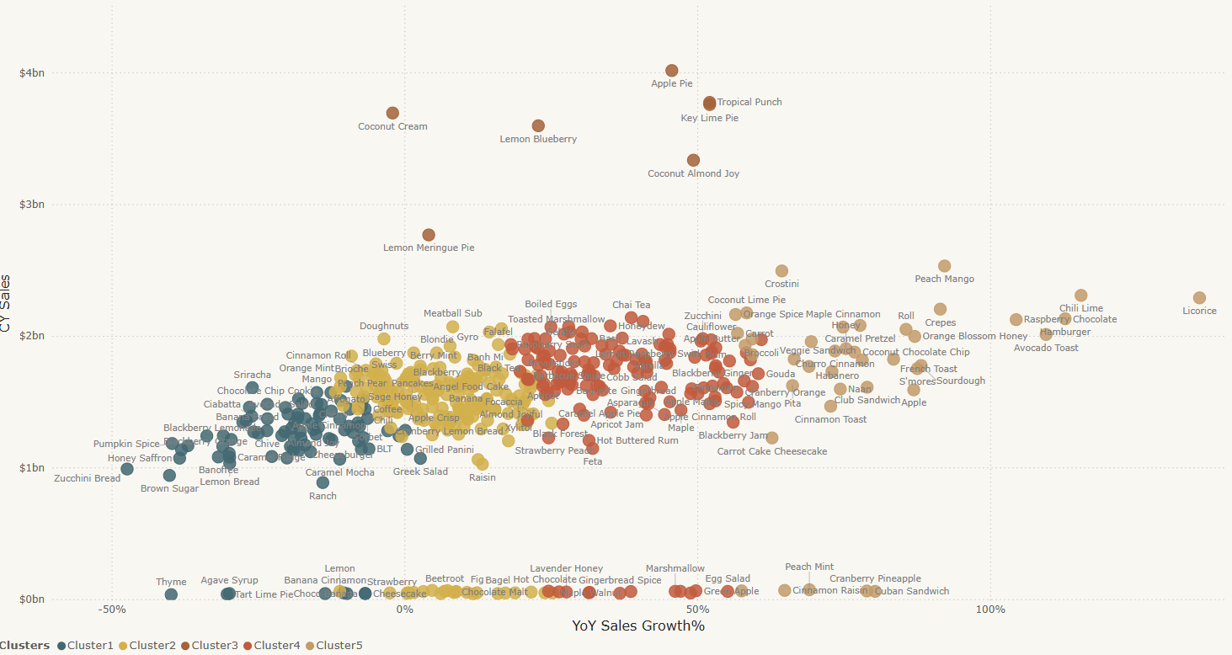
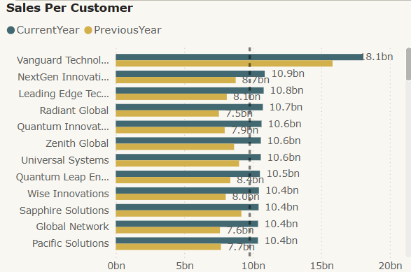
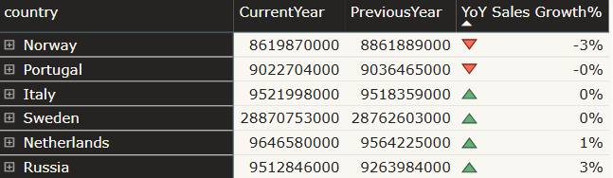
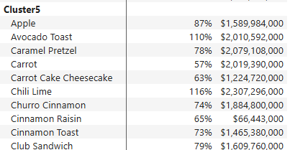
Sales increases by this much amount
Performance overview based on sales data for 2024
Countries with increase and decrease in sales
Flavours with increase in sales
Customers with increase in sales

Slide 11
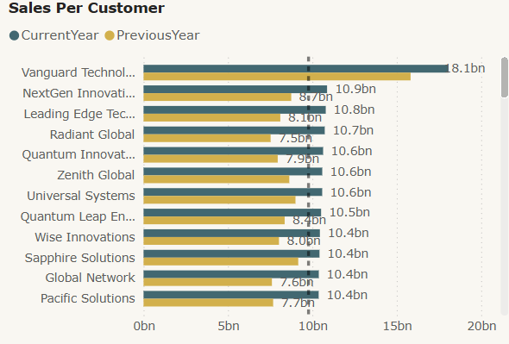
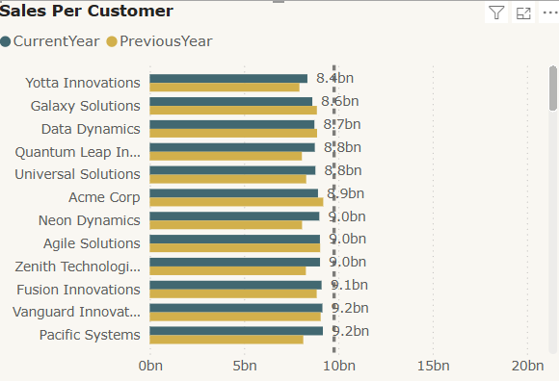
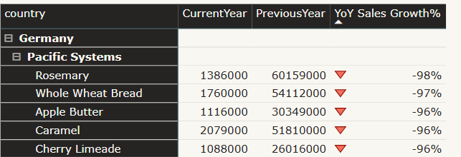
Top customers
Potential customers (Sales below average)
Example, Pacific Systems, potential customer sales declined for flavours

Slide 12
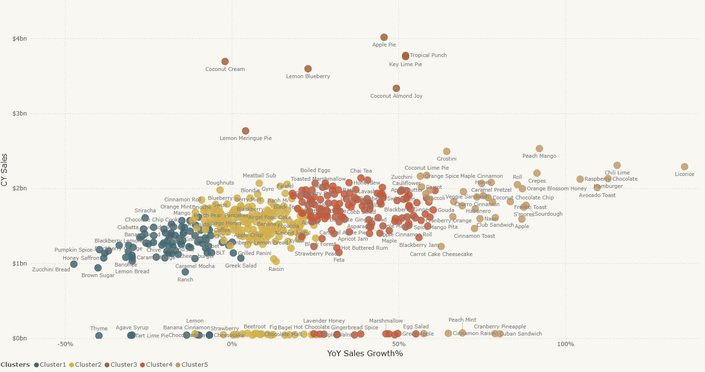
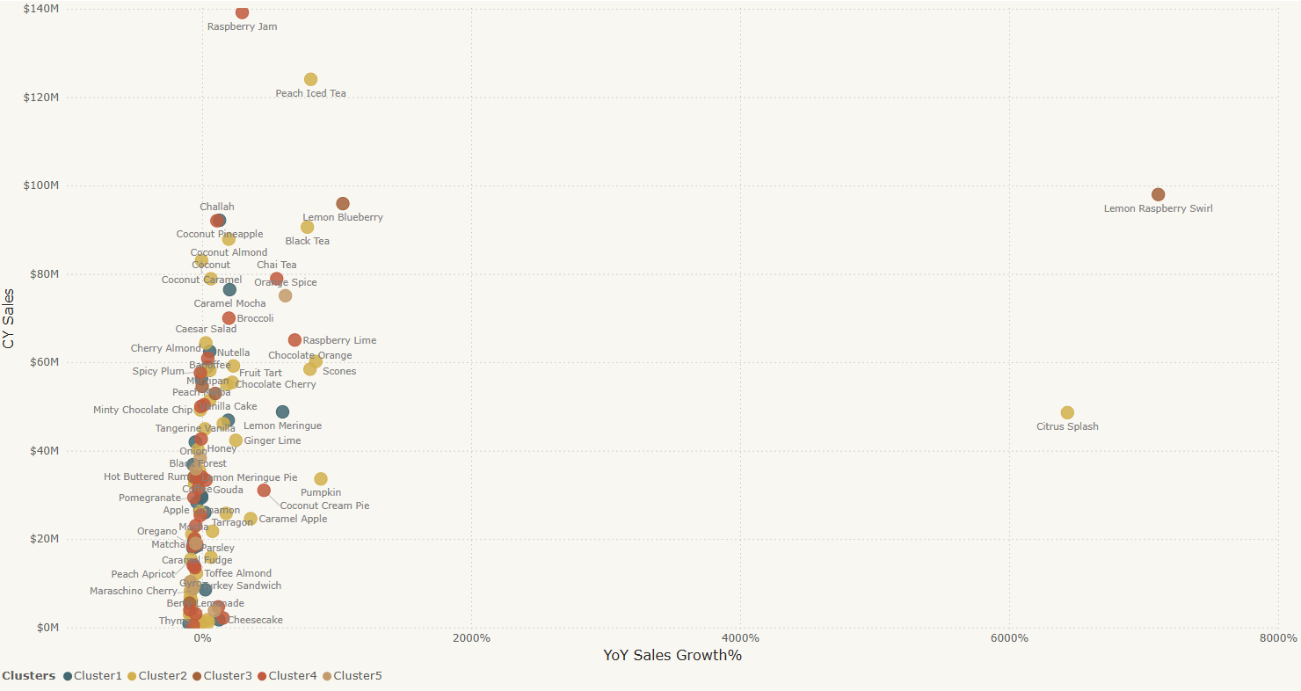
Visualize relationship between flavours
Country = Switzerland
Flavour recommendation
There are number of flavours in Switzerland with similar sales amount.
Ingredients falls in same cluster are similar to each other based on their sales value. Therefore, the customer bought ‘Apple pie’ flavour might be interested in other flavours such as ‘Lemon Blueberry’, ‘Tropical Punch’, ‘Key Lime Pie’, ‘Coconut Almond Joy’, ‘Coconut Cream’.

Slide 13
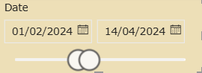
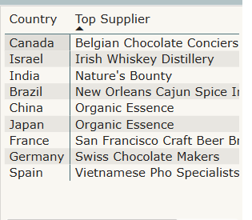
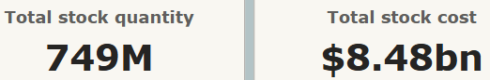
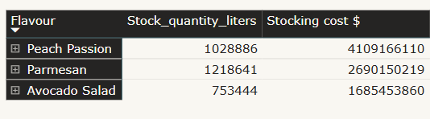
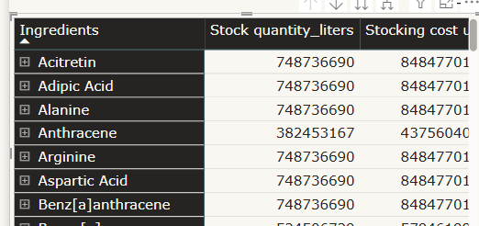
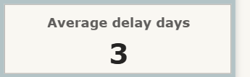
Top suppliers in different countries
Overview stock quantity and cost
Location : India/New Delhi
On average customer received their orders 3 days after the due date

Slide 14

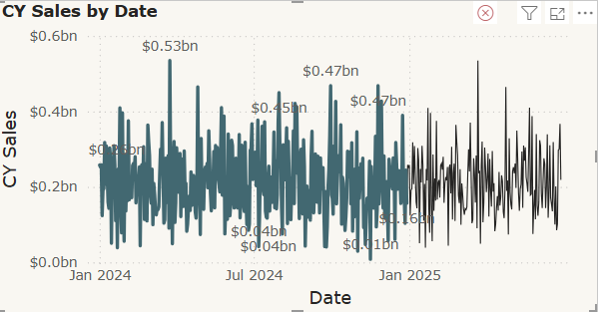
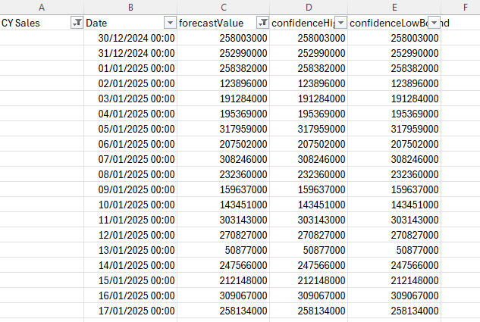
Supply Chain Optimization
Number of products we will sell based on sales forecast
Country : USA

Slide 15
Recommendations
To analyze the decline in sales across various customer segments, it’s important to examine additional key factors, such as pricing, discounts, market trends etc.
Flavor recommendations can also be enhanced by leveraging recipe data from external sources, helping to identify popular combinations of ingredients and recipes across different regions.
For more accurate predictions, consider implementing advanced forecasting models to achieve better results.

