Slide 1

PROJECT-4
Organization: Indian Institute of Technology, Delhi (IITD)
Title: Investigation on Big-Dataset to address business-oriented questions
Presented By:
Mridul Prakash Kashyap
Master of Technology (M.Tech)
Indian Institute of Technology, Delhi (IITD)

Slide 2



Objective:-
To clean the dataset on Google Apps.
(App_name, Reviews, Installs, Android_version, etc.)
How to combine the cleaned dataset with App review dataset, to address business-oriented problems (using Spark.sql)?
How to predict the prices of Apps on their transition from free to paid version (using PySpark.ml)?

Slide 3
How did I do that ?
By converting the undesirable datatypes into desirable datatypes and filter-out the unwanted characters from the column values.
Filter-out the duplicate records without using {df.dropDuplicates()}, since the rows were not exactly duplicates.
Used Spark.sql feature to embed sql queries, to address business-oriented problem.
Used PySpark.ml feature (using vector-assembler), to predict prices of Apps based on 2 independent features (Reviews and Installs).

Slide 4

The Challenges I faced:
How to find the Apps with Android version 4 and higher.
How to find Apps with more (+ve) sentiments than (-ve)+(neutral) combined?
How to predict the prices of free Apps with 2 independent features?

Slide 5
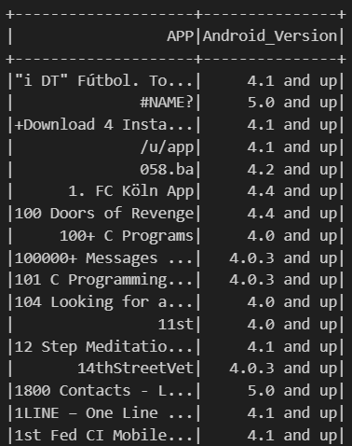
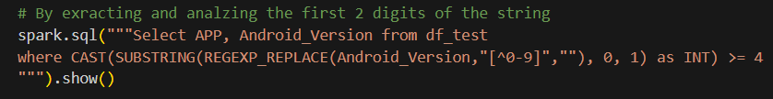
How I overcame these Challenges (part-1):
Filtered-out the unwanted characters using regexp().
Extracted out the first 2-digits with the help of substring().
Cast them into integer form.
Applied a check (>=4).

Slide 6
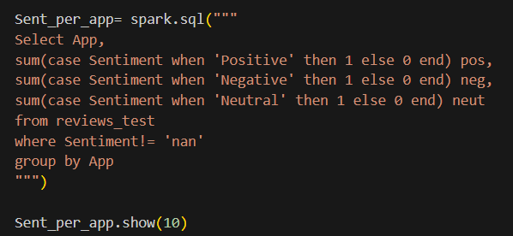
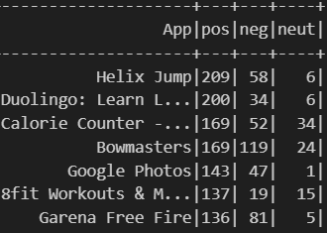
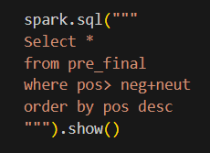
How I overcame these Challenges (part-2):
Applied the case methodology for counting pos, neg and neutral review.
Aggregate them with respect to the corresponding App.
Selected only records, having pos > (neg+neutral).

Slide 7
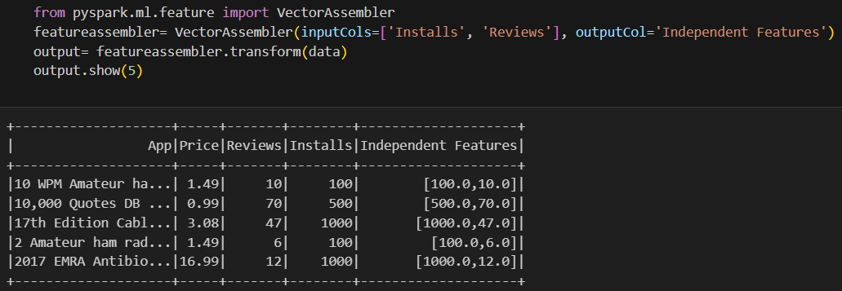
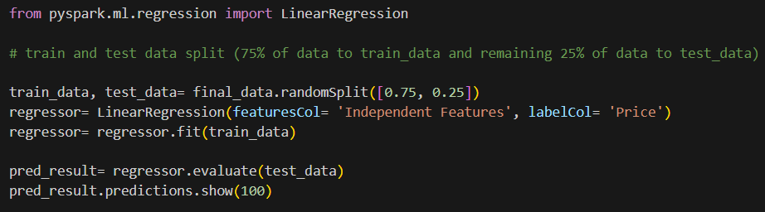
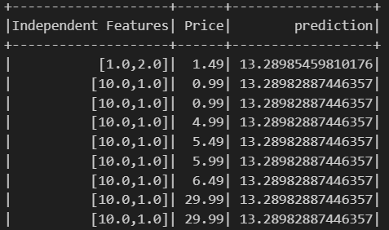
How I overcame these Challenges (part-3):
Applied vector-assembler to convert a feature-set into numeric vector(independent variable).
Carried out linear regression model on price (dependent variable).
Trained the model with 75% of dataset and predicted on remaining 25% dataset.

Slide 8

THANK YOU
(All Viewers!)

