Slide 1

PROJECT-5
Organization: Indian Institute of Technology, Delhi (IITD)
Title: On-Cloud Batch-mode Data Pipelining for seamless ETL operations
Presented By:
Mridul Prakash Kashyap
Master of Technology (M.Tech)
Indian Institute of Technology, Delhi (IITD)

Slide 2




Objective:-
To learn how the data pipeline processing is done on AWS (Amazon web services).
How to integrate the services like Apache Airflow, PySpark and SnowflakeDB with AWS?
How to conduct an automatic aggregation operation ((Class_name – counts) in each class) on ‘iris’ dataset with the help of above-mentioned services?

Slide 3
How did I do that ?
By using some services of AWS (EMR, EC2 and S3) along with Apache Airflow (setup by ubuntu shell commands), ended up with the workflow as DAG.
Used shell command, AWS EMR and S3 in EMR step-1.
PySpark (sql), AWS S3 and EC2 were used in EMR step-2.
Used Apache Airflow along with Snowflake-sql (external step) to accomplish the project, finally.
Apache Airflow
EMR cluster
EMR step-1
EMR step-2
External step

Slide 4

The Challenges I faced:
Installing the Apache Airflow correctly on my local machine (by using Ubuntu shell commands).
Defining the DAG (Data Acyclic Graph) as a workflow to Apache Airflow.

Slide 5
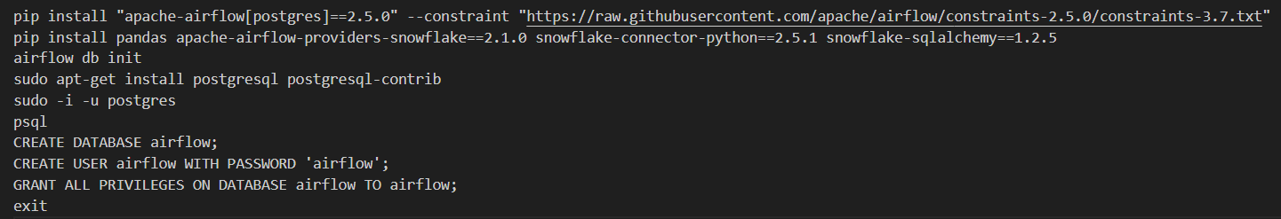
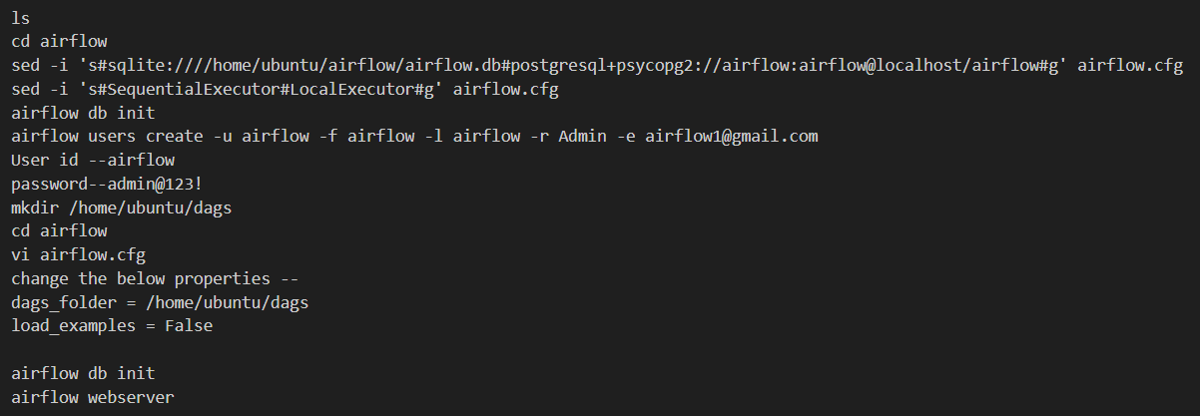
How I overcame these Challenges (part-1):
A glimpse of the shell commands used in Ubuntu terminal to run and launch airflow webserver.
Took the help of online research. Got relevant data from websites like Quora.com, medium.com, etc.

Slide 6
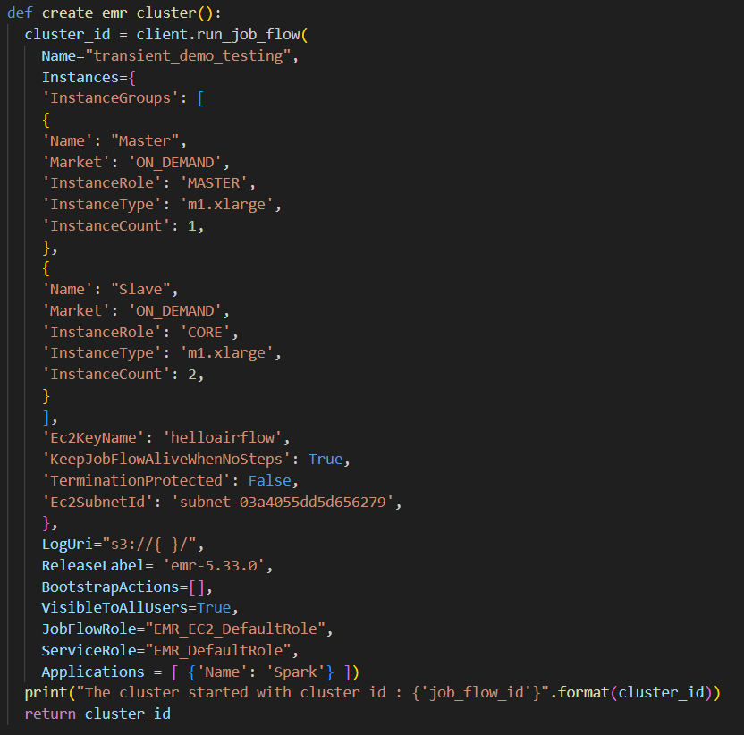
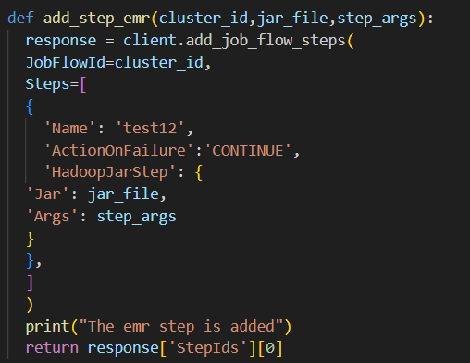
How I overcame these Challenges (part-2):
A glimpse of my DAG python code used to define the workflow in Apache Airflow.
Took the help of online research. Got relevant data in parts from websites like Quora.com, medium.com, etc.
Club-up those parts as per the need.

Slide 7
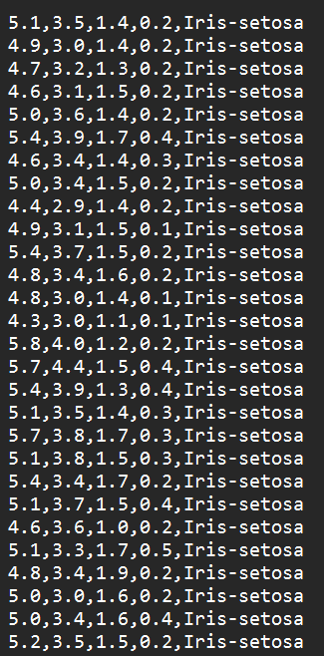

Input to Output Transformation:
Input Data
Output Data
Transformation Workflow:
Firstly, gave the header to the input file.
Carried out the aggregation operation on the dataset.
Write the data into parquet file format.

Slide 8

THANK YOU
(All Viewers!)

