Slide 1

PROJECT-2
Organization: Indian Institute of Technology, Delhi (IITD)
Title: Lending risk Analysis for a Loan provider (FinTech) Company
Presented By:
Mridul Prakash Kashyap
Master of Technology (M.Tech)
Indian Institute of Technology, Delhi (IITD)

Slide 2
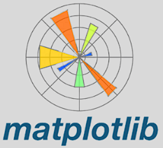




Project Brief:-
When the company receives a loan application, it must decide for loan approval based on the applicant’s profile.
Risk to the company:
If the applicant is likely to repay the loan, company doesn’t approve the loan -> Loss.
If the applicant is not likely to repay the loan, company approves his loan -> Loss.
The company wants to understand the driving factors (variables) which are strong indicators of a default.

Slide 3
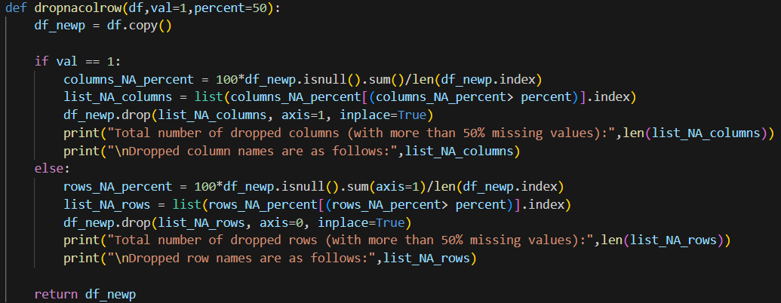
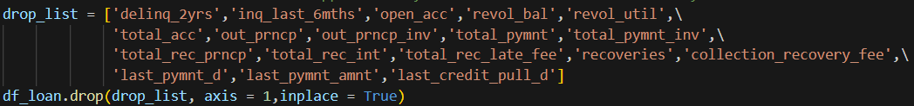
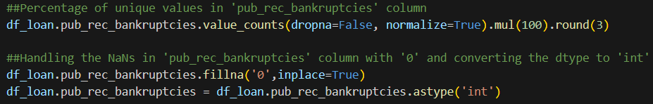
How did I do that ?
Created a function to eliminate columns/rows having more than 50% missing values.
Made a list of unrequired columns from the dataframe and drop that whole list, later on.
Some columns found with more than 94% values as ‘0’ zero, hence tackled their ‘Nan’ values by replacing them by ‘0’.

Slide 4
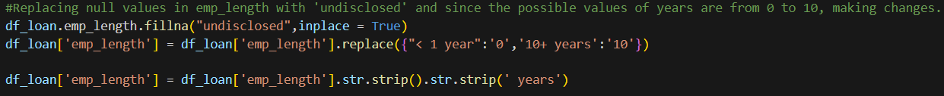

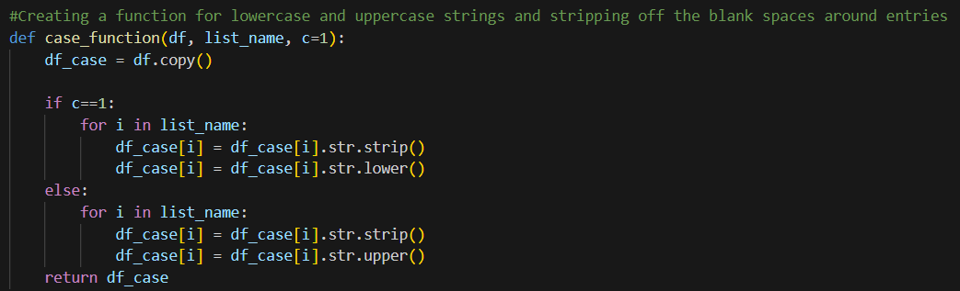
Some columns with values and containing ‘Nan’ also were replaced by ‘undisclosed’ and remove the unwanted characters.
(since their percentage is unavoidable and we don’t want to miss out the information).
Changed to data type of some columns to desired data types (int→ float).
Made a function to Strip-Off the unwanted characters and convert from lowercase to Uppercase (and vice-versa) depending on the requirements.
How did I do that ?

Slide 5
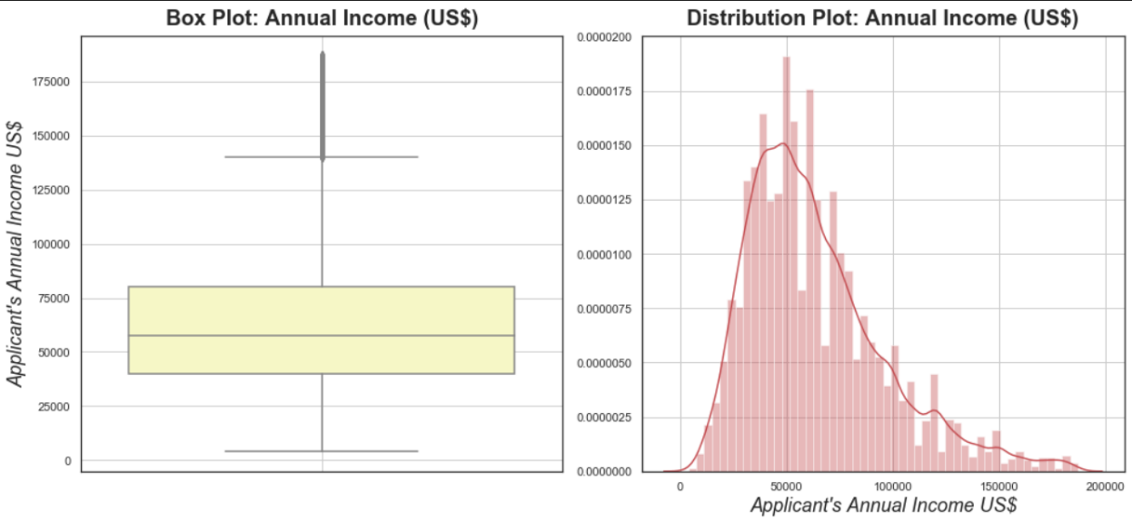
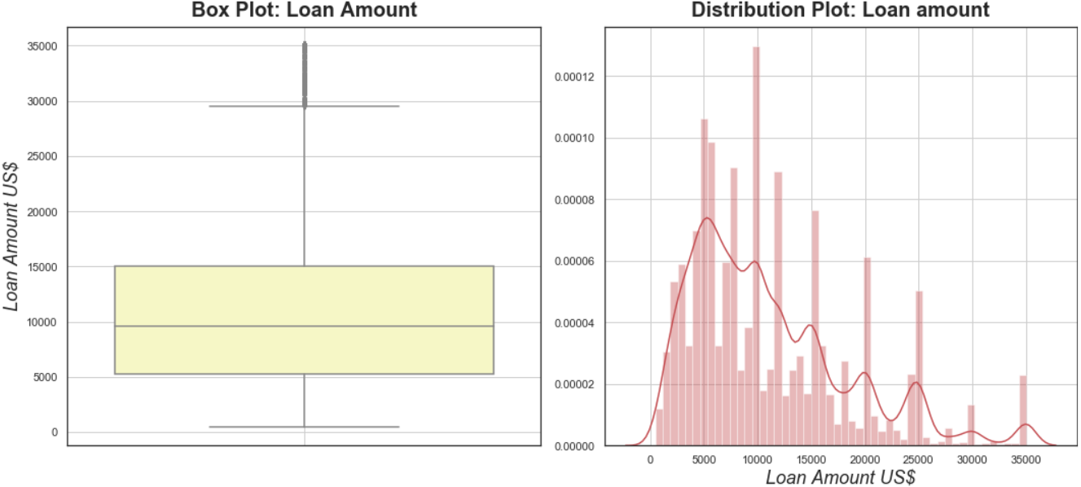
50% of the applicants earn between 40K USD and 82K USD annually.
Annual Income was highly skewed as expected; ignoring the outliers, the average salary of applicants is 68.78K USD.
50% of loan applicants request a loan amount between 5.3K USD and 15K USD.
id I do that ?

Slide 6

The Challenges I faced:
The date of Loan_issue as per the dataset must vary from 1946 to 2008 but while checking it with the column, it was found out to be 1969 to 2068.
Just to figure out dependencies (if any), wanted to plot them with the help of “Correlation Matrix”. correlation heatmap indicating the relationship among several columns (attributes) of the data frame.

Slide 7
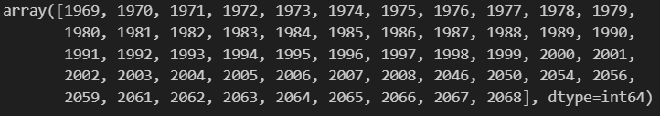
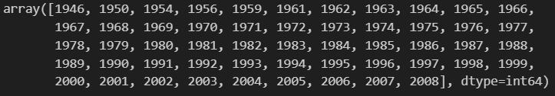
How I overcame these Challenges (part-1):
By selecting the column values greater than 2008 and subtracting them by 100 later.
Displaying the updated unique values, eventually.

Slide 8
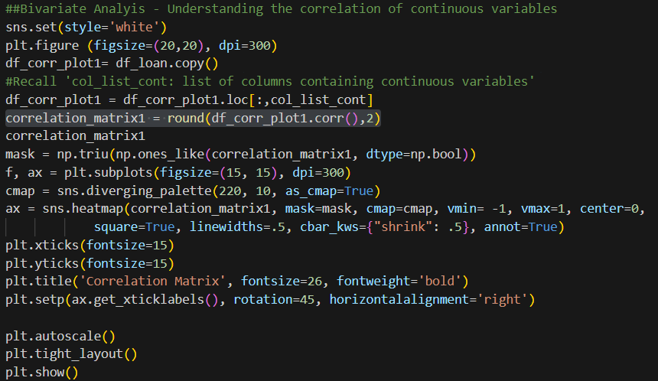
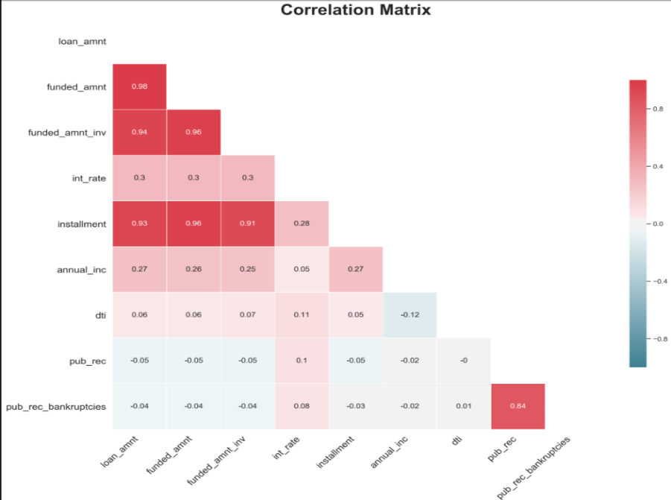
How I overcame these Challenges (part-2):
After doing an intensive online research, figured out the way and tried to plot (as per the requirement).
Correlation matrix has been calculated in ‘correlation_matrix1’ using ‘df_corr_plot1.corr()’ and rounds the values to 2 decimal places.
‘mask = np.triu(np.ones_like(correlation_matrix1, dtype=np.bool))’ creates a boolean mask (mask) with True values in the upper triangle of the correlation matrix.

Slide 9

Conclusion:
Driving Factors (analysed through plots):
▪ Loan Term: - Average Interest rate for defaulted applications is very high with 12.38 % for 36 months and 15.75 % for 60 months term.
▪ Loan Applicants on Annual Income: - Applicants from 'Low'(<=45K USD) and 'Medium'(45K-90K USD) income group have a greater share of defaulted loans.
▪ Loan Purpose: - The top two reasons for loans are debt consolidation and credit card. Such applications should be carefully assessed.
THANK YOU
(All Viewers!)

