Slide 1


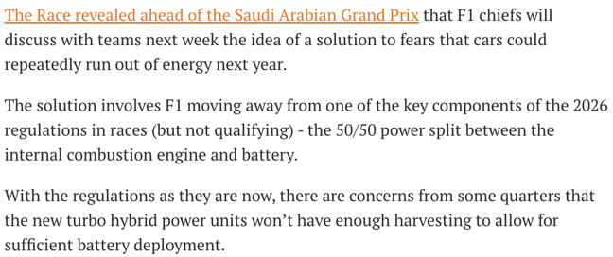
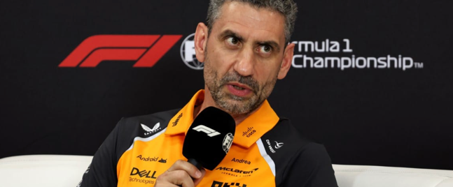
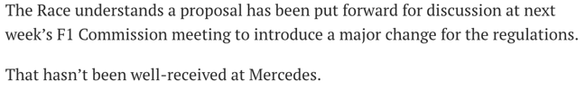
Mercedes Criticizes Proposed Adjustments to 2026 F1 Engine Regulations
REGULATIONS
20/04/2025
SUMMARY &
RELEVANT INFORMATION
Mercedes has strongly opposed proposed changes to the 2026 F1 engine regulations, labeling them a "joke."​
The proposals aim to adjust the 50/50 power split between internal combustion engines and electric power during races.​
----- relevant Information -----
While Mercedes opposes these changes, other teams like McLaren are open to discussions to ensure the success of the 2026 regulations.​
IMPLICATIONS
Mercedes' strong opposition to altering the 2026 engine regulations underscores potential instability in F1's technical direction.​
Such instability could deter OEMs seeking a predictable investment environment.​
Divergent views among teams on regulatory changes may signal a lack of consensus, increasing the risk for new entrants concerned about shifting competitive dynamics.
CREDIBILITY
RELEVANCY
Source: https://www.the-race.com/formula-1/a-joke-mercedes-slams-f1-proposal-for-major-2026-engine-changes/
1

Slide 2

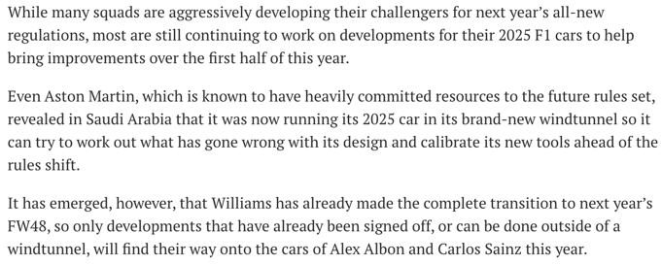
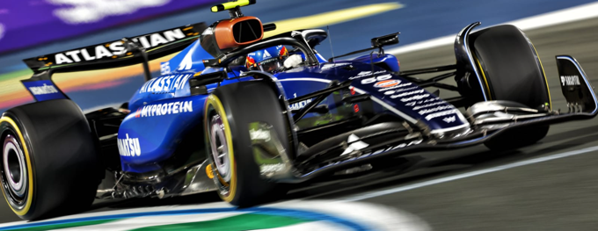
Williams Prioritizes 2026 Development, Signaling Long-Term Commitment
COMPETITIVE MOVE
PERFORMANCE
19/04/2025
SUMMARY &
RELEVANT INFORMATION
Williams has ceased wind tunnel development of its 2025 car to focus entirely on the 2026 regulations.​
Team principal James Vowles emphasizes long-term investment over short-term gains.​
----- relevant Information -----
Williams aims to establish structures and processes critical for future competitiveness.​ And the decision aligns with a five-year investment strategy agreed upon with Dorilton Capital.​
IMPLICATIONS
Williams' early shift to focus entirely on the 2026 regulations demonstrates a strategic long-term investment.​
This approach may allow them to capitalize on the regulatory overhaul and improve future competitiveness.
The move indicates that Williams is not for sale, at least not 100%, which might align with Toyota's 51% plan.​
CREDIBILITY
RELEVANCY
Source: https://www.the-race.com/formula-1/williams-first-f1-team-to-make-crucial-2026-development-step/
2

Slide 3

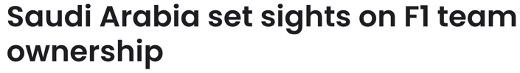
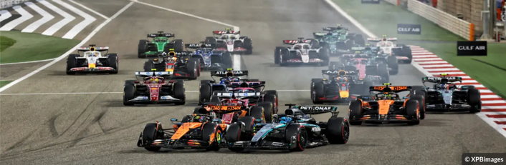
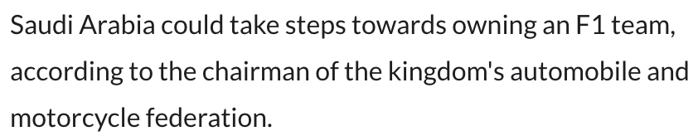
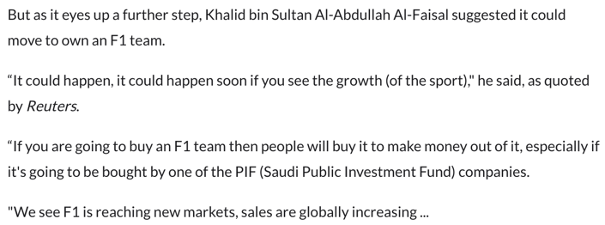
Saudi Arabia Explores Formula 1 Team Ownership to Expand Motorsport Presence
M&A
15/04/2025
SUMMARY &
RELEVANT INFORMATION
Saudi Arabia is considering acquiring or establishing a Formula 1 team, building upon its existing investments in the sport.​
Prince Khalid bin Sultan Al-Abdullah Al-Faisal indicated that the Public Investment Fund (PIF) is evaluating this move to deepen the kingdom's involvement in F1.​
----- relevant Information -----
WState-owned petroleum company Aramco is a global partner of F1 and a title sponsor of the Aston Martin team.
IMPLICATIONS
Saudi Arabia's exploration of F1 team ownership reflects its ambition to deepen involvement in the sport.​
This move could escalate financial commitments required for competitive participation, potentially impacting the dynamics of team ownership and investment in F1.​
The involvement of state-backed entities like PIF may influence the financial landscape of F1, affecting both existing teams and prospective entrants.​
CREDIBILITY
RELEVANCY
Source: https://racingnews365.com/saudi-arabia-set-sights-on-f1-team-ownership
3

